Slide 1

Predicting Peptide Binding for HLA Alleles & T Cell Receptors
Pamela Chansky
Mentor: Russell Cruz
Institution: Children’s National

Slide 2
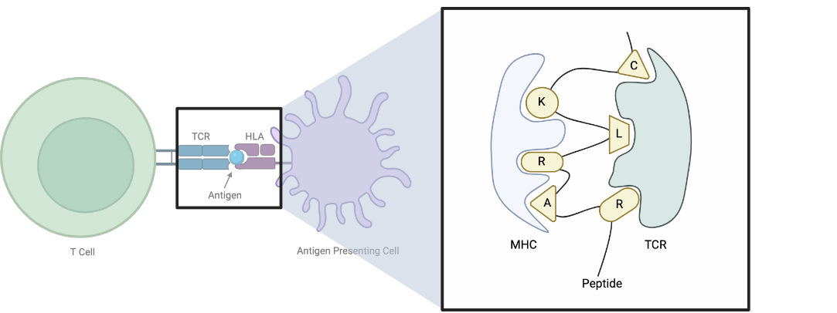
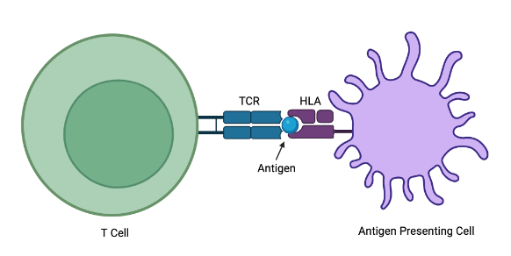
Peptide-MHC-TCR Binding
Example: PRAM Top Binders Across HLA Supertypes
A1 | A2 | A3 | A4 | B7 | B15 | B27 | B44 | B58
Peptide | Peptide | Peptide | Peptide | Peptide | Peptide | Peptide | Peptide | Peptide
VPDEIYELY | ALLPLETEV | SSLGHPPAK | GYVPRTALL | RPLPPASSL | SQPEPSAVL | SRHPLSPGF | SEAAQTPLW | FGAAGTPRW
LLPLETEVY | SLKPPPPEV | KMMIDPNAK | SLPAAVAGF | TPRSPQPEL | SPQPELSTF | KRHPQPEFF | AEREFRKKF | SGAFPRKLW
PAQPEFNVY | RQPEDIPQV | KLELSDLSK | EFNSLPRKL | VPRTALLPL | AAMESHQDF | TRSAAGLHF | GEILEVIEF | ASQPPLSDF
FSQPELSEH | QVPDEIYEL | QQLPPMDPK | QLPPMDPKL | TPRWRSGGL | LLPLETEVY | RRTRSAAGL | GEAPLKASL | KAEKAEREF
SSEPEFNSL | QLPPMDPKL | GLRPSHPPR | QVPDEIYEL | RPSAASIDL | ASQPPLSDF | RRGEILEVI | REFRKKFKF | KSGAFPRKL
Hypothesis: A peptide’s amino acid sequence indicates binding affinity (non-binding, weak binding, or strong binding) to specific HLA alleles and TCR sequences.
Notes:
Peptide binds the MHC (HLA Allele specific)
TCR recognizes the Peptide-MHC complex
TCR binds the peptide
Immune response

Slide 3
Peptide-MHC Data and CatBoost
AA at position 1 = K?
Peptide | HLA | Binding Affinity | Strength
DIVKGLSGY | HLA-B46:01 | 0.084687 | Non
QTVEDEARRM | HLA-B57:01 | 0.269270 | Non
YTFAISYCR | HLA-A33:01 | 0.949341 | Strong
ETIEEPAEVE | HLA-B15:01 | 0.084687 | Non
SLSAYIIRVT | HLA-A02:01 | 0.335903 | Non
RIKTRLFTI | HLA-B18:01 | 0.084687 | Non
LIVSLCPTK | HLA-A11:01 | 0.568492 | Weak
ETGKSIHFV | HLA-A26:01 | 0.169373 | Non
AAAYFVGYLK | HLA-A11:01 | 1 | Strong
Yes
No
AA at position 2 = A?
AA at position 2 = A?
…
+
+
Yes
No
Yes
No
AA at position 3 = C?
AA at position 3 = C?
AA at position 3 = C?
AA at position 3 = C?
Yes
No
Yes
No
Yes
No
Yes
No
Non: 0.20 Weak: 0.03
Strong: 0.65
Non: 0.12 Weak: 0.31
Strong: 0.52
Non: 0.01 Weak: 0.78
Strong: 0.04
Non: 0.10 Weak: 0.53
Strong: 0.25
Non: 0.80 Weak: 0.01
Strong: 0.05
Non: 0.31 Weak: 0.18
Strong: 0.46
Non: 0.22 Weak: 0.67
Strong: 0.17
Non: 0.65 Weak: 0.21
Strong: 0.14

Slide 4
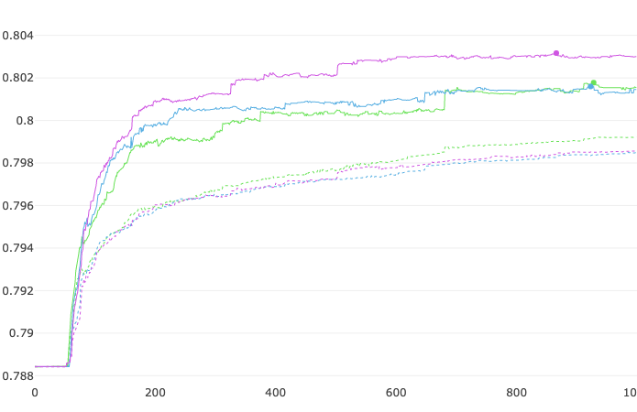
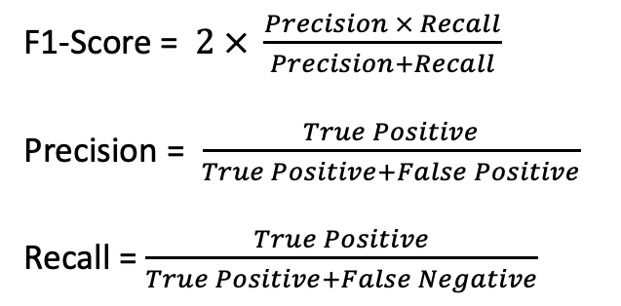
Peptide-MHC CatBoost: Evaluation and Cross Validation
A
3 Fold Cross Validation Accuracy Score
B
Accuracy
Iterations
F1-Score = $2 × \frac{Precision × Recall}{Precision+Recall}$
Precision = $\frac{True Positive}{True Positive+False Positive}$
Recall = $\frac{True Positive}{True Positive+False Negative}$
Notes:
**rerun with even split of groups

Slide 5
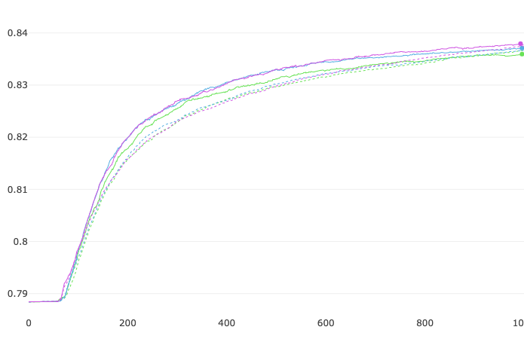
Peptide-MHC CatBoost Model Improvements
A
B
Peptide | HLA | Binding Affinity | Strength | AA1 | AA2 | AA3 | AA4 | AA5 | AA6 | AA7 | AA8 | AA9 | AA10
DIVKGLSGY | HLA-B46:01 | 0.084687 | Non | D | I | V | K | G | L | S | G | Y | Null
QTVEDEARRM | HLA-B57:01 | 0.26927 | Non | Q | T | V | E | D | E | A | R | R | M
YTFAISYCR | HLA-A33:01 | 0.949341 | Strong | Y | T | F | A | I | S | Y | C | R | Null
ETIEEPAEVE | HLA-B15:01 | 0.084687 | Non | E | T | I | E | E | P | A | E | V | E
SLSAYIIRVT | HLA-A02:01 | 0.335903 | Non | S | L | S | A | Y | I | I | R | V | T
RIKTRLFTI | HLA-B18:01 | 0.084687 | Non | R | I | K | T | R | L | F | T | I | Null
LIVSLCPTK | HLA-A11:01 | 0.568492 | Weak | L | I | V | S | L | C | P | T | K | Null
ETGKSIHFV | HLA-A26:01 | 0.169373 | Non | E | T | G | K | S | I | H | F | V | Null
AAAYFVGYLK | HLA-A11:01 | 1 | Strong | A | A | A | Y | F | V | G | Y | L | K
3 Fold Cross Validation Accuracy Score
Accuracy
Iterations

Slide 6
Peptide-TCR Binding Data Preparation
CDR3 | HLA | Peptide | Binding?
AQGLLTGGGNKLTF | HLA-A*02:01 | RLGPVQNEV | Binding
ASMFSGGGNEKFTF | HLA-A*02:01 | RLGPVQNEV | Binding
ASMYKGGGNEKFTF | HLA-A*02:01 | RLGPVQNEV | Binding
CAAAASGGSYIPTF | HLA-B*35:01 | EPLPQGQLTAY | Binding
CAAAATPGNTGKLIF | HLA-A*02:01 | GILGFVFTL | Binding
CAAAAYNQGGKLIF | HLA-A*03:01 | KLGGALQAK | Binding
CAAADDKIIF | HLA-A*02:01 | LLWNGPMAV | Binding
CAAADEEIGNQPQHF | HLA-A*01:01 | ATDALMTGY | Binding
CAAADNYGQNFVF | HLA-A*11:01 | AVFDRKSDAK | Binding
CDR3 | HLA | Peptide | Binding?
AQGLLTGGGNKLTF | HLA-A*02:01 | RLGPVQNEV | Binding
ASMFSGGGNEKFTF | HLA-A*02:01 | RLGPVQNEV | Binding
ASMYKGGGNEKFTF | HLA-A*02:01 | RLGPVQNEV | Binding
CAAAASGGSYIPTF | HLA-B*35:01 | EPLPQGQLTAY | Binding
CAAAATPGNTGKLIF | HLA-A*02:01 | GILGFVFTL | Binding
CAAAAYNQGGKLIF | HLA-A*03:01 | KLGGALQAK | Binding
CAAADDKIIF | HLA-A*02:01 | LLWNGPMAV | Binding
CAAADEEIGNQPQHF | HLA-A*01:01 | ATDALMTGY | Binding
CAAADNYGQNFVF | HLA-A*11:01 | AVFDRKSDAK | Binding
CDR3 | HLA | Peptide | Binding?
AQGLLTGGGNKLTF | HLA-A*02:01 | RLGPVQNEV | Binding
ASMFSGGGNEKFTF | HLA-A*02:01 | RLGPVQNEV | Binding
ASMYKGGGNEKFTF | HLA-A*02:01 | RLGPVQNEV | Binding
CAAAASGGSYIPTF | HLA-B*35:01 | EPLPQGQLTAY | Binding
CAAAATPGNTGKLIF | HLA-A*02:01 | GILGFVFTL | Binding
CAAAAYNQGGKLIF | HLA-A*03:01 | KLGGALQAK | Binding
CAAADDKIIF | HLA-A*02:01 | LLWNGPMAV | Binding
CAAADEEIGNQPQHF | HLA-A*01:01 | ATDALMTGY | Binding
CAAADNYGQNFVF | HLA-A*11:01 | AVFDRKSDAK | Binding
…
+
AQGLLTGGGNKLTF | HLA-B*35:01 | ATDALMTGY | Non-Binding

Slide 7
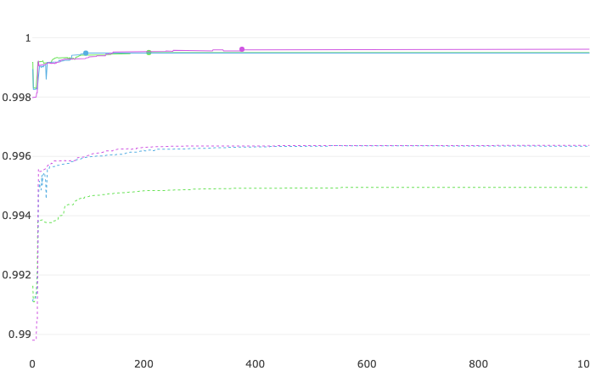
Peptide-TCR CatBoost: Evaluation Metrics
A
3 Fold Cross Validation Accuracy
B
Accuracy
Iterations

Slide 8
Future Work
Acquire TCR-Peptide negative data
Further Parameter Tuning for MHC-Peptide binding
UI web tool
User Input
Peptide TPRSPQPEL
HLA HLA-B7:01
TCR CAAAATPGNTGKLIF
Results:
TPRSPQPEL is a strong binder to HLA B7:01
TPRSPQPEL does not bind to CAAAATPGNTGKLIF
Acknowledgments
Thank you to the Cruz Lab and IBS program for their guidance and support.

