Slide 1
Mobile App 2 CA2
Group 10:
24579 Chantal Ochiai
24581 Junhyeok Han

Slide 2
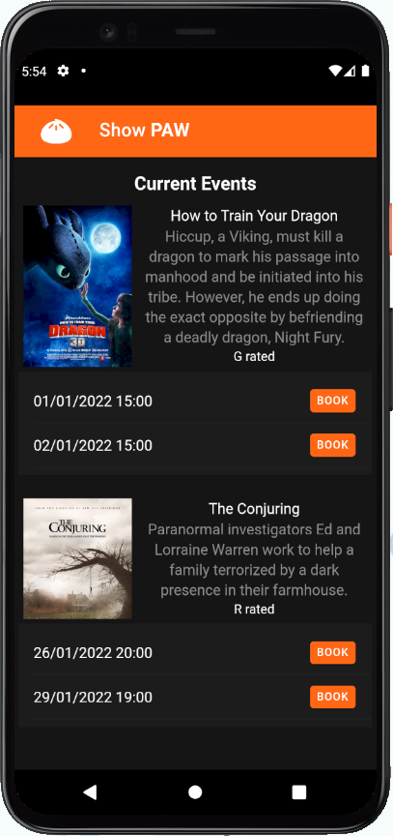
Home page
Notes:
Show data on firebase

Slide 3
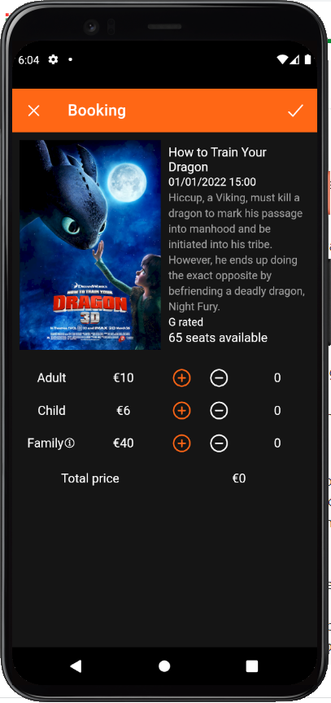
Booking page

Slide 4
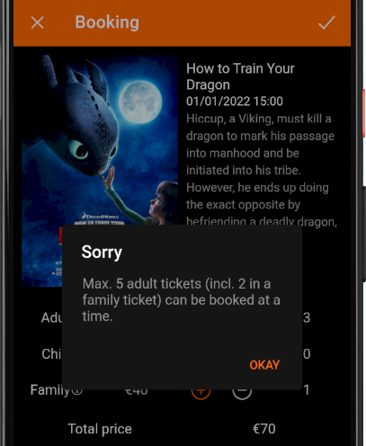

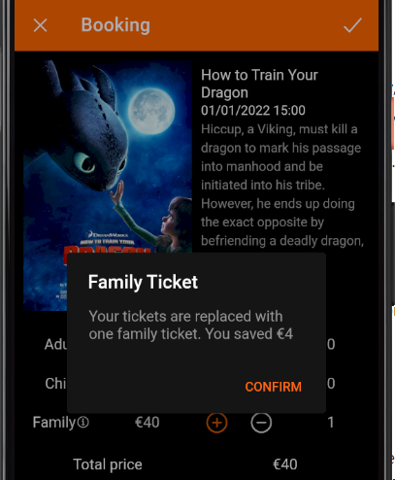
Booking page
Max. 5 adults and 4 children per booking
Family ticket – 2 adults and four children

Slide 5
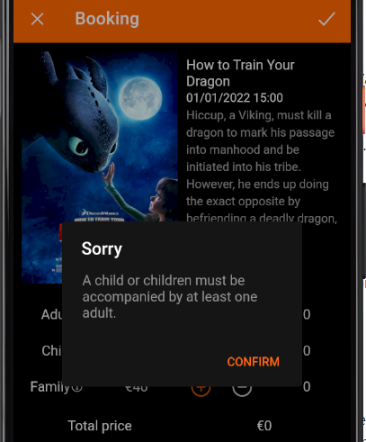

Booking page
Children must be accompanied by at least 1 adult
At least 1 participant per booking

Slide 6
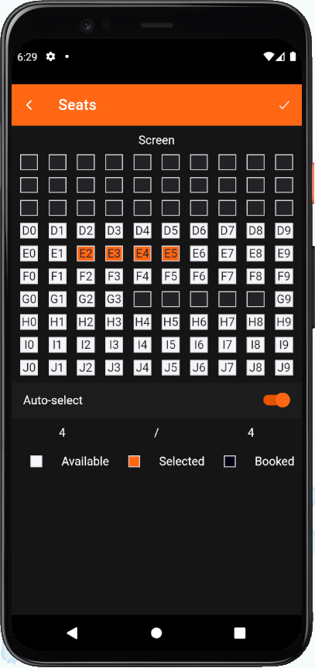
Seats page

Slide 7
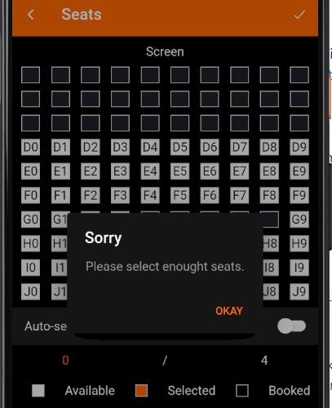
Seats page
Total participants = total selected seats

Slide 8
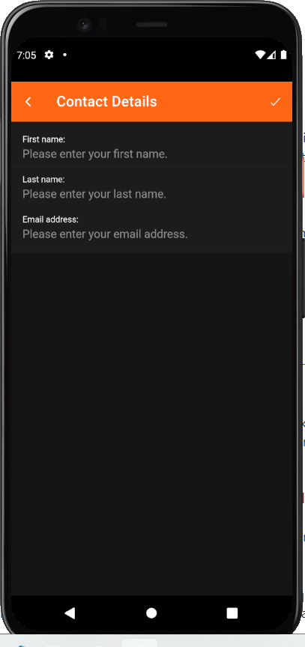
Contact page

Slide 9
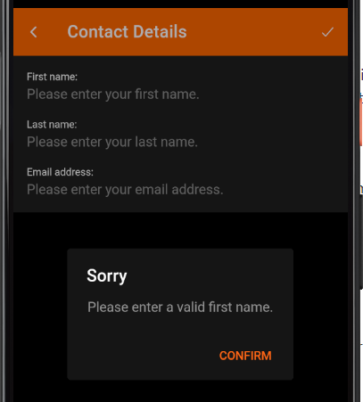

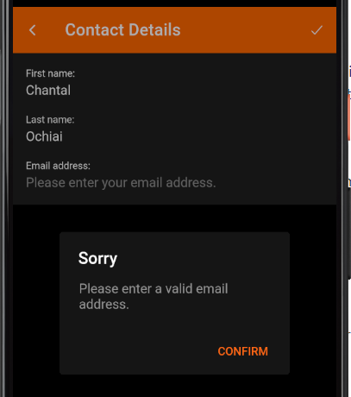
Contact page
Data validation

Slide 10
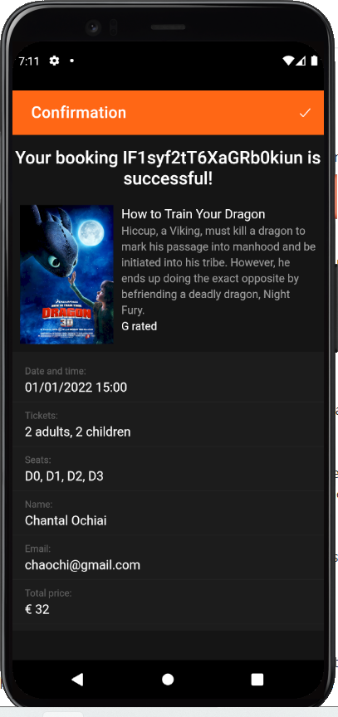
Confirmation page
Notes:
Show data on firebase

Slide 11
Improvements
Log in, register, 2FA, forgot password
Show the type of event
Movie
Musical
Theater
Etc.
Show QR code as a ticket.
Send confirmation email.
Booking cancellation
Search, filter, and sort events
List view / Grid view

