Slide 1
The Introduction to FEMU and its newly related research
Presented by Chen Haodong
HDU – Center of Cloud computing

Slide 2
Outline
_______
- 1. Backgrounds
- 2. Existing SSD platform
_____________________
- 3. Case of FEMU
- 4. Newly related work in 2023
- 5. Future work
HDU – Center of Cloud computing

Slide 3

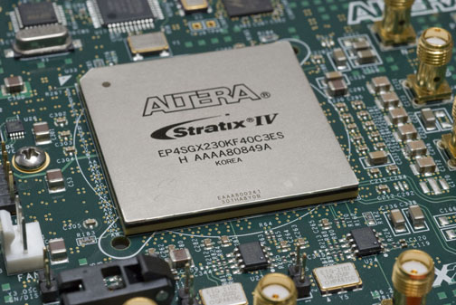
1. Backgrounds
Typical full-stack research
___________________________
APP
SSD research mainly focus on 3 parts:
1. kernel changes
2. Interface changes
3. FTL changes
Host OS
interface
FTL
Hardware platform
HDU – Center of Cloud computing

Slide 4
2. Existing SSD platforms
___________________________
Simulator
Emulator
Hardware
platform
HDU – Center of Cloud computing

Slide 5
2. Existing SSD platforms
___________________________
Simulator
Emulator
Hardware
platform
DiskSim’s SSD;
FlashSim; SSDSim;
HDU – Center of Cloud computing

Slide 6
2. Existing SSD platforms
___________________________
Simulator
Emulator
Hardware
platform
DiskSim’s SSD;
FlashSim; SSDSim;
simple
internal-SSD research
Time-saving
HDU – Center of Cloud computing

Slide 7
2. Existing SSD platforms
___________________________
Simulator
Emulator
Hardware
platform
DiskSim’s SSD;
FlashSim; SSDSim;
simple
internal-SSD research
kernel-level research
Time-saving
HDU – Center of Cloud computing

Slide 8
2. Existing SSD platforms
___________________________
Simulator
Emulator
Hardware
platform
DiskSim’s SSD;
FlashSim; SSDSim;
OpenSSD; FPGA;
OpenChannel SSD;
simple
internal-SSD research
kernel-level extension
Time-saving
HDU – Center of Cloud computing

Slide 9
2. Existing SSD platforms
___________________________
Simulator
Emulator
Hardware
platform
DiskSim’s SSD;
FlashSim; SSDSim;
OpenSSD; FPGA;
OpenChannel SSD;
simple
internal-SSD research
kernel-level extension
Time-saving
Full-stack research
Accurate

Slide 10
2. Existing SSD platforms
___________________________
Simulator
Emulator
Hardware
platform
DiskSim’s SSD;
FlashSim; SSDSim;
OpenSSD; FPGA;
OpenChannel SSD;
simple
internal-SSD research
kernel-level extension
Time-saving
Full-stack research
Accurate
high costs
complex to use

Slide 11
2. Existing SSD platforms
___________________________
Simulator
Emulator
Hardware
platform
DiskSim’s SSD;
FlashSim; SSDSim;
FlashEm;
LightNVM QEMU;
QEMU based VSSIM;
OpenSSD; FPGA;
OpenChannel SSD;
simple
internal-SSD research
kernel-level extension
Time-saving
Full-stack research
Accurate
high costs
complex to use

Slide 12
2. Existing SSD platforms
___________________________
Simulator
Emulator
Hardware
platform
DiskSim’s SSD;
FlashSim; SSDSim;
FlashEm;
LightNVM QEMU;
QEMU based VSSIM;
OpenSSD; FPGA;
OpenChannel SSD;
simple
internal-SSD research
kernel-level extension
Time-saving
Full-stack research
Low costs
Full-stack research
Accurate
high costs
complex to use

Slide 13
2. Existing SSD platforms
___________________________
Simulator
Emulator
Hardware
platform
DiskSim’s SSD;
FlashSim; SSDSim;
FlashEm;
LightNVM QEMU;
QEMU based VSSIM;
OpenSSD; FPGA;
OpenChannel SSD;
simple
internal-SSD research
kernel-level extension
Time-saving
Full-stack research
Low costs
Not scalability
Not accurate
Full-stack research
Accurate
high costs
complex to use

Slide 14
3. The CASE of FEMU
___________________________
FEMU is a software (QEMU-based) flash emulator for fostering future full-stack software/hardware SSD research.
HDU – Center of Cloud computing

Slide 15
3. The CASE of FEMU
___________________________
FEMU is a software (QEMU-based) flash emulator for fostering future full-stack soft- ware/hardware SSD research.
Cheap
Scalable
Extensible
(relatively) Accurate
Open source, download from:
https://github.com/vtess/FEMU
HDU – Center of Cloud computing

Slide 16
3. The CASE of FEMU
___________________________
FEMU is a software (QEMU-based) flash emulator for fostering future full-stack soft- ware/hardware SSD research.
Cheap
Scalable
Extensible
(relatively) Accurate
Produce an advanced openChannel SSD Model
The error of resulting latencies drops to
only 0.5-38%
HDU – Center of Cloud computing

Slide 17
3. The CASE of FEMU
___________________________
FEMU is a software (QEMU-based) flash emulator for fostering future full-stack soft- ware/hardware SSD research.
Cheap
Scalable
Extensible
(relatively) Accurate
support 32 channels/chips
HDU – Center of Cloud computing

Slide 18
3. The CASE of FEMU
___________________________
FEMU is a software (QEMU-based) flash emulator for fostering future full-stack soft- ware/hardware SSD research.
Cheap
Scalable
Extensible
(relatively) Accurate
modifiable interface
modifiable FTL
modifiable SSD
modifiable kernel
HDU – Center of Cloud computing

Slide 19
3. The CASE of FEMU
___________________________
Typical full stack research .vs FEMU full stack research
APP
Host OS
interface
FTL
Hardware platform
HDU – Center of Cloud computing

Slide 20
3. The CASE of FEMU
___________________________
Typical full stack research .vs FEMU full stack research
APP
Host OS
interface
FTL
Hardware platform
FEMU
FTL changes
QEMU

Slide 21
3. The CASE of FEMU
___________________________
Typical full stack research .vs FEMU full stack research
APP
Host OS
NVMe
Interface
changes
interface
FTL
Hardware platform
FEMU
FTL changes
QEMU

Slide 22
3. The CASE of FEMU
___________________________
Typical full stack research .vs FEMU full stack research
APP
App
Guest OS
kernel
changes
Host OS
Virtual machine
NVMe
Interface
changes
interface
FTL
Hardware platform
FEMU
FTL changes
QEMU

Slide 23
3. The CASE of FEMU
___________________________
Project Description
VM / Guest OS
NVMe Block Device
PCIe/NVMe
Blackbox
OCSSD
ZNS-SSD
NoSSD
…
FEMU NVMe SSD Controller
HDU – Center of Cloud computing

Slide 24
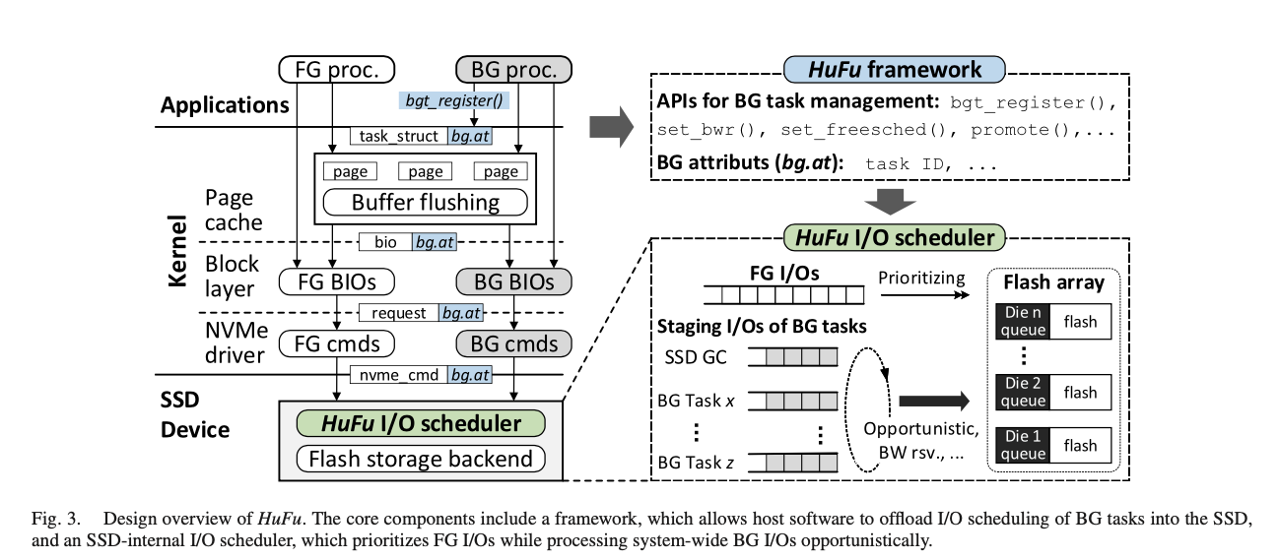
4. Newly related work in 2023
___________________________
1. Holistic and Opportunistic Scheduling of Background I/Os in Flash-based SSDs. (TC'23). Yu Wang, You Zhou, Fei Wu, Yu Zhong, Jian Zhou, Zhonghai Lu, Shu Li, Zhenghong Wang, Changsheng Xie

Slide 25
4. Newly related work in 2023
___________________________
1. Holistic and Opportunistic Scheduling of Background I/Os in Flash-based SSDs. (TC'23). Yu Wang, You Zhou, Fei Wu, Yu Zhong, Jian Zhou, Zhonghai Lu, Shu Li, Zhenghong Wang, Changsheng Xie
FEMU
Kernel changes
FTL changes
HDU – Center of Cloud computing

Slide 26
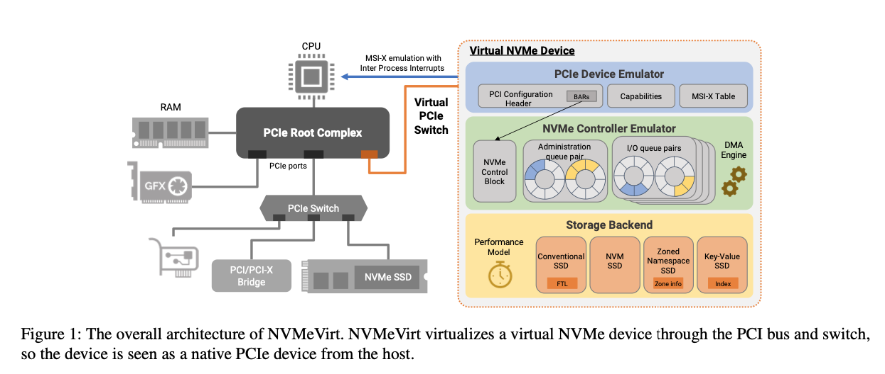
4. Newly related work in 2023
___________________________
2. NVMeVirt: A Versatile Software-defined Virtual NVMe Device. (FAST'23). Sang-Hoon Kim, Jaehoon Shim, Seongyeop Jeong, Jin-Soo Kim

Slide 27
4. Newly related work in 2023
___________________________
2. NVMeVirt: A Versatile Software-defined Virtual NVMe Device. (FAST'23). Sang-Hoon Kim, Jaehoon Shim, Seongyeop Jeong, Jin-Soo Kim
FEMU NVMe interface
.vs
HDU – Center of Cloud computing

Slide 28
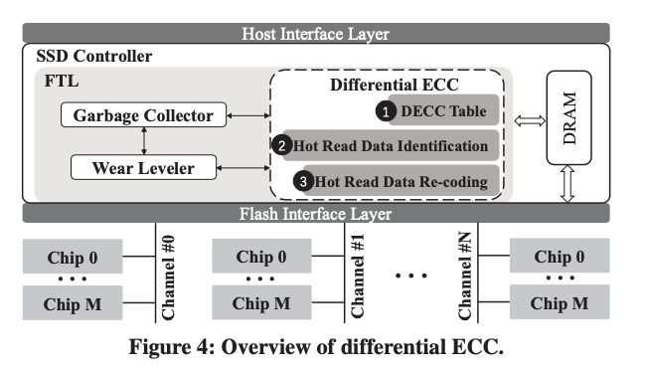
4. Newly related work in 2023
___________________________
3. DECC: Differential ECC for Read Performance Optimization on High-Density NAND Flash Memory. (ASPDAC '23). Yunpeng Song, Yina Lv, Liang Shi

Slide 29
4. Newly related work in 2023
___________________________
3. DECC: Differential ECC for Read Performance Optimization on High-Density NAND Flash Memory. (ASPDAC '23). Yunpeng Song, Yina Lv, Liang Shi
FEMU
Kernel changes
FTL changes
HDU – Center of Cloud computing

Slide 30
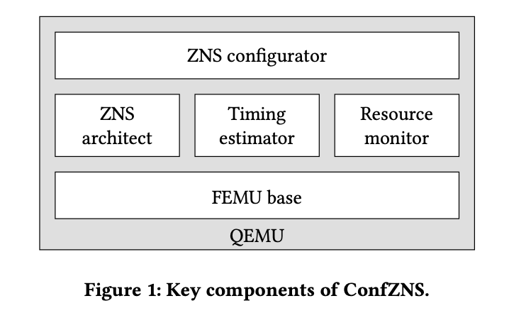
4. Newly related work in 2023
___________________________
4. ConfZNS : A Novel Emulator for Exploring Design Space of ZNS. (SYSTOR'23). Inho Song, Myounghoon Oh, Bryan S. Kim, Seehwan Yoo, Jaedong Lee, Jongmoo Choi
An advance ZNS emulator based on FEMU
HDU – Center of Cloud computing

Slide 31
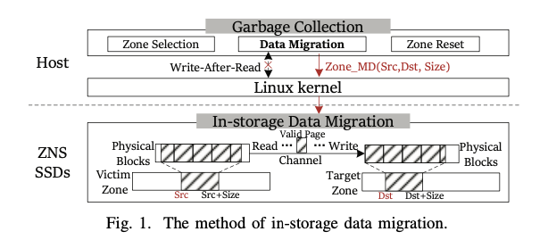
4. Newly related work in 2023
___________________________
5. Optimizing Data Migration for Garbage Collection in ZNS SSDs. (DATE'23). Zhenhua Tan, Linbo Long, Renping Liu, Congming Gao, Yi Jiang, Yan Liu

Slide 32
4. Newly related work in 2023
___________________________
5. Optimizing Data Migration for Garbage Collection in ZNS SSDs. (DATE'23). Zhenhua Tan, Linbo Long, Renping Liu, Congming Gao, Yi Jiang, Yan Liu
FEMU
Kernel changes
Interface changes
HDU – Center of Cloud computing

Slide 33
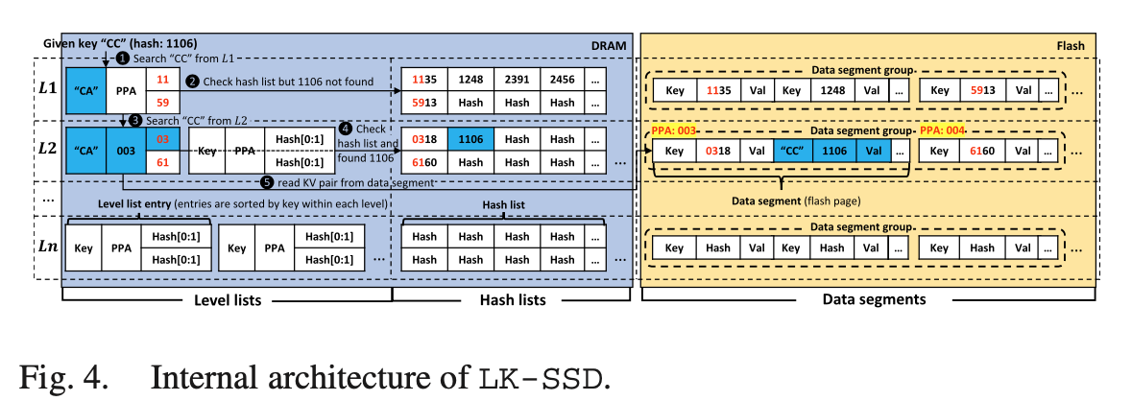
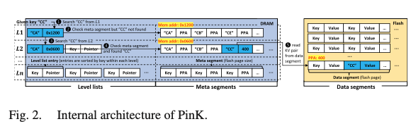
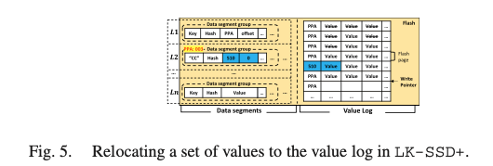
4. Newly related work in 2023
___________________________
6. Design of a High-Performance, High-Endurance Key-Value SSD for Large-Key Workloads. (IEEE CAL'23). Chanyoung Park, Chun-Yi Liu, Kyungtae Kang, Mahmut Kandemir, Wonil Choi
Emulate three architecture on FEMU,
Compare their performance
HDU – Center of Cloud computing

Slide 34
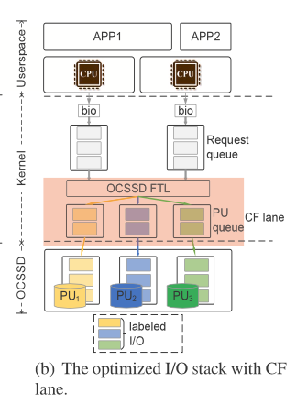
4. Newly related work in 2023
___________________________
7. CFIO: A conflict-free I/O mechanism to fully exploit internal parallelism for Open-Channel SSDs. (JSA'23). Jinbin Zhu, Liang Wang, Limin Xiao, Lei Liu, Guangjun Qi
FEMU
FTL changes:
Optimized I/O stack with CF line based on original FEMU OC-SSD
HDU – Center of Cloud computing

Slide 35
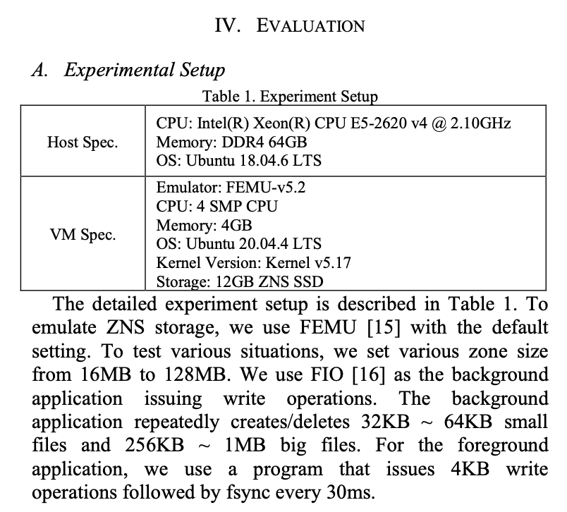
4. Newly related work in 2023
___________________________
8. An Efficient F2FS GC Scheme for Improving I/O Latency of Foreground Application. (ICCE'23). Manjong Lee, Jonggyu Pa, Young Ik Eom
Emulate different zone size on FEMU,
Compare their performance
HDU – Center of Cloud computing

Slide 36
5. Future work
___________________________
- 1. make FEMU running on my computer
_______________
- 2. Read the Friendly Source Code of FEMU
- 3. Find research direction
HDU – Center of Cloud computing

Slide 37
Thank you for listening
Presented by Chen Haodong
HDU – Center of Cloud computing

