Slide 1
Matt Amatics
Penelope Overholt
Chante Graham
Do the Types of Formative Assignments Affect a Student’s End of Chapter Score?
An analysis on how different formative questions predict student performance on end of chapter (EOC) assignments.

Slide 2
Correlation Coefficients
Linear Models
lrn_type by EOC score | Coefficients
association | 0.8784318
choicematrix | 0.492978
clozeassociation | 0.6435387
formulaV2 | 0.4004265
imageclozeassociation | 0.4086369
mcq | 0.9638452
other | 0.8825442
plaintext | 0.1851368
shorttext | 0.6116212
sortlist | 0.4556005
p-value | R^2
<2e-16 | 0.7097
<2e-16 | 0.2266
<2e-16 | 0.3553
<2e-16 | 0.1712
<2e-16 | 0.1849
<2e-16 | 0.838
<2e-16 | 0.759
0.14 | 0.0015
<2e-16 | 0.3553
<2e-16 | 0.2105

Slide 3
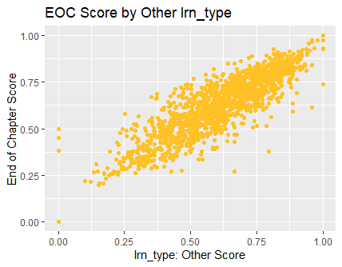
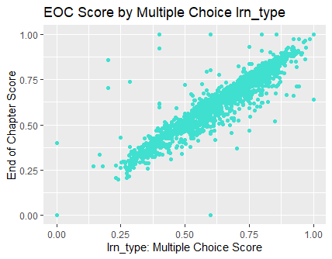
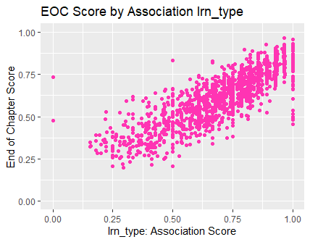
Formative Question Types with Strong Correlation Coefficients and R^2

Slide 4
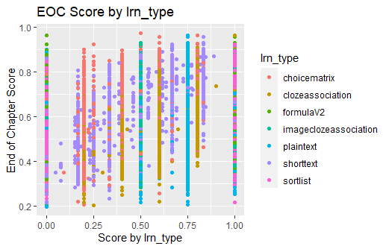
Formative Question Types with Weak Correlation Coefficients and R^2
Do we have a grading problem?

