Slide 1
Git Intro & Hands-on Practice
How we can better manage projects
October 17, 2019
Honolulu Women in Tech

Slide 2
Outline
What is Git
Git exercise
Setup git repository
Shell scriptings
Git play time!

Slide 3
Git
Centralized storage for projects
Version Control
Collaborative Workflow
Keeping track of work

Slide 4
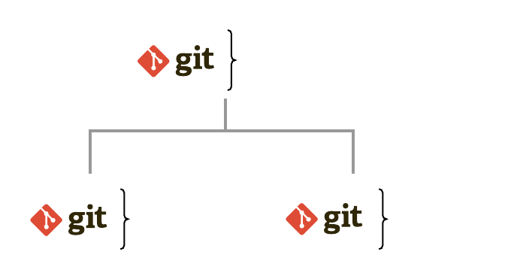
Git as a storage: Centralized Repository
Access your projects from centralized storage and get a local copy
Update projects in centralized storage
Distributed Version Control System (DVCS) - developer’s work copy is a repository with full history of changes

Slide 5

Git as Project Version Tracking tool
Take a "Snapshot" of your project
Go back to previous versions
Leave a note with each version
Keep track of important version

Slide 6

Git as Project Version Tracking tool
Take a "Snapshot" of your project
Go back to previous versions
Leave a note with each version
Keep track of important version

Slide 7
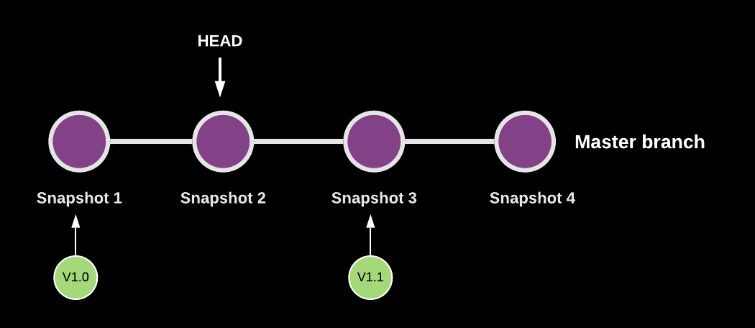
Git as Project Version Tracking tool
Take a "Snapshot" of your project
Go back to previous versions
Leave a note with each version
Keep track of important version

Slide 8
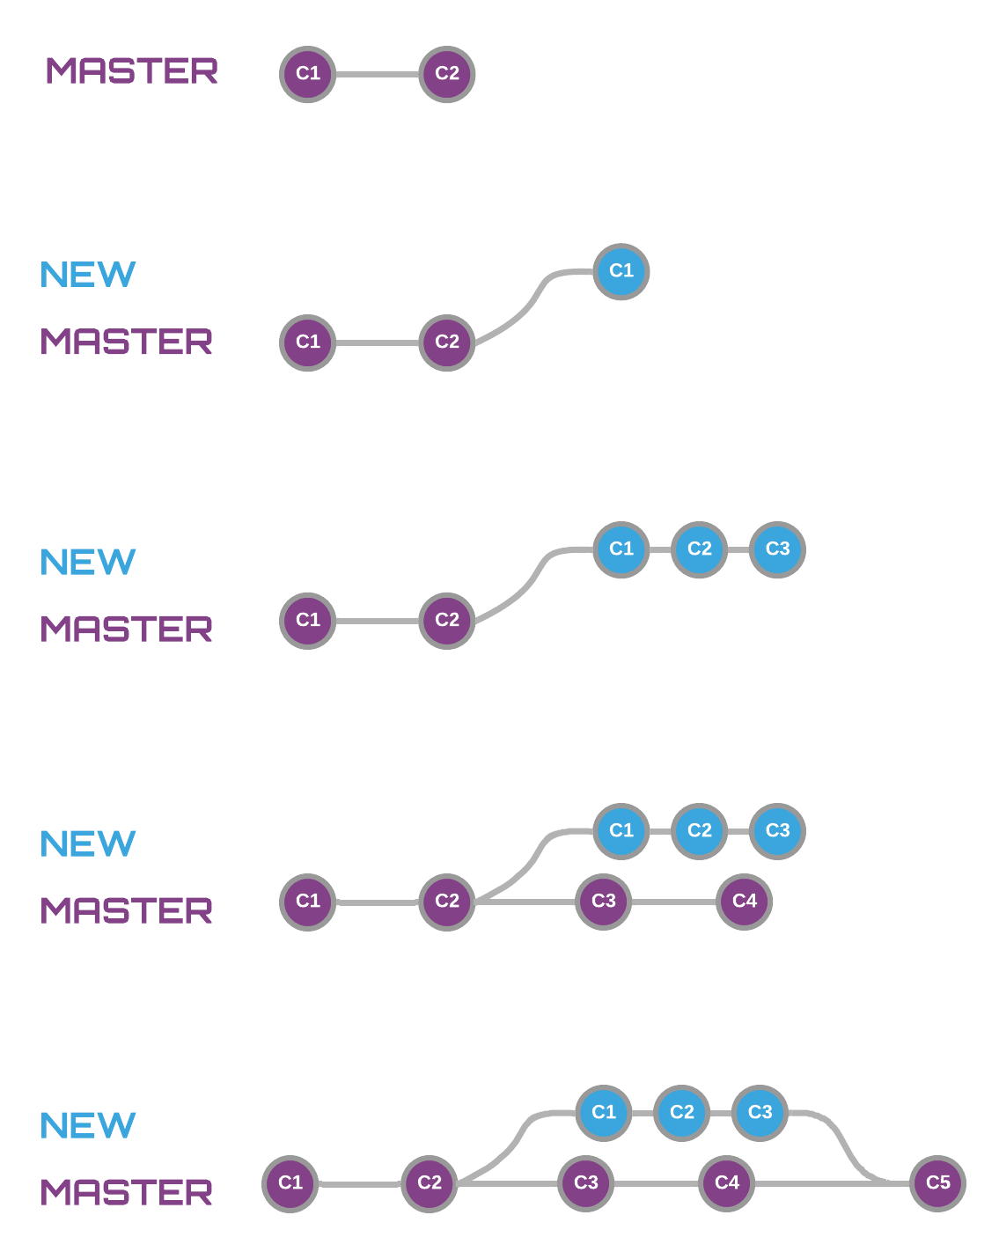
Inside of Git
Develop new features without affecting the released version
Merge back into the main code

Slide 9
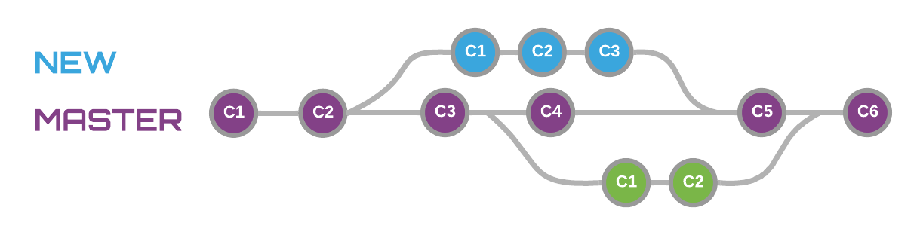
Git as a Collaboration tool
Simultaneously and independently work on features

Slide 10



Git vs. GitHub vs. GitLab
Git
GitHub & GitLab
Repository, tool
GitHub/GitLab is a website/cloud-based service
Users store and manage code
Make your repository Private/Public

Slide 11

Let’s git

Slide 12
Shell Scripting

Slide 13
https://git-scm.com/downloads
Download and Install
Open git bash

Slide 14
A few basic scripts (how to communicate with computers)
>pwd
>ls
>mkdir
>cd
>clear

Slide 15
Where am I ?
>pwd

Slide 16
View the contents of my project folder
>ls

Slide 17
Create a folder!
>mkdir

Slide 18
Clear all the text in my terminal
>clear

Slide 19
Folder navigation scripts
>cd ~/
>cd ..
>cd sub1
>cd sub1/sub2/sub3

Slide 20
How to make your project folder
a Git repository?

Slide 21
A few basic git commands
>git init
>git add
>git commit

Slide 22
>git init
Turn your local project folder into a Git repository

Slide 23
>git add
Place your updated copies into a “stage”
Notes:
Put the most updated copies to the stage to take a snapshot

Slide 24
>git commit
Add to the repository history
Notes:
Take a snapshot

Slide 25
How to use GitHub?

Slide 26
A few basic git commands
>git clone
>git push
>git pull

Slide 27
>git push
Upload your most up-to-date copy to remote

Slide 28
>git clone
Copy a project repository from remote site to local
Notes:
Copying the snapshot of your most updated folders

Slide 29
>git pull
Update your local repository with changes from remote

Slide 30
>git init
Create your local project folder into a Git repository

Slide 31
A few basic git commands
>git log
>git diff
>git checkout

Slide 32
>git log
View your repository’s revision history

Slide 33
>git diff
View your current changes since the last commit

Slide 34
>git checkout
Create a new branch or undo your current changes

Slide 35
Resources
Markdown Basics: https://www.markdownguide.org/getting-started
Markdown Cheatsheet: https://github.com/adam-p/markdown-here/wiki/Markdown-Cheatsheet
Learn Enough Command Line to Be Dangerous: https://www.learnenough.com/command-line-tutorial/basics
Git Branching and Merging: https://git-scm.com/book/be/v2/Git-Branching-Basic-Branching-and-Merging

