Slide 1
Prioritizing Groundfish
Stock Assessments
Preliminary Analysis and Ranking of
Pacific Coast Groundfish Species
for Assessment in 2023
March 2022 Presentation to the
Pacific Fishery Management Council
NWFSC
SWFSC
Dr. Jim Hastie and Dr. Chantel Wetzel
Northwest Fisheries Science Center

Slide 2
Assessment Prioritization Material Overview
E.8 Attachment 1: Description of the assessment prioritization methodology
E.8 Attachment 2: Detailed summary of available data to support stock assessments
E.8 Attachment 3: NMFS assessment prioritization workbook

Slide 3
Assessment Prioritization Material Overview
E.8 Attachment 1: Description of the assessment prioritization methodology
E.8 Attachment 2: Detailed summary of available data to support stock assessments
E.8 Attachment 3: NMFS assessment prioritization workbook

Slide 4
Outline
Goal: Identify stocks to be assessed in 2023 as benchmark (full), update, and data-moderate assessments
Review the prioritization workbook (Attachment 3)
Review the preliminary species ranks for 2023
  Discuss available data and workload
Review the calendar for possible 2023 STAR Panels
Discuss Attachment 1 and 2, if the Council desires

Slide 5
2023 Prioritization Ranking

Slide 6
Factor Summary

Slide 7
Fishery Importance –
Commercial
Description:
Average 2016-20 coastwide ex-vessel revenue transformed to compress the distribution (same transformation used in 2018)
Then re-scaled so the top score is 10
Does not include fish sold by participants in Tribal fisheries
Point Range: 0–10

Slide 8
Fishery Importance – Recreational
Description:
Pseudo-Revenue is equal to landings by state multiplied by a state specific importance weight that range between 0.50 – 2.0.
Factor score is transformed to compress the distribution then re-scaled so the top score is 10.
Point Range: 0–10

Slide 9
Tribal Importance –
Subsistence & Fish Sales
Description:
Revenue from sales is scored in the same manner as non-Tribal commercial, but with a maximum of 7
Subsistence value is scored on a 0.0-3.0 scale, based on input/responses from Tribal representatives
Point Range: 0–10

Slide 10
Choke Species and
Constituent Demand
Description:
Stocks that could constrain the catch of other healthy stocks, esp. rebuilding stocks. Informed by recent catches relative to 2024 ACLs.
Modifiers measure species that are much more important to a specific fleet or state than is reflected in the coastwide comm./rec. ranks
Point Range: (-2)–10

Slide 11
Rebuilding Stocks
Description:
Accounts for the current rebuilding progress for overfished stocks
Included quillback rockfish under the assumption the stock would be declared overfished by NMFS, however, the timeline is currently uncertain.
Point Range: 0–10

Slide 12
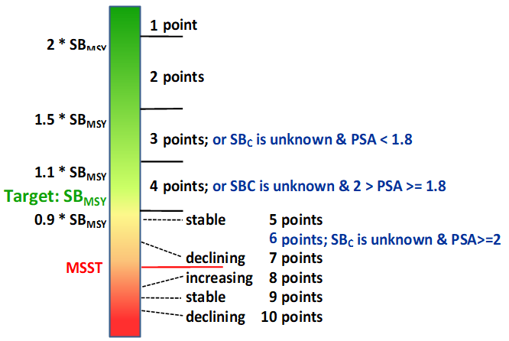
Stock Status
Description:
Scoring based on estimated percent of unfished spawning biomass/output.
PSA (vulnerability) scores used when status is unknown
Point Range: 1–10
*Pacific spiny dogfish percent of unfished updated

Slide 13
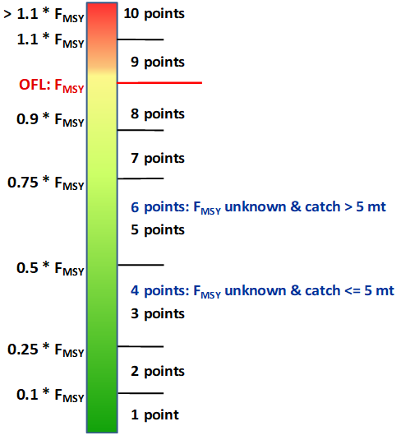
Fishing Mortality
Species | Rank | Factor Score | % OFL Attain. | OFL - Catch (mt)
Quillback rockfish | 1 | 10.0 | 212% | -14
Rosethorn rockfish | 1 | 10.0 | 143% | -6
Squarespot rockfish | 1 | 10.0 | 145% | -5
Stripetail rockfish | 1 | 10.0 | 124% | -15
Vermilion/Sunset rockfish | 1 | 10.0 | 138% | -107
Blue/Deacon rockfish | 3 | 8.0 | 94% | 24
Petrale sole | 4 | 7.0 | 84% | 489
Redbanded rockfish | 4 | 7.0 | 84% | 9
Rougheye/Blackspotted rockfish | 4 | 7.0 | 87% | 59
Treefish rockfish | 4 | 7.0 | 82% | 2
Widow rockfish | 4 | 7.0 | 77% | 2,919
Brown rockfish | 9 | 5.0 | 53% | 85
China rockfish | 9 | 5.0 | 58% | 18
Copper rockfish | 9 | 5.0 | 51% | 164
Flathead Sole | 9 | 5.0 | 60% | 14
Description:
Scoring is based percent attainment of the average 2018-20 catch to OFLs in those years
Italicized values indicate that the species makes an OFL contribution to an assemblage
Values are Bold for species with individual OFLs
Point Range:
1–10

Slide 14
Ecosystem Importance
Description:
Based on Top-down and Bottom-up importance for managed and protected (M-P) species, using all species in the Koehn et al. (2016) Ecopath model
Top-down: what eats M-P species -
max (10) = P. hake
Bottom-up: what M-P species eat -
max (10) = Phytoplankton & infauna
Ecopath ‘assemblage’ scores were distributed among spp. using 2018-20 OFLs/contributions
Point Range: 0–10

Slide 15
Assessment – New Information
Description:
Scoring reflects subjective rating of the expected availability of important (new) data/sources or methods that could:
  Affect the findings of or resolve uncertainties from previous assessments,
  Allow the assessment “uncertainty” category to be upgraded, or
  Facilitate a 1st-time assessment.
Point Range: 0-10

Slide 16
Target Frequency & Years Since Last Assessment
Most important Factor for lowering ranking after assessment
Applies additive adjustments based on:
  Recruitment variability, σ_{R}, and mean catch
  Fishery Importance (using the sum of
  weighted Fishery Factor scores)
  Ecosystem Importance
Rounded to the nearest 2 years, between 4
and 10.
Initial score is calculated as:
Max[(Years since last assessment –
Target Frequency), 0]
Point Range: (-4)–10
Number of species in the detailed analysis, by target assessment frequency
Species w/o assessments

Slide 17
Target Frequency &
Years Since Last Assessment
Splitnose and greenstriped rockfishes are ranked high because they are beyond their calculated assessment frequency.
Both English and rex sole were last assessed as index-based data-moderate assessments.
Majority of top ranked species are ones that have not been assessed to-date.

Slide 18
Total Weighted Factor Scores
All Factor Scores are assembled in the ‘Factor Summary’ tab
The Factor Scores are weighted, using the weights shown below
The summation of those weighted scores forms the basis for ranking species

Slide 19
2023 Prioritization Ranking

Slide 20
Data Availability: Species 1-15
Note that data adequacy, length and age totals, are summarized on a coastwide basis where some species may have multiple assessment areas.
Detailed data summaries available in E.8 Attachment 2
Index data is based on information from both the NWFSC West Coast Groundfish Trawl or the NWFSC Hook & Line survey.

Slide 21
Data Availability: Species 16-30
Note that data adequacy, length and age totals, are summarized on a coastwide basis where some species may have multiple assessment areas.
Detailed data summaries available in E.8 Attachment 2
Index data is based on information from both the NWFSC West Coast Groundfish Trawl or the NWFSC Hook & Line survey.

Slide 22
Items to Consider
Black rockfish (#2) are a highly important stock. There is new survey data available in Oregon that could be used to better inform the assessment of this area. Likely to have area specific assessments (2015 had 3 areas).
Some of the top ranked species this cycle are stocks that have not been previously assessed:
  Rosethorn rockfish has limited commercial and recreational data but is well observed in the NWFSC WCGBT survey. Data-moderate or a full assessment may be feasible.
  Redbanded rockfish has enough commercial data and is observed well by the NWFSC WCGBT survey. Full assessment could be feasible.
  Treefish are only observed in California and have medium recreational sampling. Not observed by either of the NWFSC surveys. A catch and length data-moderate would be the most feasible option.

Slide 23
Items to Consider
Quillback rockfish (#1) was the top ranked species this year primarily driven by several factors: 1) fishing mortality was 212% of the OFL, 2) potential to be a choke species, and 3) combined coastwide stock status of 26 percent. A new assessment of quillback rockfish in 2023 would potentially have little additional data compared to the data included in the 2021 assessment.
There may be a desire to select copper rockfish (#27) for a full assessment in 2023 given the 2021 assessment results in California. The next full assessment could include the following omitted data in California specifically: recreational indices of abundance north and south of Point Conception (often uncertain), CCFRP index of abundance (North of Point Conception), historical length observations that were evaluated in the 2021 mop-up panels, age data from the NWFSC hook & line survey (south of Point Conception), and very limited recreational ages.
SSC recommended workshops on using ROV data in assessments and how to handle spatial issues could provide recommended approaches that could be applied in a new assessment for both copper rockfish and quillback rockfish.

Slide 24
Items to Consider
The last full assessment of petrale sole (#3) was in 2013 and there is a new ecosystem driver of recruitment that could be included in the next full assessment.
The 2017 rebuilding analysis of yelloweye rockfish (#14) indicated the stock would rebuild with 50% probability in 2027. Given the limited additional available data since 2017, there may not be enough information to inform potential early rebuilding.
The last assessment of rougheye/blackspotted rockfish (#26) was last assessed in 2013. In the absence of a new assessment future catches may be limited by future ACLs. Additionally, there may be new genetic information to inform the proportion of blackspotted rockfish and if low, a new assessment may be considered category 1 (existing model is a category 2).

Slide 25
Items to Consider
The last assessments of longspine thornyhead (#44) and shortspine thornyhead (#37) were in 2013. These species may be ideal candidates for a catch, length, and index data-moderate assessment since thornyhead are unable to be aged and both species are well by the NWFSC WCGBT survey allowing for the inclusion of an index of abundance.
English sole (#29) and rex sole (#23) were last assessed in 2013 as data-moderate assessments (index-based). These two species are well observed by the NWFSC WCGBT survey and may be good candidates for a catch, length, and index data-moderate assessment.
Greenstriped rockfish (#25) was last assessed in 2009. Similar to the above species, greenstriped rockfish may be a candidate for a catch, length, and index data-moderate assesements in 2023.

Slide 26
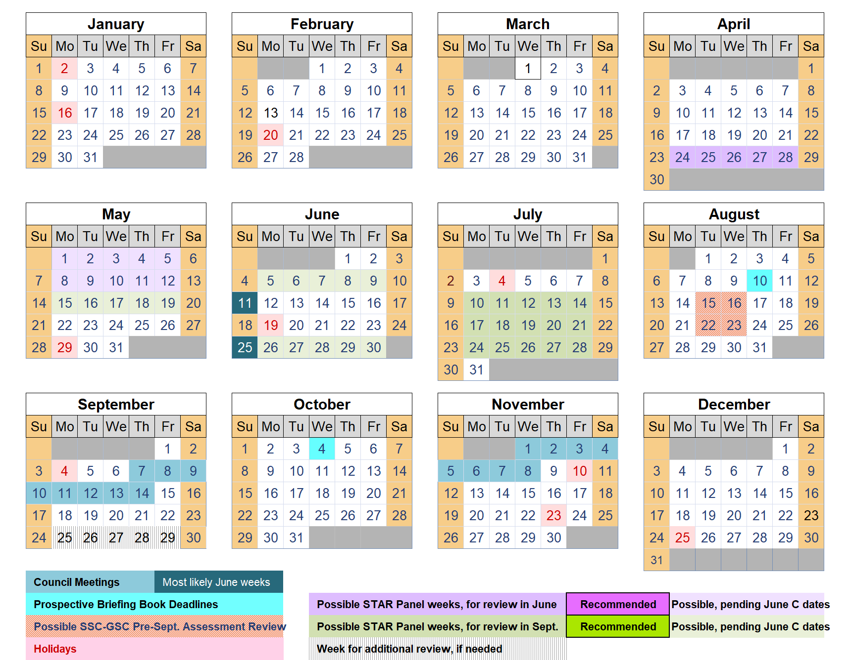
2023 Calendar, with potential review meeting dates

Slide 27
Questions
Additional question on E.8 Attachment 3: NMFS assessment prioritization workbook?
Questions on E.8 Attachment 2: Detailed summary of available data to support stock assessments?

