Slide 1
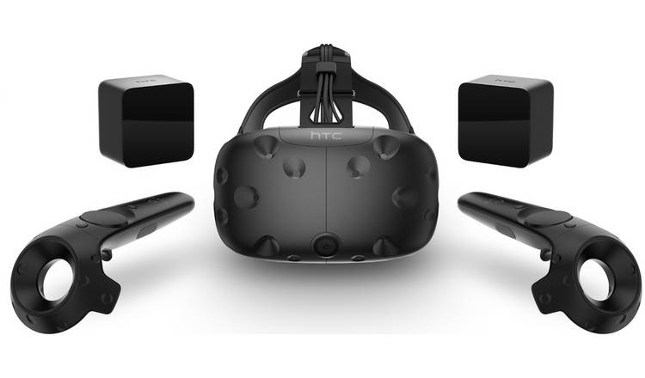
Development Platform: | Unity
VR Software: | SteamVR Compatible with multiple devices (e.g. HTC Vive, Oculus Rift, Samsung Odyssey)
VR Hardware: | HTC Vive More functionality than cheaper mobile devices (e.g. use of hand controllers) Likely to get cheaper and more accessible in future

Slide 2
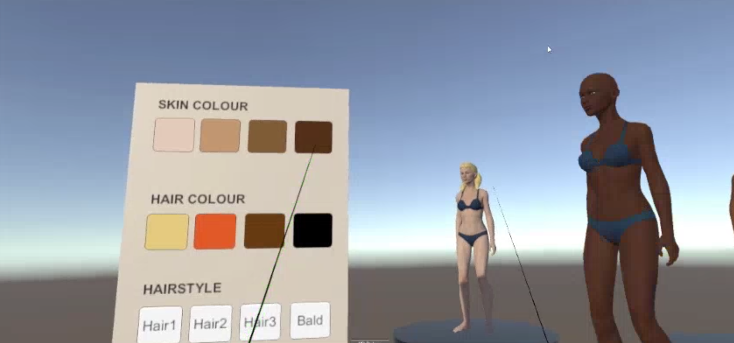
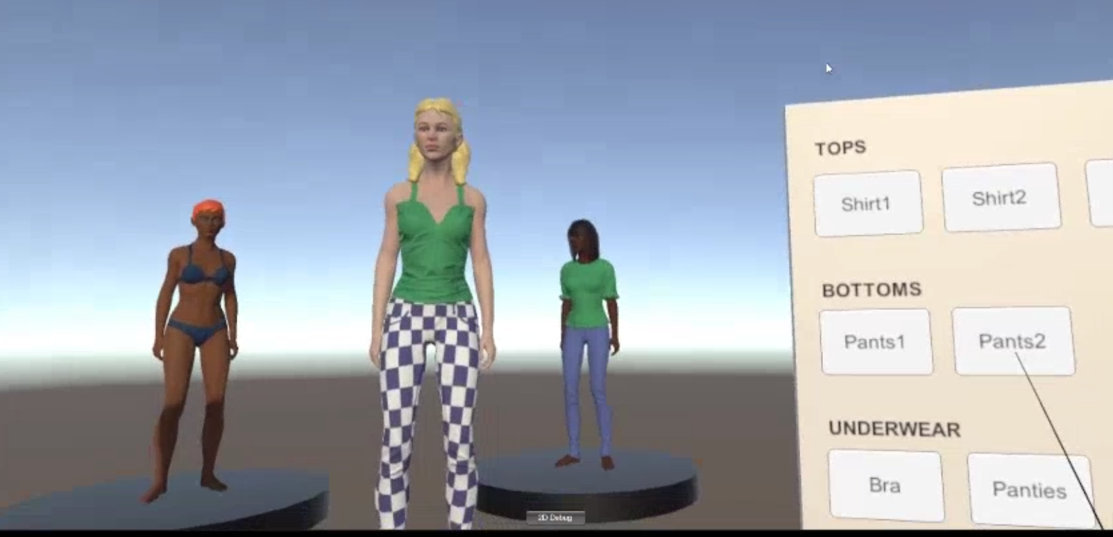
Dressing Room
Uses laser pointer and trigger to interact with menus
Can adjust model’s individual genetics and clothing
Potential addition: apply face photo to model using AI technology

Slide 3
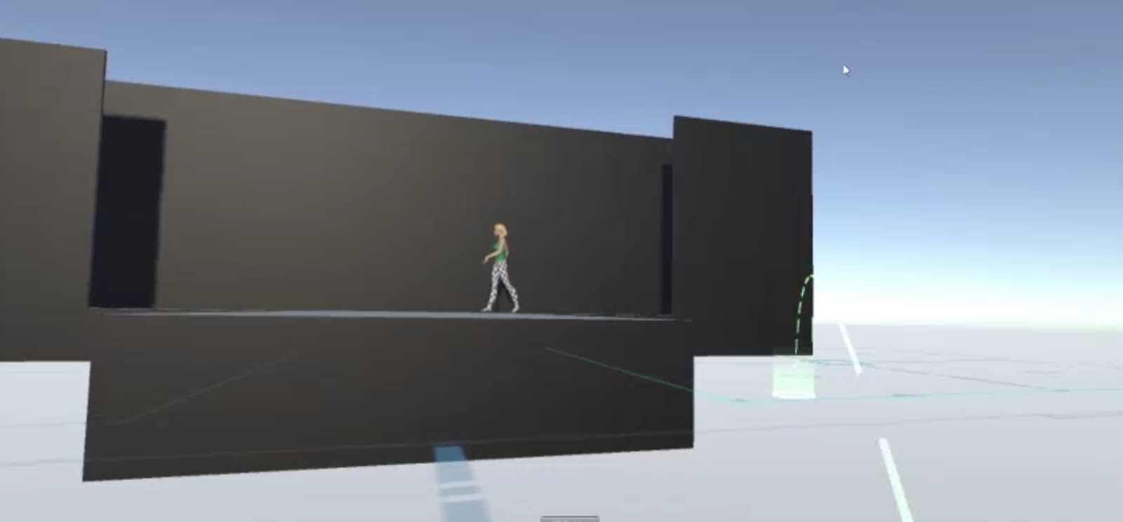
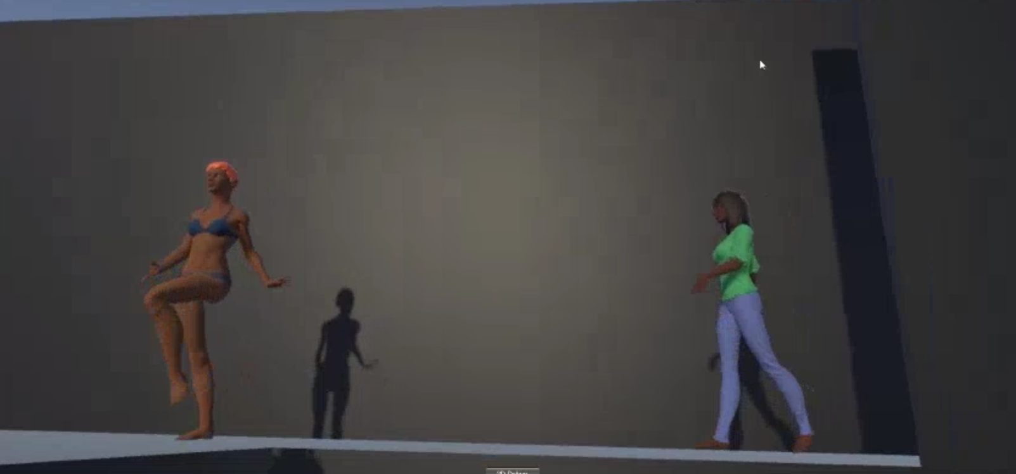
Fashion Show
Uses SteamVR Teleportation mechanics to move around the show
Future addition: ability to change environment (e.g. background and lighting)
Future addition: ability to change walking and posing style of the models

