Slide 1
Project flutter

Slide 2
01
What you have learned from this project.
A
G
E
N
D
A
02
What are your difficulties?
02
Question and Answer
1

Slide 3

This project I have learn
Text Field
Alert Dialog
Design logo
TextEditingController
3

Slide 4
This project we have learn
Checkbox
Build in mobile
FloatingActionButton
Research skill
Create function and meaning full name
Flat Button
3

Slide 5
The difficult during do the project
New code
Emulator not working
Can not get value from
text Field
Create multiple class
Build on real mobile
3

Slide 6
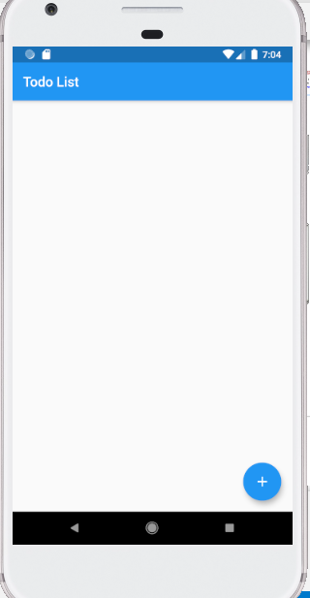
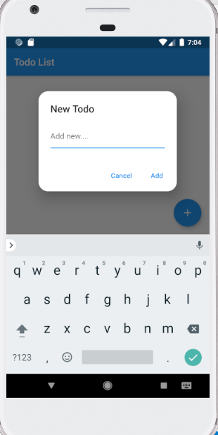
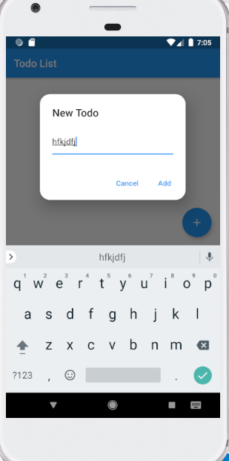
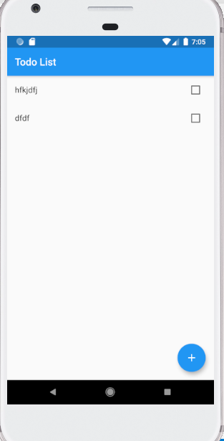
The process of project
3

Slide 7





Thank you !
www.passerellesnumeriques.org

