Slide 1
Passerelles numériques
A Gateway for Life
Chapter09: Interface

Slide 2
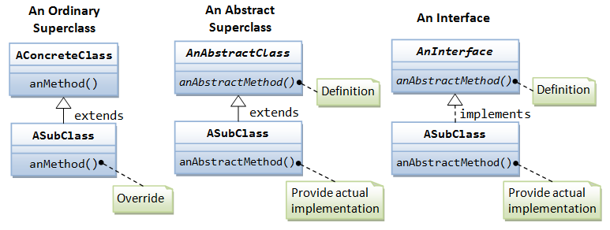
Abstraction
Processing of hiding the set of services
By using abstract class and interface

Slide 3
Interface
Extension of abstract class
Declare interface by using interface keyword
Interface allows only abstract methods (100% pure abstract class)
By default all methods are public abstract
By default interface is abstract
By default interface can’t create object

Slide 4
Interface
Naming conventions
In Java, interface names are written in CamelCase, that is, first letter of each word is capitalized.
Some programmers prefix the letter ‘I’ with the interface name to distinguish interfaces from classes.
Snippet
interface IEnumerable
interface Icomparable

Slide 5

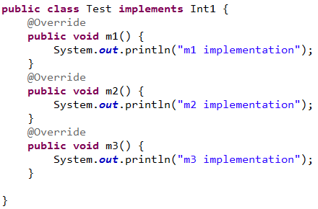
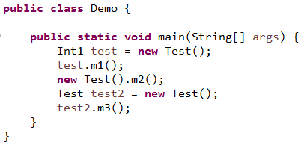
Interface
public abstract
Notes:
Interface is be able to hold the reference like type
===output=====
m1 implementation
m2 implementation
m3 implementation

Slide 6
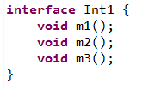
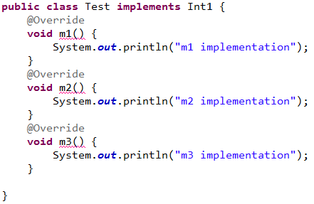

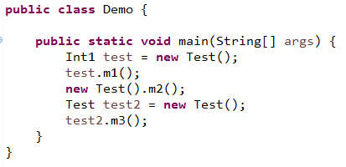
Interface
The implementation methods need to be public
Notes:
Can’t reduce the visibility of the inheritance class
So: public in the base class and it can’t be default in sub class.
Remember about the polymorphism rules: we can’t reduce the visibility when doing overriding in sub class

Slide 7
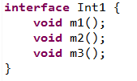
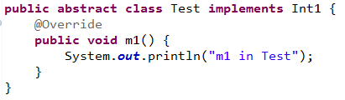
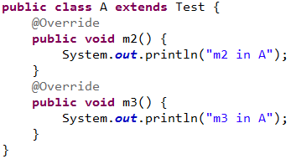
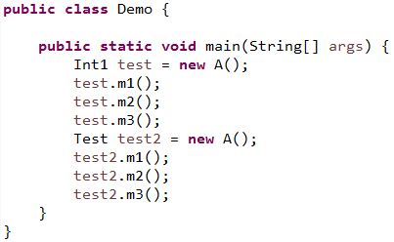
Interface
Notes:
m1 in Test
m2 in A
m3 in A
m1 in Test
m2 in A
m3 in A

Slide 8
Interface
All methods in the sub class that implements the interface must be implemented otherwise declared as abstract. And let the other class extends it to implement the rest methods
Notes:
m1 in Test
m2 in A
m3 in A
m1 in Test
m2 in A
m3 in A

Slide 9


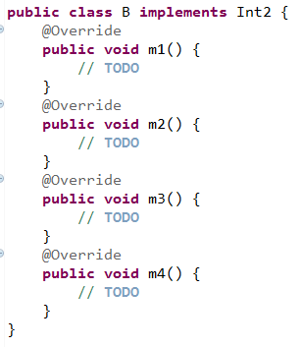
Interface
Inheritance is possible with interface
Notes:
How many methods in Int2???
How many methods need to override in B??

Slide 10
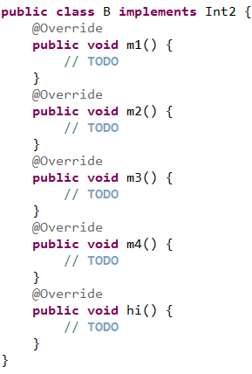

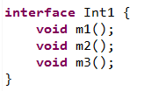

Interface
A class could only extend one parent class no multiple inheritances
An interface could extend multiple interfaces at a time
Notes:
Can we create a class to implement Int1 or Int??

Slide 11

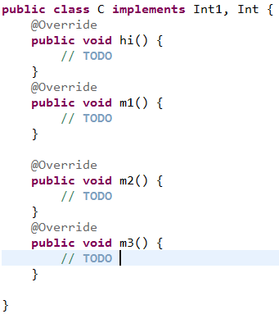
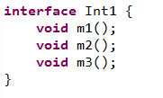
Interface
A class could also implement many interfaces at a time

Slide 12
Interface
class extends class
class implements interface(s)
Interface extends interface(s)
Notes:
An interface cannot be instantiated.
An interface cannot have constructors.
All the methods of an interface are implicitly abstract.
An interface is not extended but implemented by a class.
An interface can extend multiple interfaces.
The fields declared in an interface can be both static or final. In addition, an interface can contain constant declarations. All constant values defined in an interface are implicitly public, static, and final. Once again, you can omit these modifiers
And these variable could be use directly within the class that implements the interface without a qualifying class name but it isn’t a good practise

Slide 13
Interface vs Abstract class
Abstract Class | Interface
An abstract class can have both abstract and normal methods. | An interface can have only abstract methods.
An abstract class may have non-final variables. | Variables declared in an interface are implicitly final.
An abstract class may have members with different access modifiers such as private, protected, and so on. | Members of an interface are public by default.
An abstract class is inherited using the extends keyword. | An interface is implemented using the implements keyword.
An abstract class can inherit from another class and implement multiple interfaces. | An interface can extend from one or more interfaces.

Slide 14
key points to remember about interfaces
1) Interface can’t create object
2) Interface is full abstraction(methods have no body). Abstract class is partial abstraction(normal and abstract methods).
3) class implements interface(s).
4) Every method implemented from interface need to be public.
5) Class that implements any interface must implement all the methods of that interface, else the class should be declared abstract.
6) Interface cannot be declared as private, protected.
7) All the interface methods are by default abstract and public.
https://beginnersbook.com/2013/05/java-interface/
Notes:
https://beginnersbook.com/2013/05/java-interface/

Slide 15
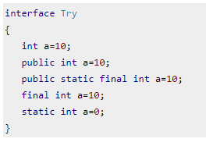
8) Variables declared in interface are public, static and final by default.
All of the above statements are identical.

Slide 16

9) Interface variables must be initialized at the time of declaration otherwise compiler will throw an error.

Slide 17
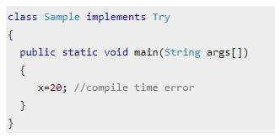
10) Inside any implementation class, you cannot change the variables declared in interface because by default, they are public, static and final.

Slide 18
11) An interface can extend any interface but cannot implement it. Class implements interface and interface extends interface.
12) A class can implement any number of interfaces.

Slide 19
13) If there are two or more same methods in two interfaces and a class implements both interfaces, implementation of the method once is enough.
interface A
{
public void aaa();
}
interface B
{
public void aaa();
}
class Central implements A,B
{
public void aaa()
{
//Any Code here
}
public static void main(String args[])
{
//Statements
}
}

Slide 20
14) A class cannot implement two interfaces that have methods with same name but different return type.
interface A
{
public void aaa();
}
interface B
{
public int aaa();
}
class Central implements A,B
{
public void aaa() // error
{
}
public int aaa() // error
{
}
public static void main(String args[])
{
}
}

Slide 21
15) Variable names conflicts can be resolved by interface name.
interface A
{
int x=10;
}
interface B
{
int x=100;
}
class Hello implements A,B
{
public static void Main(String args[])
{
/* reference to x is ambiguous both variables are x
* so we are using interface name to resolve the
* variable
*/
System.out.println(x); //error
System.out.println(A.x);
System.out.println(B.x);
}
}

Slide 22
Interface
class A extends B --> Valid or Invalid?
class A extends B,C --> Valid or Invalid?
class A implements It1 --> Valid or Invalid?
class A implements It1,It2 --> Valid or Invalid?
class A extends A --> Valid or Invalid?
interface It1 extends It2 --> Valid or Invalid?
interface It1 extends It2,It3 --> Valid or Invalid?
interface It1 extends A --> Valid or Invalid?
interface It1 extends It1 --> Valid or Invalid?
class A extends B implements It1,It2 --> Valid or Invalid?
class A implements It1,It2 extends B --> Valid or Invalid?

Slide 23


Interface
class A extends B
class A extends B,C
class A implements It1
class A implements It1,It2
class A extends A
interface It1 extends It2
interface It1 extends It2,It3
interface It1 extends A
interface It1 extends It1
class A extends B implements It1,It2
class A implements It1,It2 extends B

Slide 24
interface calculate {
void cal(int item);
}
class display implements calculate {
int x;
public void cal(int item) {
x = item * item;
}
}
class Testinterfaces {
public static void main(String args[]) {
display arr = new display();
arr.x = 0;
arr.cal(2);
System.out.print(arr.x);
}
}
Notes:
Output: 4
https://www.youtube.com/watch?v=OOCneA6FAPY : part 6,33mn

Slide 25
interface calculate {
void cal(int item);
}
class displayA implements calculate {
int x;
public void cal(int item) {
x = item * item;
}
}
class displayB implements calculate {
int x;
public void cal(int item) {
x = item / item;
}
}
class interfaces {
public static void main(String args[]) {
displayA arr1 = new displayA();
displayB arr2 = new displayB();
arr1.x = 0;
arr2.x = 0;
arr1.cal(2);
arr2.cal(2);
System.out.print(arr1.x + " " + arr2.x);
}
}
Notes:
Output: 4 1

Slide 26
interface calculate {
int VAR = 0;
void cal(int item);
}
class display implements calculate {
int x;
public void cal(int item) {
if (item<2){
x = VAR;
}else{
x = item * item;
}
}
}
class interfaces {
public static void main(String args[]) {
display[] arr=new display[3];
for(int i=0;i<3;i++) {
arr[i]=new display();
}
arr[0].cal(0);
arr[1].cal(1);
arr[2].cal(2);
System.out.print(arr[0].x+" " + arr[1].x + " " + arr[2].x);
}
}
Notes:
Output: 0 0 4

Slide 27
Exercise
Create an interface called IPlayable. The interface has an abstract method called play() that displays a message describing the meaning of “play” to the class. Create classes called Child, Musician, and Actor that all implement IPlayable. Create an application that demonstrates the use of the classes.

Slide 28
What have you learned?

Slide 29
Q&A

