Slide 1
MATERIALIZE PRATICE
Your project must comply with following requirements

Slide 2
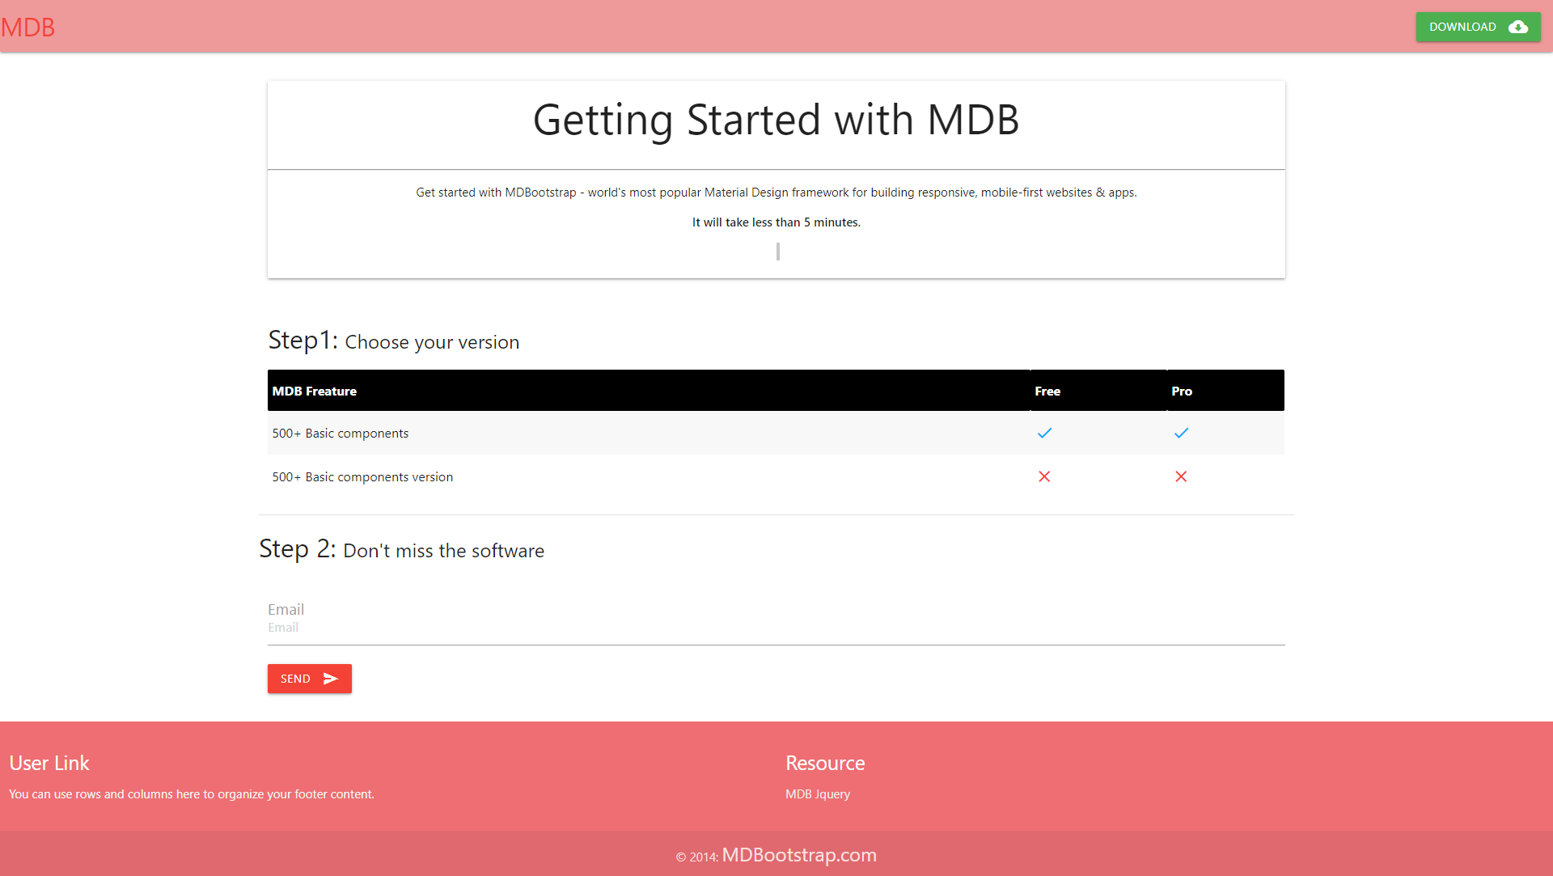
1. Card panel with
header
2. Table
With header
4. Table with zebra
3. Icons
5. Styled
button

Slide 3
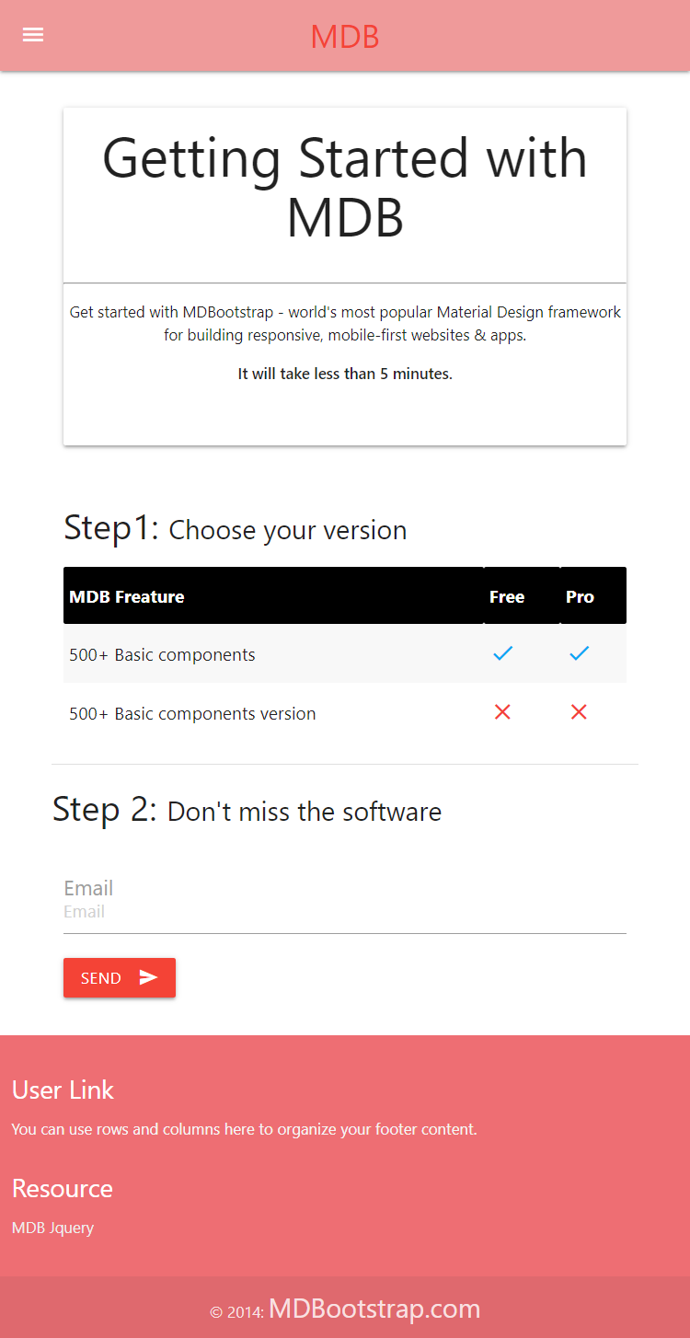
6. After browsing to medium/small screen

Slide 4
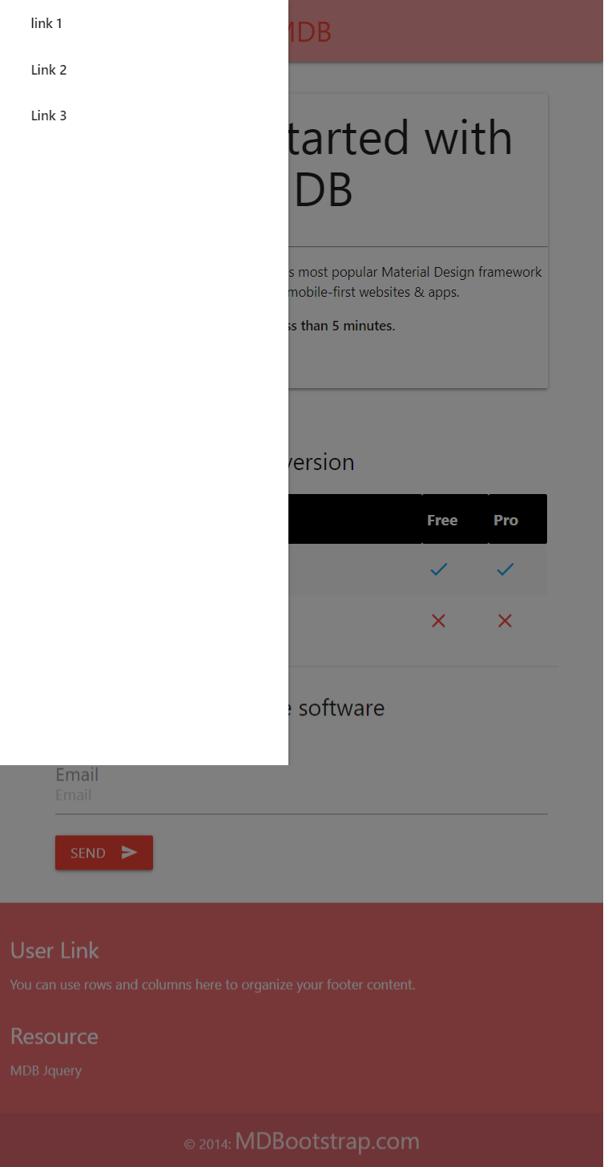
7. A menu is displayed
After click on hamburger button

