Slide 1
Passerelles numériques
A Gateway for Life
06-Inheritance

Slide 2
Outline
Super and sub class

Slide 3
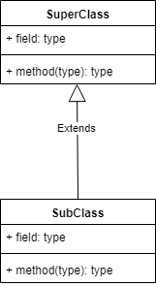

Slide 4
Inheritance
It is the mechanism in java by which one class is allow to inherit the features(fields and methods) of another class.

Slide 5
Inheritance
Super Class: The class whose features are inherited is known as super class(or a base class or a parent class).
Sub Class: The class that inherits the other class is known as sub class(or a derived class, extended class, or child class). The subclass can add its own fields and methods in addition to the superclass fields and methods.

Slide 6
Inheritance
The keyword used for inheritance is extends
Syntax:
class SubClass extends SuperClass
{
//methods and fields
}

Slide 8
Which member can be inherited?
A subclass inherits all the members from its super class with public, default, protected access modifier
Except members with private, static access modifier
Constructors (but can be invoked using super)
One can declare a field with the same name in the subclass as the one in the super class. This will lead to hiding of super class field which is not advisable.

Slide 9


Example
public class Dog {
public String name;
public String breed;
public String color;
public int age;
public void bark() {}
public void eat() {}
public void run() {}
}
public class Cat {
public String name;
public String breed;
public String color;
public int age;
public void meow() {}
public void eat() {}
public void run() {}
}

Slide 10
public class Animal {
public String name;
public String breed;
public String color;
public int age;
public void eat() {}
public void run() {}
}
public class Dog extends Animal {
public void bark() {}
}
4 instance variables
3 methods
4 instance variables
3 methods
public class Cat extends Animal {
public void meow() {}
}

Slide 11
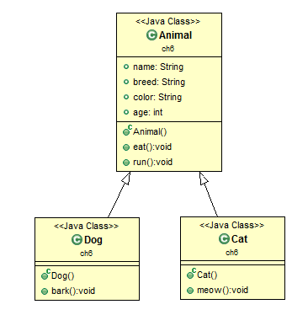

Slide 12
super
super() method to invoke the super class constructors
super keyword to invoke the super class methods

Slide 13
public class Animal {
public String name;
public String breed;
public String color;
public int age;
public Animal() {
}
public Animal(String name) {
this.name=name;
}
public void eat() {
System.out.println("Eating....");
}
public void run() {
System.out.println("Running....");
}
}

Slide 14
public class Dog extends Animal{
public Dog(String name,int age) {
super(name);
this.age = age;
}
public void bark() {
System.out.println("WoahWoah....");
}
public void runAndBark() {
super.run();
this.bark();
}
}

Slide 15
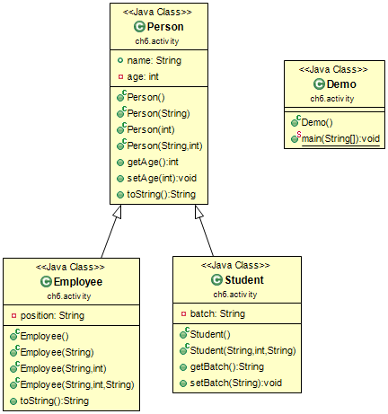
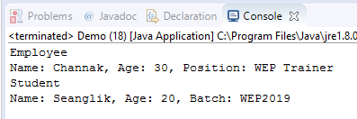
Activity
30mn

Slide 16
Q&A

