Slide 1
Passerelles numériques
A Gateway for Life
07-Polymorphism

Slide 2
Polymorphism
Overloading (Static binding)
Overriding (Dynamic binding)

Slide 3
What does Polymorphism mean?
Poly: many
Morphism: forms
Polymorphism: many forms
One thing in many form
The ability to appear in more than one form
Notes:
Ex: one person with different behavior called polymorphism. You might behavior differently at home, school, in front of camera, mirror, in front of education,…

Slide 4
Type of Polymorphism
Compile time Polymorphism / static binding / early binding
Method overloading or constructor overloading
Runtime Polymorphism / dynamic binding / late binding
Method overriding

Slide 5
I. Overloading
Method overloading
Constructor overloading
Notes:
Binding/mapping will be done during the compile time only
In cpp: there exists operator overloading but not in java since it is implicitly performed by jvm (like + concatenate operator)

Slide 6
I. Overloading
Method Overloading
multiple methods of a class can have the same name but with different parameter lists
Changing the number of parameters
Changing the sequence of parameters
Changing the type of parameters

Slide 7
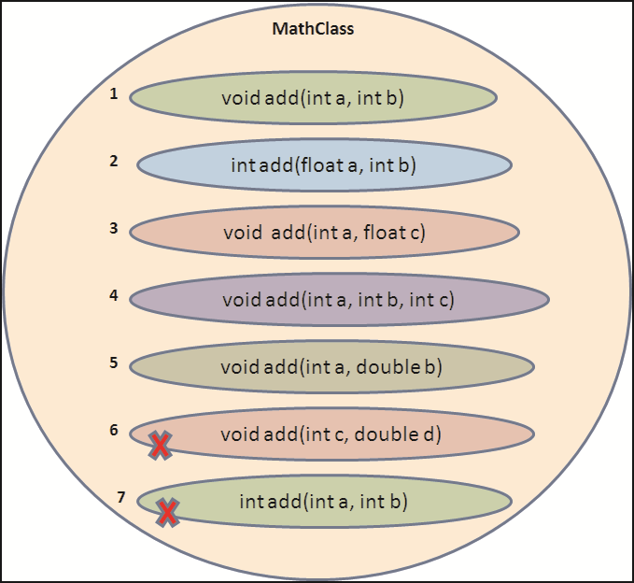
I. Overloading
Method Overloading
Notes:
Do you remember about our Dog method overloading?
Same functionality but internal logic will be varied based on the provided inputs
The other examples: search by id, name, dob….. Sort by: name, size, item type, date modified
The method execution is happened at compile time (the mapping is happened at compile time)
Method overloading is an example of static binding where binding of method call to its definition happens at Compile time.
* Coding on the fly. Try with some wrong mapping!!!

Slide 8


I. Overloading
Method Overloading
Compile time error. Argument lists are exactly same. Both methods are having same number, data types and same sequence of data types.

Slide 9
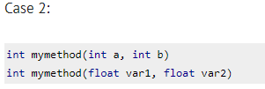

I. Overloading
Method Overloading
Perfectly fine. Valid case of overloading. Here data types of arguments are different.

Slide 10
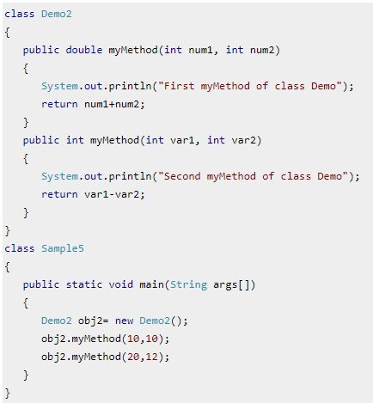

Slide 11
It will throw a compilation error: More than one method with same name and argument list cannot be given in a class even though their return type is different. Method return type doesn’t matter in case of overloading.

Slide 12
I. Overloading
Constructor Overloading
A class can have many overloaded constructors
Changing the number of parameters
Changing the sequence of parameters
Changing the type of parameters

Slide 13
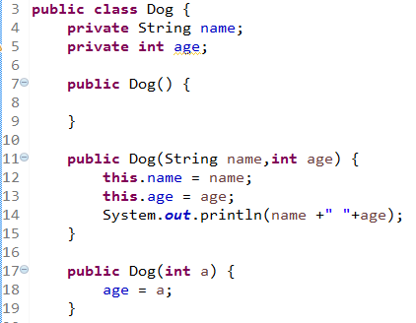
Notes:
To create an object we have 2 approaches :
naming : Dog d = new Dog();
name less : new Dog(); // anonymous object : Java designers advice to use anonymous objects when the object is required only once in the program. The advantage is to save memory, as anonymous object dies immediately.

Slide 14
II. Overriding
Old contents gone new contents are added
Method Overriding
Overriding just means that a subclass redefines one of its inherited method when it need to change or extend behaviour of that method
At least two java classes with inheritance relationship (extends keyword)
Notes:
To overload the method, one java class is enough.

Slide 15
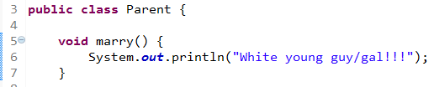
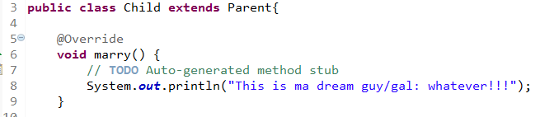
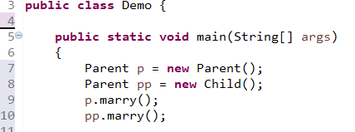
II. Overriding
Method Overriding
Notes:
What would be the output?
Line8: child object is created
Line9: compile time parent runtime parent
Line10: compile time parent runtime child

Slide 16
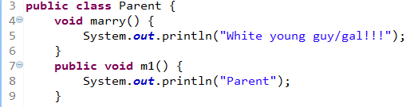
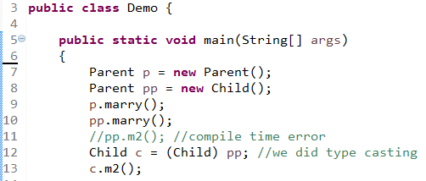
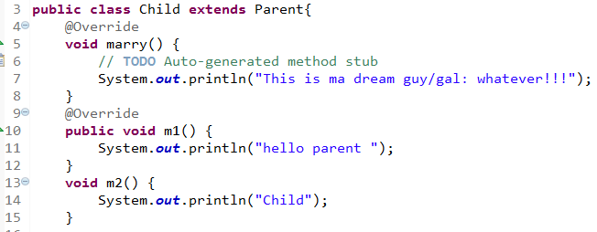
II. Overriding
Method Overriding
Notes:
Can we do : Child c = new Parent() ? // incompatible type

Slide 17




II. Overriding
Animal
Cat
Dog
Duck
Notes:
What would be the output?

Slide 18
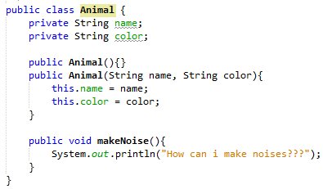
II. Overriding
Animal
Notes:
What would be the output?

Slide 19
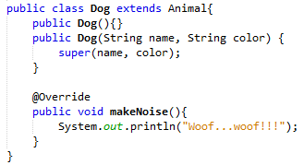

II. Overriding
Dog
Continue to create inheritance hierarchy for Cat and Duck and make the overriding implementation in makeNoise() method
10 minutes
Notes:
Overriding method in child class and overridden method in parent class

Slide 20
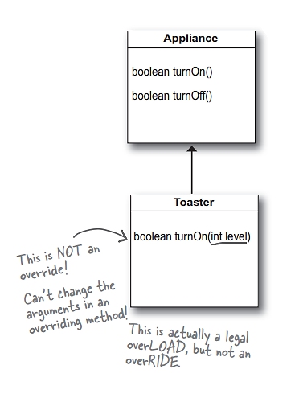
II. Overriding
Rules:#1
Parent’s signature and child’s signature is the same

Slide 21
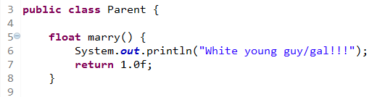
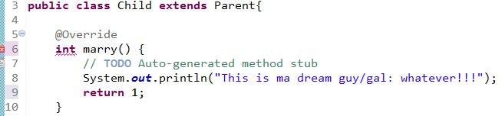
II. Overriding
Rules:#2
Method return type must be the same for both parent and sub class at primitive level

Slide 22


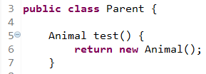
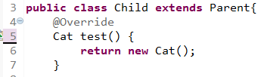
II. Overriding
Rules:#3
Method return type could be change at class level
Notes:
Overriding method is sub type
Overridden method is parent type

Slide 23
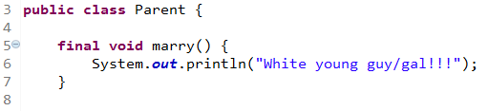
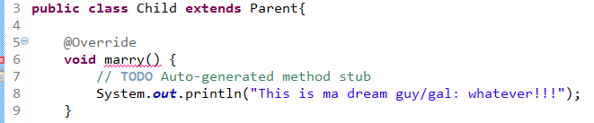
II. Overriding
Rules:#4
If the method declared as final, overriding isn’t possible
Notes:
Overriding method is sub type
Overridden method is parent type

Slide 24
Final Keyword
The final keyword in java is used to restrict the user.
Final variable
If you make any variable as final, you cannot change the value of final variable(It will be constant).
Final method
If you make any method as final, you cannot override it.
Final class
If you make any class as final, you cannot extend it.
Variable
Method
Class

Slide 25
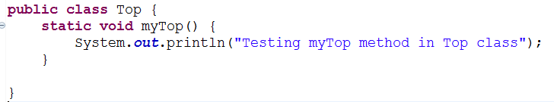
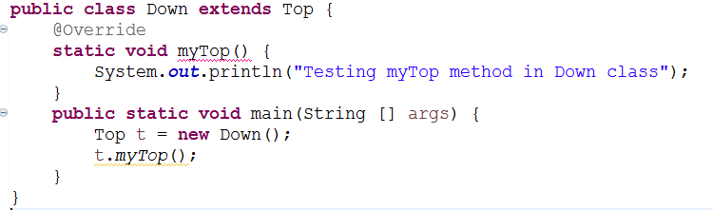
II. Overriding
Rules:#5
Not possible to overriding static methods (method hiding concept)
Notes:
Static methods are specific to class not to the object
What would be the output??

Slide 26

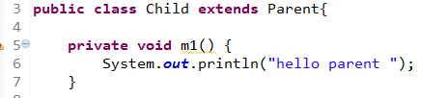
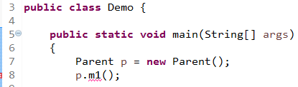
II. Overriding
Rules:#6
Private methods are not possible to override
Notes:
Private: variables and methods
Be able to access private members within the class only
Not accessible to the sub class

Slide 27


II. Overriding
Rules:#7 (Access Modifiers) [get back when study Access Modifiers]
Case1: same level, overriding is possible
Notes:
Access modifiers:
Public: var, methods, class =>any packages
Protected: var, method => within packages, outside package by inheritance (child class)
Private: var methods => within class
Default: var, methods, class => within package (package level)

Slide 28

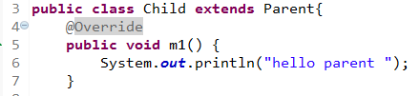
II. Overriding
Rules:#7 (Access Modifiers)
Case2: increase level of accessibility, overriding is possible
Notes:
Access modifiers:
Public: var, methods, class =>any packages
Protected: var, method => within packages, outside package by inheritance (child class)
Private: var methods => within class
Default: var, methods, class => within package (package level)

Slide 29

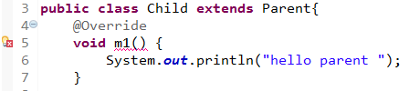
II. Overriding
Rules:#7 (Access Modifiers)
Case3: decrease level of accessibility, overriding isn’t possible
Notes:
Access modifiers:
Public: var, methods, class =>any packages
Protected: var, method => within packages, outside package by inheritance (child class)
Private: var methods => within class
Default: var, methods, class => within package (package level)

Slide 30
Q&A

