Slide 1
Optimizing Cereal Production

Slide 2

MOTIVATION
All humans depend on agriculture for food
Urban-industrial societies depend on the base of
food surplus generated by farmers and herders
Agriculture remains the most important economic activity in the world

Slide 3
Employs 45 percent of the working population
In some parts of Asia and Africa, over 80 percent
of labor force is engaged in agriculture
Cereals are a big part of it !!

Slide 4
Underlying Problem
Even after a large proportion of population is
involved in cereal production
the existing yield amount does not fruition
to economic prosperity of farmers
Notes:
Even after a large proportion of population in Asia and Africa is involved in cereal production, the yields don’t fruition to economic prosperity of farmers

Slide 5
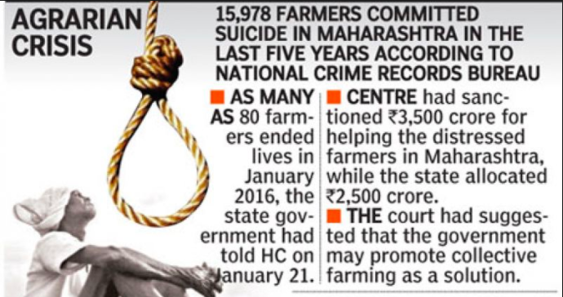
Notes:
The number of farmers suiciding in India is ever increasing.

Slide 6
Our Solution
Identify the factors on which cereal crop largely
depends and use different models to predict the
optimum combination of those factors to achieve
better yield and higher annual income of
the farmers

Slide 7
Features Used For Cereal Production
Land Area- Total and Arable
Precipitation
Fertilizers Consumption
Land under cereal production
Number of Tractors
Cereal Yield

Slide 8
Process
Performed EDA- data cleaning- null, imputation for scarce data
Studied distribution of cereal production – Geographically and Quantitatively
Feature Selection
Normalization of data
Prediction Models – Linear Regression, Support Vector Regression, Random Forest

Slide 9
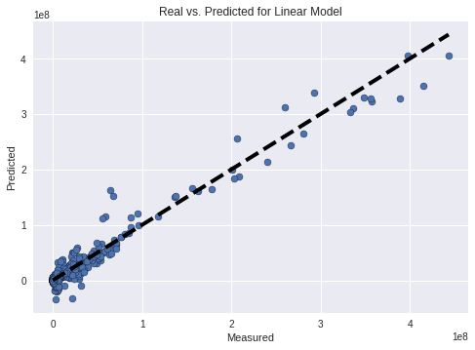
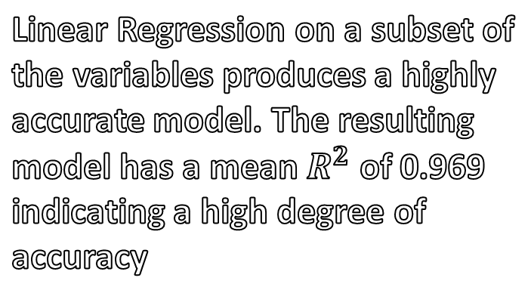
Results
Linear Regression on a subset of the variables produces a highly accurate model. The resulting model has a mean $R^{2}$ of 0.969 indicating a high degree of accuracy

