Slide 1
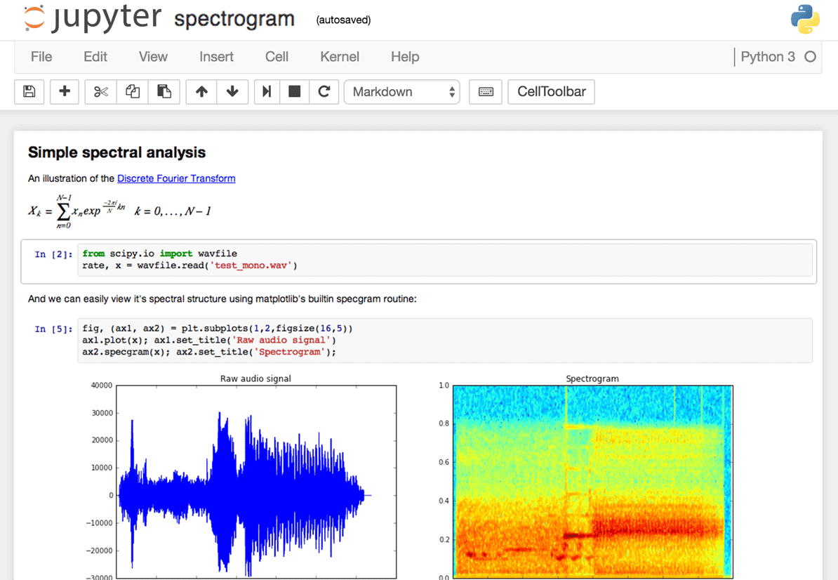
Objectives
Describe key features of Jupyter notebooks which lead to their broad acceptance in data science
https://www.dataquest.io/blog/images/jupyter/interface-screenshot.png

Slide 2
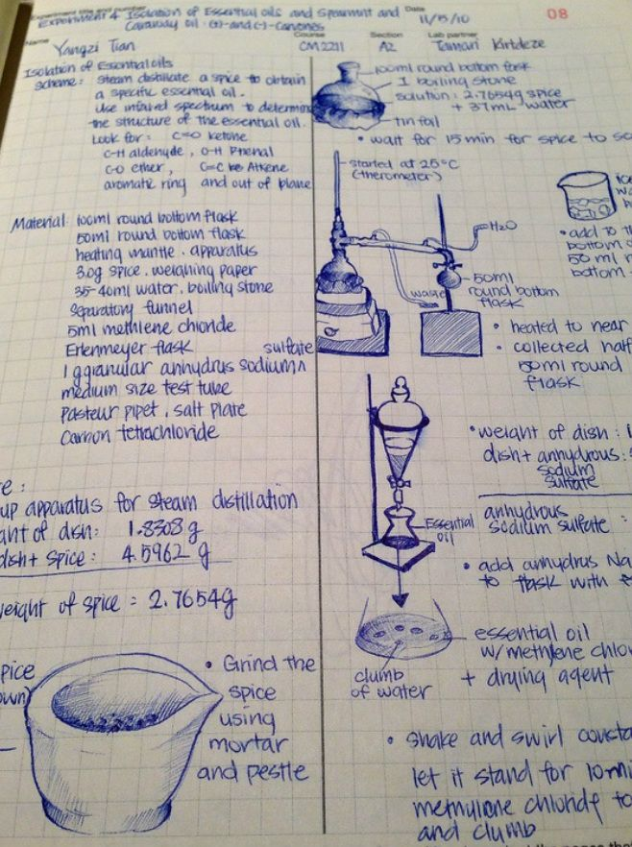
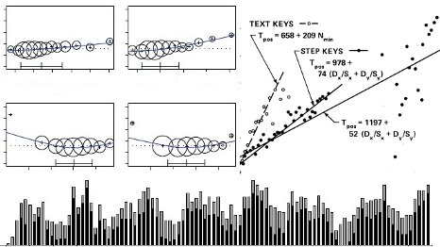
Key features of Jupyter Notebooks
Documented Data Science
Reproducible Science
Presentations of Results
Support for Python and R
https://s-media-cache-ak0.pinimg.com/736x/01/e5/3d/01e53d80842e87c8e50faeb1b127b16f--science-notebooks-experiment.jpg
http://sing.stanford.edu/cs303-sp11/cs303_picture_mashup.jpg

