Slide 1
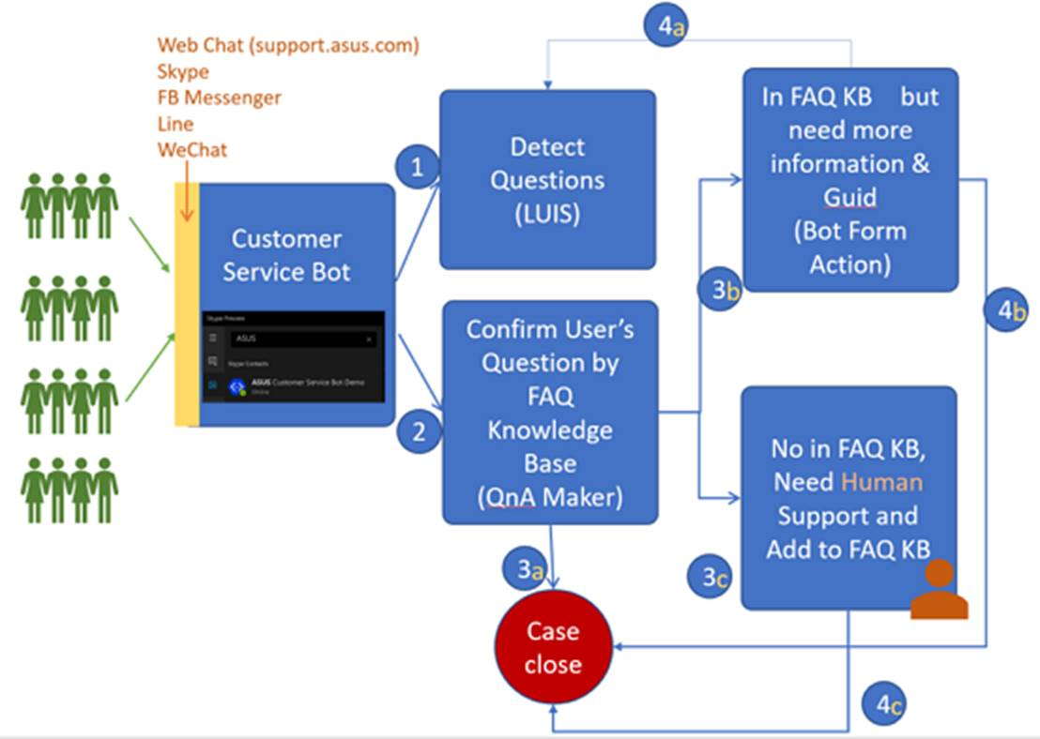

Slide 2
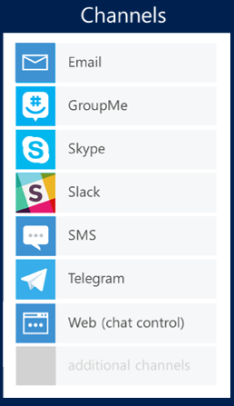


Customer Service Bot
Customer Service Bot
Local Bot
Channel
Local Bot
Channel
Remote Directline Bot
Remote Directline Bot

