Slide 1
HUMAN COMPUTER INTERACTION — TICT 2153 (T)
Mini Group Project - Final Presentation
Ergonomic Posture Monitor for Computer Users
A physical Desk Companion that Monitors Posture and Provides Progressive visual and Audio Feedback.
GROUP NUMBER
PROJECT LEADER
PRESENTATION DATE
Group No.05
2023/ICTS/39
15/August/2026

Slide 2
I
Introduction
Presented by: 2023/ICTS/43
Who we are and what we set out to build
About the Team
• We are Group 05.
• Project Domain: Workplace Ergonomics and Healthy Computer use.
• We chose this problem because prolonged computer use and poor posture can contribute to back, neck and spinal strain.
• And Our Goal is a non-intrusive physical reminder that works without desktop software or mobile notifications.
Team Members
1
I.D.T. Chathubhashana
2023/ICTS/38
Hardware Design
2
H.D.H. Erandaka
2023/ICTS/39
Team Leader
3
T.M.D. Madhusanka
2023/ICTS/40
Circuit Designer
4
G.G.S. Chanuka
2023/ICTS/43
Testing
5
A.T. Dilhari
2023/ICTS/44
Presentation
6
F.M.F. Faara
2023/ICTS/45
Documentation
Agenda
Problem Statement
Empathise
W.A.D.M. Weerasinghe
2023/ICTS/46
Prototype Builder
7
Define
Ideate
Prototype
Test & Demo
Section: Conclusion & Demo
TICT 2153 (T) — Human Computer Interaction

Slide 3
II
Problem Statement
Presented by: 2023/ICTS/46
Defining the real-world problem, we address
The Problem
POINT OF VIEW
University students, software developers and office workers may sit for more than 4 hours a day at computers. Poor sitting posture can contribute to musculoskeletal complications, chronic back pain and spinal strain. Existing desktop and mobile reminders can be dismissed, muted or hidden, creating notification fatigue. The project therefore addresses the need for a non-intrusive physical workspace companion that continuously reminds users to maintain better posture.
A computer user needs a simple physical reminder when posture becomes poor, because digital reminders can be ignored or hidden.
Target Users
Why it matters?
A physical reminder can support self-correction without interrupting focused computer work.
• Primary users: university IT/Engineering students, software developers and administrative corporate workers aged 18–45.
• Needs: passive physical prompts to correct subconscious slouching.
• Context: computer laboratories, libraries, offices and home study desks.
Section: Conclusion & Demo
TICT 2153 (T) — Human Computer Interaction

Slide 4
1
Empathise
Presented by: 2023/ICTS/45
Understanding our users through observation & interviews
Key User Insights
Research Methods Used
Problem/context analysis
Proposal-based user insights:
• Users may remain seated at computers for more than 4 hours.
• Slouching and leaning forward can occur subconsciously.
• Users need a reminder that does not interrupt focused work.
• Desktop/mobile notifications can be dismissed, muted or hidden.
• A physical desk object can provide an ambient, visible prompt.
Target-user definition
Ergonomic use-case analysis
Proposal evidence & product sketch
Section: Conclusion & Demo
TICT 2153 (T) — Human Computer Interaction

Slide 5
2
Define
Presented by: 2023/ICTS/45
Framing the core problem worth solving
Problem Statement (recap)
POV Statement
Computer users...
Users who spend long hours at computers need a reminder that helps them correct poor posture without the interruption of software notifications.
Need a non-intrusive physical posture reminder...
Because digital notifications can be dismissed, muted or hidden...
Section: Conclusion & Demo
TICT 2153 (T) — Human Computer Interaction

Slide 6
3
Ideate
Presented by: 2023/ICTS/38
Generating and selecting the best solution concept
Ideas Generated
Why We Chose This Idea
We considered three directions:
Digital reminder approach — software/mobile notifications; easy to dismiss or hide.
Ambient physical reminder — a desk-based visual indicator that avoids active-screen disruption.
ESP32-CAM posture monitor — combines real-time tracking with progressive LED and delayed buzzer feedback.
We selected Idea 3.
Feasibility — Uses listed off-the-shelf ESP32-CAM and basic modules.
Impact — Encourages self-correction and reduces notification fatigue.
Novelty — A standalone physical desk companion rather than a software-only reminder.
Section: Conclusion & Demo
TICT 2153 (T) — Human Computer Interaction

Slide 7
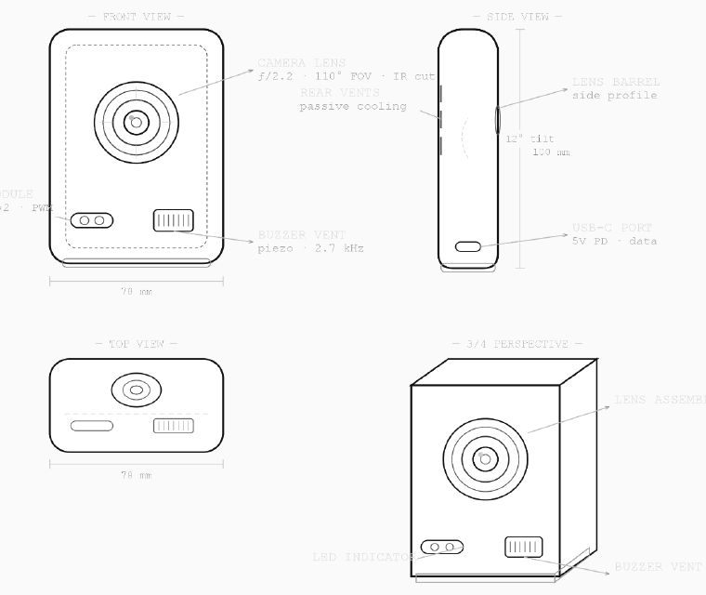
4
Prototype
Presented by: 2023/ICTS/40
Building a working, interactive artefact
Build Process
What It Does
Place the ESP32-CAM/OV2640 camera in a compact desktop enclosure.
Connect the RGB LED module and active buzzer to the controller.
Program the posture-monitoring logic using Arduino IDE and ESP32 camera libraries.
Implement the three feedback states and the 3-minute escalation threshold.
Assemble the prototype as a standalone physical desk object.
Good posture → RGB LED glows Green.
Poor posture → Yellow/Blue warning; over 3 minutes → Red LED + brief buzzer.
ESP32-CAM + OV2640 camera; RGB LED; active buzzer; breadboard/jumper wires; USB-C/micro-USB power/programming.
Section: Conclusion & Demo
TICT 2153 (T) — Human Computer Interaction

Slide 8
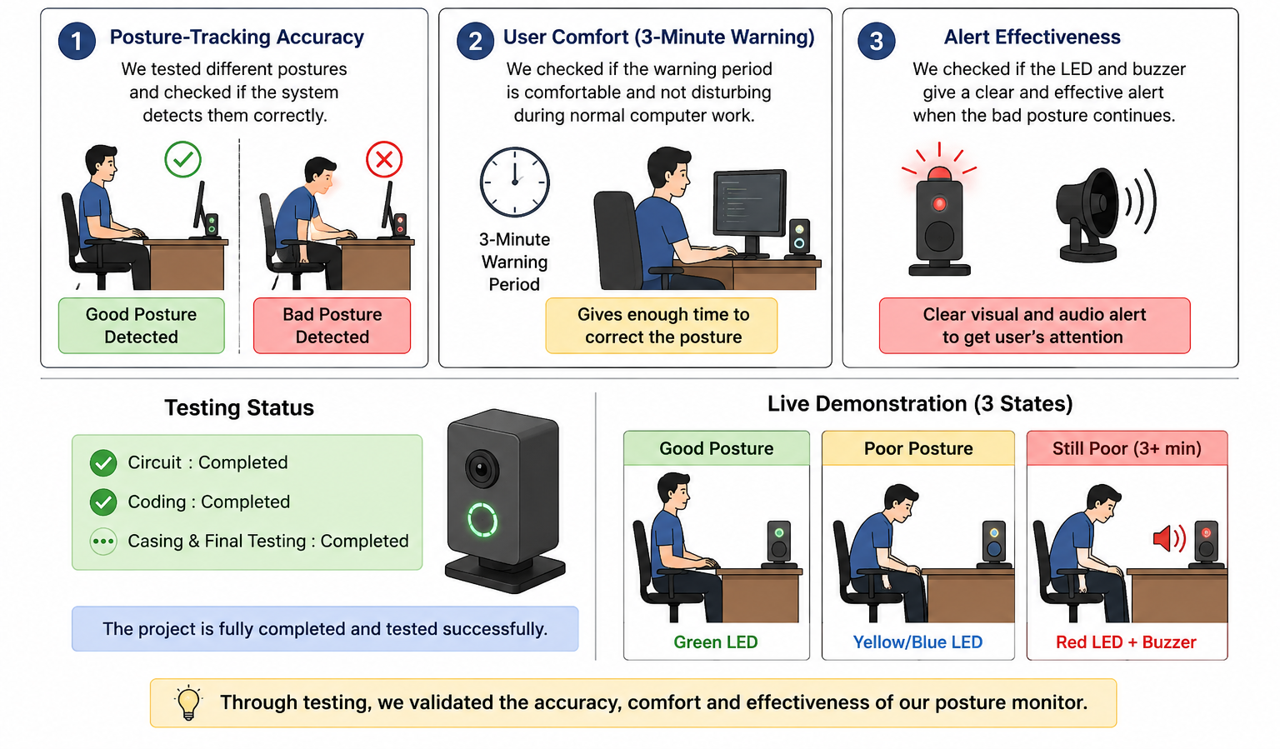
5
Test
Presented by: 2023/ICTS/39
Validating the prototype with real users
Testing Summary
Feedback & Improvements
We will test:
• Check posture-tracking accuracy using the ESP32-CAM.
• Evaluate user comfort during the 3-minute warning buffer.
• Evaluate whether the final alert is effective without being overly disruptive.
Accuracy → check posture tracking.
Comfort → check the 3-minute buffer.
Alerts → check if the buzzer is useful.
Section: Conclusion & Demo
TICT 2153 (T) — Human Computer Interaction

Slide 9
Presented by: 2023/ICTS/44
Conclusion & Live Demonstration
Group 5 developed a concept for a standalone Ergonomic Posture Monitor for computer users. The proposed system combines ESP32-CAM posture tracking with a 3-tier progressive feedback mechanism: Green for good posture, Yellow/Blue for a temporary warning, and Red plus a brief buzzer after more than 3 minutes of persistent poor posture. The design aims to encourage self-correction while avoiding digital notification fatigue.
LIVE DEMONSTRATION: Show the prototype and demonstrate the three feedback states.
Thank you! Questions?
Section: Conclusion & Demo
TICT 2153 (T) — Human Computer Interaction

