Slide 1
Deploying Arima and Artifical Neural Networks Models to Predict Energy consumption in Taiwan
Authors: Chih-Young Hung, Chi-Ya-Chang
By: Chanukya Lakamsani

Slide 2
Problem:
Predicting Taiwan’s Energy consumption for
1) short term (1 year)
2) medium term (3 years)
3) medium- long term (5 years)
4) long-term (10 years)
Energy policy devotes to clean sustainable and independent sources.

Slide 3
Introduction
Taiwan imports 99% of its energy.
1990 – 50.99 million killoliters 2010- 120.31 million killoliters (4.5% increase per year)

Slide 4
Models
ARIMA: Autoregressive Integrated Moving Average
Time-Series - ARIMA eg: energy price, water quality, air quality, consumer expenditure
Conditions:
1) Time series should be stationary
2) No missing data
3) requires good amount of historical data to develop accurate results.
ANN: Artificial Neural Networks
1) models can learn from samples
2) catch appropriate operating associations among the data even if the underlying relationship are hard to define (nonlinear data).

Slide 5
Granger causality relationship
Granger causality is a way to investigate causality between two variables in a time series. The method is a probabilistic account of causality; it uses empirical data sets to find patterns of correlation.
Energy consumption and Economic growth are correlated :
X. P. Zhang and X. M. Cheng, Ecological Economics 68, 2706
(2009).
38. J. E. Payne, Applied Energy 86, 575 (2009).
39. C. C. Lee and C. P. Chang, Energy 32, 2282 (2007a).
40. C. C. Lee and C. P. Chang, Energy Economics 27, 857 (2005).
41. B. S. Cheng and T. W. Lai, Energy Economics 19, 435 (1997).
42. G. Erdal, H. Erdal, and K. Esengun, Energy Policy 36, 3838 (2008).
43. H. T. Pao and C. M. Tsai, Energy 36, 685 (2011).
Most Common energy consumption: electricity
Factors dependent on electricity: national income(NI), population, GDP, consumer price index.

Slide 6
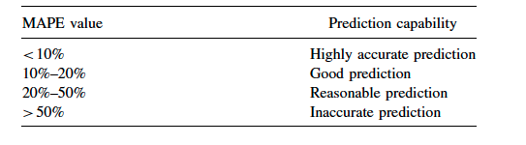
Methodology
Data Description: 46 observations, timeline 1965 -2010, Directorate- Genral of budget accounting and statistic and BP statistical review of world energy 2011.
Four distinct time periods. Short term (45 train-set), medium terms (43), medium long term (41) and long term (36) for prediction.
Measurement of Forecast:

Slide 7
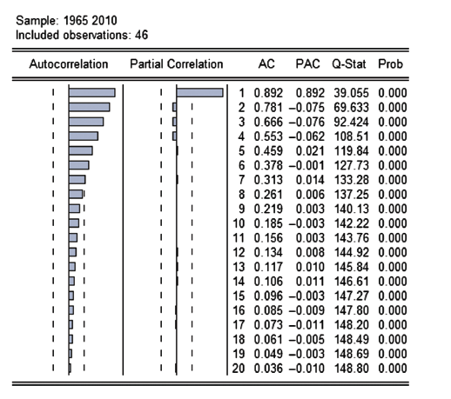
ARIMA
Consists of three steps: model identification, parameter estimation , diagnostic checking.
ADF (Augmented Dickey-Fuller) approach is to employs to test the stationary.
Finite difference method to make data stationary.
lag 1 protrudes to double the range of the standard deviation, while the PACF graph illustrates an exponential drop.
(t-value = 1 3443, p-value = 0 9985)
the preliminary model is determined as ARIMA (1, 1, 1).
Box-Jenkins approach: to check the residuals of the model.(residuals helps in checking the goodness of the fit)

Slide 8
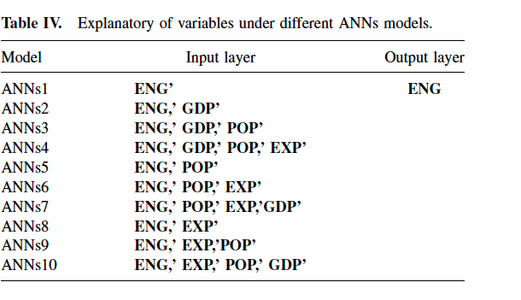
ANN
Input layer : Taiwan’s energy, consumption, GDP, population, exports.
4 inputs and one output layer.
8 different ANN models are developed.
ANNs1: Taiwan’s energy consumption (ENG’)
(2) ANNs2: Taiwan’s energy consumption and GDP
(ENG,’ GDP’)
(3) ANNs3: Taiwan’s energy consumption, GDP and population
(ENG,’ GDP,’ POP’)
(4) ANNs4: Taiwan’s energy consumption, GDP, population
and exports amounts (ENG,’ GDP,’ POP,’ EXP’)
(5) ANNs5: Taiwan’s energy consumption and population
(ENG,’ POP’)
(6) ANNs6: Taiwan’s energy consumption, population,
and exports amounts (ENG,’ POP,’ EXP’)
(7) ANNs7: Taiwan’s energy consumption, population,
exports amounts and GDP (ENG,’ POP,’ EXP,’ GDP’)
(8) ANNs8: Taiwan’s energy consumption and exports
amounts (ENG,’ EXP’)

Slide 9
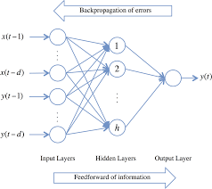
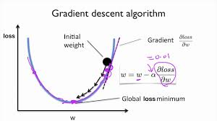
ANN model Architecture

Slide 10
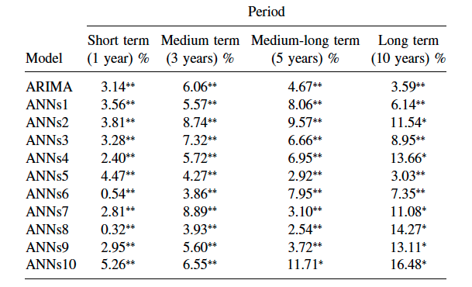
Results

Slide 11
Conclusion:
Comparsion of Univariate Arima and ANN’s models consisting of single variable as well as multivariable to predict Taiwan’s energy consumption.
Single Variable performed better In both ARIMA and ANN’s.
my inference: influence other variables is too small to be measured and/or modelled accurately. Thus introduces more noise than signal, leading to poorer forecasts.
ARIMA performed better than ANN (for long term)

Slide 12
Drawbacks
ANN - Sigmoid function – Vanishing gradient
no information on hyperparametric tuning methods and on hidden layer.

Slide 13
Thank you

