Slide 1
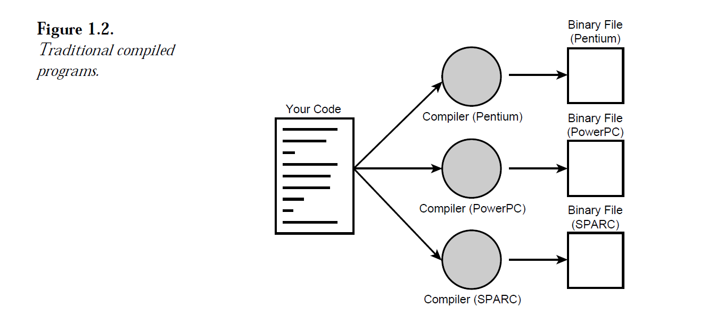

Slide 2
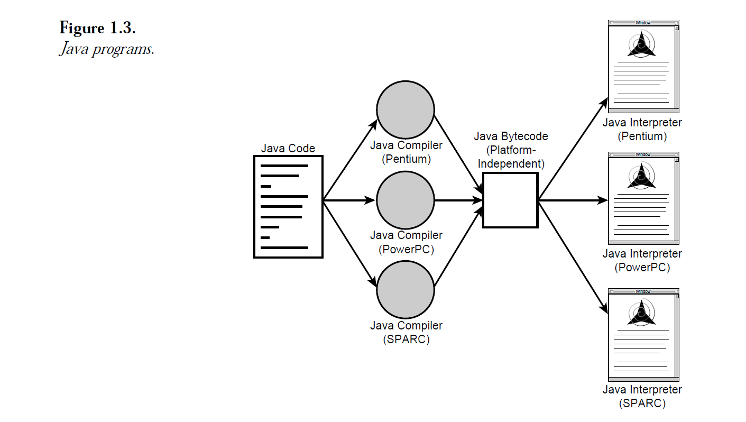

Slide 3
Language Fundamentals
Identifiers
Reserved words
Data Types
Literals
Arrays
Types of Variables
Var arg methods
Main method
Command line arguments
Java Coding standards

Slide 4
Identifier
Identifier : A name in java program is considered as identifiers which can be used for identification purpose. It can be method name/variable/class/label
Rules of defining identifiers
Allowed characters : [A-Z, a-z], [0-9] $, _
Eg : Valid : Total_number,
Invalid Variable : Total#
Identifiers should not start with digits
Total123
Case sensitive (Case sensitive programming language)
Should not use reserved words
No limit on length of identifier.

Slide 5
Case sensitive
Class Test
{
Int number = 10;
Int Number = 20;
Int NUMBER = 30;
}
Predefined class names and Interface names can be used as identifier
Class Test
{
Int String=888;
}
Class Test
{
Int Runnable=999;
}

Slide 6
Identifier-Exercise
Total_number (Valid)
Total#(invalid)
123total(invalid)
Total123(valid)
Cas$h(valid
_$_$_$ (Valid)
call@Hands(invalid)
Java2share(valid)
Integer(Valid)
Int(Valid)
Int(invalid)

Slide 7
Reserved words(Jan-22-2018)
53 reserved words
Keywords – 50
Reserved literals – 3 (True, false, null)
Keywords
Userkeywords – 48 (if, else, switch, …..)
Unuser keywords – 2(goto, const)

Slide 8
Reserved words
Reserved Words - 53
Keywords - 50
User Keywords – 48
(If, else, break, case, catch ….)
UnserKeywords - 2
(goto, const)
Reserverd Literals - 3

Slide 9
Data Types – Keywords -8
byte
short
int
long
float
double
boolean
char

Slide 10
Key words - Flow Control - 11
If
Else
Switch
Case
Default
Do
While
For
Break
Continue
return

Slide 11
Keywords – modifiers - 11
Public
Private
Protected
Static
Final
Abstract
Synchronized
Native
Strictffp(1.2)
Transient
Volatile

Slide 12
Key words – Exception handling (6)
Try
Catch
Finally
Throws
Assert(1.4)

Slide 13
Keyword - Class related (6)
Class
Interface
Extends
Implements
Package
Import

Slide 14
Keywords –Object related -4
New
Instanceof
Super
This

Slide 15
Keyword - Return type
Void
In java return type is mandatory. If a method wont return anything, then we have to declare that method with void return type.
In c, return type is optiona. Default return type is int.

Slide 16
Keywords – unuser keywords
Goto
Const : Use final instead of const.

Slide 17
Keywords - literals
true
false
null – default value for object reference.

Slide 18
Keyword - enum
enum (1.5v)
We can use enum to define a group of named constants.
Eg : enum month{JAN, FEB, …….}

Slide 19
In java we have only new keyword.
There is no delete key. Because destruction of useless objects is the responsibility of garbage collector.

Slide 20
Exercies
Which of the following list contains only java reserved words
new, delete
goto constant
break, continue, return, exit
final, finally, finalize
throw, throws, thrown,
notify, notifyAll
implements, extends, imports
sizeof, instanceof
instanceOf, StrictFp
byt, short, Int
None of the above.

Slide 21
Excercise
Which of the following are java reserved words
public
static
void
main
String
args

Slide 22
DataType
Every variable should belong to some data type
Every expression should resolve to some data type ( a + b + c)
Every type is strictly typed defined.
Eg: bye 8 bits
Strongly typed language.
Every assignment should be checked by the compiler for type compatibility.

Slide 23
Is Java Pure object oriented programming
No
Several OOPS features are not supported by java
multipe inheritence
Depends on primitive data types

Slide 24
Primitive Datatype
Primitive Data Types
Numeric Data Types
Integral Data Types
Floating Point Data Type
Non Numeric
Byte
Short
Int
long
Char
boolean

Slide 25
Integral
Byte
Short
Int
Long
Floating point data type
Float
Double
Non numeric
Char
Boolean

Slide 26
Signed datatype
Common for all data types
Except boolean datatypes, remained datatypes are considered as Signed data type

Slide 27
byte
Size : 8 bits
Signed (MSB)
Max_Value : 127
Min : -128
Range : -128 to 127

Slide 28
Byte b = 10;
Byte b = -127
Bye b = 128;
Compile Error :
error: incompatible types: int cannot be converted to Byte
Byte b = 128;
^

Slide 29
Eg1
byte b = 10.5
Test.java:4: error: incompatible types: double cannot be converted to Byte
Eg2
Byte b = 10
Compile successfully
Eg3 :
Byte b = true;
Test.java:4: error: incompatible types: boolean cannot be converted to Byte
Eg4
Byte b = “Chanu”
Test.java:4: error: incompatible types: String cannot be converted to Byte
Byte b = "Chanuk";
^
Note
Usage of Byte : If we want to handle data interms of Streams either from the files or from the network (File support or network supported form is BYTE).

Slide 30
Datatype : Short
Size : 2 bytes
Range : -2e15 to 2e15-1
[-32768 to 32767]
Rarely used data type in java
Eg : 32767
Eg : short s = 32768
Test.java:4: error: incompatible types: possible lossy conversion from int to short
short s = 32768;
^

Slide 31
In 1995s 8085 8086 processors used 16 bit processors. Short data type was best suitable for that. Now it is outdated

Slide 32
Datatype - int
Size : 4 Bytes(32 bits)
Range : -2e31 to 2e31-1
[-2147483648 to 2147483647
If int cannot hold big values, then we should go for long

Slide 33
Long
long - 8 Bytes -2e63 to 2e63-1

Slide 34
float
Float : 3.66666 (5 to 6 decimal places of accuracy)
Single precision
-1.7e38 to 1.7e38

Slide 35
Double
10 to 15 decimal places of accuracy
Double precision
8 bytes
-3.4e308 to 3.4e308

Slide 36
boolean
Size is negiligable.
Its platform dependent
Eg : boolean b = 0;
Eg : if(true)
{Print true}
Else {print false}

Slide 37
char
Size : 2Bytes
ASCII :
In c/c++ : a – z, A – Z, 0 to 9, special characters(256 characters)
In Java :
256 chars are same
Telugu chars
Tamil Chars
Hindi Chars
Etc of most languages in the world

Slide 38
Java Literals
Unicode characters : \u0000
Eg : char ch = “\u0061”
Escape Character | Description
\n | New line
\t | Horizontal Tab
\r | Carriage Return
\b | Back space
\f | Form feed
\’ | Single Quote
\” | Double quote
\\ | Backslash symbol

Slide 39
Char ch = 65536 (X)
Char ch = 0XBeer; (X)
Char ch = \uface (X)
Char ch = ‘\uBeef’
Char ch = ‘\m’ (X)
Char ch = ‘\iface’; (X)

Slide 40
Java 1.7 enhancements for literals
1.7 ver enhancement w.r.t literals
1. Binary literals
For integral datatypes until 1.6 we can specify literal values in the following ways
1. Decimal
2. Octal
3. Hexa decimal
From 1.7 ver onwards we can specify literal values even in binary form also. Allowed digits are 0,1
Literal value should be prefixed with 0b/0B
Eg : int x = 0b1111
System.out.println(x) ➔ 15

Slide 41
Java 1.7 enhancements for literals
Usage of “_” symbol in numeric literals.
From 1.7 version onwards we can use _ symbol between digits of numeric literals
Double d = 1_23_456.7_8_9
Double d = 123_456.7_8_9
The main advantage of this approach is readability of the code will be improved.
At the time of compilation, these _ symbols will be removed automatically.

Slide 42
Literals
Byte -> Short -> Int -> Long -> Float -> Double
Char -> Int

Slide 43
Types of Variables
Based on type of values all variabls are divided into two types.
1. Primitive variables : int x = 10;
2. Reference variables : Student s = new Student();
Based on position of declaration and behaviour all variables are divided into 3 types
1. Instance variables
2. Static variables
3 Local variables

Slide 44
Instance Variables
If the value of variable varies from object to object then such variables are called instance variables. For every object a separate copy of instance variables will be created.
Should be declared inside the class directly and outside of any methods/block/constructor.
Instance variable will be created at the time of object creation and destroyed at the object destruction. Hence the scope of instance variable is same as scope of object.
Instance variables will be stored in the heap memory as a part of the object.
We can’t access instance variables directly from static area. But we can access by using object reference.
But we can access instance directly from instance area.
Class Student {
String name;
int rollno;
…
}
eg1. Class Test{Int x = 10; psvm(String[] args){Sysout.print(x) }} ➔ Compile Error : Non static variable x cannot be referenced from a static context
eg2. Class Test{int x =10; psvm(String[] args){Test t = new Test(); Sysout.println(t.x)➔10

Slide 45
If the value of a variable is not varied from object to object then it is not recommended to declare variable as instance variable. We have to declare such type of variables at class level by using Static modifier.
In the case of instance variables, for every object, a separate copy will be created. But in the case of static variables, a single copy will be created at class level and shared by every object of the class.
Static variables will be created at the time of class loading and destroyed at the time of class unloading. Hence scope of static variable is exactly same as scope of .class file.

Slide 46
(Executing a program)
Java Test
Start jvm
Create and start main Thread
Locate Test.class file
Load Test.class➔Static variables creation
Execute the main() method
Unload Test.class➔Static variables destruction
Termiate main Thread
Shutdown JVM

Slide 47
How to access static variables
Static variables will be stored in method area.
Example of Static and instance variables

Slide 48
Local variables
Sometimes to meet the temporary requirements of the programmer, we can declare variables inside a method/block/constructor. Such type of variables are called local variables/temporary variables/stack variables/automatic variables.
Local variables will be stored inside the stack memory.
When it is created ?
When executing the block in which we declared, the variable will be created.
When execution of block is completed, the local variable will be destroyed.
For every execution of the block, local variables will be created and destroyed once execution of block is completed.
Cons
JVM won’t take much care of local variable
Scope related issues will be there
Eg : class Test{ psvm(String[] args){
Int i=0;
For(int j=0;j<=2;j++){
I = I +j;
Sysout(I + “ “+ j);
}
}

Slide 49
Variable Type | Thread Safe
Instance Variable | No
Static Variable | No
Local variable | Yes

Slide 50
Operators
Increment and decrement
Arithmetic operators
String concatenation operator
Relational operators
Equality Operators
Instanceof operators
Bitwise operators
Shortcircuit operators
Typecase operators
Assignment operators
Conditional operators
New operator
[] operator
Evaluation of Operator precedence
New vs newInstance()
Instance vs isInstance()
ClassNotFoundException vs NoClassDefFoundError

Slide 51
Increment and decrement operators
Preincrement, post increment
Predecrement, post decrement
Expression | Initial value of X | Initial value of Y | Final value of X
y=++x | 10 | 11 | 11
Y=x++ | 10 | 10 | 11
Y=--x | 10 | 9 | 9
Y=x-- | 10 | 10 | 9

Slide 52
1. ++ and -- Operators only for variables not for constants
1.
++(++x)
int x=10;
x++;
char ch='a';
a++;
double d = 10.5;
d++
boolean b = true;
b++

Slide 53
byte b =10;
b=b+1
sopln(b)
byte b = 10;
b++;
sopln(b)
max(int, type(a), type(b))
Possible loss of precision

Slide 54
Today
In integral arithmetic, there is no way to represent infinity. But in floating point arithmetic there is a way to represent infinity.
System.out.println(10/0)
System.out.println(10/0.0)
System.out.println(0/0)
System.out.println(0.0/0)

Slide 55
System.out.println(10 < Float.NaN)
10<=Float.NaN
10>Float.NaN
10==Float.NaN
Float.NaN == Float.NaN
Float.NaN != Float.NaN

Slide 56
String Concatenation Operators(+)
The only overloaded operator in java is +.
eg 10 + 20 ➔ 30
“ab” + “cd” ➔ “abcd”
Eg : String a = “chanu”
Int b=10; c=20; d=30;
Eg : sopln(a+b+c+d);
Sopln(b+c+d+a);
Sopln(b+c+a+d);
Sopln(b+a+c+d);

Slide 57
String a = “Chanu”
Int b=10; c=10; d=10;
A = b+c+d;
A=a+b+c;
B=a+c+d;
B=b+c+d;

Slide 58
Relational Operator (<, <=, >, >=)
Sopln(10<20) true
Sopln(‘a’<10) false
Sopln(‘a’<97.6)true
Sopln(‘a’ > ‘a’) true
Sopln(true > false)
Conclusion : we can apply relational operators for every primitive types except for boolean

Slide 59
Sopln(“chanu123” > “chanu”) ➔ operator greater than cannot be applied to j.l.string, j.l.String
We apply equality for object references also.
R1 == r2 returns true if and only if both references pointing to the same object.(Reference comparision or address comparision)

Slide 60
Arrays
Introduction
Array declaration
Array Creation
Array initialization
Array declaration, creation and initialization in a single line.
Length vs length()
Anonymous arrays
Array element assignments
Array variable assignments

Slide 61
Arrays-Introduction
Int x=10, Int y =20; ……
Array : indexed collection of fixed no of homogeneous data elements
Advantages : We can represent huge number of values by using single variable so that readability of the code will be improved.
Disadvantage : fixed in size. Once we created an array, there is no chance of increasing / decreasing the size based on our requirements. Hence to use arrays concept, we should know the size in advance, which may not be possible always.

Slide 62
Array - declaration
One dimensional declaration :
Int[] x, int []x, int x[] – Valid. But good practice to use the first type. Because name is separated from type.
At the time of declaration, we can’t specify the size. Otherwise we will get compile time error. Eg : int[6] x; (Invalid) int[] x (valid)
Two dimensional arrays :
Int[][] x, int [][]x, int x[][], int[] []x, int[] x[], int []x[] all are valid.
Int[] a,b//
Int[] a[],b
Int[] a[], b[]
Int[] []a, b; (a -2d, b-2d)
Int[] []a, b[](a-2d, b-3d)
Int[] []a, []b(Compile error)

Slide 63
Array - initialization
Every array in java is object. Hence we can create arrays by using new
Eg : int[] a = new int[3];
a.getClass().getNamxe(); ➔ [I
For everytype corresponding classes are available. These classes are part of java language and not available at the programmer level.
Array Type | Class Name
Int[] | [I
Int[][] | [[I
double[] | [D
byte[] | [B
boolean[] | [Z

Slide 64
Loop holes in array creation
At the time of array creation, we should compulsary specify the size. Otherwise we will get the compile error.
Eg : int[] x = new int[]; (Invalid)
Int[] x = new int[6] (valid)
Its legal to have any array with size 0 in java
Eg : int[] x = new int[0];
Int[] x = new int[-3] ➔ Runtime Error (Negative array size exception)

Slide 65
To specify array size, the allowed datatypes are byte, short, char, int. If we try to specify any other type then we will get compile error.
Int[] x = new int[10];
Int[] x = new int[‘a’]
Byte b = 20;
Int[] x = new int[b];
Short s = 30;
Int[] x = new int[s];
Int[] x = new int[10l]; ➔ Compile Error.
The max allowed size in java is 2147483648 which is the limit of integer.

Slide 66
Array – 2d array
Array of Arrays approach
In java 2d array not implement by using matrix style representation. Some people followed array of arrays approach for multi dimensional array creation. The main advantage this approach is memory utilization will be improved.
Int[][] x=new int[2][];
x[0]=new int[2];
X[1]=new int[3];

Slide 67
3d Array
Int[] a= new int[];
Int[] a= new int[3];
Int[][] a = new int[][];
Int [][] a = new int[3][];
Int[][] a = new int[][4];
Int [][][] a = new int[3][4][5];
Int [][][] a=new int[3][][5];
Int [][][] a = new int[][4][5];

Slide 68
Once we create any array every element is initialized with default values( 0 )
Whenever we try to print any reference variable internally two string method will be called which is implemented by default to return the string in the following form.
Classname@hashcode in hexdecimalformat.
Int[][][] x=new

Slide 69
Int [][] x = new int[2][]; (Specify the base structure)
X[0] = new int[5];
X[1]=new int[3];
Array declare, create and initialize in a single line
Int[] a;
A = new int[3];
A[0]=10;a[1]=20;a[2]=30;
In a single line Int[] a = {10, 20,30}
char ch={‘a’, ‘e’, ‘I’, ‘o’, ‘u’}
Int[][] x = {{10,20,30}, {5,6,7}};

Slide 70
Int a[] = new int[10]
A.length
String str = “Chanukya”;
Str.length();
String[] str = {“aa”, “a”, “b”};
A.length ➔ Valid
A.length() ➔ invalid
A[0].length ➔ invalid
A[0].length() ➔ valid

Slide 71
There is no direct way to find the total length of multidimensional array. Indirectly we can find as follows, to find, sum all the individual lengths
Anonymous array : new int[]{10,20,30}
In anonymous array we cant specify the size.
Add(new int[]{10,20,30,40);
Public static int add(int[] x){
For(x1:x)
{total = total + x1;
}
Return total;
}

Slide 72
Object[] a = new Object[10];
A[0]=new Object();
A[1]=new String(“Chanu”);
A[2]=new Integer[10];
Number[] n = new Number[10];
N[0]=new Integer(10);
N[1] = new Float(20.3);
N[2]=new String(“Test”)
Note : In the case of object type arrays as array elements we can either declared type object or its child class objects
Number
Byte
Short
Int
Long
Float
Double

Slide 73
Interface-Implementation class Array
Runnable[] r = new Runnable[10];
R[0]=new Thread();
R[1]=new String ( “abc”);
Runnable(Interface)
Thread(Implementation class)

Slide 74
Int[] x={10,20,30,40};
Char ch={‘a’, ‘b’};
Int[] b = x;
Int[] c=ch;
Note : Char element can be promoted to int type. Char array cannot be promoted to int array type

Slide 75
Array promotions
Char -> int
Char[] -> int[]
Int -> double
Int[] -> double[]
float -> int
Float[] -> int[]
String -> object
String[] -> Object[]

Slide 76
Reference variable assignment
Int[] a = {10,20,30,50};
Int[] b = {70,80};
A=b;
B=a;
Note : Whenever we assign one array to another array internal elements are wont be copied. Just reference variables will be reassigned.

Slide 77
Eg1 : int[][] a = new int[3][];
A[0] = new int[4][3];(Invalid : Expectes 1d array)
A[0]=10(Invalid : reference variable cannot be assigned a value)

