Slide 1
Machine Learning – An Introduction

Slide 2
Background knowledge
Calculus (Differential equations)
Statistics
Linear Algebra
Matrix operations
Cartesian geometry
Programming languages : Octave (Matlab open source), Python
Tools: Jupyter Notebook (Anaconda Distribution), Octave, Big ML (no-code tool)

Slide 3
Agenda
Why ML?
Introduction to ML
Types of Machine learning
Common Issues and Challenges

Slide 4
Why now?
Flood of available data (especially with the advent of the Internet)
Increasing computational power (e.g. Multi-core)
Growing progress in available algorithms and theory developed by researchers
Increasing support from industries
Cloud computing

Slide 5
In other words…
“A computer program is said to learn from experience (E) with some class of tasks (T) and a performance measure (P) if its performance at tasks in T as measured by P improves with E”

Slide 6
ML vs Traditional programming
Traditional Programming
Machine Learning
Data
Computer
Output
Program
Learning Algorithm
Data
Computer
Program
Output

Slide 7
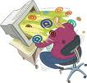
Motivating Example Learning to Filter Spam
Example: Spam Filtering
Spam - is all email the user does not want to receive and has not asked to receive
T: Identify Spam Emails
P:
% of spam emails that were filtered
% of ham/ (non-spam) emails that were incorrectly filtered-out
E: a database of emails that were labelled by users

Slide 8
Terminology
Features
The number of features or distinct traits that can be used to describe each item in a quantitative manner.
Samples
A sample is an item to process (e.g. classify). It can be a document, a picture, a sound, a video, a row in database or CSV file, or whatever you can describe with a fixed set of quantitative traits.
Feature vector
is an n-dimensional vector of numerical features that represent some object.
Feature extraction
Preparation of feature vector
transforms the data in the high-dimensional space to a space of fewer dimensions.
Training/Evolution set
Set of data to discover potentially predictive relationships.

Slide 9
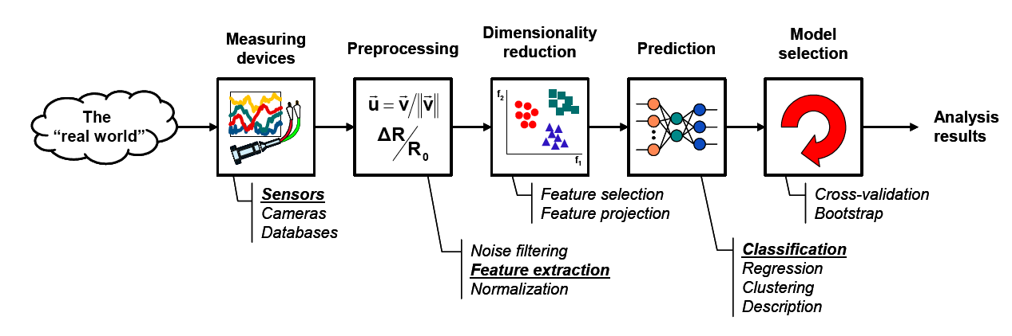
The Learning Process
Model Learning
Model Testing

Slide 10

The Learning Process in our Example
Model Learning
Model Testing
● Number of recipients
● Size of message
● Number of attachments
● Number of "re's" in the subject line
…
Email Server

Slide 11

Data Set
Target Attribute
Input Attributes
Email Type | Customer Type | Country (IP) | Email Length (K) | Number of new Recipients
Ham | Gold | Germany | 2 | 0
Ham | Silver | Germany | 4 | 1
Spam | Bronze | Nigeria | 2 | 5
Spam | Bronze | Russia | 4 | 2
Ham | Bronze | Germany | 4 | 3
Ham | Silver | USA | 1 | 0
Spam | Silver | USA | 2 | 4
Instances
Numeric
Nominal
Ordinal

Slide 12

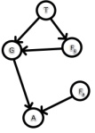
Model Learning
Learner
Inducer
Induction Algorithm
Classifier
Classification Model
Database
Training Set

Slide 13




Model Testing
Database
Training Set
Learner
Inducer
Induction Algorithm
Classifier
Classification Model

Slide 14
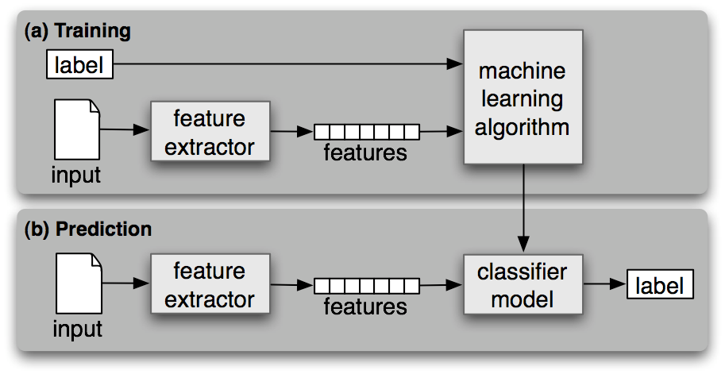
Workflow

Slide 15
The 3 Pillars of Machine Learning
1️⃣ Representation – What is being learned?
Defines the hypothesis space of the model
Examples: Linear models, decision trees, neural networks
Includes feature selection, model type, and data representation

Slide 16
Evaluation & Optimization
2️⃣ Evaluation – How well is it doing?
Defines the performance metric
Examples: Accuracy, Precision, Recall, RMSE, F1-Score
3️⃣ Optimization – How to improve performance?
Process of finding the best parameters
Examples: Gradient descent, grid search, backpropagation

Slide 17
What Is a Model? What Is a Hypothesis Space?
A Model in ML is a function that maps inputs to outputs:
- Learns from data to make predictions or decisions
- Example: y = wx + b (linear model)
📘 A Hypothesis Space is the set of all models the algorithm can choose from:
- Defined by the model type and its parameters
- Example: All linear functions with different weights w and biases b
🎯 Learning = Finding the best model within the hypothesis space

Slide 18
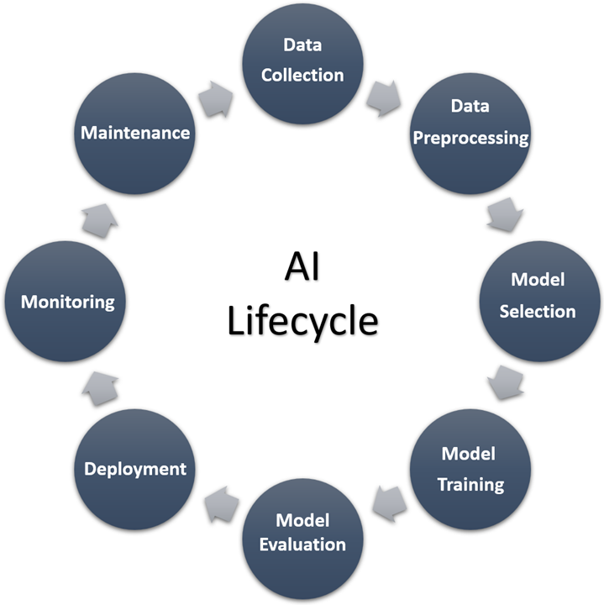

Slide 20
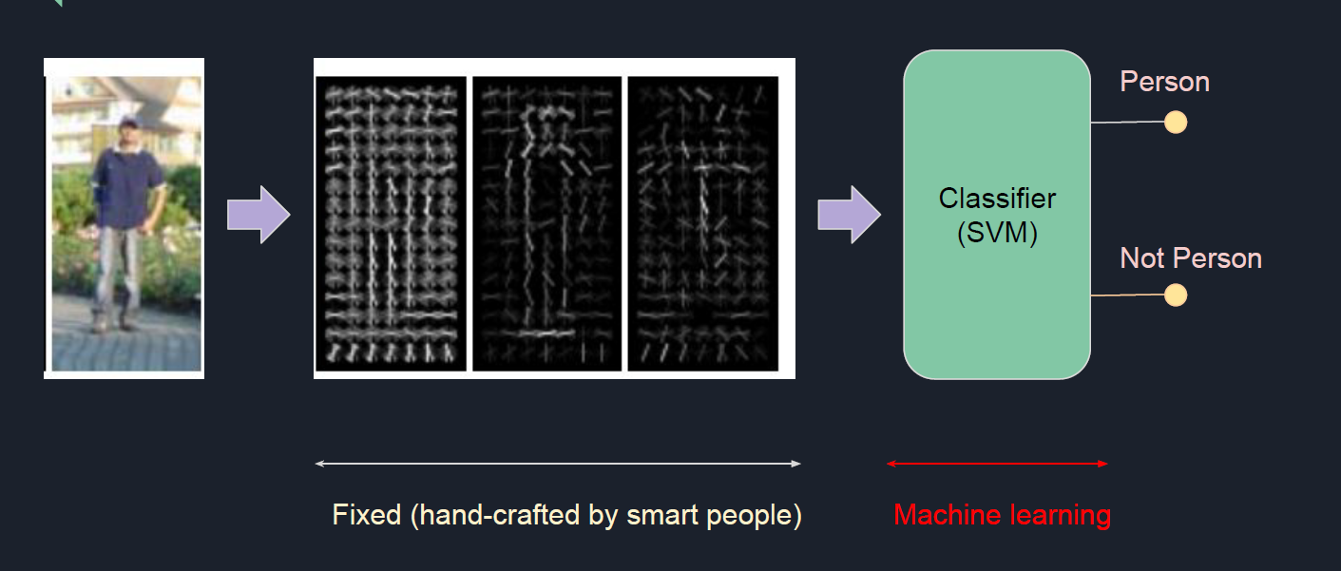
Machine Learning vs Deep Learning

Slide 21
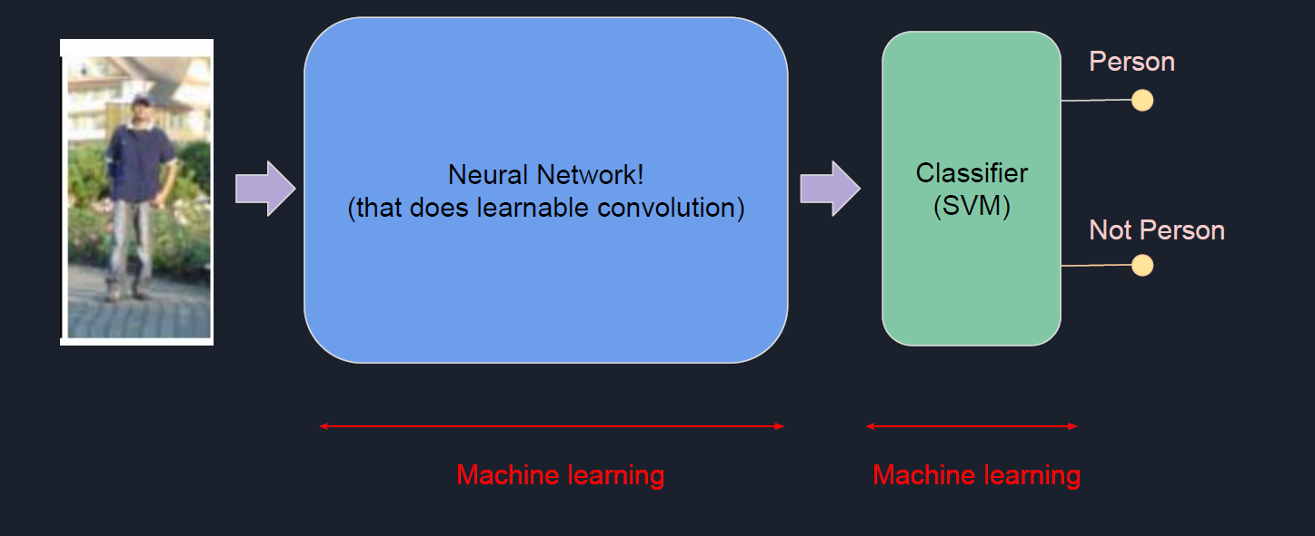
Machine learning vs Deep Learning

Slide 22
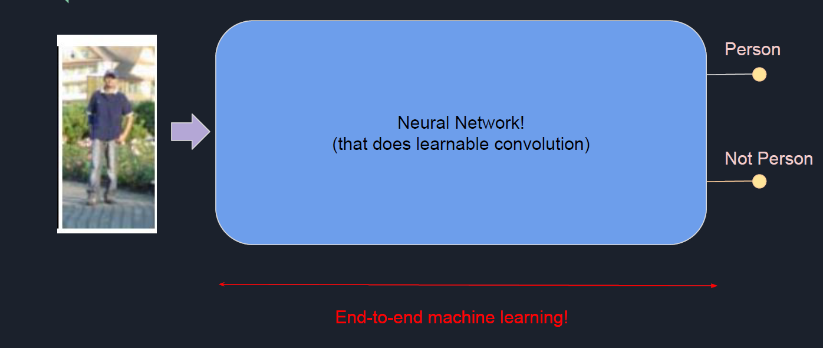
Machine Learning vs Deep Learning

Slide 23
Categories
Supervised Learning
Unsupervised Learning
Reinforcement Learning
Generative learning
Bayesian learning
Semi-Supervised Learning
Self-supervised learning

Slide 24
Use-Cases
Spam Email Detection (Classification)
Image Search (Similarity/Classification)
Clustering (KMeans) : Social media analysis
Autonomous driving/flying : Reinforcement learning
continued…

Slide 25
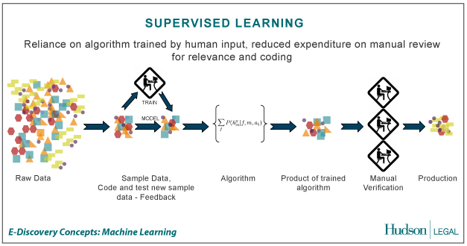
Supervised Learning (Classification)
the correct classes (labels) of the training data are known
Credit: http://us.hudson.com/legal/blog/postid/513/predictive-analytics-artificial-intelligence-science-fiction-e-discovery-truth

Slide 26
Supervised learning examples
A Bank may have borrower details (age, income, gender, etc.) of the past (features)
Also it may have details of the borrowers who defaulted in the past (labels)
Based on the above, can train a classifier to learn the patterns of borrowers who are likely to default on their payments

Slide 27
Supervised learning
Used when the dataset has classes/labels
Includes a ‘training’ phase with the dataset and a ‘testing’ phase to validate the accuracy of the classifier
Algorithms – Regression, Support Vector Machines, Neural Networks, Convolutional Neural Networks, Decision Trees, Logistic Regression, Random Forest, Naïve Bayesian, etc.

Slide 28
Supervised learning
Regression – Predict continuous variables (salary, rent)
Binary classification (facial recognition, whether a tumor is benign or malignant)
Multi-class classification (the type of a vehicle, the stage of progression of a cancer – level 1,2,3)

Slide 29
Example
https://www.youtube.com/watch?v=chzq2E75M84
https://www.youtube.com/shorts/tpOg87AQvbo

Slide 30
Unsupervised learning
Used when the dataset does not have the labels (classes)
Used to group/cluster the data into clusters, which may then be used for decision making, making recommendations, classification, etc.
Algorithms – K-means, Self Organizing Maps, Deep belief Networks, etc.

Slide 31
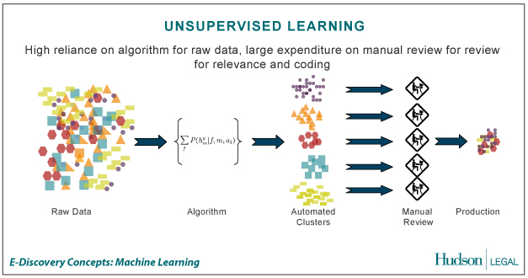
Unsupervised Learning/Clustering
The correct classes of the training data are not known
Credit: http://us.hudson.com/legal/blog/postid/513/predictive-analytics-artificial-intelligence-science-fiction-e-discovery-truth

Slide 32
Unsupervised learning examples
A Supermarket may store each buyer’s basket content details (features)
There are NO grouping (labels)
Need to group the buyers based on their buying patterns in order to best use the shelf space (recommendation)

Slide 33
Unsupervised learning/Clustering
K-means clustering
Self organizing maps
Deep Belief Networks

Slide 34
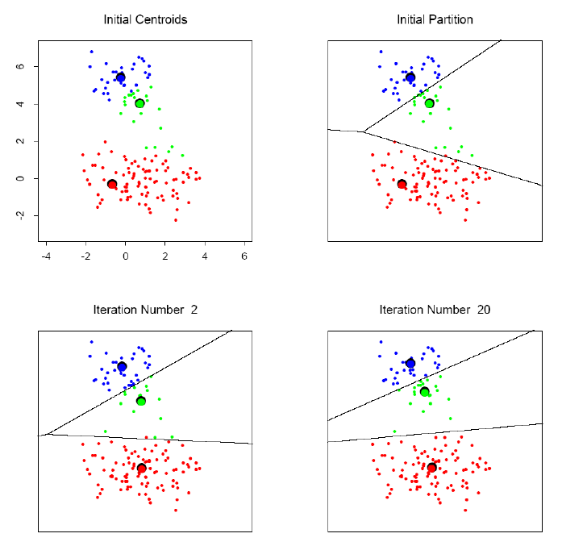
K-means clustering example

Slide 35
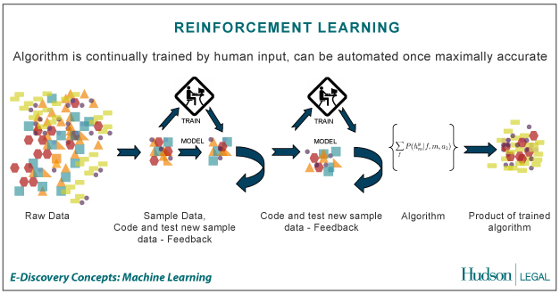
Reinforcement Learning
Allows the machine or software agent to learn its behavior based on feedback from the environment.
This behavior can be learnt once and for all, or keep on adapting as time goes by.
Credit: http://us.hudson.com/legal/blog/postid/513/predictive-analytics-artificial-intelligence-science-fiction-e-discovery-truth

Slide 36
Reinforcement learning
Can be used when there’s no data available
A reward function is used to measure the reward for a given action
Based on the reward values, a probability distribution can be obtained for a given set of functions
This can continued over time and also can be deployed in both single/multi-agent systems
Algorithms – Actor Critic learning, Q learning, Monte-carlo methods, etc.

Slide 37
Reinforcement learning examples
A group of robots have been deployed in an unknown territory
The objective is for them to collaboratively find the navigation path to reach a particular destination/goal
Can use reinforcement learning where achieving the goal/getting closer to the goal gives a positive reward. Negative reward otherwise
Can share the information among robots (multi-agent system)
https://www.youtube.com/watch?v=V1eYniJ0Rnk

Slide 38
Generative Learning
Learning the underlying distribution of a dataset in order to generate new data points that resemble the original dataset.
E.g. Generative Adversarial Networks (GANs), Variational Autoencoders
https://www.youtube.com/watch?v=G06dEcZ-QTg&t=118s
https://www.youtube.com/watch?v=3wVpVH0Wa6E

Slide 39
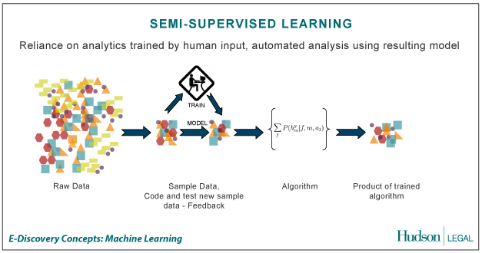
Semi-Supervised Learning
A Mix of Supervised and Unsupervised learning
Credit: http://us.hudson.com/legal/blog/postid/513/predictive-analytics-artificial-intelligence-science-fiction-e-discovery-truth

Slide 40
Semi-supervised learning
Labeled data is expensive/difficult to get
Unlabeled data is cheap/easier to get
The idea is to use smaller amount of labelled data with larger amount of unlabeled data to creating the training/testing datasets
Algorithms - Self Training, Generative models
Semi-Supervised Support Vector Machines, etc.

Slide 41
Semi-supervised learning applications
Web page classification
Speech to text conversion
Video/image generation

Slide 42
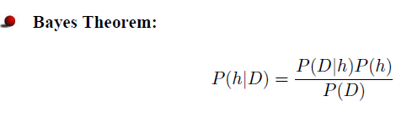
Bayesian learning
Naïve basian, Multinomial bayesian, Bayesian networks, Hidden markov model
Applications: Sentiment analysis, medical diagnosis
Needs some initial knowledge

Slide 43
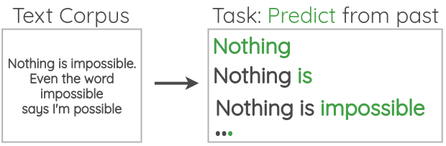
Self-supervised learning
The key idea is to automatically generate labels from the data itself.
Combination of both supervised and unsupervised learning

Slide 44
Exercise
Identify a problem at your workplace where ML can be used.
Identify the class of algorithms to be used (supervised, unsupervised, reinforcement, etc).
Identify two input features that you can use to build the model

Slide 45
Dimensionality Reduction
Too many attributes!!!
Which attributes to choose for the feature vector?
3D picture –> 2D Image
Dimensionality Reduction
Principal Component Analysis (PCA) is a commonly used technique

Slide 46
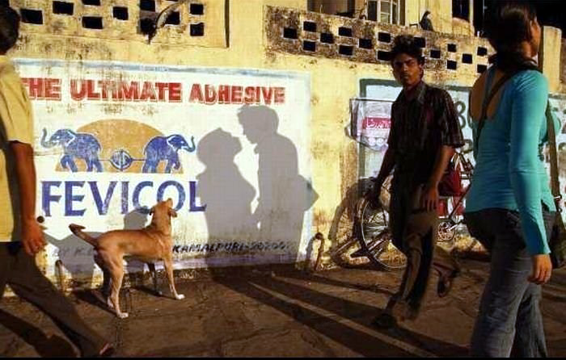
Dimensionality Reduction - Challenges
While dimensionality reduction is an important tool in machine learning/data mining, we must always be aware that it can distort the data in misleading ways.
Above is a two dimensional projection of an intrinsically three dimensional world….

Slide 47
Original photographer unknown
See also www.cs.gmu.edu/~jessica/DimReducDanger.htm (c) eamonn keogh

Slide 48
Large Language Models
Multiple ML techniques used (supervised, unsupervised, Reinforcement, Self-supervised, Transfer learning)
Multi-modal LLMs (MLLMs)

Slide 49
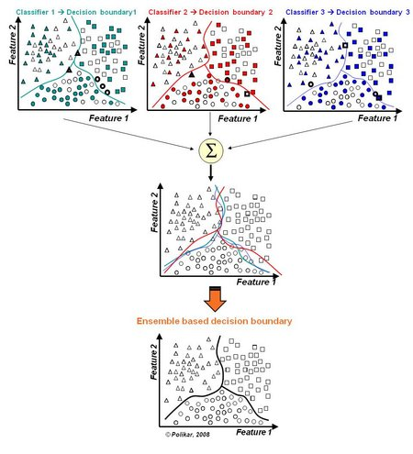
Ensemble Learning
Often, multiple classifiers need to be combined to solve a real-world problem.

Slide 50
Machine learning on Big Data and GPGPU computing
Use large unstructured data sets for learning (Call records, Social media data, etc.)
Two main approaches
Use a Big Data Platform (e.g. Apache Hadoop, Apache Spark/Spark ML)
Use a Cloud based Big Data Analytics platform (Amazon AWS Services, Microsoft Azure ML)
GPUs to speed up the learning (particularly in Deep learning)

Slide 51
Popular Frameworks/Tools
Scikit-learn - Python (Anaconda Python Distribution)
Google Tensorflow (Python library for Deep neural networks), Pytorch (Facebook)
Apache Keras (Python library of neural networks)
R (R studio)
Matlab/Octave (can export DLLs)
Weka (Java based)
Java OpenNLP/Python NLTK (Natural language processing + ML)
Apache Spark/Spark ML (part of the Apache Hadoop platform)
Theano (Python library for Multicore processing of DNNs)
Amazon AWS Services/Microsoft Azure ML (Cloud based ML)

Slide 52
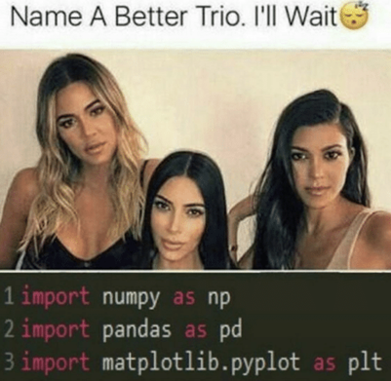
Commonly used python libraries
NumPy
- Matrix computations
Pandas
- Data Frames, Series
Matpotlib
- Visualization

Slide 53
Things to consider in Selecting a ML Algorithm
If there’s an algorithmic method instead of ML, better to use the algorithmic method (ML is messy)
Refer the literature
Try different ML algorithms (no single algorithm is the best)
Check the dataset against the usage/strength of each algorithm (e.g. RNNs, ARIMA is good in time-series predictions)
Test your algorithm(s) with test data and select the best performing one for production (include the test results in your thesis/publications)
No algorithm will be perfect! (There will be an error. The objective is to keep the error at an acceptable rate)

Slide 54
Issues/Challenges in AI
Hallucination
“What is the seahorse emoji?”
https://www.techradar.com/pro/almost-all-genai-pilots-companies-deploy-are-failing-are-they-really-worth-the-hype

Slide 55
Bias
“Draw an image of a clock showing the time 4.38pm”
https://www.forbes.com/sites/mzhang/2015/07/01/google-photos-tags-two-african-americans-as-gorillas-through-facial-recognition-software/
https://www.reuters.com/article/world/insight-amazon-scraps-secret-ai-recruiting-tool-that-showed-bias-against-women-idUSKCN1MK0AG/

Slide 56
Privacy/IP issues/Data sensitivity
https://www.bbc.com/news/technology-67133157
https://www.theguardian.com/technology/2025/nov/11/chatgpt-violated-copyright-laws-german-court-rules

Slide 57
Issues/Challenges in AI
Interpretability/Explainability
Generalizability
Legal issues
Ethical issues
Social issues
Misinformation
Security threats
Data availability/Data democracy
External factors

Slide 58
Issues/Challenges in AI
Concept drift/Data drift
Energy usage/Environmental cost
Sustainability of AI
Impact on education/skills/creativity
https://www.youtube.com/watch?v=R8Up9Ph_a0Y

Slide 59
Resources
MOOCS (Massive Online Open Courseware) – Coursera, Udemy, Udacity
Introduction to Statistical Learning
https://hastie.su.domains/ISLR2/ISLRv2_website.pdf
https://www.statlearning.com/
Hands on Machine Learning with scikit-learn
http://powerunit-ju.com/wp-content/uploads/2021/04/Aurelien-Geron-Hands-On-Machine-Learning-with-Scikit-Learn-Keras-and-Tensorflow_-Concepts-Tools-and-Techniques-to-Build-Intelligent-Systems-OReilly-Media-2019.pdf
Deep Learning – Ian Goodfellow
https://www.deeplearningbook.org/
https://github.com/janishar/mit-deep-learning-book-pdf/blob/master/complete-book-bookmarked-pdf/deeplearningbook.pdf
Dive into Deep Learning
https://d2l.ai/

Slide 60
Questions ?

