Slide 1
The Planner
Intelligent Symbolic Task Planning for Robot Manipulation
Group 11 | AIS08 | NUS-ISS Intelligent Reasoning Systems Practice Module — Project Proposal
Chan Wai Jye — Team Leader (Solo)
GitHub: https://github.com/chanwaijye/IRS-PM-2026-03-29-AIS08-GRP-11-ThePlanner
Date: 8–9 April 2026
Notes:
30 sec. State the system name, module, your solo-team status upfront — pre-empts "where's your team?" questions.

Slide 2
Problem Statement
The Problem: Manual Robot Reprogramming is Costly
Industrial scenario:
• Warehouse/hospital logistics robots must be reprogrammed for every new task variant
• A single robot work cell requires 3–6 weeks of programming time by a specialist engineer at $80k–$120k/year
• When task specs change — new products, new layouts — the cycle repeats
• Global industrial robot installations exceeded 500,000 units in 2023 (IFR World Robotics Report)
The gap:
Robots today execute instructions. They cannot reason about goals.
Target: A system where an operator says:
"Stack the red cube on the blue cylinder"
→ Robot plans autonomously, replans on failure
Notes:
60 sec. All figures from IFR / proposal — cite if asked. The word "reason" is the IRS hook — use it deliberately.

Slide 3
Market Context
Market Opportunity
Metric | Value | Source
Global warehouse automation market by 2027 | USD 41B | MarketsandMarkets, 2023
Hospital logistics robots market CAGR | 15% | Proposal market research
Global industrial robot installations (2023) | 500,000+ units | IFR World Robotics Report
Engineer cost per work cell | 3–6 weeks @ $80k–$120k/yr | Proposal market research
Unmet need: Few open-source, interpretable, LLM-integrated task planners run fully local on commodity GPU hardware.
The Planner targets: Zero licensing cost, offline operation, explainable plans.
Notes:
60 sec. All figures are from the proposal's cited sources — defensible if challenged. "Fully local" differentiates from GPT-4-dependent solutions.

Slide 4
Existing Approaches & Why Not
What Exists Today — And Why It Falls Short
Approach | Representative Tools | Limitation | Gap
Pre-built symbolic planners | FastDownward, FF, ENHSP | Open-source but used as external executables — calling them does not show direct understanding of search algorithms | Calling an external binary does not demonstrate working knowledge of the underlying search algorithms
Pure LLM planning | GPT-4, PaLM, LLaMA alone | Hallucinated actions; unverifiable plans | No formal correctness guarantee
Behaviour Trees only | Nav2, BT.cpp | Hard-coded; no search or optimisation | Cannot handle novel task combinations
RL / model-based RL | DreamerV3, TD-MPC2 | Millions of env steps; uninterpretable | Impractical for sparse-reward manipulation
MoveIt/OMPL only | MoveIt2 + OMPL | Motion-only; no task-level reasoning | No PDDL; no goal decomposition
Key insight
LLMs are good at language understanding, not plan correctness.
Symbolic planners are good at correctness, not natural language.
The Planner combines both — each doing what it does best.
Notes:
2 min. This is the most important slide for Q&A. Walk the table row by row. Pause on "hallucinated actions" — panel will likely probe this.

Slide 5
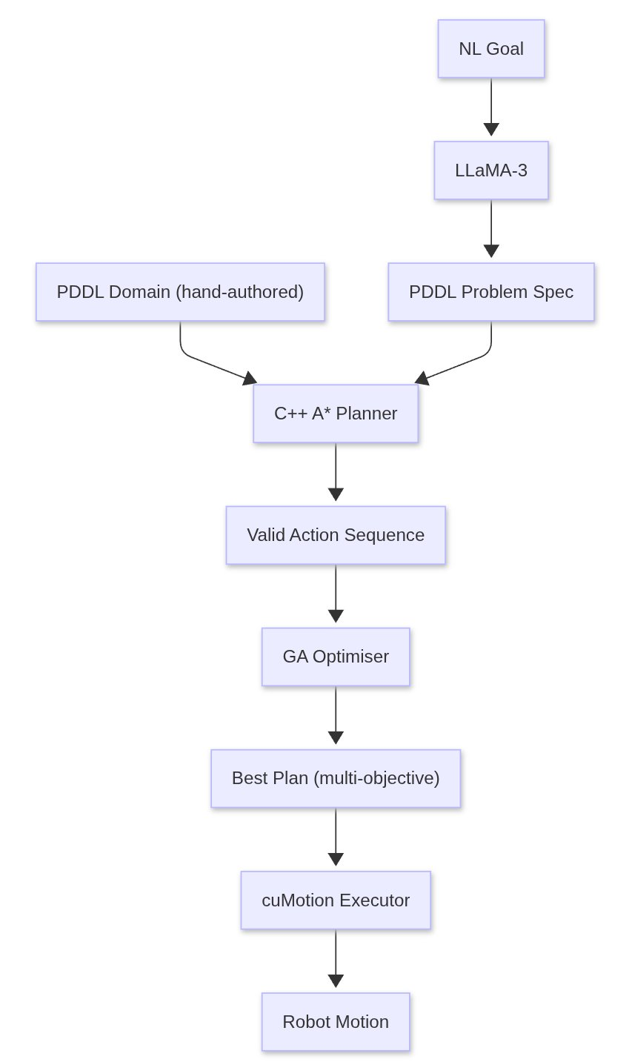
Why This Approach
Design Rationale: Hybrid Symbolic + Neural
Why C++ from scratch (not FastDownward)?
• FastDownward and FF are open-source (GPL v3) — but invoking them as external executables does not directly show understanding of how A* search works
• The IRS PM assessment rewards a direct implementation of search algorithms
• Custom A exposes state-space expansion, heuristic design, and cost function — this is the primary technical contribution*
Why LLaMA-3 local (not GPT-4 API)?
• Zero API cost; zero data egress; offline capable
• NL→PDDL extraction is bounded task — 8B parameters sufficient
• ~5–6GB VRAM (model weights + KV cache), fits on RTX 5070 Ti alongside Isaac Sim
Notes:
60 sec. Anticipate "why not just use FastDownward?" — answer is already on this slide.

Slide 6
IRS Technique Coverage
All 4 IRS Technique Groups Covered
# | Technique Group | Implementation | Agent
① | Decision Automation | Custom C++ PDDL A* Planner — state-space search with typed preconditions/effects | Agent 2 ★
② | Resource Optimization | Genetic Algorithm plan ranker — minimises steps×w₁ + time×w₂ + collision_risk×w₃ | Agent 2 ★
③ | Knowledge Discovery | FoundationPose 6-DoF pose estimator + nvblox SDF scene map | Agent 3
④ | Cognitive Systems | LLaMA-3:8b (local) NL→PDDL + NetworkX knowledge graph (affordances, relations) | Agent 1
★ Agent 2 (C++ Planner) is the primary technical contribution — built from first principles, no external planner binary.
Notes:
30 sec. Read the table. Emphasise ① and ② are both in Agent 2 — this is the differentiator.

Slide 7
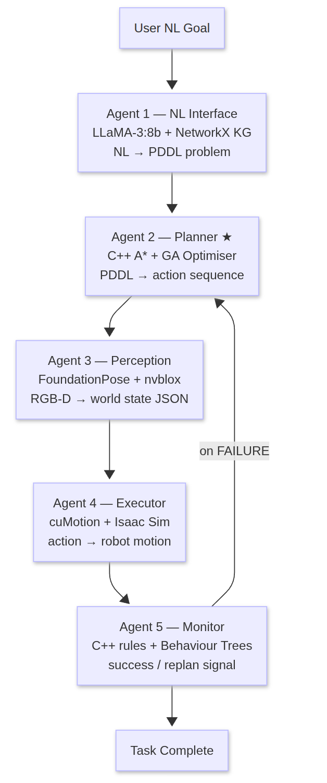
System Architecture
5-Agent Pipeline
Integration bus: ROS2 topics + FastAPI REST
Web UI: React + Three.js 3D viewer + D3.js plan timeline
Notes:
90 sec. Walk the arrows. Emphasise the replanning loop — this is what makes it an *intelligent* system, not just a script.

Slide 8
Agent 1: NL Interface
Natural Language → Formal PDDL
Components:
• LLaMA-3:8b via Ollama (local, Q4_K_M quantised, ~5–6GB VRAM including KV cache at 4K–8K context)
• NetworkX knowledge graph — nodes: objects + robot; edges: affordances (graspable, stackable, fragile, too-heavy)
• PDDL validator layer — catches malformed output; falls back to template generator
Example:
Input | Output
"Stack the red cube on the blue cylinder" | (:goal (on red-cube blue-cylinder))
"Move all fragile objects to the safe zone" | (:goal (forall (?o) (when (fragile ?o) (at ?o safe-zone))))
Failure handling: If LLaMA-3 produces invalid PDDL syntax → VAL validator rejects → template fallback triggers.
Notes:
45 sec. One example is enough. Mention VAL validator — shows rigour.

Slide 9
Agent 2: Planner ★
Custom C++ PDDL A* + Genetic Algorithm
*A Search:
// C++17 — PDDLPlanner::solve()
while (!open.empty()) {
auto [state, g, h] = open.pop();
if (problem_.goal.satisfiedBy(state)) return reconstruct(state);
for (auto& a : domain_.applicable(state)) {
auto next = a.applyEffects(state);
float f = g + a.cost + heuristic(next); // admissible: unsatisfied goal count
open.push({next, g + a.cost, heuristic(next), f});
}
}
Heuristic: Unsatisfied goal count — (goal & ~current).count() — admissible; A* guarantees optimal plan length.
GA Plan Optimiser:
• Population: valid A* plan candidates
• Fitness: min(steps × w₁ + est_time × w₂ + collision_risk × w₃)
• Output: Pareto-optimal plan for execution
PDDL Domain: 5 actions — pick, place, stack, move-to, inspect
Notes:
90 sec. Show the code snippet — it demonstrates direct implementation of A*, not a library wrapper. Be ready to explain h+ inadmissibility (see Q&A slide).

Slide 10
Agents 3, 4, 5
Perception → Execution → Monitoring
Agent 3 — Perception
• FoundationPose (Wen et al., NVIDIA 2024): 6-DoF object pose estimation, minimal per-object setup (reference images or CAD model; no model fine-tuning required)
• nvblox: builds live SDF obstacle map from depth stream
• Omniverse Replicator: synthetic training data (domain-randomised RGB-D)
• Output: world state JSON {object_id, pose_6dof, class, affordances}
Agent 4 — Executor
• Isaac ROS cuMotion (MoveIt2 plugin): GPU-accelerated collision-free trajectory planning
• Isaac Sim: photorealistic physics simulation, Franka Research 3 robot
• Up to 60× faster motion generation than CPU-based planners (Sundaralingam et al., NVIDIA 2023)
Agent 5 — Monitor
• C++ rule engine + ROS2 Behaviour Trees
• Failure classes: grasp_failure, collision_detected, object_not_found
• On failure: re-observe → update world state → trigger replan (→ Agent 2)
• SQLite episode logging for post-hoc analysis
Notes:
60 sec. Keep this fast — these are supporting agents. The panel cares most about Agent 2.

Slide 11
Technology Stack
NVIDIA-Only Stack — Zero Licensing Cost
Layer | Technology | Rationale
Simulation | Isaac Sim (Omniverse) | Free via NVIDIA Dev Program; photorealistic
Motion Planning | Isaac ROS cuMotion + cuRobo | GPU-accelerated; up to 60× faster than CPU motion generation (cuRobo paper, 2023)
Perception | FoundationPose + nvblox | SOTA 6-DoF; minimal per-object setup (CAD/reference images, no fine-tuning)
Synthetic Data | Omniverse Replicator | Bundled; unlimited domain-randomised data
Task Planner | Custom C++ PDDL A* + GA | Core technical contribution
LLM Interface | LLaMA-3:8b via Ollama | Local; zero API cost; ~5–6GB VRAM (Q4_K_M + KV cache)
Middleware | ROS2 Jazzy + FastAPI | Standard robotics bus
Knowledge Graph | NetworkX | Affordance encoding
Web UI | React + Three.js + D3.js | 3D viewer + plan timeline
Build | CMake 3.20 + GCC 12 + C++17 | —
Hardware: Ryzen 9700X, 64GB RAM, RTX 5070 Ti 16GB VRAM
Notes:
45 sec. "Zero licensing cost" is a selling point — say it once clearly. Hardware spec reassures panel that this can actually run.

Slide 12
Benchmark & Evaluation
3 Benchmark Tasks + Failure Injection
Task | NL Command | Success Criterion
T1 — Pick & Place | "Move the red cube to the green zone" | Object at target ± 2cm, no collision
T2 — Stacking | "Stack the blue cylinder on the yellow block" | Stable stack, no topple within 5s
T3 — Conditional Sort | "Separate fragile objects from heavy ones" | All fragile→safe-zone, all heavy→staging
Failure Injection Tests:
• Object slips mid-grasp → monitor detects → replan triggered
• Object disappears (simulated occlusion) → object_not_found → replan
• Gripper joint limit violation → grasp_failure → alternative grasp attempted
Metrics:
• Task success rate (%)
• Plan generation time (ms)
• Replanning frequency per episode
• cuMotion trajectory optimisation time (ms)
Notes:
60 sec. The replan loop on failure is what makes this an IRS system — emphasise it.

Slide 13
Timeline & Current Status
Project Schedule
Week | Dates | Milestone | Status
Wk 1 | Mar 14–21 | Repo setup, Isaac Sim install, PDDL domain design, C++ skeleton | ✅ Done
Wk 2 | Mar 22–28 | C++ A* core, PDDL parser, LLM prompt engineering, NetworkX KG | ✅ Done
★ Wk 3 | Mar 29 | Proposal submission | ✅ Submitted
★ Wk 4 | Apr 5–11 | Proposal presentation ← We are here | 🔄 Now
Wk 4 cont. | Apr 5–11 | Isaac Sim scene, Franka URDF, FoundationPose pipeline | 🔄 In progress
Wk 5 | Apr 12–18 | End-to-end agent integration; 3 benchmark tasks | Planned
Wk 6 | Apr 19–25 | GA optimiser, monitor loop, FastAPI, React UI, 2 videos | Planned
★ Wk 7 | May 3 | Final submission (videos, report, peer review) | Planned
Notes:
45 sec. Point to "We are here." Proposal is submitted and clean. Implementation starts this week.

Slide 14
Risks & Mitigations
Known Risks — Already Addressed in Design
Risk | Impact | Mitigation
VRAM contention (LLaMA + Isaac Sim + cuMotion) | System OOM | LLaMA-3 invoked only at task init; sequential not concurrent. Total ~12–14GB on 16GB VRAM (LLaMA ~5–6GB + Isaac Sim ~6–8GB)
LLaMA-3 produces invalid PDDL | Pipeline stall | VAL validator layer + template-based fallback generator
Isaac Sim install failure on Ubuntu 24.04 | Week lost | Pre-tested on desktop RTX 5070 Ti. Fallback: cloud Isaac Sim (RunPod)
FoundationPose accuracy on novel objects | Poor scene state | PM1 uses Isaac Sim ground-truth poses as fallback — perception is PM2's scope
Solo workload (10 man-days) | Scope creep | Claude Code orchestrator + 5 specialised subagents; each module independently testable with mock I/O
Notes:
45 sec. Showing you've thought about failure modes signals engineering maturity. The VRAM budget is a concrete number — say it.

Slide 15
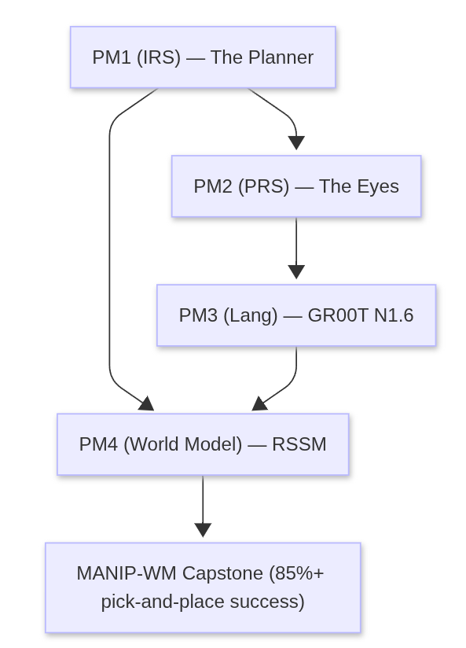
Conclusion
Technical Contributions
This is an engineering integration project. The contribution is a working implementation of these techniques in a coherent pipeline — not claiming novel algorithms.
1. Custom C++ PDDL A planner — implemented from first principles; direct implementation of heuristic search, not a library wrapper
2. Hybrid LLM + symbolic architecture — LLM for language understanding; PDDL for plan correctness; each doing what it does best
3. GA multi-objective plan optimiser — Pareto-optimal plan selection beyond simple A* output (steps, time, collision risk)
4. Full 4-technique IRS coverage in a single coherent pipeline, not disconnected modules
Capstone Roadmap
PM1 is the load-bearing foundation — the symbolic planner feeds every downstream module.
Thank you. Questions welcome.
AI Usage Declaration
These presentation slides were completed with assistance from Claude (AI assistant by Anthropic), used for structuring answers, referencing course materials, and drafting responses. All content was reviewed and validated by the group.
Notes:
30 sec. Say the framing line out loud — examiners respect intellectual honesty. Then list the four deliverables. End on the capstone diagram to show this feeds a larger system.

