Slide 1
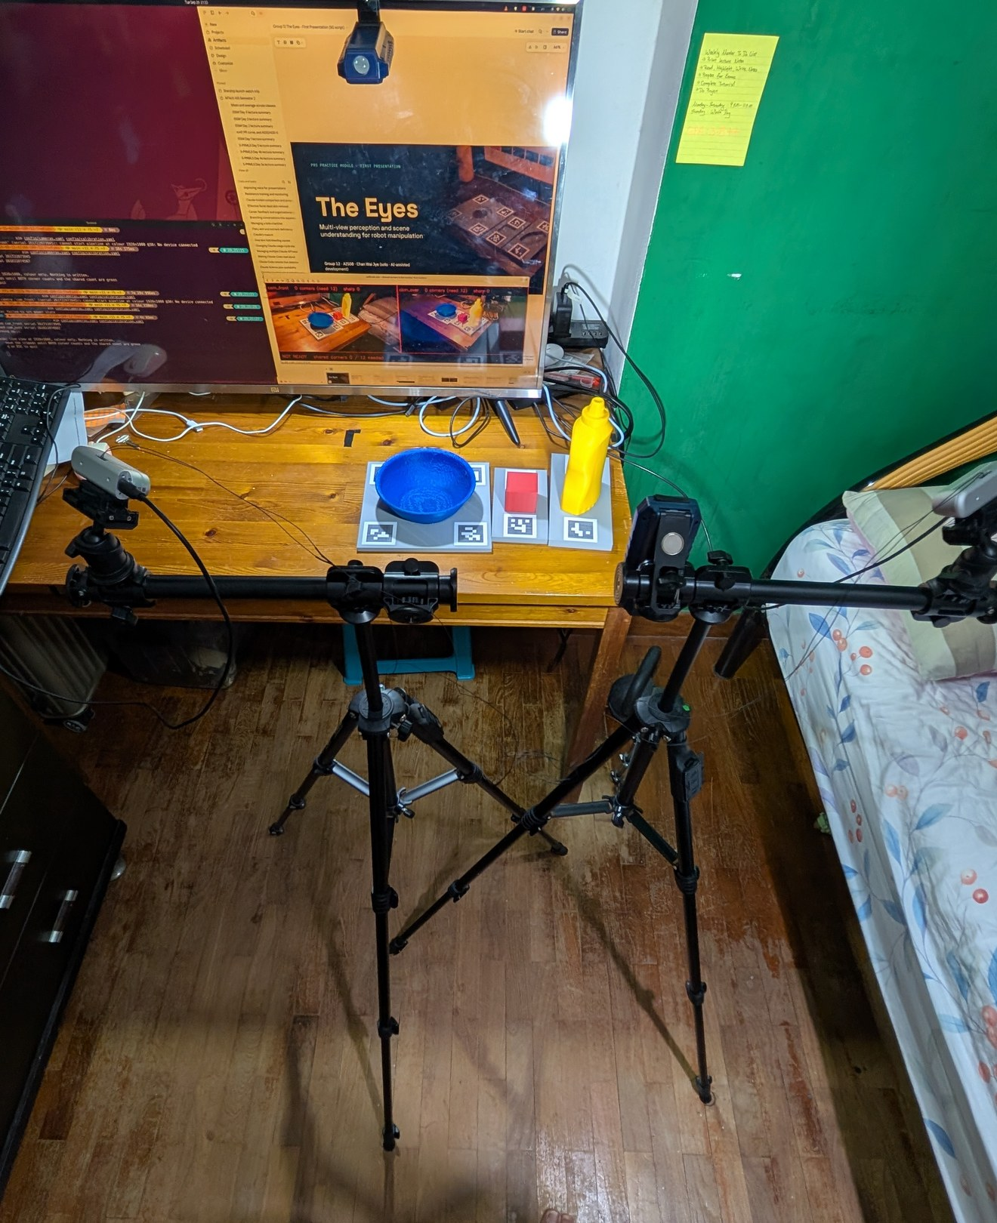
PRS PRACTICE MODULE · FIRST PRESENTATION
The Eyes
Multi-view perception and scene understanding for robot manipulation
Group 12 · AIS08 · Chan Wai Jye (solo · AI-assisted development)
30 September 2026
The rig: two D435i on tripods, printed objects in their marker trays, 29 Sep
Notes:
About 30 seconds. The Eyes is the perception layer for a tabletop robot: two depth cameras, detection, 6-DoF pose, fusion across the two views, and a symbolic scene graph a planner can use. This is a solo project; the code was built with Claude Code under my design and review. The photo is the rig itself: two RealSense cameras on tripods, and the three printed objects in their marker trays.

Slide 2
01 · OBJECTIVES
Why one camera is not enough
A mug behind a cereal box is invisible from the front. A second camera restores it, but now every object has two estimates that disagree.
1 Association
Which detection in one view is the same object in the other?
2 Arbitration
Is a disagreement noise to average, or one wrong view to reject? Two cameras give no majority vote.
In this rig's first real run, the two views of a printed cube disagreed by 11 mm.
3 Symbolisation
Turning noisy poses into facts: a pose 1 cm low once put a cube inside a 20 mm table.
The Eyes · Group 12 · First Presentation
2 / 18
Notes:
About 1 minute. The motivation. A single camera fails under occlusion. Adding a second view fixes visibility but creates a new problem: two estimates per object that disagree. On this rig the first real run showed 11 mm between views. So the project has to answer three questions a single camera never asks: association, arbitration, and turning poses into symbols. The occlusion ablation tests how well those answers hold up on real captures.

Slide 3
01 · OBJECTIVES
Five project goals
G1
Supervised detection and 6-DoF pose pipeline: RGB-D YOLOv8 + FoundationPose on tabletop objects
G2
Object-level fusion of two RGB-D cameras, to resolve occlusion
G3
A C++ scene-graph bridge from fused poses to relations and PDDL facts
G4
A measured sim-to-real gap: train on Isaac Sim data, evaluate on real captures
G5
All four PRS technique categories in one runnable system
PM1 · DONE
PM2 · THIS PROJECT
CAPSTONE
The Planner
The Eyes
MANIP-WM
NL → PDDL plans; consumes our facts
RGB-D → fused poses → scene graph
world model over our object state
The Eyes · Group 12 · First Presentation
3 / 18
Notes:
About 1 minute. Five goals. G1 to G3 are the pipeline: detection and pose, fusion, and the scene graph. G4 is an honest sim-to-real measurement, because the detector is trained on synthetic data only. G5 is breadth: all four PRS technique categories in one system. Along the bottom, where it fits: the previous module's Planner consumes these facts, and the capstone's world model will run on the object state this project defines, so that interface has to stay stable.

Slide 4
02 · SCOPE
Scope: what is in and what is out
In scope
Out of scope
Up to 6 rigid, closed-set objects with CAD models; 3 classes today
2 × Intel RealSense D435i, front and overhead, hardware-synced
One workstation: RTX 5070 Ti, 16 GB
Output: fused 6-DoF poses, a scene graph, PDDL facts
Open-vocabulary detection
Articulated or deformable objects
Robot arm manipulation: the SO-ARM101 is a stretch demo only
Live integration demo with The Planner: cut 8 Sep, logged output instead
MVP: real single-camera pipeline → second camera + fusion + occlusion ablation, never cut → scene graph → evaluation numbers.
Cut first under schedule pressure: Jetson test, then unknown-object DBSCAN, then the digital-twin viewport.
The Eyes · Group 12 · First Presentation
4 / 18
Notes:
About 1 minute. Scope is deliberately closed-set: rigid objects with known CAD models, because FoundationPose needs a mesh. Two D435i cameras, one GPU workstation. Out of scope: open vocabulary, deformable objects, and the robot arm itself. The live Planner demo was cut on 8 September; logged planning output covers that instead. The MVP line at the bottom is what must ship. The occlusion ablation is the main experiment and is never cut. Everything else has a fixed cut order.

Slide 5
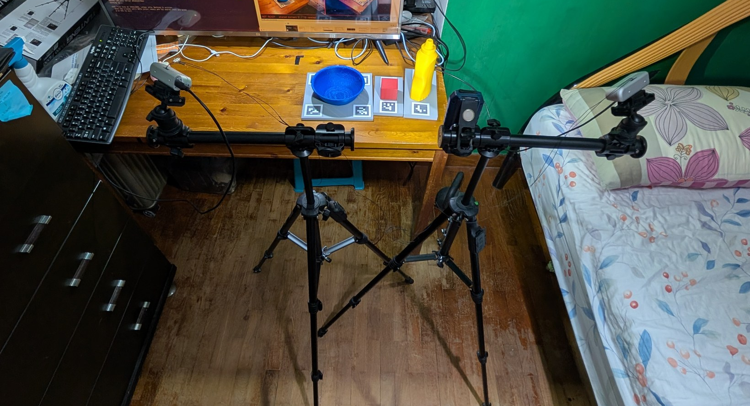
03 · DATA
The rig
2 × D435i on tripods
Hardware-synced
Objects in marker trays
Phone photo, 29 Sep
The Eyes · Group 12 · First Presentation
5 / 18
Notes:
About 30 seconds. The rig itself: two RealSense D435i cameras on tripods with boom arms, about 0.73 m apart with roughly 79 degrees between their views (calibrated 20 September), linked by a hardware-sync cable so both capture at the same moment. The printed objects sit in their marker trays on the desk, and one workstation runs the whole pipeline.

Slide 6
03 · DATA
Data: synthetic for training, real for evaluation
TRAINING · SYNTHETIC
OBJECTS · CAD
EVALUATION · REAL
50,000
3
10 × 300
RGB-D frames, synth50k_v2
classes, all 3D printed
scenes × synchronised pairs
Isaac Sim Replicator with domain randomisation: lighting, materials, pose, viewpoint, distractors, occlusion. Depth passed through the measured D435i noise model. 40,012 train / 9,988 val; labels generated automatically.
Mustard bottle (YCB 006), bowl (YCB 024), 50 mm cube. Printed from the meshes the data was rendered from, in the rendered colours, so no object–mesh mismatch hides inside ADD-S.
Four tiers, from isolated objects to targets under 25% visible from one view. Recorded once, replayed bit-exact for every ablation arm. Ground truth from marker trays. Not captured yet.
The Eyes · Group 12 · First Presentation
6 / 18
Notes:
About 1 minute. Three kinds of data. Training is fully synthetic: 50,000 RGB-D frames from Isaac Sim with domain randomisation, and the depth passes through a noise model I measured on the real cameras. The three object classes are 3D printed from the same meshes, so any pose error is the estimator's, not a mismatched object. Real evaluation is ten scenes in four difficulty tiers, recorded once and replayed identically for every ablation arm. That capture has not happened yet; it is the main remaining work.

Slide 7
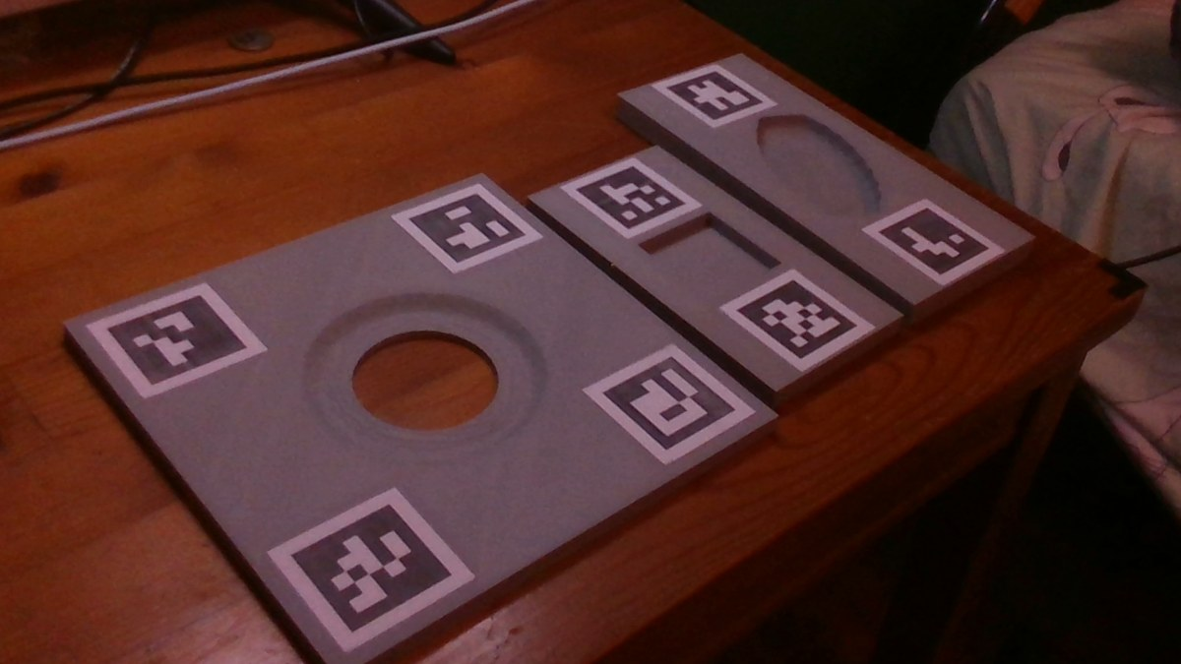
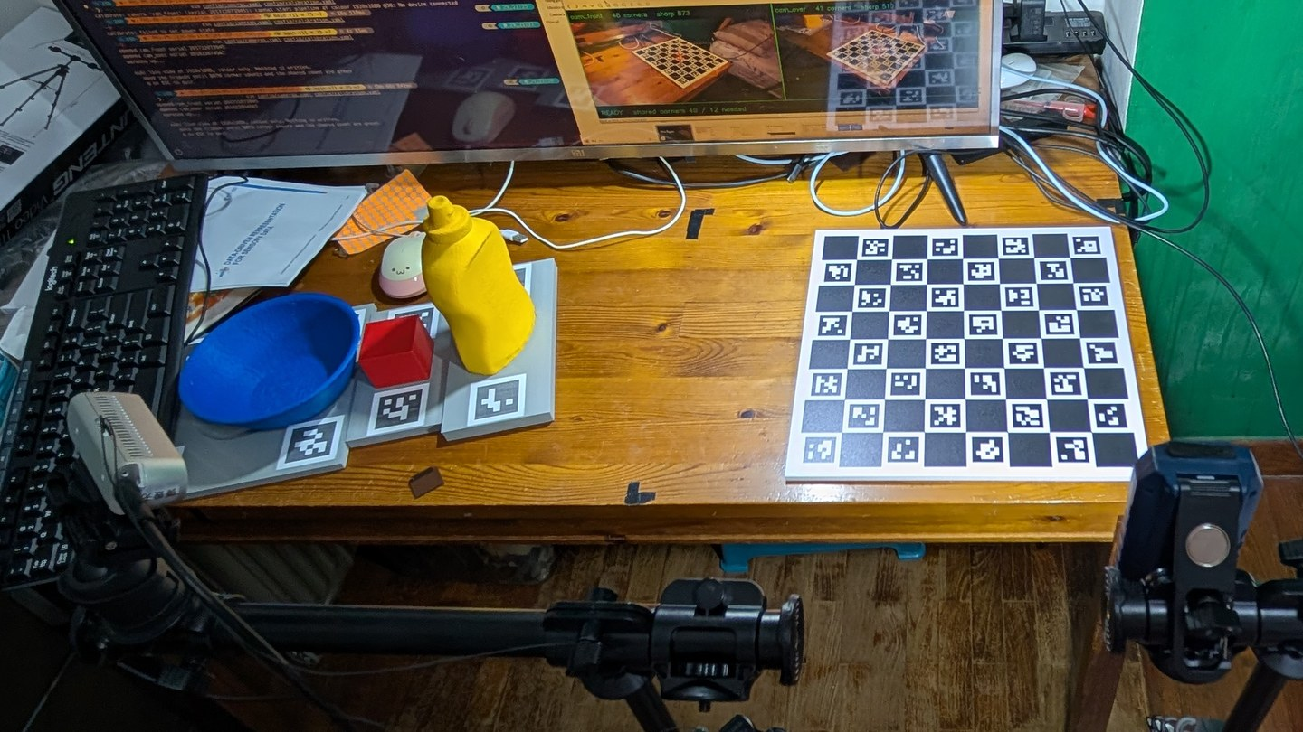
03 · DATA
Ground truth from printed marker trays
cam_front, 1920 × 1080 still, 20 Sep
Phone photo, 29 Sep: objects in their trays, beside the ChArUco calibration board
T_cam_object = T_cam_marker · T_marker_tray · T_tray_object
Socket cut from the object's own mesh · worst clearance 0.23 mm · markers callipered at 40.0 mm · evaluation only, never used at inference
The Eyes · Group 12 · First Presentation
7 / 18
Notes:
About 1 minute. How I get ground truth without modifying the objects. Each object sits in a printed tray whose socket is cut from that object's own mesh, with ArUco markers in the same plate. Only the camera-to-marker transform is observed; the rest comes from CAD. The worst socket clearance, 0.23 mm, bounds the ground-truth error, about 1% of the bottle's ADD-S threshold. The left image is a real still from the front camera on 20 September; the right photo, from 29 September, shows the objects seated in their trays beside the ChArUco board used to calibrate both cameras. The markers are used only to score, never by the pipeline.

Slide 8


04 · TECHNICAL APPROACH
System design: one C++ process, two views
PER VIEW · runs for each camera, learned models
2 × D435i
RGB-D YOLOv8n
FoundationPose
World-frame lift
RGB-D, 30 fps each
4-channel input stem
6-DoF from mesh + RGB-D
world = table frame
chosen by serial, synced
ONNX Runtime CUDA
pretrained, frozen
from ChArUco extrinsics
ONCE PER FRAME PAIR · C++, written from first principles
Association ★
Fusion ★
Scene graph ★
Outputs
nearest neighbour
50 mm / 30° gate
on · in · clear
scene graph JSON
per class, ≤ 150 mm
score-weighted + EKF
occluded_from
PDDL (:init) facts
★ = no fusion, pose-averaging or scene-graph library; Eigen for linear algebra only. One C++17 process, no ROS2; Python only for training.
The Eyes · Group 12 · First Presentation
8 / 18
Notes:
About 1.5 minutes. The whole runtime is one C++ process. Top row runs once per camera: frames from two D435i units selected by serial number and hardware-synced; the RGB-D detector; FoundationPose for a 6-DoF pose; then each pose is lifted into a shared table frame using the calibration. Bottom row runs once per frame pair, and the three starred modules are the project's core modules, written from first principles in C++ with no library: association across views, fusion with a disagreement gate, confidence weighting and an EKF, and the scene graph that emits relations and PDDL facts. Every run is logged to SQLite, and recorded sessions replay bit-exact.

Slide 9
04 · TECHNICAL APPROACH
Techniques: three networks, one trained here
Network | Parameters | Trained here? | Role
RGB-D YOLOv8n | 3,011,577 | Yes · 40 epochs | Detect objects, gate the pose step
FoundationPose refiner | 17,043,797 | No · frozen | Refine pose hypotheses (transformer)
FoundationPose scorer | 15,986,512 | No · frozen | Rank hypotheses; its score weights fusion
144
parameters added by the depth channel, initialised from the mean of the pretrained RGB filters (COCO stem inflation)
8.4%
Why early fusion: depth enters as a 4th input channel, so the whole COCO-pretrained backbone is reused; a separate depth branch would train from scratch. An RGB-only twin is kept as the ablation control.
of 36.0 M runtime parameters are trained in this project
The Eyes · Group 12 · First Presentation
9 / 18
Notes:
About 1 minute. Three networks run at inference. Only the detector is trained here: YOLOv8n with a four-channel stem, RGB plus aligned metric depth. The depth channel costs just 144 parameters, and I initialise it from the mean of the pretrained RGB filters rather than leaving it random, which the library would otherwise do. FoundationPose's refiner and scorer are pretrained and frozen; they need only a CAD mesh per object, not retraining. The scorer's output is what fusion uses as a confidence weight.

Slide 10
04 · TECHNICAL APPROACH
Fusion and scene graph, from first principles
Association ★
Fusion ★
Scene graph ★
Lift every per-view pose into the table frame first, so distances are metric
Greedy nearest neighbour per class, within 150 mm
At most one estimate per camera per object
Disagreement gate: views over 50 mm or 30° apart are not averaged
Weight each view by its FoundationPose score
Rotations by Markley quaternion averaging; per-object EKF over time
Geometric rules on bounding volumes
on, in, clear, occluded_from
in only for declared containers: a pose 1 cm low once put a cube in the table
Interface contract: ObjectState fields may be added, never removed or re-typed. It carries pose, confidence, which views saw the object, and 1-sigma uncertainty, so the capstone world model gets a belief, not just a pose.
(on red_cube_01 table_01)
The Eyes · Group 12 · First Presentation
10 / 18
Notes:
About 1.5 minutes. The three starred modules in more detail. Association first moves everything into the table frame so the 150 mm radius and the gate are in millimetres, not pixels. Fusion gates on disagreement over 50 mm or 30 degrees, weights by the pose score, averages rotations with Markley's eigenvector method, and smooths with a per-object EKF. The scene graph turns poses into relations with geometric rules; one real bug taught me that 'in' needs a declared container. The ObjectState struct is a contract for later modules: fields can be added, never removed.

Slide 11
04 · TECHNICAL APPROACH
All four PRS technique categories
# | PRS category | Where it is in The Eyes
① | Supervised / unsupervised | Supervised: RGB-D YOLOv8 fine-tuned on 40k labelled synthetic frames. Unsupervised: DBSCAN on residual depth for objects with no CAD model (planned, above MVP)
② | ML / DL techniques | Multimodal RGB-D YOLOv8n with COCO stem inflation; FoundationPose transformers; ONNX Runtime CUDA deployment in C++
③ | Hybrid / ensemble | Two per-view estimators fused by confidence weighting and a disagreement gate; learned front end with a classical EKF back end
④ | Intelligent sensing / sense-making | Calibrated, hardware-synced dual RGB-D; poses turned into relations and PDDL facts
The Eyes · Group 12 · First Presentation
11 / 18
Notes:
About 45 seconds. The project covers all four PRS technique categories. Supervised learning is the detector; the unsupervised part is DBSCAN for unknown objects, which is planned but sits above the MVP, so it is second in the cut order. If it is cut, category one is still covered by the supervised detector. Deep learning is the multimodal detector and FoundationPose. Hybrid is the fusion of two estimators with a classical filter. Sensing is the calibrated dual-camera rig and the step from poses to symbols.

Slide 12
05 · PROGRESS
What is built and measured
Item | Status | Key figure
Dual-camera capture | Verified on hardware | 30 fps each, hardware-synced, pair jitter 0.14–1.1 ms σ
Calibration | Recalibrated 20 Sep | Reprojection RMSE 0.260 / 0.318 px
Sensor error budget | Measured | 2–4 mm depth noise at working distance
RGB-D detector | Trained, deployed in C++ | mAP@0.5:0.95 0.957 (synthetic val); 3.6 ms per view
Fusion, 8-arm ablation | Run on synthetic only | Second camera: recall 0.352 → 0.485
Whole chain, live | Run on hardware | p50 51.7 ms per frame pair
Objects, trays, markers | Printed, callipered | Markers 40.0 mm; first ground-truth stills solved
Real ADD-S, mAP, predicates | Not measured yet | Needs the scored capture
The Eyes · Group 12 · First Presentation
12 / 18
Notes:
About 1 minute. Where things stand. The hardware is verified: both cameras at 30 fps, hardware-synced to about a millisecond. Calibration was redone on 20 September after I found a slipping mount. The detector is trained and running in C++ on the GPU. The fusion ablation has run, but only on synthetic input, and I label it that way everywhere. The whole chain has run live on the rig. The honest gap is the last row: no real-capture accuracy numbers yet. That is October's work.

Slide 13
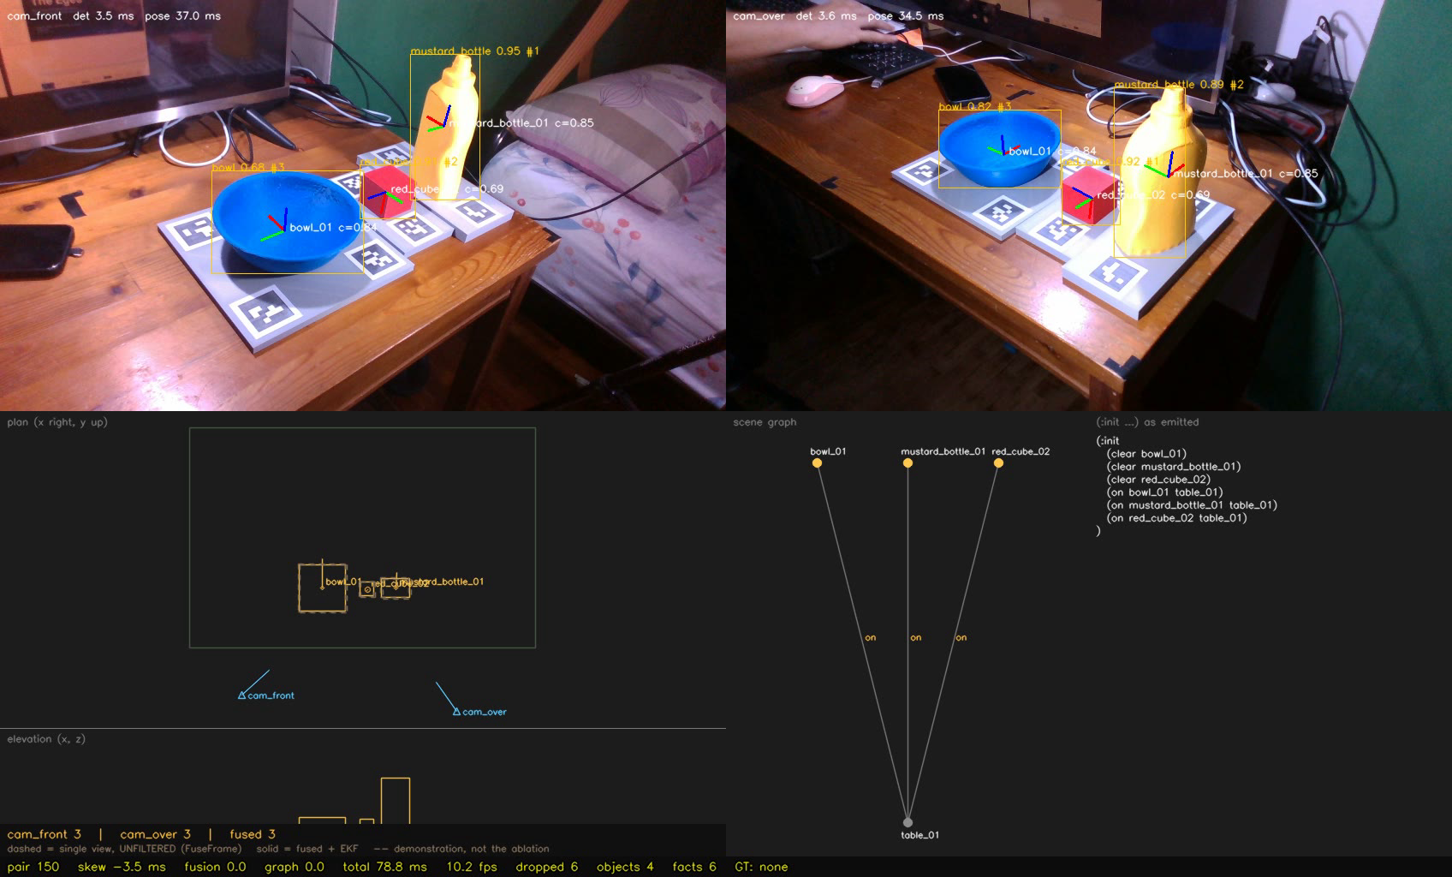
05 · PROGRESS · REAL
The whole chain, live on the rig
LIVE · 29 SEP · REAL POSE ESTIMATOR
Top: both cameras
detections with class and score; fused pose drawn back into each view as axes
Bottom left: plan view
fused objects in the table frame, with the camera positions
Bottom right: scene graph
3 objects on table_01; 6 PDDL facts emitted
Median 90 ms per frame pair over 200 live pairs. Detector still synthetic-only: other frames show a false cube on the monitor. No ground truth in this run.
The Eyes · Group 12 · First Presentation
13 / 18
Notes:
About 1 minute. A live frame from the running system on 29 September, with the real pose estimator. Top row: both camera views; the boxes come from the detector, and the axes are the fused pose projected back into each view, so they show the world estimate agrees with the pixels. Bottom left: the same objects in the table frame. Bottom right: the scene graph and the PDDL facts it emits; here all three objects are on the table and clear. Over 200 live pairs the median was about 90 ms per pair. Two caveats: the detector is still trained only on synthetic data, and in other frames it fired on the monitor; and there is no ground truth in this run, so it shows the chain working, not its accuracy.

Slide 14
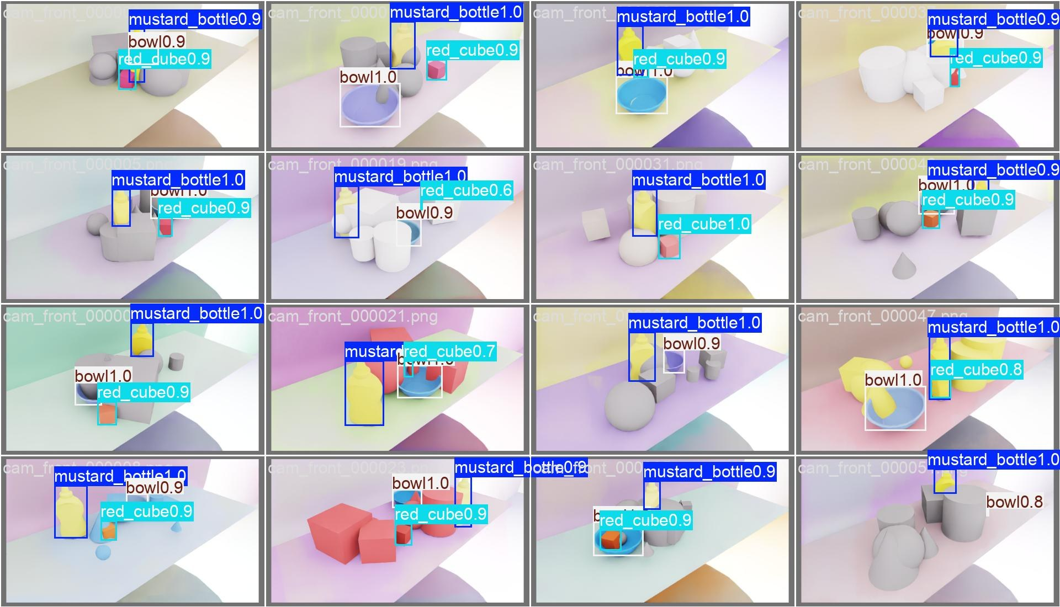
05 · PROGRESS
Detector: depth did not help on synthetic data
0.957
mAP@0.5:0.95 on 9,988 synthetic validation frames
+0.00076
what depth adds over an RGB-only twin: a negative result, reported as one
+0.032
what 8× more training data adds (5k → 40k frames): headroom is in localisation, and depth does not reach it
Synthetic validation renders with predicted boxes. Real-capture mAP not measured yet.
The Eyes · Group 12 · First Presentation
14 / 18
Notes:
About 1 minute. The detector reaches 0.957 mAP at 0.5 to 0.95 on synthetic validation. The interesting result is negative: an RGB-only twin on identical frames scores within 0.00076, so depth added nothing measurable here. The dataset-size ablation shows the task is not saturated, since eight times more data still gains 0.032, mostly on the small cube. So the headroom is in localisation, and early-fusion depth does not reach it. Real captures are where depth could still matter, because real depth has holes and the real appearance differs.

Slide 15
05 · PROGRESS · SYNTHETIC
Fusion ablation: what each part adds
Arm | Views | Policy | Filter | ADD-S mm | Recall
cam_front | 1 | — | raw | 9.97 | 0.352
cam_over | 1 | — | raw | 10.37 | 0.152
naive | 2 | naive | raw | 9.00 | 0.485
gated | 2 | gated | raw | 9.01 | 0.483
cam_front+ekf | 1 | — | EKF | 6.62 | 0.855
cam_over+ekf | 1 | — | EKF | 7.85 | 0.318
naive+ekf | 2 | naive | EKF | 6.28 | 0.902
fused (system) | 2 | gated | EKF | 6.29 | 0.902
Second camera
recall 0.352 → 0.485
EKF
about 2.7 mm lower ADD-S
Gate policy
0.01 mm, as expected: symmetric noise gives it nothing to reject. It can only win on a confidently wrong view, which is what real captures test.
Synthetic input: 200 frames, 3 objects, 10 mm/axis noise per view, two objects hidden from cam_over on 3 of 4 frames. Recall at 0.1 × diameter.
The Eyes · Group 12 · First Presentation
15 / 18
Notes:
About 1.5 minutes. Eight arms, so that views, fusion policy and the temporal filter each vary independently. Read rows in pairs that differ in one thing. The second camera lifts recall from 0.35 to 0.49. The EKF buys about 2.7 mm. The gate policy buys nothing here, and that is correct: with symmetric Gaussian noise there is nothing to reject. An earlier four-arm version credited the EKF's gain to the policy; splitting the arms fixed that confound. The gate earns its place only when one view is confidently wrong, and a unit test with an 8 cm outlier shows it winning then. Whether FoundationPose produces such views on this rig is what the real ablation measures.

Slide 16
05 · PROGRESS · REAL
First real data from the rig
WHOLE CHAIN, LIVE · 6 SEP
GROUND-TRUTH TRAYS · 20 SEP
Printed cube, 150 frame pairs
First real stills solved
Two views fused into one object on 150 / 150 pairs
Per-view disagreement 11 mm, well under the 50 mm gate
Fused pose stable to 0.1 mm sd, at 22.3 pairs/s
Fixed boxes stood in for the detector. One observation, not an ADD-S number
All 8 tray markers decode in both views; 152 / 160 observations pass the gates. Cross-camera disagreement of the tray pose:
Tray | Cross-camera
bowl | 2.71 mm
mustard_bottle | 3.78 mm
red_cube | 7.55 mm
The cube is weakest, against an ADD-S threshold of about 8.6 mm.
Seen only on real data: FoundationPose scores vary 0.75–0.92, so confidence weighting has something to weight; real frames are much darker than the training set (82–93% of pixels below its 1st percentile).
The Eyes · Group 12 · First Presentation
16 / 18
Notes:
About 1.5 minutes. Two pieces of real evidence. On 6 September the whole chain ran live on a printed cube: both views fused into one object on every one of 150 pairs, 11 mm apart, well inside the gate. That shows the multi-view path works end to end, but it is not an accuracy number. On 20 September the ground-truth trays were solved from real stills: the bowl and bottle agree across cameras to under 4 mm; the cube is weakest at 7.55 mm and needs work. Real data also exposed two things synthetic data could not: pose scores do vary, and the room is far darker than the training renders.

Slide 17
06 · NEXT
Next: the occlusion ablation on real captures
Fix the lighting: diffuse the lamp, which clips markers, and narrow the exposure gap
Fit-check bottle and bowl; check tray flatness
Capture 10 scenes × 300 synchronised pairs
Score real mAP, ADD-S single vs fused, predicate accuracy
Occlusion ablation: 8 arms, 95% bootstrap CI over scenes
Final system, report and video: 31 Oct
Tier | Scenes | Tests
T1 isolated | 2 | single-view floor
T2 clutter | 3 | detection, association
T3 partial | 3 | confidence weighting
T4 full | 2 | the multi-view test
Stated in advance: if gated fusion does not beat naive on real captures, the second camera buys recall and the EKF buys accuracy, and that is the reported result.
The Eyes · Group 12 · First Presentation
17 / 18
Notes:
About 1 minute. The plan to 31 October. First the lighting, because glare clips the markers and the scene is darker than the training data. Then fit checks, then the capture: ten scenes in four tiers, with T4, targets under a quarter visible from one camera, the main test of the multi-view approach. Then the scores and the eight-arm ablation with bootstrap confidence intervals over scenes. The negative outcome is written down before any data is seen, so the result gets reported either way.

Slide 18
THE EYES · GROUP 12
Questions
Built: dual-camera rig, RGB-D detector, C++ fusion and scene graph, live end-to-end runner.
Measured: calibration, sensor noise, detector and fusion ablations on synthetic data.
Next: the occlusion ablation on real captures, by 31 October.
AI tool declaration: I used Claude (Anthropic), through Claude Code, to write the system's code under my design and review, and to draft these slides and their speaker notes from my proposal and interim report. I am responsible for the content and quality of the submitted work.
Chan Wai Jye · AIS08 · 18 / 18
Notes:
Wrap up in 20 seconds, then questions. Likely questions: why depth did not help (answer: the negative result and the dataset-size ablation); why not just average the two views (answer: the gate only matters for confidently wrong views, which the real ablation tests); how ground truth is trusted (answer: the tray chain, 0.23 mm clearance, callipered markers, cross-camera agreement).

