Slide 1
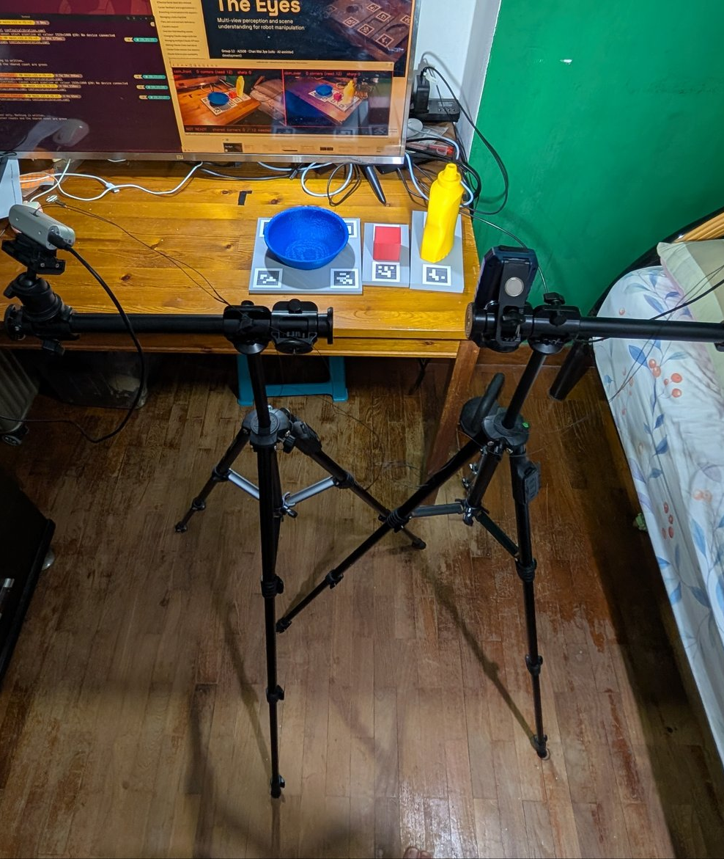
PRS PRACTICE MODULE · FINAL PRESENTATION
The Eyes
Multi-view perception and scene understanding for robot manipulation
Group 12 · AIS08 · Chan Wai Jye (solo)
31 October 2026
Code built with Claude Code under the author's design and review
The rig: two RealSense D435i on tripods, the printed objects in their marker trays

Slide 2
01 · THE PROBLEM
Why one camera is not enough
the table, from above
A planner works with statements, like (on cube table). A real robot has to get them from cameras.
the cube
seen by both: two estimates that never quite agree
1
Association
Which estimates, one per camera, are the same object?
a box
2
Arbitration
When two views disagree, which one is wrong?
3
Symbolisation
How do poses become facts reliable enough to plan with?
camera 1
camera 2
The Eyes · Group 12 · Final Presentation
2 / 18

Slide 3
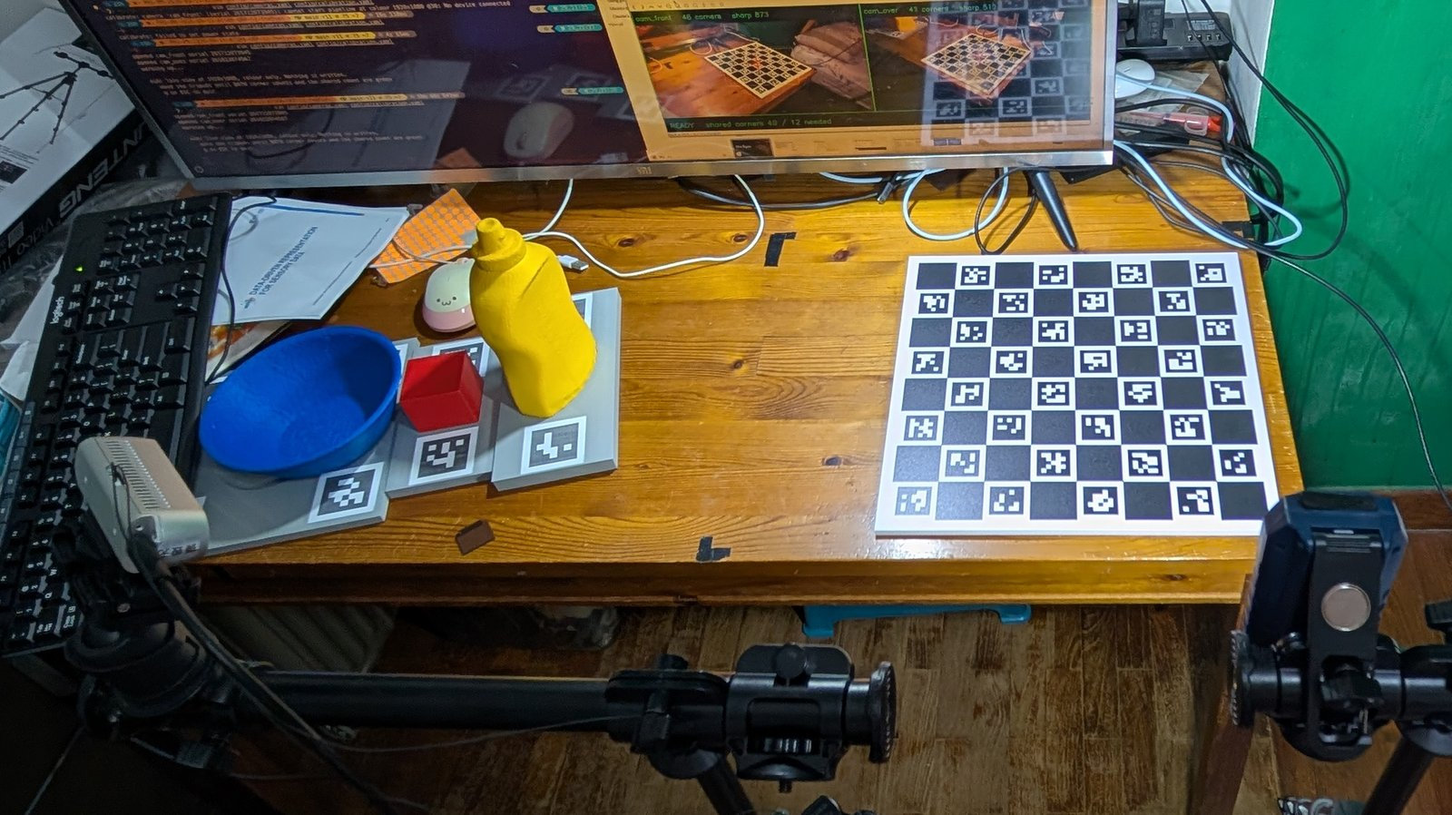
02 · THE SYSTEM
The rig
2 × Intel RealSense D435i
Active IR stereo depth plus colour, on tripods, each selected by its serial number
About 0.74 m apart, 80° between views
Frames paired by timestamp, never more than 16.7 ms apart
Calibrated to about 0.3 px
Against the ChArUco board, and registered again at the start of every session
Three printed objects
Printed from the pose estimator's own meshes; the grey marker trays are for ground truth only
Source: config/extrinsics.yaml; frames.skew_ms of every scored scene and take
The Eyes · Group 12 · Final Presentation
3 / 18

Slide 4
02 · THE SYSTEM
One C++ process, two views
PER VIEW · once for each camera
2 × D435i
RGB-D YOLOv8n
FoundationPose
World frame
RGB-D frames, 30 a second
4-channel input; trained here on 40,012 synthetic frames, fine-tuned on 360 real
6-DoF pose from the CAD mesh; pretrained, frozen
Each pose moved into the shared table frame
PER FRAME PAIR · the project's core, written from first principles in C++
Depth check ★
Association ★
Fusion ★
Scene graph ★
Outputs
Does the other camera see through this pose?
The same object, matched across the views
Gate at 50 mm / 30°; confidence weighting; an EKF per object
on, in, clear, occluded_from; the support check
PDDL (:init …) facts and ObjectState
★ No sensor-fusion, pose-averaging or scene-graph library: Eigen for linear algebra only. The code was written with Claude Code under the author's design and review.
The Eyes · Group 12 · Final Presentation
4 / 18

Slide 5
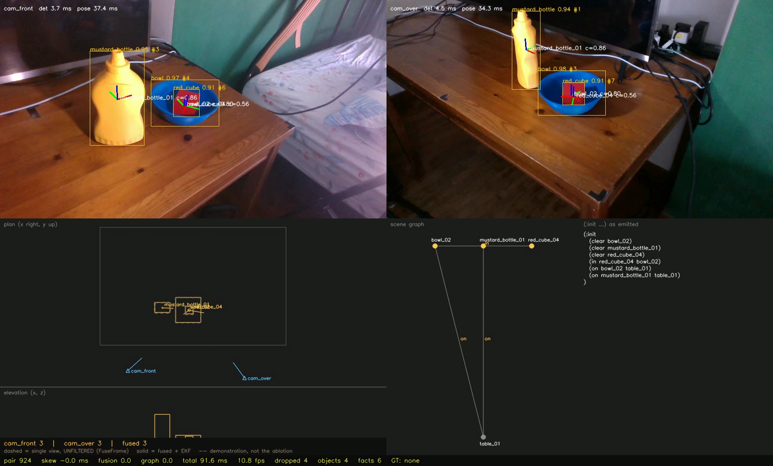
02 · THE SYSTEM
What the console shows
1
1
Both camera views
Boxes from the detector, axes from the pose estimator, per camera
2
The table from above
The fused objects in the shared frame, and the two cameras
2
3
4
3
The scene graph
Each object and what it rests on or sits in
4
The facts
The (:init …) block a planner reads
Source: the live take demo_live_d, 25 Oct 2026, at 60 s: the cube is in the bowl
The Eyes · Group 12 · Final Presentation
5 / 18

Slide 6
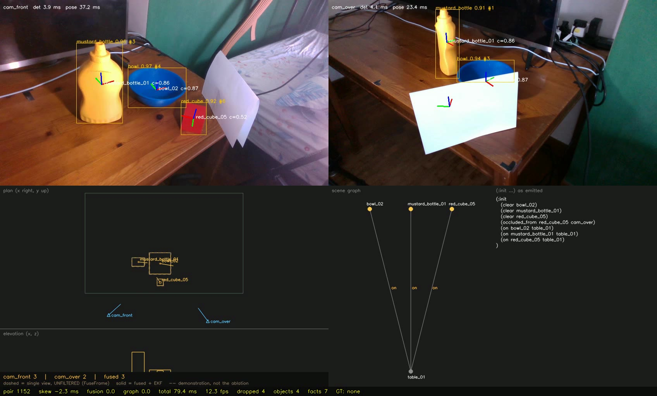
03 · LIVE
Live on the rig
13.3
frame pairs a second over the 195 s take
10
a second with three objects tracked in each view
79%
of a three-object pair is the pose estimator
1.1 s
per new object per view, while the pose estimator registers it
LIVE, one take, not replayed. At 84 s the card hides the cube from cam_over: cam_front 3, cam_over 2, fused 3.
Source: demo_live_d, 25 Oct 2026, its metrics.sqlite; final report §9.8
The Eyes · Group 12 · Final Presentation
6 / 18

Slide 7
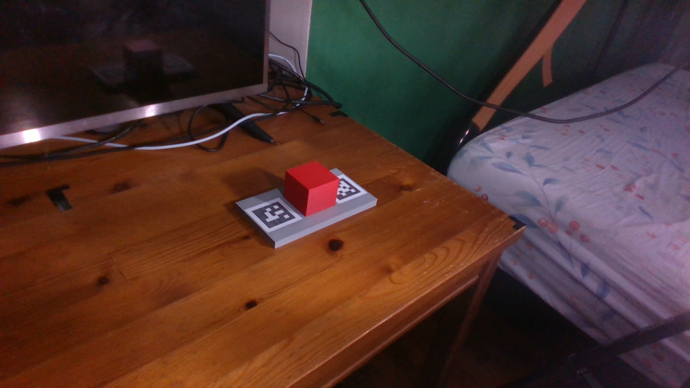
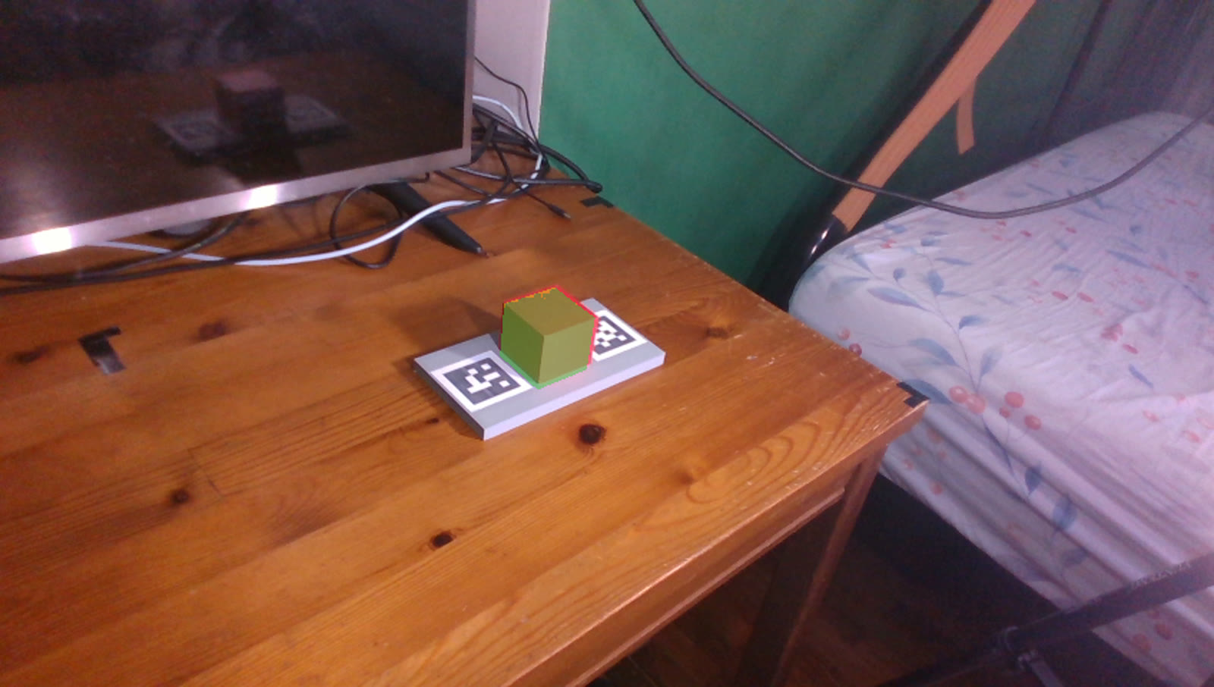
04 · EVALUATION
Ground truth from printed marker trays
A ground-truth still: the cube in its tray, with the tray's markers
The pose the markers give, drawn back onto the frame (green)
Within 1.5 mm
Recorded once
Under 10% of the diameter
The two cameras agree on each tray's true pose
300 frame pairs a scene, replayed for every method
ADD-S, the surface-to-surface error, counts as right: 8.7 mm for the cube
Source: final report §7–8; ground truth across cameras 0.3–1.4 mm (docs/OCTOBER_PLAN.md); config/meshes.yaml
The Eyes · Group 12 · Final Presentation
7 / 18

Slide 8
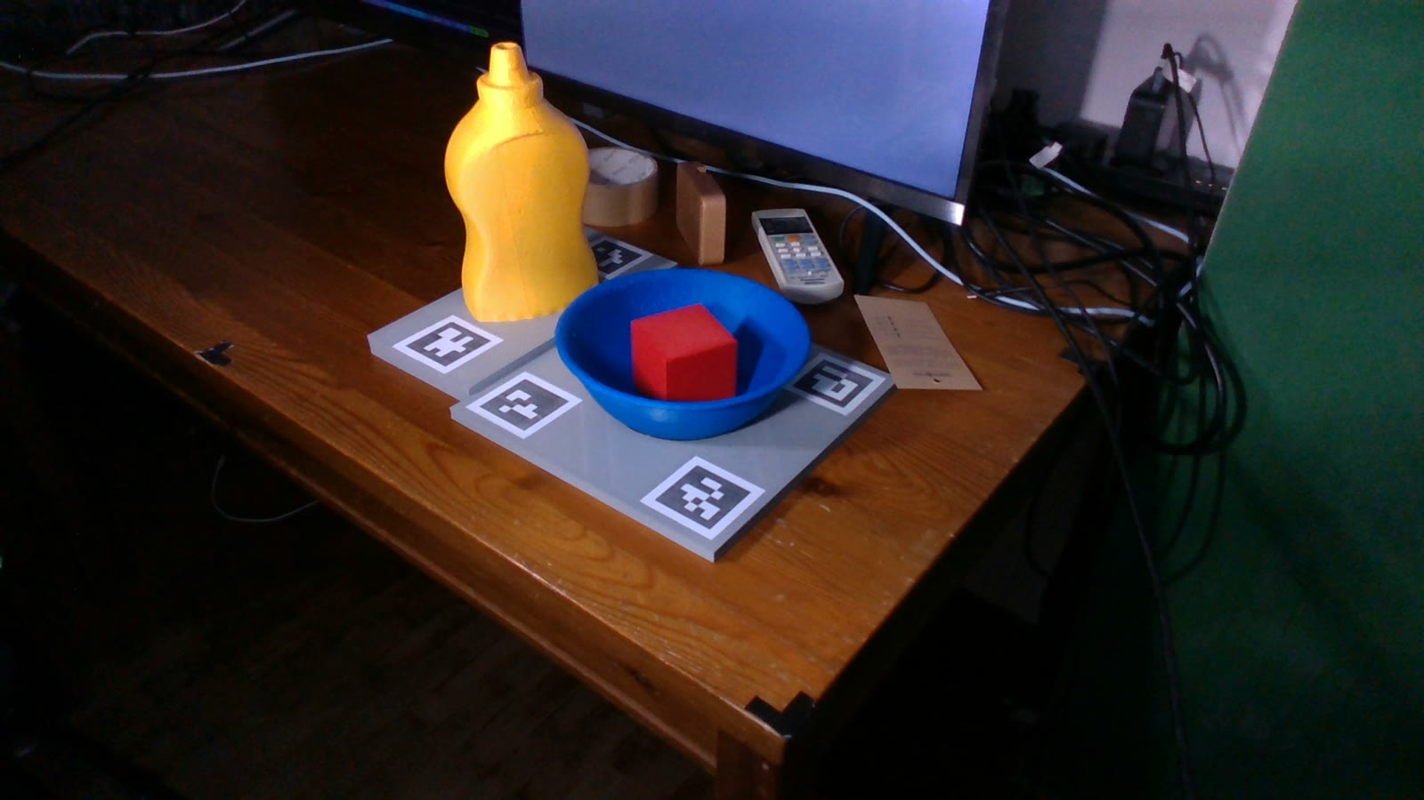
04 · EVALUATION
Sixteen scenes, four levels of occlusion
T1
T2
T3
T4
Alone
In clutter
Half hidden
Fully hidden
5 scenes
3 scenes
4 scenes
4 scenes
A cube or the bottle, nothing else
Three objects among distractors
From one camera; one scene's level not certified
From one camera, which sees 0–6% of it
Two more with the cube inside the bowl
(in red_cube bowl) is reported on 300 of 300 frame pairs in both.
Every method runs on the same recorded frames. Intervals are 95% bootstrap over scenes; a difference counts only if it is beyond the 2–4 mm sensor floor.
Source: final report §8, §9.4; t2_in_a and t2_in_b, 10 Oct
The Eyes · Group 12 · Final Presentation
8 / 18

Slide 9
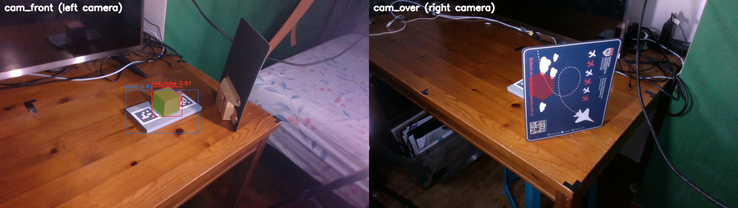
05 · RESULTS
A hidden object is still found
t4_cube_over: cam_front (left) sees the cube; from cam_over (right) the card hides it
Scene | Blocked camera sees | It finds it on | Fused finds it on | Fused ADD-S
t4_cube_over | 0% | 0 / 300 | 300 / 300 | 3.08 mm
t4_cube_front | 0% | 0 / 300 | 300 / 300 | 1.65 mm
t4_bottle_over | 6% | 0 / 300 | 300 / 300 | 3.91 mm
t4_bottle_over_b | 2% | 0 / 300 | 300 / 300 | 2.85 mm
+1.00
recall, fused against the blocked camera, 95% interval [1.00, 1.00]
A single camera does as well only when it is the open one. No single camera covers all four scenes.
Source: final report §9.4; the share each blocked camera sees from runs/scored/*/visibility.csv
The Eyes · Group 12 · Final Presentation
9 / 18

Slide 10
05 · RESULTS
How the views are combined matters
Averaging fails
The cube looks the same from several directions; the cameras pick different ones, and their average is a rotation neither saw.
Gated vs plain average
All 16 scenes: −9.81 mm [−16.96, −3.75], beyond the sensor floor.
Fused vs the better camera
All 16: 2.76 against 3.19 mm, a difference of −0.36 [−0.83, 0.08]. Not resolvable on this rig.
Source: runs/scored/20261005/t1_cube*/ablation.log (all arms with the EKF); final report §9.4, docs/results/ablation_ci.json
The Eyes · Group 12 · Final Presentation
10 / 18

Slide 11
05 · RESULTS
When fusion believed the wrong camera
the table, from above
Keep the higher score
70.75 and 83.72 mm
the bottle
cam_front measures a surface here
the good camera alone: 3.06 and 3.14 mm
where cam_over put it: score 0.99, 70–86 mm off
the cover
Veto by the other camera's depth
3.03 and 3.12 mm
1,035 estimates vetoed
Over all 22 recordings. One of them was within 30 mm of the truth, of 17,121 that were.
cam_front sees past the claimed spot, so nothing is there: the estimate is vetoed
cam_front
cam_over
Source: final report §9.4–9.5; t3_bottle_over_b and t3_bottle_over; refusals over all 22 scenes, docs/OCTOBER_PLAN.md, 17 Oct
The Eyes · Group 12 · Final Presentation
11 / 18

Slide 12
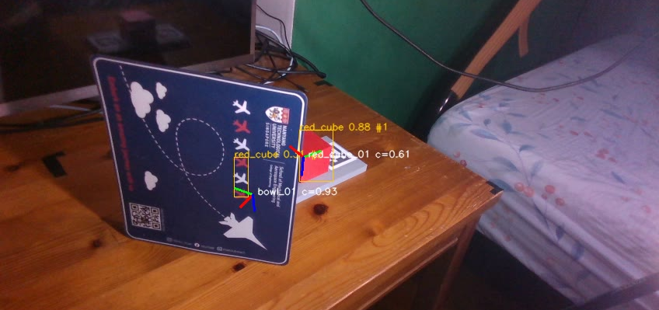

05 · RESULTS
Objects that are not there
Synthetic-only detector, cam_front: a cube boxed on the card's red print
Fine-tuned detector, the same frame: no false object
The support check: 2,771 → 1
Fine-tuning: 731 → 0
An object is reported only if something supports it. Seven scenes: false object-pairs 2,771 → 1, all 2,100 real ones kept.
On 360 real frames of ten unscored layouts. mAP@0.5:0.95 0.670 → 0.934; false objects over 22 recordings 731 → 0.
Source: final report §9.2, §9.7; replays of 20261005/t3_cube_front with each detector
The Eyes · Group 12 · Final Presentation
12 / 18

Slide 13
05 · RESULTS
Facts checked against hand labels
on, in, clear: met
Precision 0.994 to 1.000, recall 1.000. The few false on and clear facts are one duplicate bottle in one dim scene.
occluded_from: 0.557
A half-hidden object (44–68% visible) reads as hidden from the camera whose estimate was refused. The definition fixed in advance is under 25% visible. And the fact cannot tell a blocked camera from a detector that missed.
Source: final report §9.7; scripts/predicate_accuracy.py, docs/predicate_labels.yaml
The Eyes · Group 12 · Final Presentation
13 / 18

Slide 14
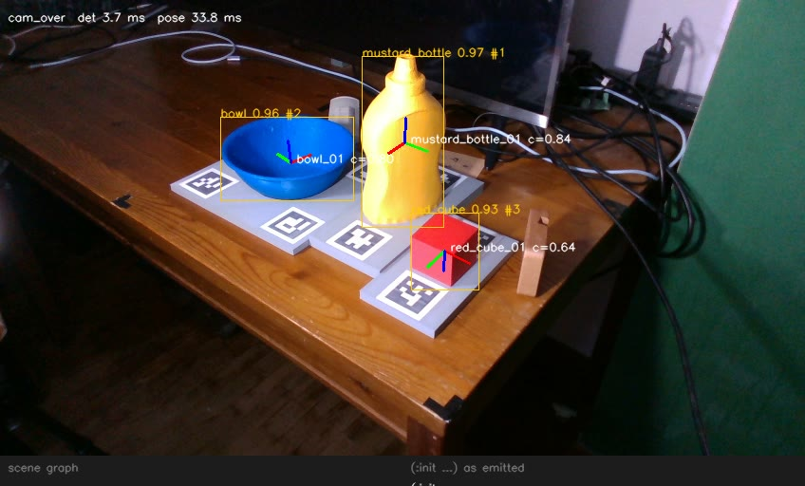
06 · LIMITS
What it still gets wrong
occluded_from
A half-hidden object reads as hidden; precision 0.557
A hand in view
A pose can register on the hand; a passing hand can start a duplicate track for one frame
Registration stalls
t2_clutter_c from cam_over: the cube is small and far away. Fused, it is inside the threshold on 75.7% of frames
About 1.1 s per new object per view, with nothing processed meanwhile
One rig, one room
Still scenes for every accuracy figure; four distractors, not eight
Source: final report §9.4, §9.7, §9.8, §11; the live takes of 25 Oct
The Eyes · Group 12 · Final Presentation
14 / 18

Slide 15
06 · FINDINGS
On real frames, depth is what finds the cube
+0.00076
what depth added on synthetic frames: nothing
+0.169
what it adds on real frames; the cube's AP@0.5 goes 0.099 → 0.905
0.934
after fine-tuning on 360 real frames: most of the sim-to-real gap closed
Source: final report §9.2, §9.9; 9,988 synthetic validation frames, 960 real frames of the 16 scored scenes
The Eyes · Group 12 · Final Presentation
15 / 18

Slide 16
06 · TECHNIQUES
Four kinds of technique in one system
1
Supervised deep learning
2
A multimodal network
An RGB-D YOLOv8n trained on 40,012 synthetic frames from Isaac Sim, then fine-tuned on 360 labelled real ones
A 4-channel early-fusion stem, its depth channel made by inflating the COCO weights; FoundationPose, a pretrained transformer; ONNX Runtime on CUDA
3
Hybrid estimation
4
Intelligent sensing
Two per-view estimators combined by confidence weighting, a disagreement gate and depth evidence; a learned front end with a classical EKF behind it
Two calibrated RGB-D cameras; each camera's depth used as evidence against the other's poses; poses turned into relational facts
Source: final report §4–7; CLAUDE.md, technique map
The Eyes · Group 12 · Final Presentation
16 / 18

Slide 17
07 · OUTPUT
What a planner receives
(:init …) as emitted, live, at 60 s
ObjectState: a fixed contract
(:init
(clear bowl_02)
(clear mustard_bottle_01)
(clear red_cube_04)
(in red_cube_04 bowl_02)
(on bowl_02 table_01)
(on mustard_bottle_01 table_01)
)
id, cls instance and class
pose_w fused 6-DoF pose, table frame
confidence fused score
relations filled by the scene graph
visible_views, observed_views fused from, seen by
extent half-extents, axis-aligned
position_sigma_m, orientation_sigma_rad uncertainty
velocity_w, stamp_ns motion and time
Fields may be added, never removed or re-typed: the capstone, MANIP-WM, builds on it.
Source: demo_live_d at 60 s; INTERFACES.md §5
The Eyes · Group 12 · Final Presentation
17 / 18

Slide 18
THE EYES · GROUP 12
Two cameras do see more than one
But the second camera matters most as a witness: it is what tells you when the first one is wrong.
2.76 mm
every frame
9.8 mm
≥ 0.994
fused ADD-S over the 16 scored scenes
an object hidden from one camera, still found
the gate's margin over a plain average
precision of on, in and clear
Code built with Claude Code under the author's design and review.
Chan Wai Jye · Group 12 · AIS08 · 31 October 2026

