Slide 1
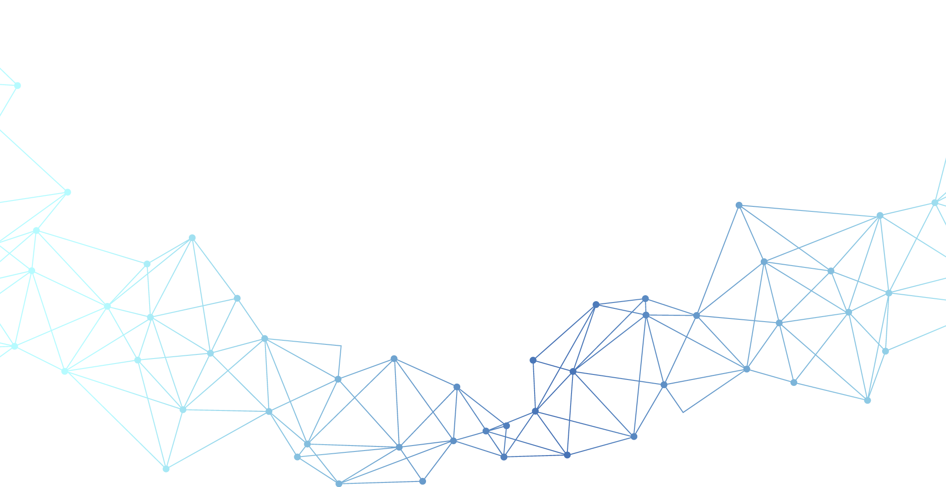


Quantize LLM with GPTQ
Presenter : Hyunku Kang (M.S)
Date : 2024-12-17
Notes:
용어정리
중요성
이전의 전통적인 기법 현황 한계
모델 overview
데이터셋
실험 결과
Future work
conclusion

Slide 2
Contents
Ⅰ. Introduction
Ⅱ. Method
Ⅲ. Process
Ⅳ. Result
Notes:
용어정리
중요성
이전의 전통적인 기법 현황 한계
모델 overview
데이터셋
실험 결과
Future work
conclusion

Slide 3
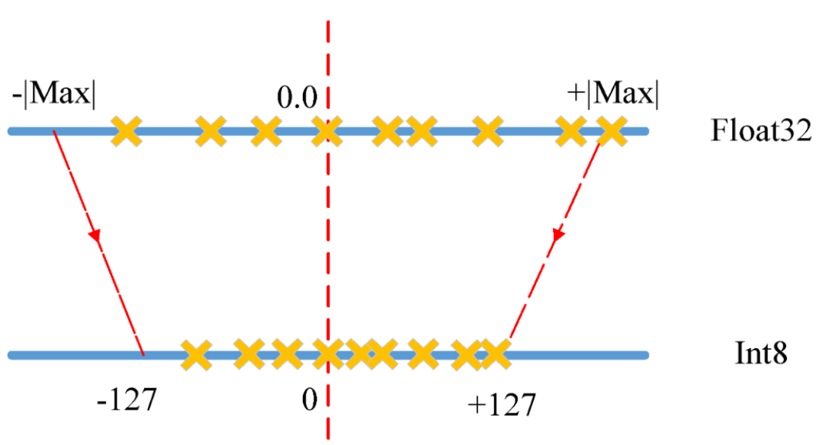
Introduction What is Quantize?
What is Quantization?
A compression method that represents high-bit model weights in lower-bit form, thereby increasing operations and memory access.
The goal is to convert 16/32 bit weights into 4/8 bit weights
We can quantize Weight, Activation

Slide 4
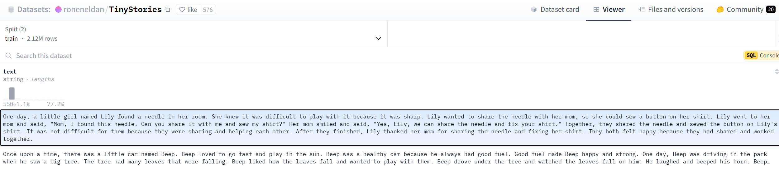
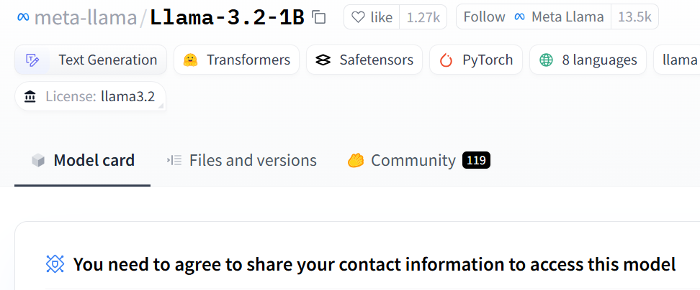
Introduction Calibration Dataset & LLM
Information about Calibration Dataset
TinyStories – Short Storybook data
Information about objective LLM
Llama3.2-1B - Meta

Slide 5
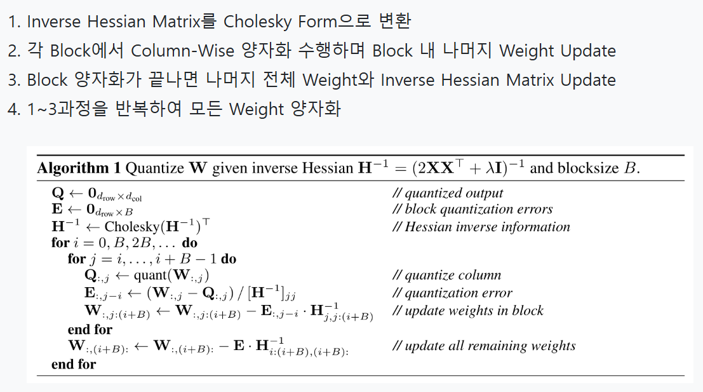
Method GPTQ
Summary of GPTQ
1. Convert the Inverse Hessian Matrix to Cholesky Form
2. Perform column-wise quantization for each block and update the remaining weights within the block
3. After completing the quantization for the block, update the remaining weights and the Inverse Hessian Matrix for the entire model
4. Repeat steps 1-3 until all weights quantized

Slide 6
Method GPTQ
Step 1. Convert Inverse Hessian Matrix to Cholesky Form
Our Objective is minimizing quantization error
L(W) is quantization error, which means |WX – W’X|, W is original Weight, W’ is Quantized Weight
We can approximate this expression using a Taylor series.
Unlike general optimization in deep learning, which is based on the first-order approximation of the Taylor series, GPTQ performs more sophisticated optimization using a second-order approximation requiring the Hessian matrix.
The value of the loss function at W=0
First derivative at W=0
Second derivative at W=0

Slide 7

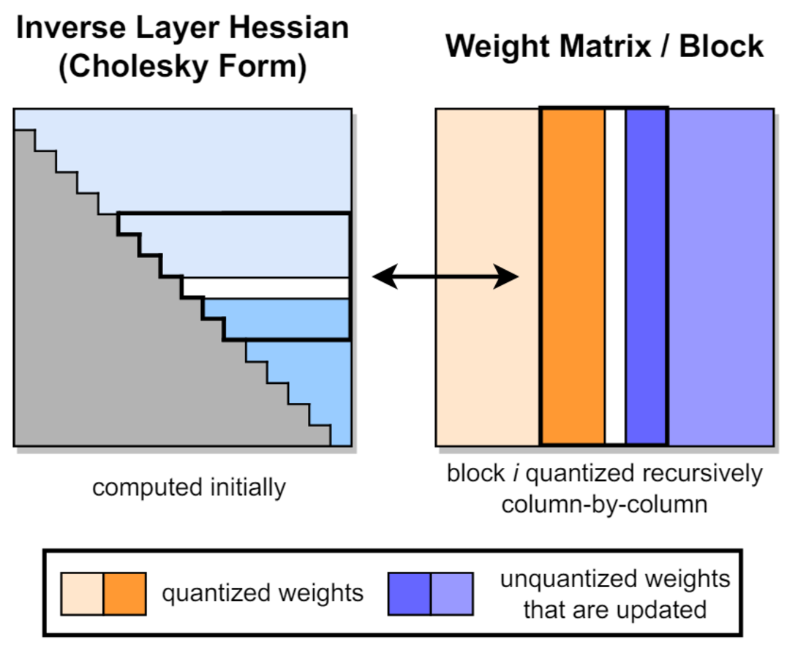
Method GPTQ
Step 1. Convert Inverse Hessian Matrix to Cholesky Form
Thus, the first derivative determines the direction in which the loss function decreases, while the second derivative indicates the rate at which to move in that direction
To compensate for quantization loss, the Hessian inverse matrix is used to adjust the weights
Directly computing the inverse of the Hessian matrix is very time-consuming, but it can be efficiently computed using Cholesky decomposition
In GPTQ, block-wise operations enable efficient
computation by applying Cholesky decomposition
to each block instead of using the entire Hessian.

Slide 8
Method GPTQ
Step 2. Block Wise Quantization
GPTQ propose a method that processes columns in blocks of size B, where each block is fully quantized before updating the corresponding block of the residual weights and H−1.
Step 3. Update Remaining Weights and Hessian Matrix
After block quantization is completed, the remaining weights and the inverse Hessian matrix are updated.
Repeat steps 1–3 until all weights are quantized.

Slide 9
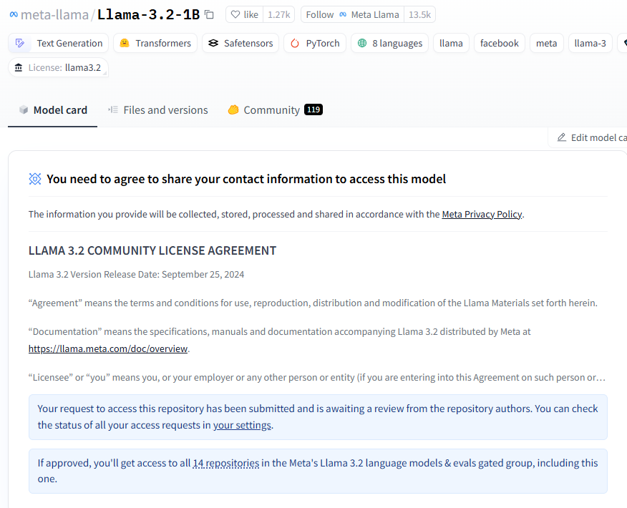

Process Fow to quantize model
Get Access from Huggingface Meta
Models of Meta needs additional access from your huggingface credentials.
Experimental Setup
Google Colab T4 GPU was used in my experiment
We need to install additional libraries below
Then, log in to huggingface using authorized credentials

Slide 10

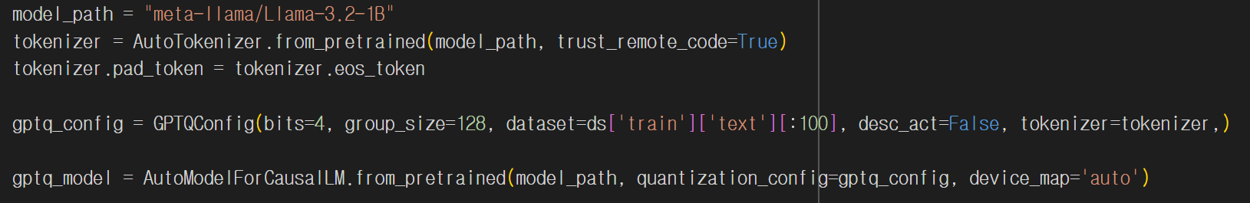
Process Fow to quantize model
Load Callibration Dataset
Models of Meta needs additional access fro
Load Model with GPTQ, Callibration set
Google Colab T4 GPU was used in my experim

Slide 11
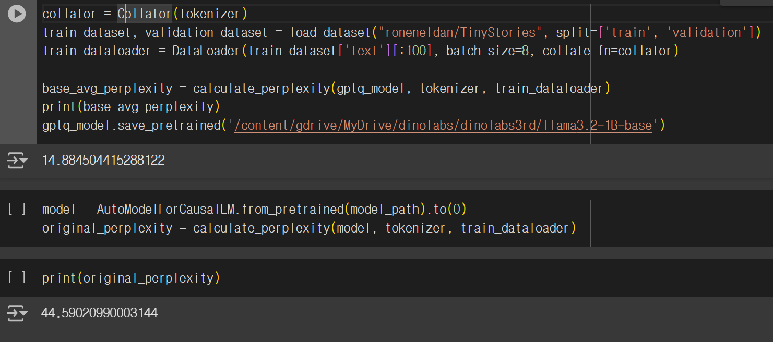
Process Fow to quantize model
Evaluation – Calculate Perplexity
Llama has no pad token -> define pad token as eos token
Convert batch text to batch token using collator

Slide 12
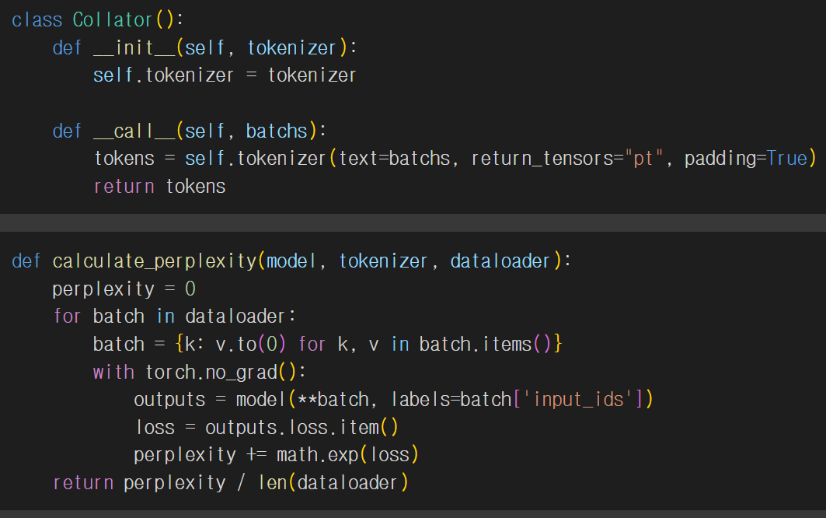
Process Fow to quantize model
Evaluation – Calculate Perplexity
Perplexity is calculated by applying exp⁡ to the next token prediction loss

Slide 13
Thank You
Notes:
용어정리
중요성
이전의 전통적인 기법 현황 한계
모델 overview
데이터셋
실험 결과
Future work
conclusion

