Slide 1
Bike Theft in California
By: Liz Chan

Slide 2
Bike Theft in California
Acquire the Data
Exploratory Data Analysis
Predict
Next Steps

Slide 3
Acquire the Data
Stolen bike data from the Bikeindex API3
Income data by Zipcode from the IRS website
Demographic and Housing data from American Community Service DP05 - American Factfinder
Census Population data from the Decennial Census - American Fact Finder

Slide 4

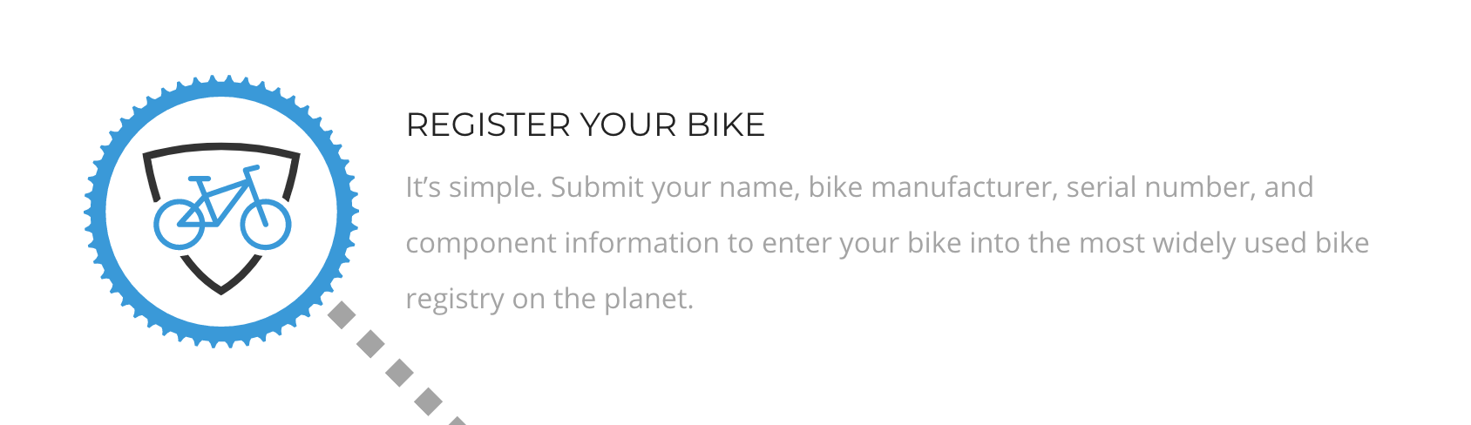
Real-World Data

Slide 5

Real-World Data

Slide 6
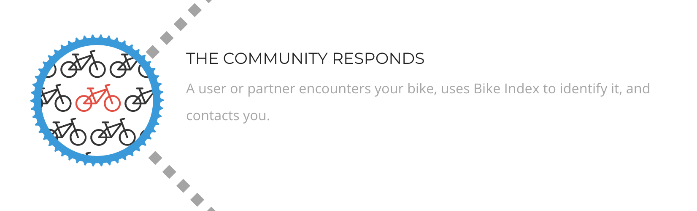
Real-World Data

Slide 7
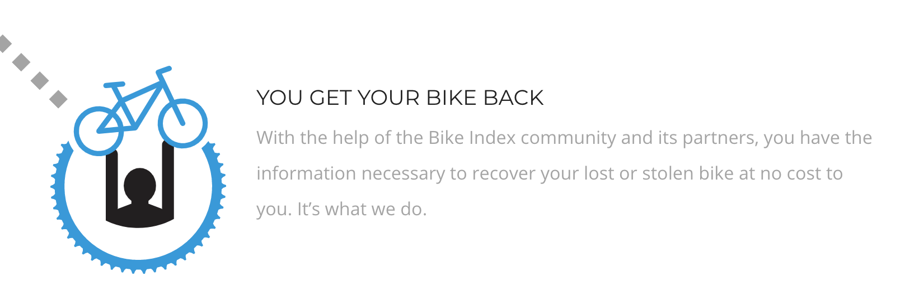
Real-World Data

Slide 8




Limitations of the BikeIndex Data
I only have location data for bikes that have been stolen.
Plugin Principle to generalize the trends from this dataset of samples to all of California
zipcode = sample
Difficult to acquire and clean

Slide 9

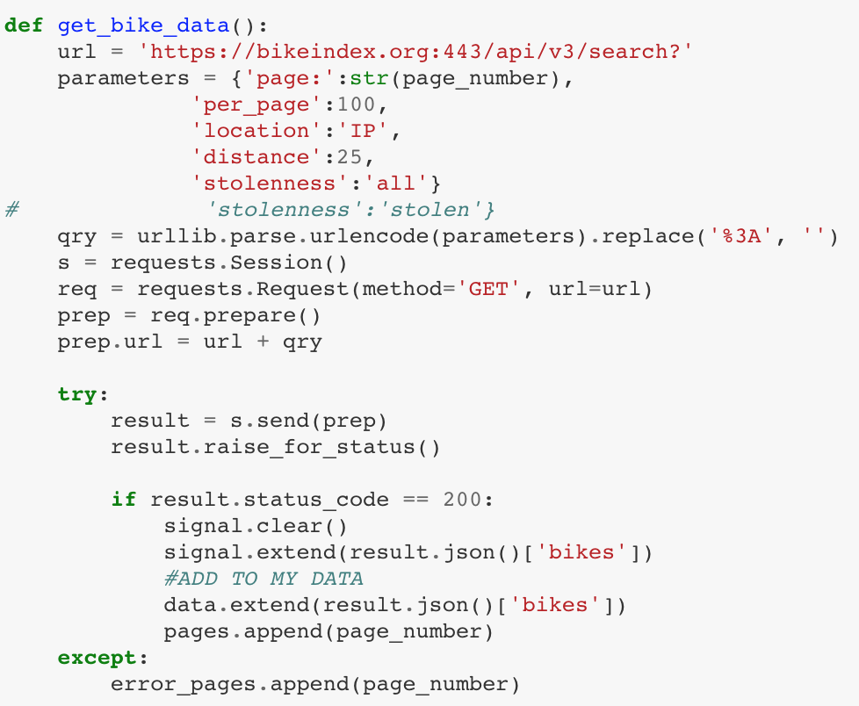


Accessing and Scraping the API

Slide 10
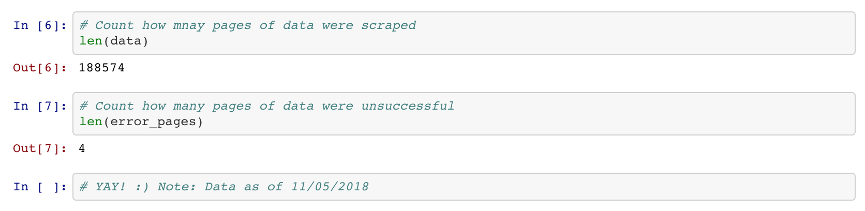
The first challenge: DONE

Slide 11



Demographics - Zipcodes
2016 tax return data
Average Income
Demographic/Race/Ethnicity
2016 5 year estmates DP05
Used Percentages
2010 Census
Total Population

Slide 12
Data Cleaning – Limitations
Limitation 1: I only have location data for bikes that have been stolen.
Limitation 2: Demographic data could not be found in all zipcodes and do not come from the same data source.
Stitched demographic data from 2010 and 2016

Slide 13
Data Cleaning – Assumptions/Limitations
Assumption 1: Knowing that my demographic data covers a span of 2010 - 2016, I will be generalizing those metrics to BikeIndex information from 2010 to 2018.
Assumption 2: I am using demographic data of areas proportioned by zipcodes to predict a theft rate.

Slide 14
Exploratory Data Analysis
Preliminary sense of the data
822 samples
87 features

Slide 15
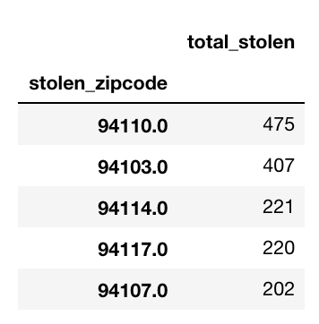
Exploratory Data Analysis
Interesting observation - Since 2010, the cities with the most bike theft in this dataset are in San Francisco:
94110 → Cesar Chavez and Mission Street, San Francisco, CA
94103 → 10th and Harisson, San Francisco, CA
94114 → Dolores Heights, 20th and Castro Street, San Francisco, CA
94117 → the Pandhandle, Fell St. and Masonic Ave, San Francisco, CA
94108 → Potrero Hill, Mariposa St. and Arkansas, San Francisco, CA

Slide 16
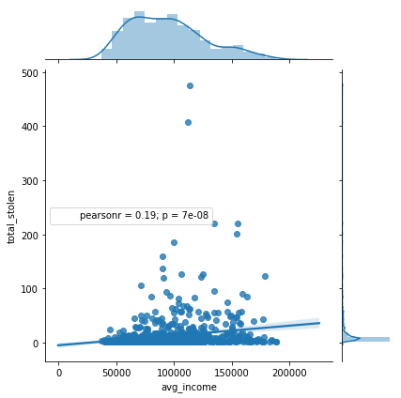
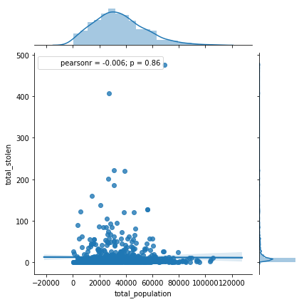
Exploratory Data Analysis
total stolen vs income
total stolen versus total population

Slide 17
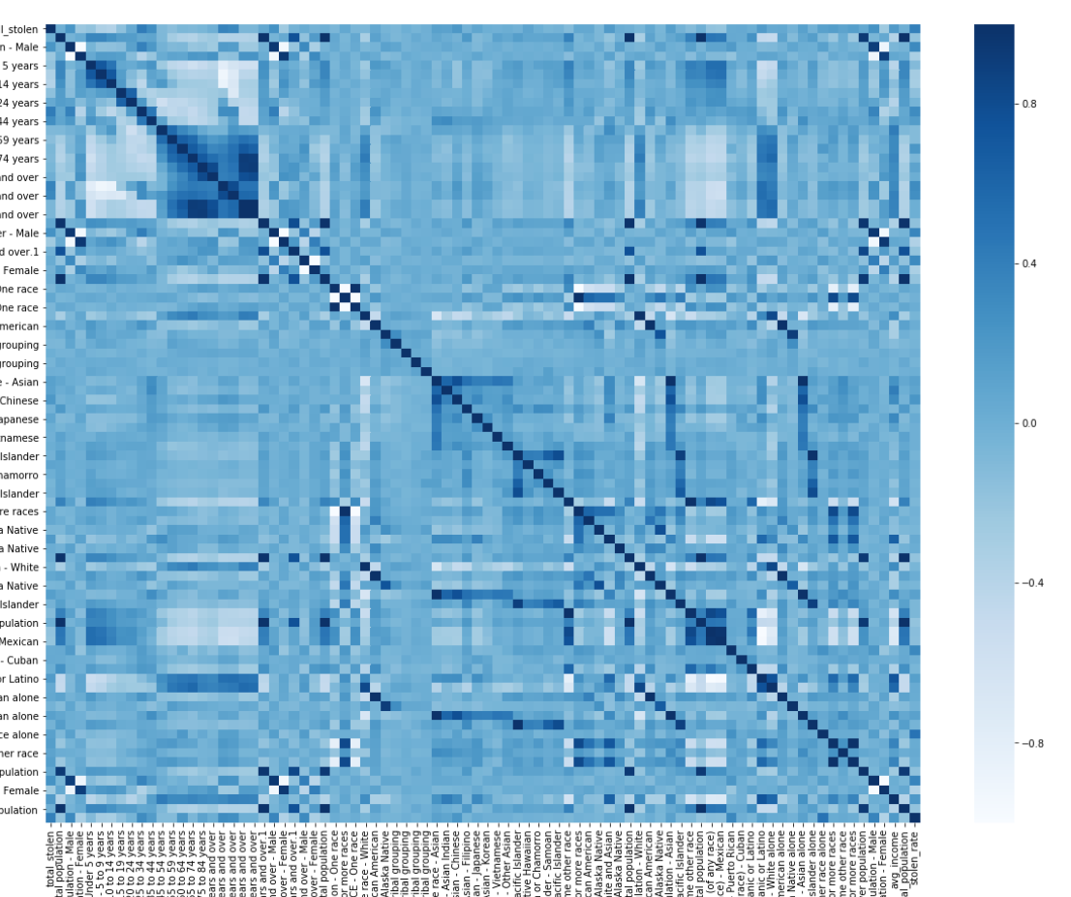
Exploratory Data Analysis
Too many variables for my heatmap

Slide 18
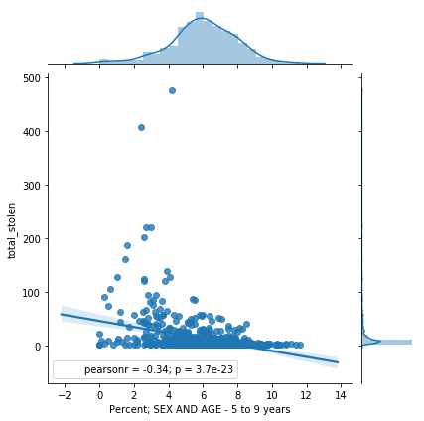
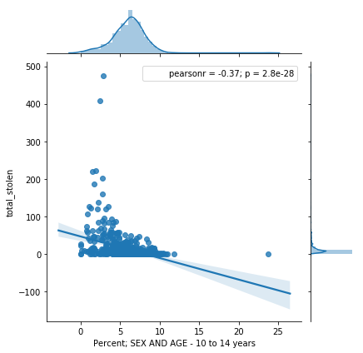
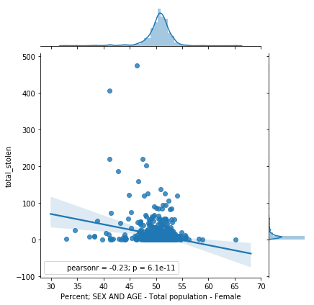
Exploratory Data Analysis
Top negative correlations

Slide 19
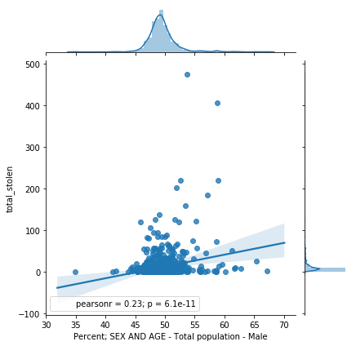
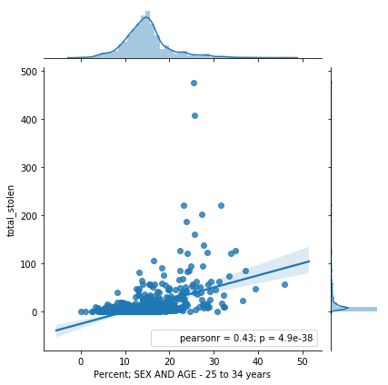
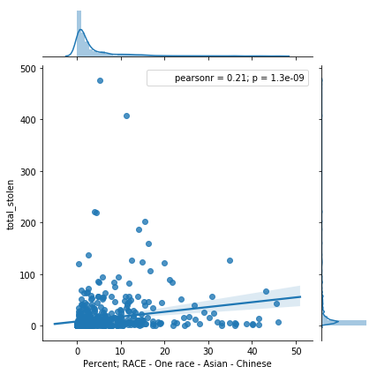
Exploratory Data Analysis
Top positive correlations

Slide 20
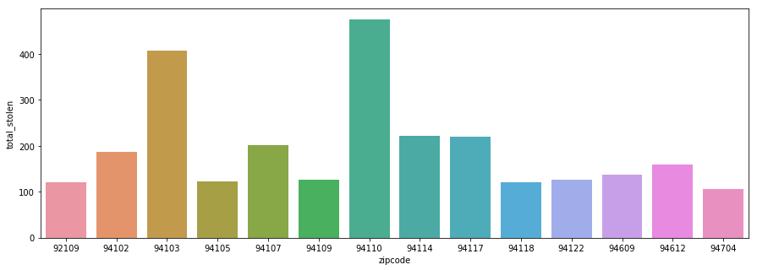
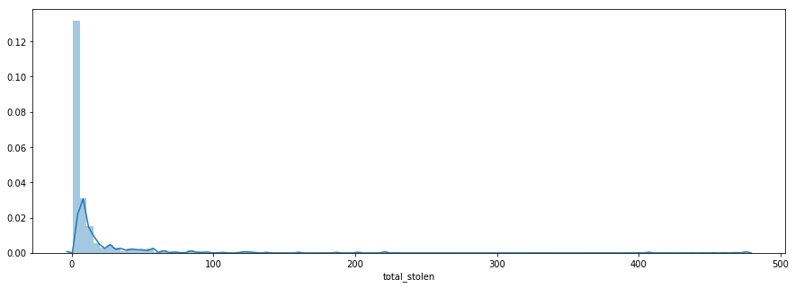
Exploratory Data Analysis
Notice my data is totally skewed

Slide 21
Predict
Random Forest Regressor
Random Forest Classifier

Slide 22
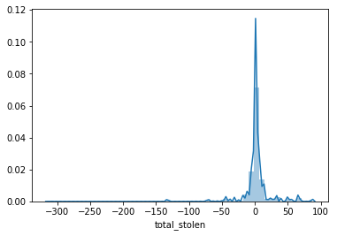
Random Forest Regressor
Model Score
Distribution of Errors
Variance | Mean: 12.05 STD: 31.87
Random Forest Train Score: | 0.9050799978897456
Random Forest Validation Score | -0.14173956820798828
Random Forest Train-Validation MAE: | 9.70971098265896
Notes:
Although the Train Score is quote good, the Validation Score has a bit to be desired. Looking at the mean and standard deviation of total bikes stolen, the variance is quite large which may explain the extreme error measures.
Looking at the distribution of the errors, there are outliers that are causing the validation score to be so poor.

Slide 23
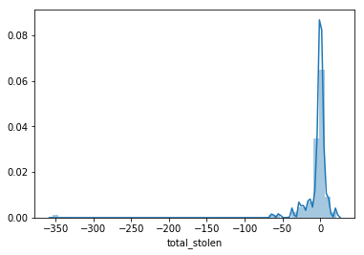
Random Forest Regressor - Log
Model Score
Distribution of Errors
Variance | Mean: 12.05 STD: 31.87
Random Forest Train Score: | 0.9310689831704924
Random Forest Validation Score | 0.655671736161114
Random Forest Train-Validation MAE: | 9.057139284534959

Slide 24
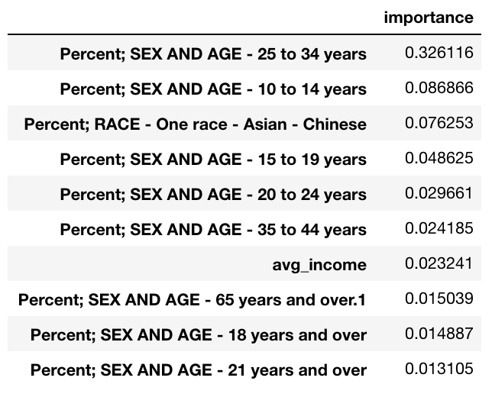
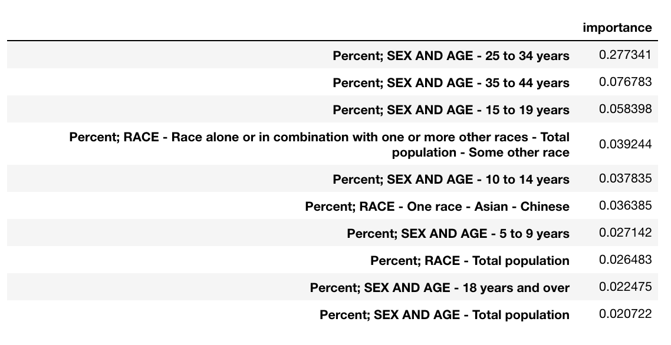
feature_importance
Random Forest
Random Forest - Log

Slide 25
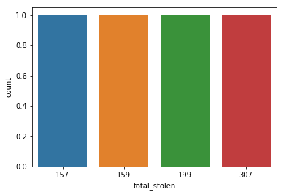
Random Forest Classifier
Stolen Total into bins
Frequency in each bin
Bin Label | Range
1 | 1 - 2 stolen
2 | 2 - 4 stolen
3 | 4 - 9 stolen
4 | 9 - 475 stolen
1 2 3 4

Slide 26
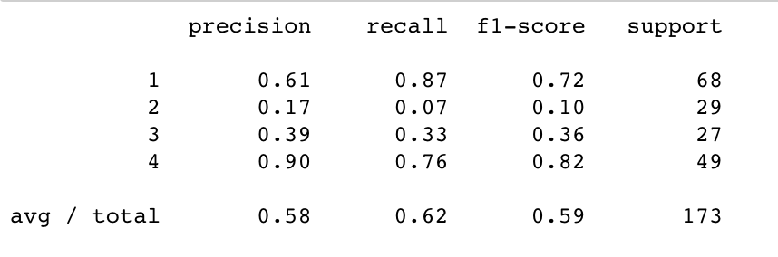
Random Forest Classifier
Model Score
Roc Auc Scores
Variance | Mean: 12.05 STD: 31.87
Random Forest Train Score: | 1.0
Random Forest Validation Score | 0.6184971098265896
Random Forest Train-Validation MAE: | 0.5722543352601156

Slide 27
Random Forest Classifier
Model Score
Roc Auc Scores
Variance | Mean: 12.05 STD: 31.87
Random Forest Train Score: | 1.0
Random Forest Validation Score | 0.6184971098265896
Random Forest Train-Validation MAE: | 0.5722543352601156

Slide 28
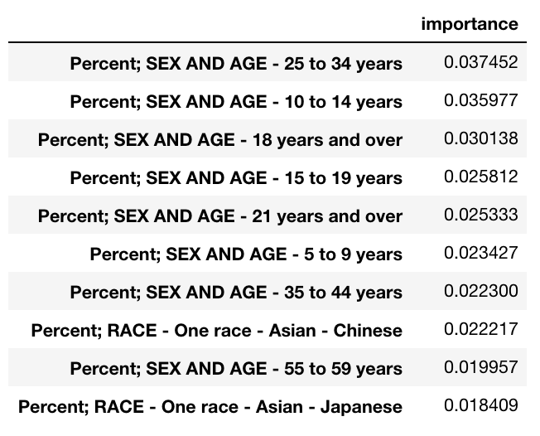
feature_importance

Slide 29
Next Steps
Extreme scenarios –
High theft (bin 4 - 475+ thefts)
Low theft (bin 1 - 1 theft.)
Outliers!!
How do I deal with these outliers?
Classify zipcodes with high theft versus low theft more clearly and predict within these two classifiers
Predict number of stolen bikes in High Theft areas
Predict number of stolen bikes in Low Theft areas

Slide 30
What I learned
Git/source control
Python/Libraries
Scrape an API
Handle API errors
Use python to do maths:
Average Income from Tax Statements
Total bikes stolen in time frame
Merge DataFrames
Random Forests
Linear Regression Models
When to stop....

Slide 31
"...sometimes research doesn’t turn out the way you want it to. but you still did the work and are still learning..." ~ Alex Lin

Slide 32
Liz Chan
chanwinyee@gmail.com
Github: https://github.com/chanwinyee/
LinkedIn: https://www.linkedin.com/in/chanwinyee/

