Slide 1
Food Delivery System
Implementation of the a contract net protocol

Slide 2
Goal
Implement an autonomous food delivery system
Restaurant, Clients, Delivery Boys, Broker
Contract net protocol
Request -> bids -> winner
Combine the Pddl language and a MultiAgent System framework
Pddl (Planning Domain Definition Language): standard language for planning tasks
MultiAgent System: set of agent, which interact in an environment

Slide 3
Implementation: Domain in Pddl
Predicates:
restaurant
waiting
has-food
ready-at-food
(me/not-me)
delivery boy
with food
free
at
food
client
served
location
next-to
r1
pizza
c1
b1
r2
pizza
r3
sushi
c2

Slide 4
Implementation: Domain in Pddl
Actions:
Action | Precondition list | Delete list | Add list
prepare-food(r, f) | restaurant(r), food(f), me(r), waiting(r), has-food(r, f) | waiting(r), | ready-at-food(r, f)
go-to(b, dep, dest) | delivery_boy (b), location (dep), location (dest), at (dep, b), next_to (dep, dest) | at (dep, b) | at (dest, b)
pickup-food(b, f, r) | delivery_boy (b), food (f), restaurant (r), at (r, b), free (b), ready_at_food (r, f) | free (b), ready_at_food (r, f) | waiting(r), with-food(b, f)
deliver-food(b, f, c) | delivery_boy (b), food (f), client (c), not (free ?b), at (c, b), with_food (b, f) | with_food (b, f) | free (b), served (c, f)

Slide 5
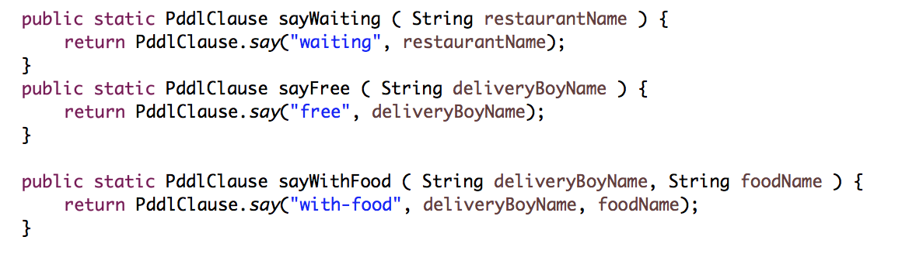
Implementation: Domain in Java
Clauses -> Predicates
same name as in Pddl

Slide 6
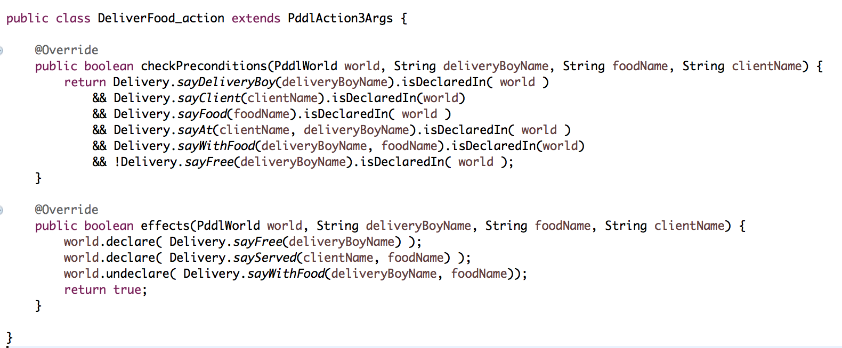
Implementation: Domain in Java
Actions
parameters
preconditions
effects

Slide 7
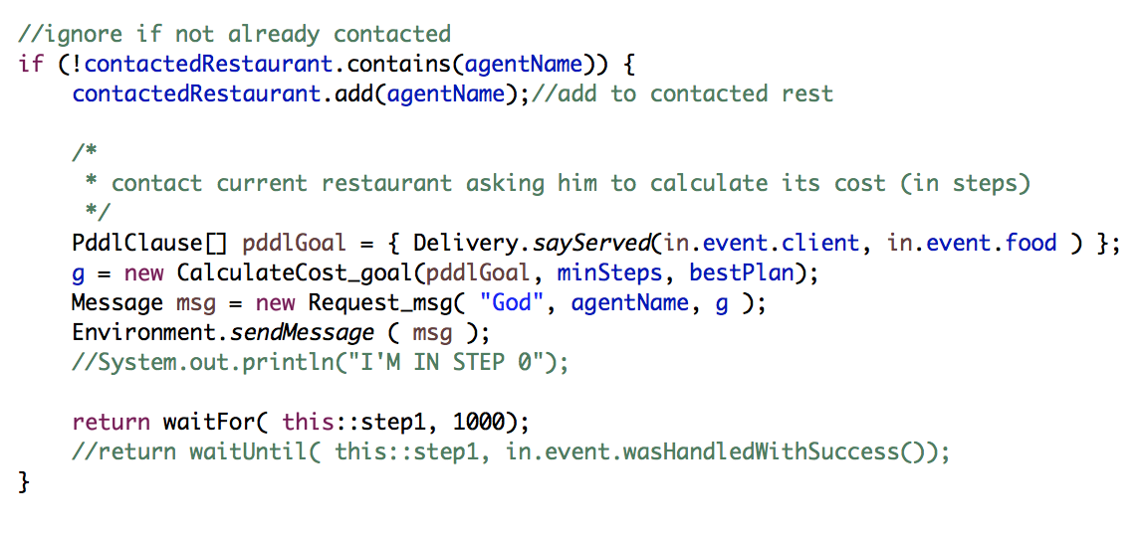
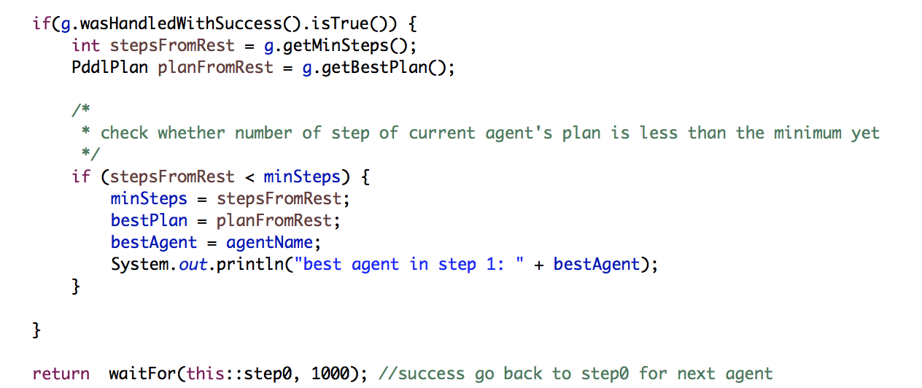
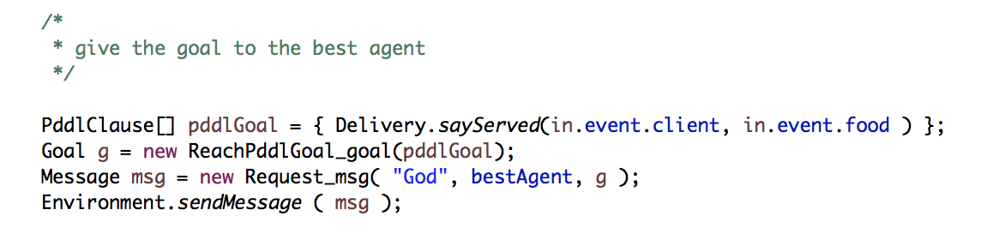
Implementation: Contract Net
RequestPddlCost_msg/RequestPddlCost_intention (broker)
process response of each
restaurant, selecting the
best one
give the goal to the restaurant,
so he can calculate its cost
give the goal the be actually executed

Slide 8
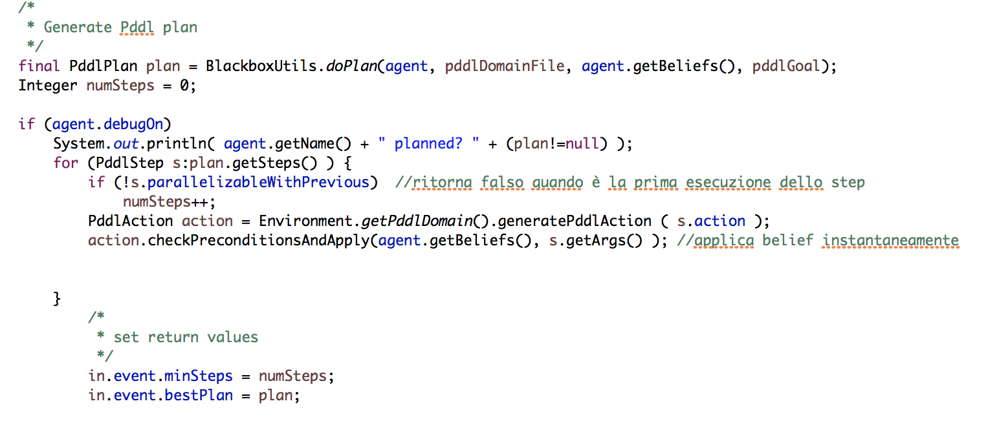
Implementation: Contract Net
CalculateCost_goal/CalculateCost_intention (restaurants)
ReachPddlGoal without executing the plan. Gets number of steps (assumption: that is the cost of time)

Slide 9
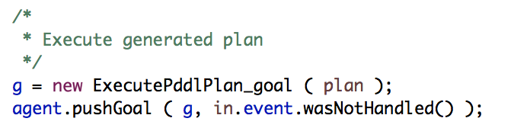
Implementation: Contract Net
ReachPddlGoal_goal/ReachPddlGoal_intention (restaurants)
similar to CalculateCost, additionally has a call to execute the plan
execute the plan on the world
changing the environment

Slide 10
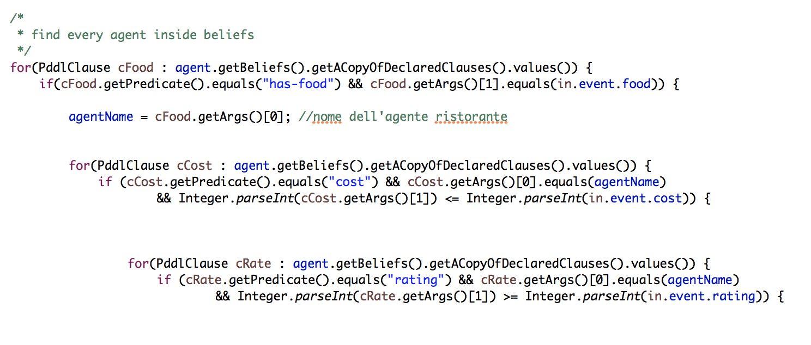
Optimizing Efficiency
reduce number of requests
broker has knowledge of the restaurants, so filters out those which cannot reach the goal
reduces time

Slide 11
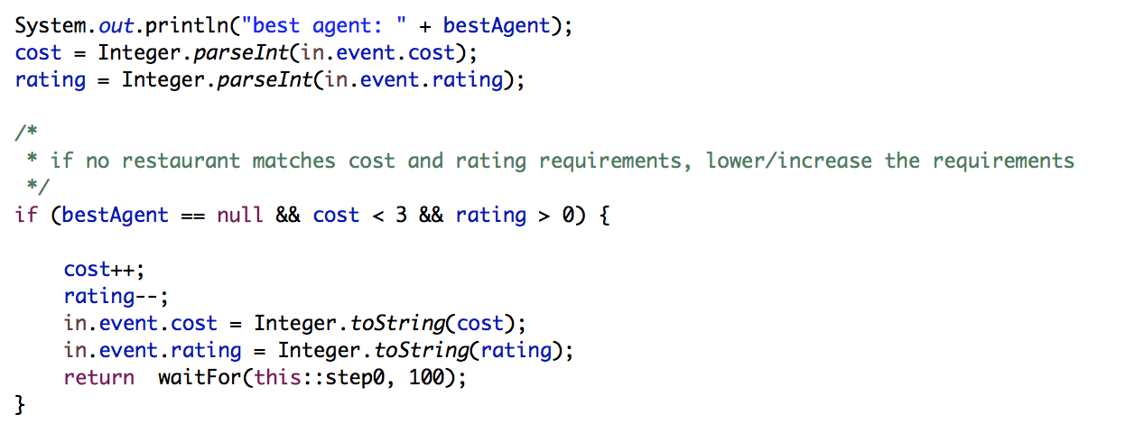
Handling Conflict
Consecutive requests (delay between one and another)
restaurant and delivery boys can deal with only one request at the time
-> so a delay between messages to the broker was added
Requirements for cost and rating not found
client gets the closest
to what he required

Slide 12
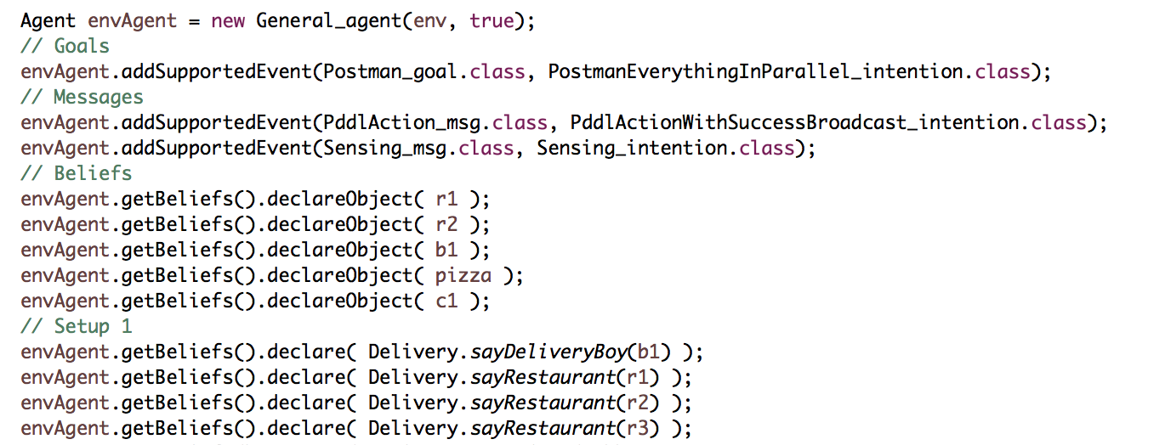
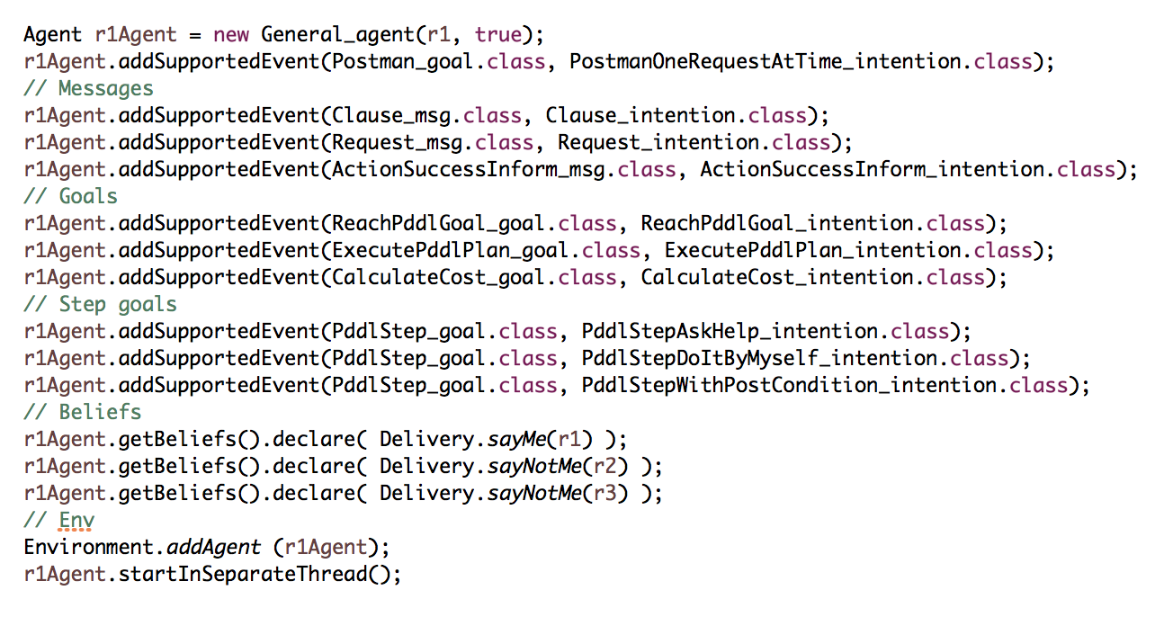
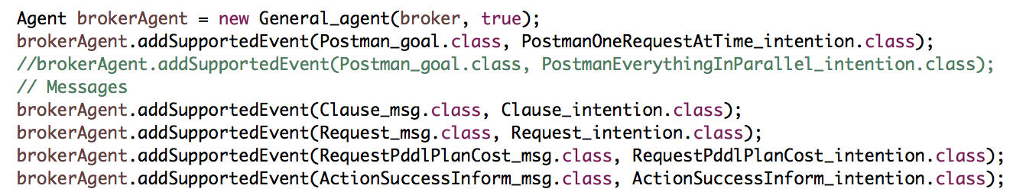
Example 1 – one request
Setting the Environment Agent
Setting the Restaurant Agent
Setting the Broker
Sending message to Environment about client request

Slide 13
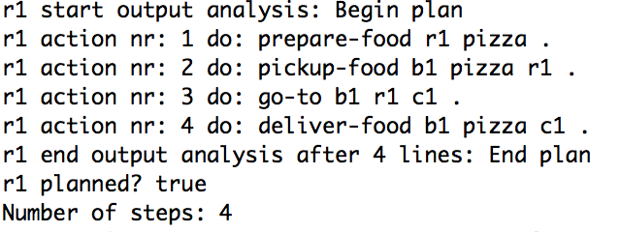
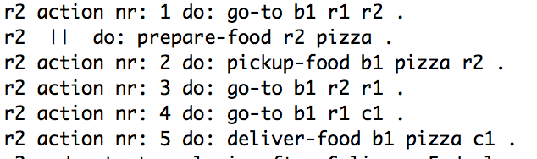
- starts the contract net protocol
- r1 calculating number of steps (winner)
- r2 calculating number of steps (loser)
- gives the goal to winner
- goal achieved

Slide 14
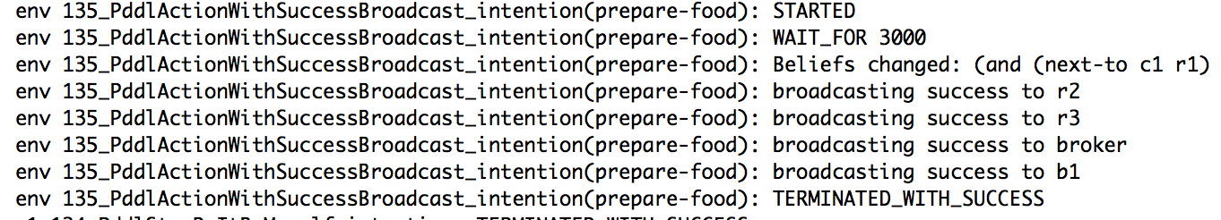
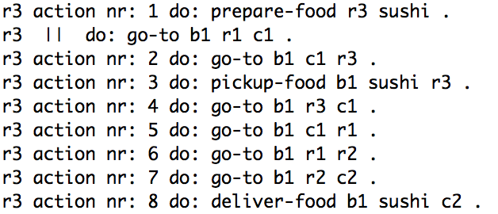
Example 2 - Multiple Requests
served (c1 pizza 2 1)
same as before, additionally a broadcast message to change every agent’s beliefs, for each action taken. Needed to update position of Delivery Boy
consecutively served (c2 sushi 2 2)
this time only r3 is asked to provide its cost,
as he is the only one serving sushi

Slide 15
Limitations
Sleep time between requests to the broker:
restaurants can handle one request at a time
beliefs might change
System can handle one request at the time

Slide 16
Conclusion
Introduce more requirements to ensure picking the best choice:
previously ordered
Extending the domain to have more control over the environment:
to handle more request

