Slide 1


Language Classifier for Tweets
ISYE 7406 Project
Group 40
Tianjin Ji
Notes:
Hello everyone, my name is Tianjin. Today I will introduce a project that uses machine learning to build a language classifier that classifies if a given tweet is English or not.
Twitter imager comes from Twitter.com

Slide 2
Introduction
Large amount of unorganized data generated on social media sites such as Twitter
A universal language classifier could help us understand analyze text data effectively
It can also be used to identify spam, send automatic messages and for ads recommendation
People prefer to read and write in a language they understand
we will analyze if a given tweet is English or not
Classification methods
KNN
SVM
Logistic Regression
Random forest
Gradient boosting
Notes:
The challenge of natural language processing includes unorganized giant amount of text data on social media sites such as Twitter.
A language classifier could be the first step to help us understand the meaning of messy tweets so we can effectively analyze these data.
After we understand the content of the tweets, we can use them to identify spam, send automatic messages and for ads recommendation.
Another advantage of building a language classifier is that people prefer to read and write in a language they understand.
In this project, we work with a pre-annotated small dataset to determine if a given tweet is English or not.
We will use KNN, SVM, Logistic Regression, Random forest and Gradient boosting for classification

Slide 3
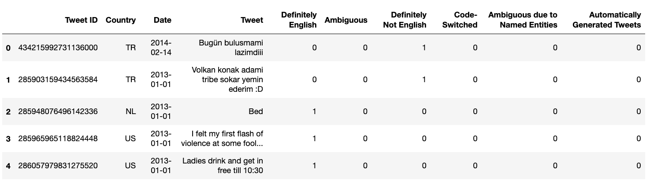
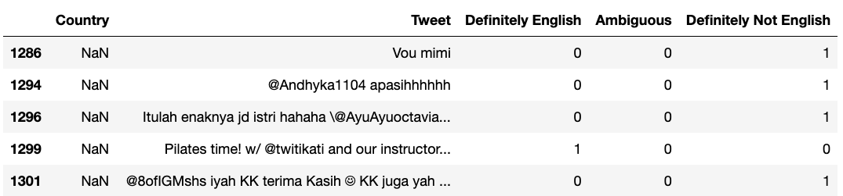
Data and preprocessing
Data: The UMass Global English on Twitter Dataset on Kaggle (10,502 tweets from 130 countries)
This dataset is pre-annotated by researchers¹
Extract useful columns
Remove nan rows(10 rows)
Combine response variable y into one column ( 1 ~ 'Definitely English’ , 2~ 'Ambiguous’, 0~ 'Definitely Not English’)
Encode Country into numerical value using LabelEncoder()
1. [A Dataset and Classifier for Recognizing Social Media English](https://aclanthology.org/W17-4408) (Blodgett et al., WNUT 2017)
Notes:
Large Twitter dataset can be easily retrieved from Twitter API – developer account
For simplicity purpose, we will use the Umass Global English on Twitter Dataset on Kaggle. The advantage of this dataset is that it’s already annotated by Blodget et al. It has 10,502 tweets from 130 countries
The useful columns for our analysis are show in the red circles, which include the response variable: Definitely English, Ambiguous, Definitely not English, and the predicting variables, Country and Tweet. We will perform feature extraction on these text strings later.
For data preprocessing, We first remove nan rows since there are only 10 of them. We don’t study other columns for this project because there are few data points.
We then combine response variable y into one column ( 1 ~ 'Definitely English’ , 2~ 'Ambiguous’, 0~ 'Definitely Not English’) for easier model fitting and prediction since these categories are mutually exclusive.
Lastly we Encode Country into numerical value using LabelEncoder(), this feature is scaled later before dimension reduction and model fitting

Slide 4
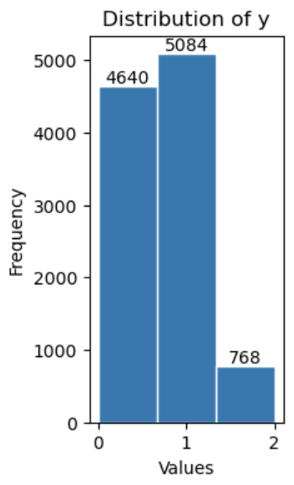
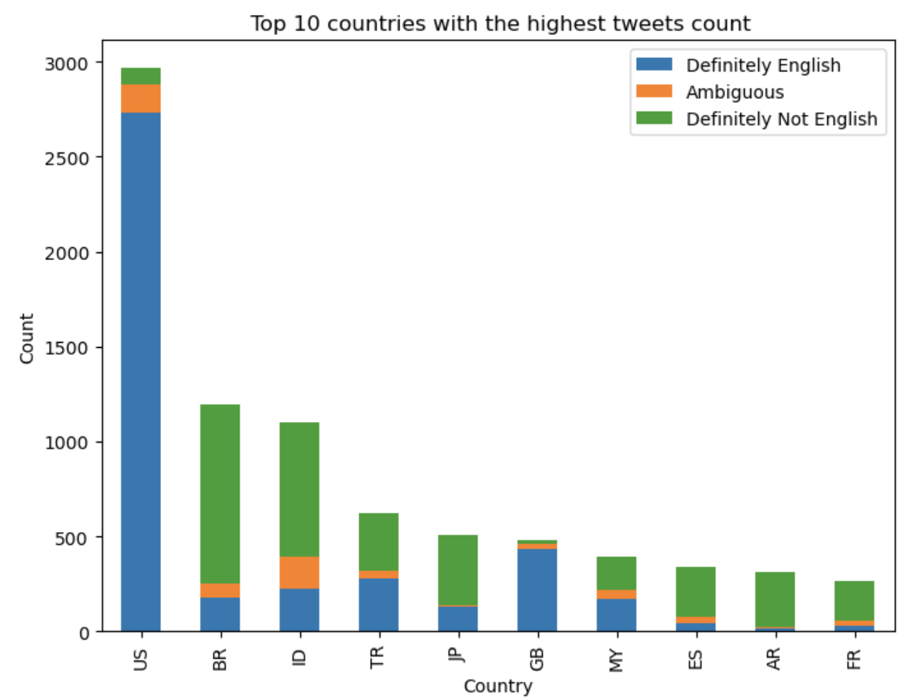
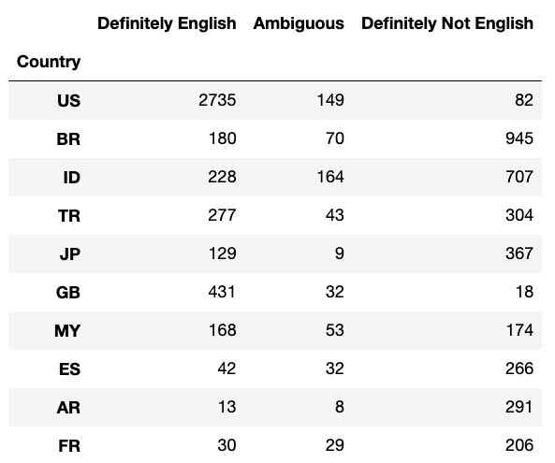
Exploratory Data Analysis
Notes:
For EDA, we first plot the distribution of the response variable, which shows that less than slightly half of the tweets are Definitely not English and around half of the tweets are Definitely English
The Ambiguous category only has around 7% of the data.
Because the dataset consists of130 countries, we plot the top 10 countries with the highest tweets count, shown also in the summary table on the right. The top country is the United States, with nearly all tweet classified as Definitely English.
Britain has lots of Tweets that are not English and other non-English speaking countries such as Japan has majority of tweets that are not English.
The ambiguous group has tweets that are not in English-speaking countries, making it hard to interpret.

Slide 5
Methodology
Training test Split (80/20):
8393 rows(training),
2099 rows(testing)
Feature extraction
Feature selection/dimension reduction
Model fitting
Use GridSearchCV from sklearn to find the best parameter
Fit the model with optimal parameter and compare performance for testing data
Notes:
To analyze the data, we first split the data into 80/20 split, resulting in 8393 training data points and 2099 testing data points.
We then perform feature extraction on the tweets text data. Since this results in over 16,000 dimensions, we perform feature selection/dimension reduction use SVD(singular value decomposition)
We then fit the selected features into our classification models and use cross validation to find the best parameter.
To evaluate model performance, we fit the model with optimal parameter and compare performance for testing data.
Because high-dimension data processing takes a long time, including dimension reduction, model fitting and tuning, we are not performing Monte Carlo CV on the testing dataset to obtain the average accuracy rate for the models due to limitation of computational power. The other reason is that we have 2099 for a testing dataset, which is not small. Not performing Monte Carlo CV should not impact the final result very much..

Slide 6
feature extraction
Python sklearn package: TfidfVectorizer
TfidfVectorizer(sublinear_tf=True, analyzer='char', ngram_range=(1, 2))
Frequency for 1 word or 2-word phrase
Stored in a sparse matrix
Over 16,000 features now
Notes:
We will use TfidfVectorizer from sklearn to perform feature extraction.
We set ngram_range=(1, 2) to obtain the frequency for 1 word or 2-word phrase, stored in a sparse matrix. This result in over 16,000 features now
This parameter is selected because it’s the most frequently used in NLP. If we expand the ngram range , we will have a much larger features to perform any further analysis. Since we are limited by our computational power, we choose the ngram_range to be (1,2)

Slide 7
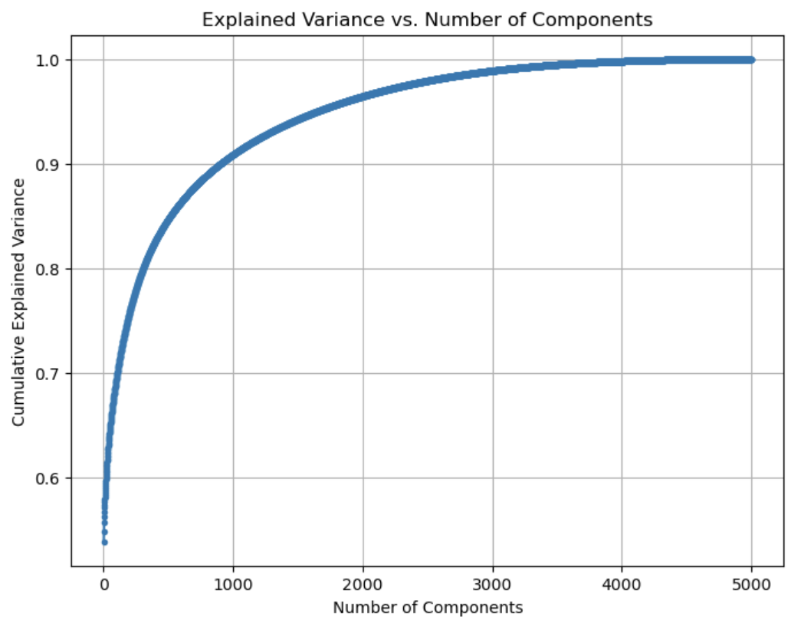
Dimension Reduction
We need feature selection: 16,329 columns after feature extraction!
SVD (singular value decomposition) for sparse matrix¹
TruncatedSVD(n_components=5000)
Cumulative explained variance plot
99% around 3000 components (more than 80% features reduced!)
Need to transform both training and testing data to fit models
1. https://machinelearningmastery.com/singular-value-decomposition-for-dimensionality-reduction-in-python/#:~:text=SVD%20is%20typically%20used%20on,to%20use%20the%20PCA%20method.
Notes:
We need to perform dimension reduction since we have too many features, over 16,000
For sparse matrix, we use SVD(singular value decomposition) for feature selection, this is shown in Python as TruncatedSVD(n_components=5000), as we set the max_component to be 5,000. This process is very time consuming and takes a while to run.
We plot the cumulative explained variance plot, which is shown the right
The plot shows that 99% of the cumulative variance is around 3,000 components
We have successfully reduced 80% of the features
After feature selection, we need to transform both training and testing data to fit models.

Slide 8
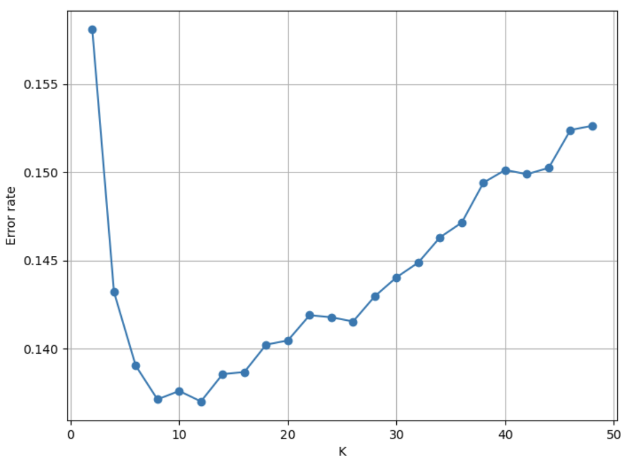
KNN
Computational time: very fast (around 0.1-0.2 sec!)
Use the elbow method to find optimal K
20-fold CV result: optimal K = 12
Dimension reduction/feature selection reduces computational time.
Notes:
We then start to fit the training data into different models.
For KNN, we have very fast computational time per run of the model, around 0.1-0.2 sec. This is probably because it’s a non-parametric model.
Using the elbow method with 20-fold CV, we find that the optimal K is equal to 12, as shown in the figure
The dimension reduction has definitely saves us some computational time!

Slide 9
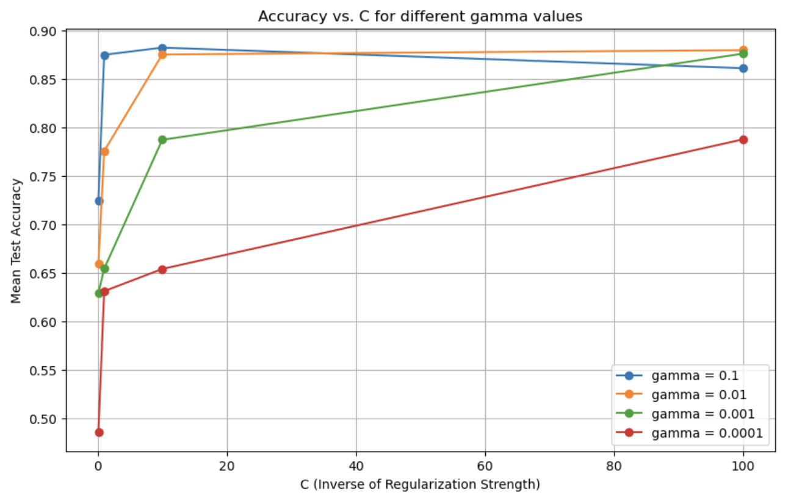
SVM
Long computational time for high-dimension data ~ 1-2 min
“rbf” kernel: similar to Gaussian
C: inverse of L2 regularization strength (smaller C – high regularization, larger margin and less likely to overfit)
Gamma: how far the influence of the points( High gamma, nearby points; Low gamma, faraway points)
10-fold CV result: C = 10, gamma = 0.1
Notes:
Next, we fit support vector machine model. The computational time for SVM is much greater than KNN, around 1-2 per run depends on different parameter selection
We use the rbf kernel for SVM, which is similar to the Gaussian distribution
We then tune the parameter C and gamma.
C is the inverse of L2 regularization strength , smaller C means high regularization, larger margin between boundaries and less likely to overfit
Gamma controls how far the influence of the data points: High gamma means nearby points have more influence over the decision boundary; Low gamma means faraway points have more influence over the decision boundary
The figure on the right shows the 10-fold CV results, with the optimal C of 10 and gamma of 0.1

Slide 10
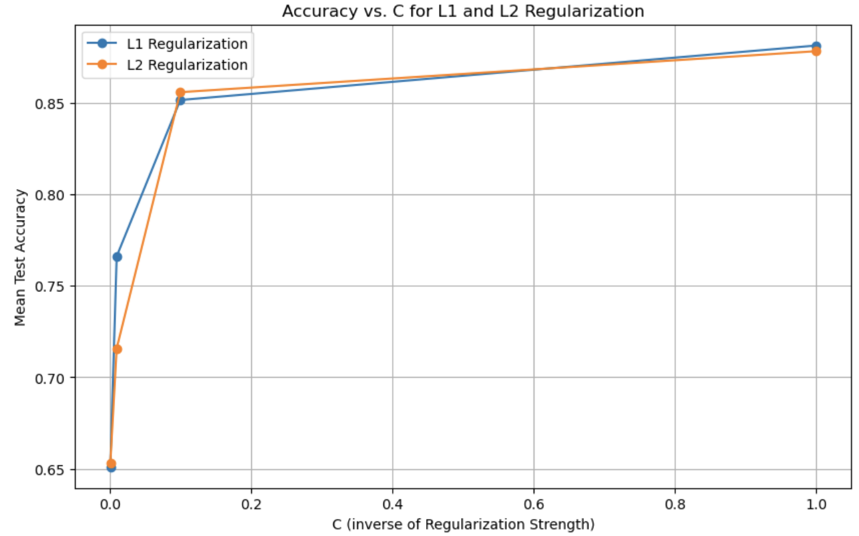

Logistic Regression
Faster computation time( 5 to 40 secs)
Use “saga” solver to tune L1 or L2 penalty
Tune C: inverse of Regularization Strength (similar as SVM)
20-fold CV result: L1 regularization with C = 1
Very large C (C$≥$10) the solver has problem converging: limited computational power
Notes:
Next, we fit the logistic regression to the data. It has faster computational time than SVM. Depends on the choice of parameters, each run take around 5 to 40 secs
We use the saga solver to tune L1 or L2 penalty.
We also tune C, which is the inverse of Regularization Strength, similar as SVM
The 20-fold CV result is on the right. The plot shows that the mean test accuracy differs every little when C>=0.1 with either L1 or L2 regularization. L1 is similar to LASSO, which performs feature selection and L2 is similar to ridge, which shrinks the coefficients but does not force them to be zero.
The plot shows that the optimal parameter is L1 regularization with C = 1, which corroborate that L1 performs better with sparse matrix.
We encounter some computation difficulty with convergence for the sage solver for C>=10 so our CV tuned C from 0-1

Slide 11
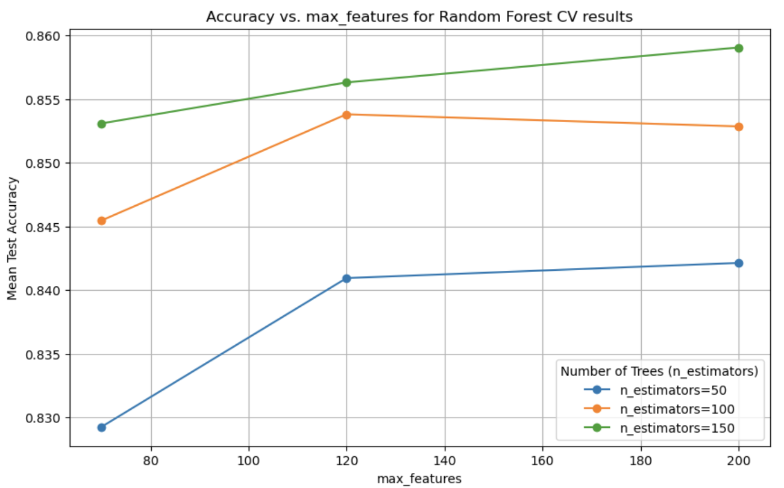
Random Forest
Computation time is long for when number of tree(n_estimators) is large
Computation time varies between 15 seconds and around 2min depends on parameters
Set min_samples_leaf = 20 to prevent overfitting
max_features: number of features to consider when looking for the best split¹
n_estimators: number of trees in the random forest¹
10-fold CV result: n_estimators = 150, max_features = 200
1. https://scikit-learn.org/stable/modules/generated/sklearn.ensemble.RandomForestClassifier.html
Notes:
Next, we start to fit two ensemble methods.
First, we fit the random forest model to the training dataset. The Computation time varies between 15 seconds and around 2min , mainly depends on the n_estimators, which is the number of trees in the forest
We also set the minimum leaf size to be 20 to prevent overfitting
We tune two parameters for 10-fold CV: max_features, which represents number of features to consider when looking for the best split and n_estimators
The figure on the right shows the CV result. In general, we get a higher accuracy rate with larger number of estimators, with higher running time.
The 10-fold CV result shows that the optimal parameter is with n_estimators = 150 and max_features = 200

Slide 12
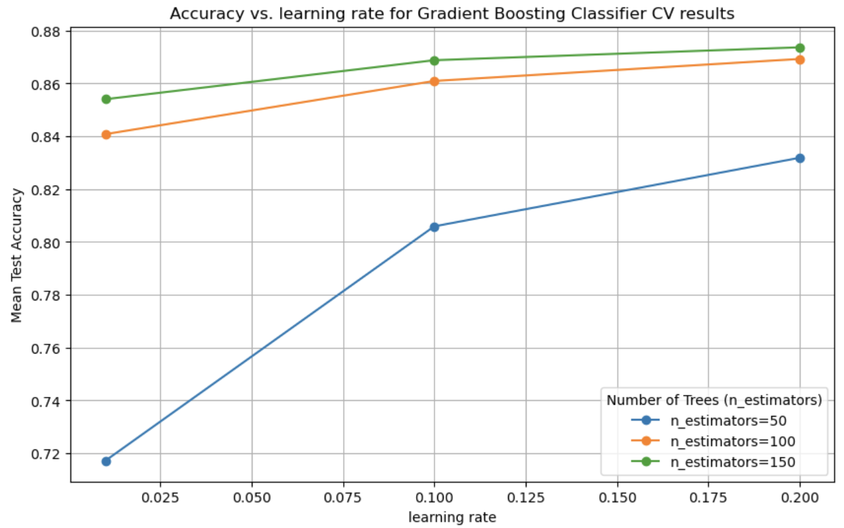
Gradient Boosting
Computational time: slightly longer than random forest
Ensemble method using gradient boosting
Additive model using forward stages¹
N classes regression trees are fit on the negative gradient of the loss function for each stage¹
For 10-fold CV, max_features=100,min_samples_leaf = 20 to save computational time
Tune n_estimators and learning_rate
Optimal parameters: n_estimator = 150, learning_rate = 0.2
1.https://scikit-learn.org/stable/modules/generated/sklearn.ensemble.GradientBoostingClassifier.html
Notes:
For the second ensemble method, we choose to use the gradient boosting classifier with sklearn. This algorithm runs slightly longer than the random forest.
This ensemble method uses gradient boosting algorithm that uses additive model using forward stages. N classes regression trees are fit on the negative gradient of the loss function for each stage to perform boosting.
For 10-fold CV, we set max_features=100,min_samples_leaf = 20 to save computational time. We tune n_estimators and learning_rate and the result is shown in the figure on the right.
From the figure, we can see that the optimal parameter that gives the highest mean test accuracy is n_estimator = 150, learning_rate = 0.2. Please note that as n_estimator becomes larger, the running time is also longer. The figure also shows that there is not much significant difference when learning rate is 0.2 with n_estimators of 100 and 150

Slide 13
Results
Accuracy on test data: SVM and Logistic Regression performs the best!
computational time: KNN and Logistic regression much faster than the rest
Slowest model: SVM, not good for high-dimensional data
 | KNN | SVM | Logistic Regression | Random Forest | Gradient Boosting
Testing Accuracy | 0.85 | 0.88 | 0.88 | 0.85 | 0.86
Notes:
This table shows testing accuracy for the five model. We can see from the table that SVM and Logistic Regression performs the best with the highest accuracy. With regards to computational time , KNN runs fastest and logistic regression also runs very fast. Although SVM has good test accuracy, it runs so slow and might not work well for high-dimensional data

Slide 14
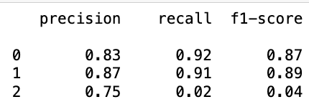
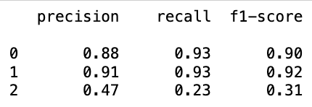
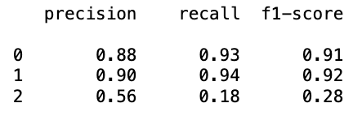
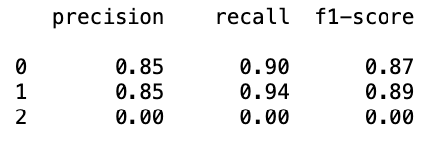
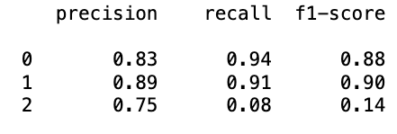
Results
The “Ambiguous” group: much lower precision, recall and f1-score
SVM and logistic regression: better performance for the “Ambiguous group”
Random Forest fails to predict the “Ambiguous group”
KNN result
SVM result
Logistic Regression result
Random Forest result
Gradient Boosting result
Notes:
I have also generated the confusion matrix for the three categories and compute the precision, recall and f-1 score.
As we can see from these result tables, category 2, which represents the “Ambiguous” group has the lowest score for precision, recall and f1-score. For the 0(“Definitely not English”) and 1(Definitely English”) categories, the five models generate much better predictions than “Ambiguous” group. One thing to note is that SVM and Logistic regression has generated better metrics for precision, recall and f1-score especially for the Ambiguous group, as well as slightly better predictions for the other two groups.
Random Forest fails to predict the “Ambiguous group”, resulting in 0 for the metrics. This is probably because fewer data belong to this group and the majority vote makes the classification go to the other two category. On the other hand, gradient boosting generates some prediction for the ambiguous group, so it’s an improvement of the random forest model.

Slide 15

Applications for business
Good predictions for ”definitely English” and “definitely not English” group, poor prediction for “Ambiguous” group
Understand and interpret social media data
Require human judgement for classification of “Ambiguous”
Cater to consumer needs based on language they speak
Recommend goods and services more naturally
Help identify spam and phishing acts
Help identify trends among different ethics group
Notes:
Our models show Good predictions(around 90% accuracy rate) for ”definitely English” and “definitely not English” group, poor prediction for “Ambiguous” group.
This language classifier could be the first step in understanding and interpreting social media data.
It also shows that machine learning isn’t about fitting various models, we need human judgment in correctly classification the “Ambiguous” group.
The application for this language classifier include building app that helps brand promote products using the language consumers speak and understand.
Some of the ambiguous group classification could lead to identification of spam and phishing acts on social media websites.
Because language is associated with cultural context, language classifier with different popular language filter could help identify trends among different ethics group

Slide 16


Limitation and future work
High-dimensional data issues
Non-parametric models(KNN) has computational advantage
Better feature selection for NLP (e.g. Pytorch supports multiple language extractions)
Sklearn has limited computational power for large dataset
Other machine learning models(neuron networks) from Pytorch or TensorFlow
Annotation for millions of tweets could be costly (human review is necessary to prevent junk in – junk out!)
Need further analysis for the “Ambiguous” group
Extend to a multi-language classifier
Notes:
Our work is mainly limited by the computational power and it brings up challenges for proper processing and analysis for high-dimensional data.
Perhaps future work could include further study of Non-parametric models such as KNN because it has computational advantage
We could also try to explore better feature selection methods for NLP (e.g. Pytorch supports multiple language extractions) for multi-language classifier
Since Sklearn has limited computational power for large dataset, we can explore other machine learning models(neuron networks) from Pytorch or TensorFlow to compare the performance of other models.
The potential challenge when processing large quantity of social media data is Annotation for millions of tweets could be costly (human review is necessary to prevent junk in – junk out!)
In order to improve our predictions, future work could involve further analysis for the characteristic of “Ambiguous” group
Lastly, we can extend this simple English language classifier to a multi-language classifier to help business interpret meaning of tweets

