Slide 1
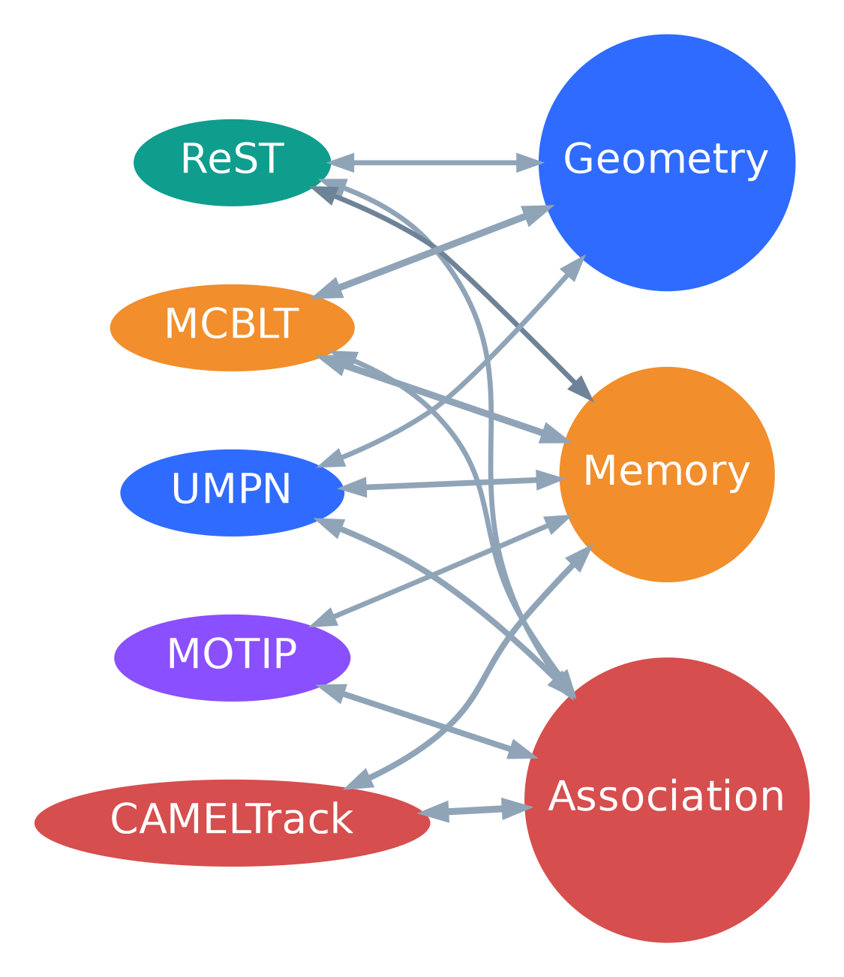
MTMC papers review
From reconfigurable graphs to BEV long-term tracking
Goal: extract what matters for a production-quality multi-target multi-camera system
5 papers • 3 direct MTMC • 2 association lessons
ReST • MCBLT • One Graph / UMPN • CAMELTrack • MOTIP
Direct MTMC papers in focus; CAMELTrack and MOTIP are included to borrow stronger association ideas.
Primary sources: Cheng et al. 2023; Wang et al. 2025; Engilberge et al. 2025; Somers et al. 2025; Gao et al. 2024
1
Notes:
[Sources] - ReST - A Reconfigurable Spatial-Temporal Graph Model for Multi-Camera Multi-Object Tracking.pdf, pp. 1-12. - MCBLT - Multi-Camera Multi-Object 3D Tracking in Long Videos.pdf, pp. 1-13. - One Graph to Track Them All - Dynamic GNNs for Single and Multi-View Tracking.pdf, pp. 1-21. - CAMELTrack - Context-Aware Multi-cue ExpLoitation for Online Multi-Object Tracking.pdf, pp. 1-9, 13-21. - Multiple Object Tracking as ID Prediction.pdf, pp. 1-8.

Slide 2
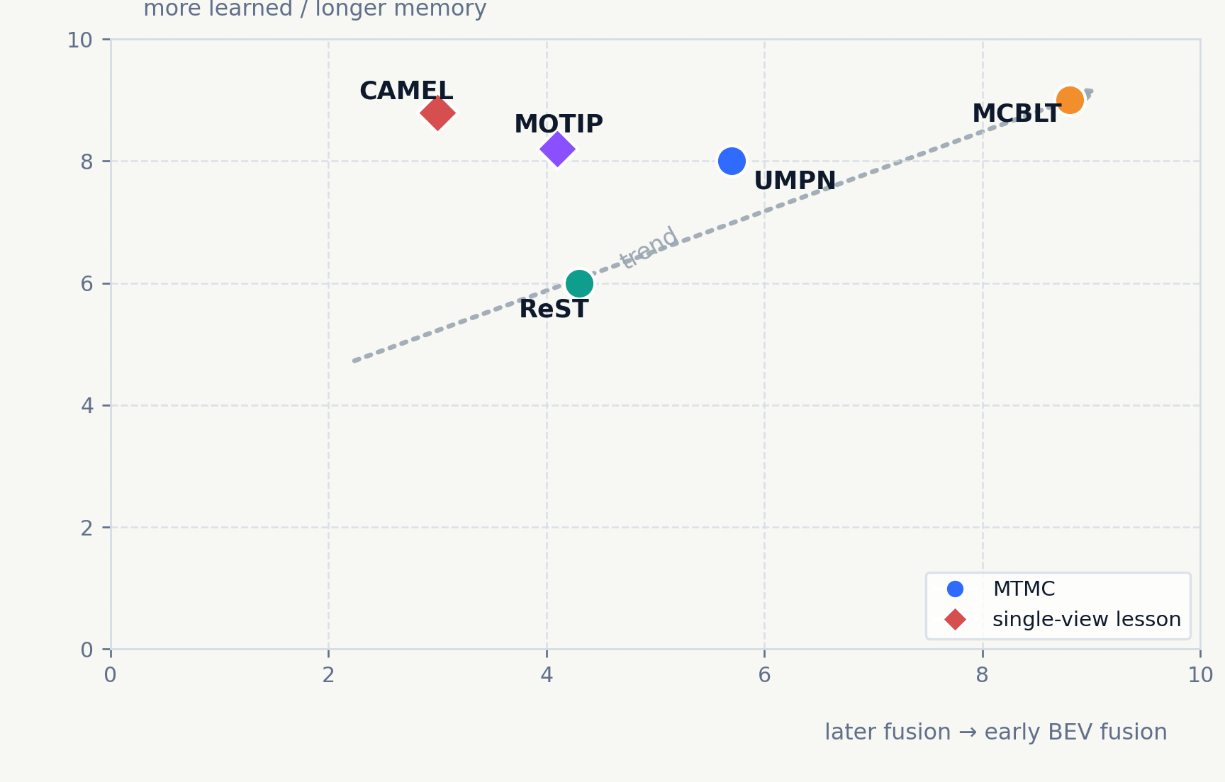
1
Executive synthesis
The biggest MTMC gains come from geometry + memory; the next portable gain comes from learned association.
• ReST proves that splitting the problem into same-time cross-view linking and across-time linking repairs fragmented tracklets with very little compute.
• MCBLT gets the largest quality jump by fusing views earlier: detect in BEV, attach cleaner 2D appearance, then add a global long-term block.
• UMPN shows a single dynamic graph can cover both single- and multi-view tracking; scene priors help hardest sites.
• CAMELTrack and MOTIP suggest the next MTMC upgrade is not another handcrafted matcher, but a learned association layer over modular cues.
Synthesis: if cameras are calibrated, invest first in world/BEV geometry and long-term memory; then replace static cue fusion with a learned association head.
Sources: all five papers; chart is a qualitative synthesis of their design choices and reported capabilities.
2
Notes:
[Sources] - ReST - A Reconfigurable Spatial-Temporal Graph Model for Multi-Camera Multi-Object Tracking.pdf, pp. 1-12. - MCBLT - Multi-Camera Multi-Object 3D Tracking in Long Videos.pdf, pp. 1-13. - One Graph to Track Them All - Dynamic GNNs for Single and Multi-View Tracking.pdf, pp. 1-21. - CAMELTrack - Context-Aware Multi-cue ExpLoitation for Online Multi-Object Tracking.pdf, pp. 1-9. - Multiple Object Tracking as ID Prediction.pdf, pp. 1-8. - The scatterplot is a qualitative synthesis generated for this deck from the cited papers' architectures and claims.

Slide 3
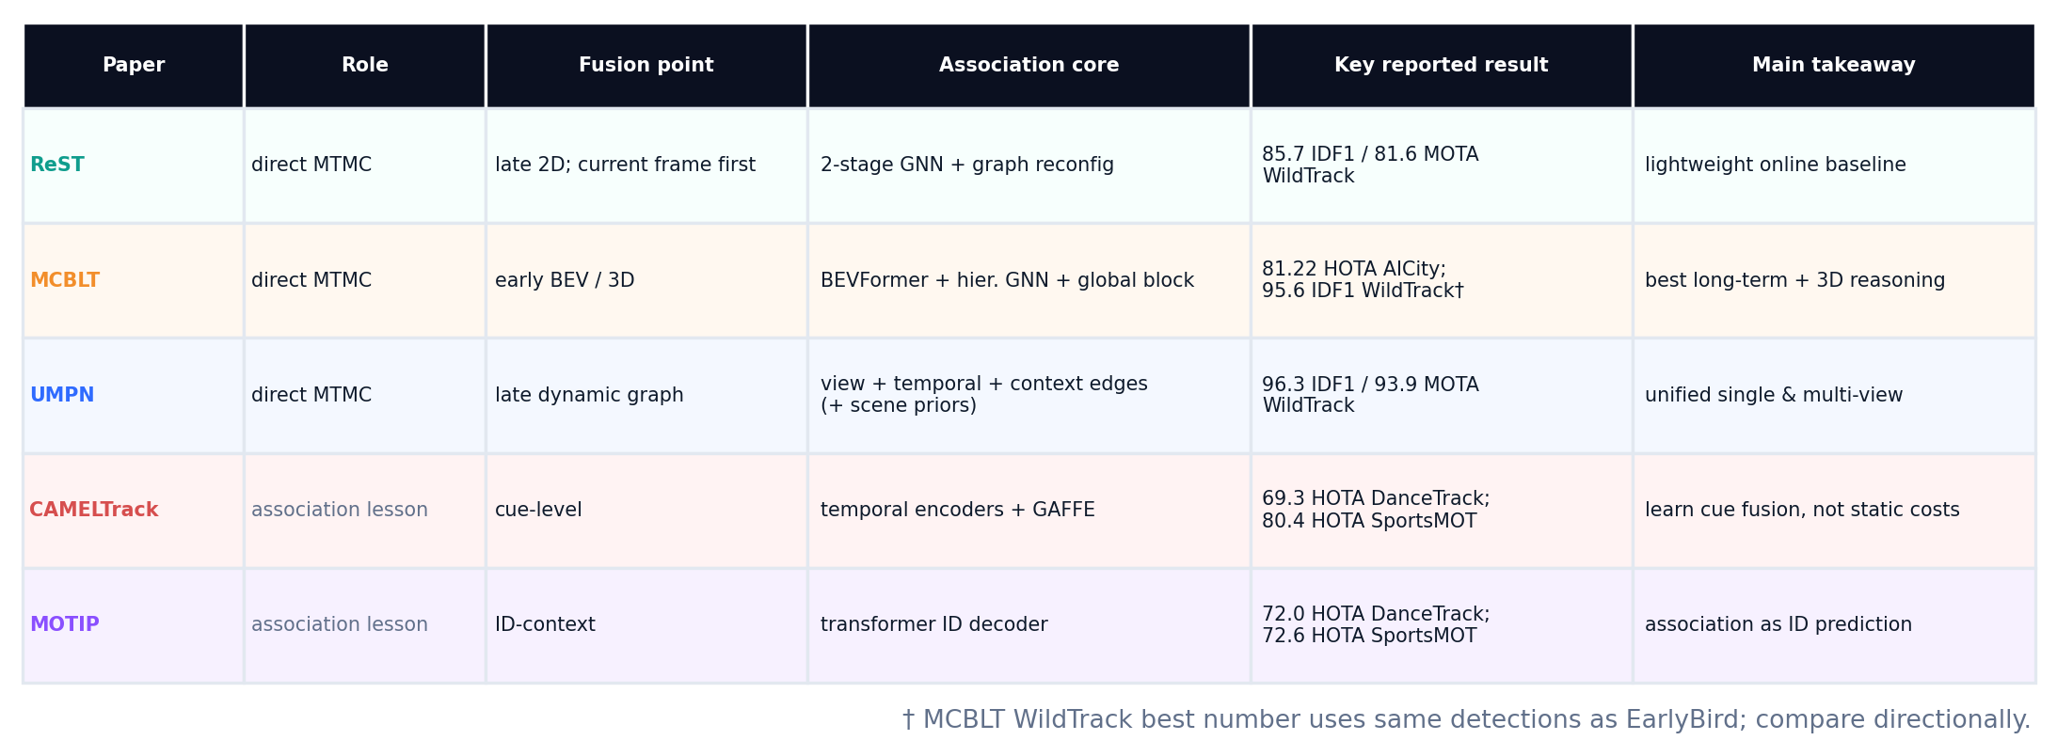
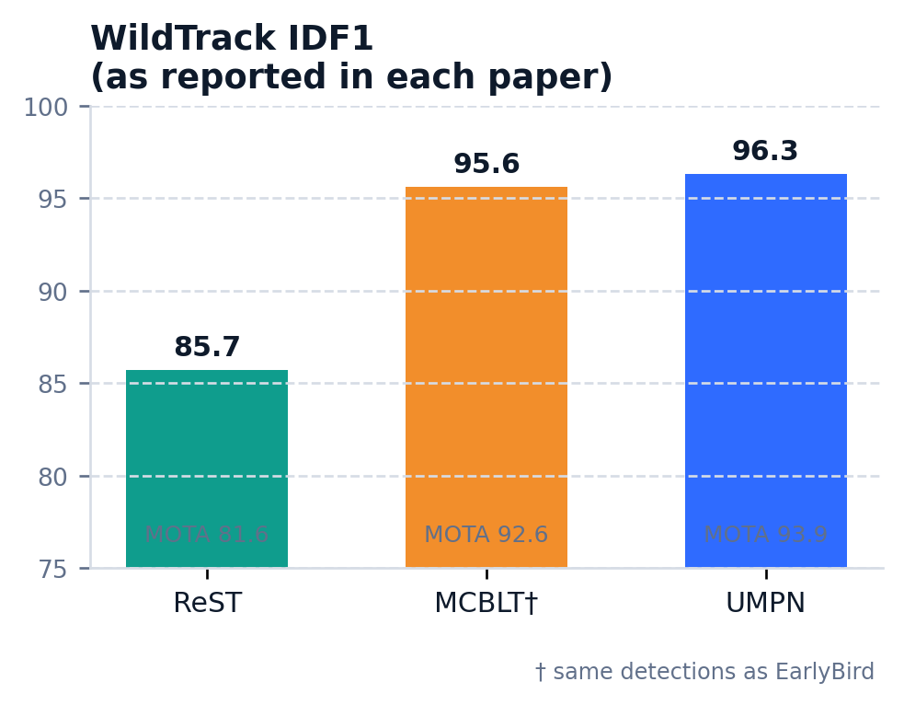
2
Compact comparison
Use the table for architectural fit; use the chart only directionally because detection settings differ.
How to read this slide
Raw benchmark values are not apples-to-apples: the papers use different detectors, training data, and evaluation settings. Compare the system design first, then re-run on your own site data.
Bottom line: MCBLT is the strongest “full-stack” MTMC paper here; ReST is the leanest online baseline; UMPN is the cleanest unification of single- and multi-view tracking.
Metrics from ReST (WildTrack), MCBLT (WildTrack/AICity), UMPN (WildTrack), CAMELTrack (DanceTrack/SportsMOT), and MOTIP (DanceTrack/SportsMOT).
3
Notes:
[Sources] - ReST - A Reconfigurable Spatial-Temporal Graph Model for Multi-Camera Multi-Object Tracking.pdf, p. 7 (WildTrack Table 1), pp. 11-12 (model size and post-processing ablation). - MCBLT - Multi-Camera Multi-Object 3D Tracking in Long Videos.pdf, pp. 7-8 (AICity Table 1, WildTrack Table 3), pp. 12-13 (runtime). - One Graph to Track Them All - Dynamic GNNs for Single and Multi-View Tracking.pdf, pp. 9-12 (WILDTRACK/SCOUT/runtime). - CAMELTrack - Context-Aware Multi-cue ExpLoitation for Online Multi-Object Tracking.pdf, pp. 6-8 (DanceTrack/SportsMOT/MOT17). - Multiple Object Tracking as ID Prediction.pdf, pp. 6-8 (DanceTrack/SportsMOT/BFT).

Slide 4
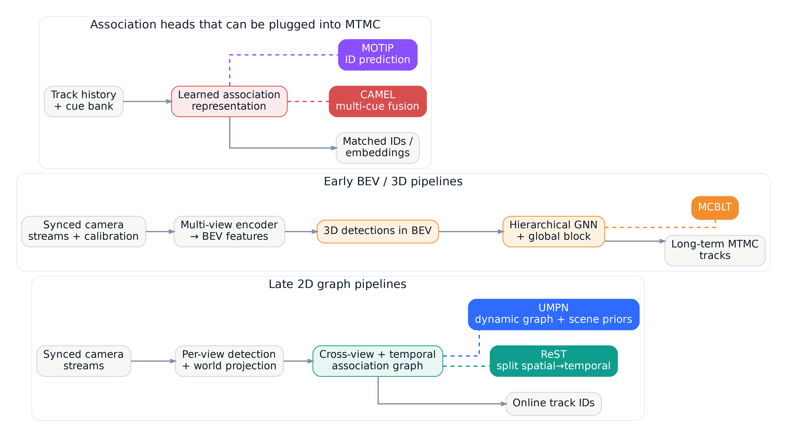
3
Three architectural patterns
The papers cluster into late 2D graphs, early BEV/3D pipelines, and learned association heads that can sit on top of either.
Late 2D graph
Early BEV / 3D
Learned association head
Fastest to adopt; easiest to retrofit into an existing detector + world-projection stack.
Best choice when overlap is dense and long occlusions / re-entries dominate product risk.
Reusable upgrade: keep modular cues, but stop hand-tuning how they are fused for matching.
Diagram synthesized from the cited method sections: ReST, MCBLT, UMPN, CAMELTrack, and MOTIP.
4
Notes:
[Sources] - ReST - A Reconfigurable Spatial-Temporal Graph Model for Multi-Camera Multi-Object Tracking.pdf, pp. 3-6. - MCBLT - Multi-Camera Multi-Object 3D Tracking in Long Videos.pdf, pp. 3-6. - One Graph to Track Them All - Dynamic GNNs for Single and Multi-View Tracking.pdf, pp. 4-7, 17-18. - CAMELTrack - Context-Aware Multi-cue ExpLoitation for Online Multi-Object Tracking.pdf, pp. 3-5, 13-14. - Multiple Object Tracking as ID Prediction.pdf, pp. 3-5.

Slide 5
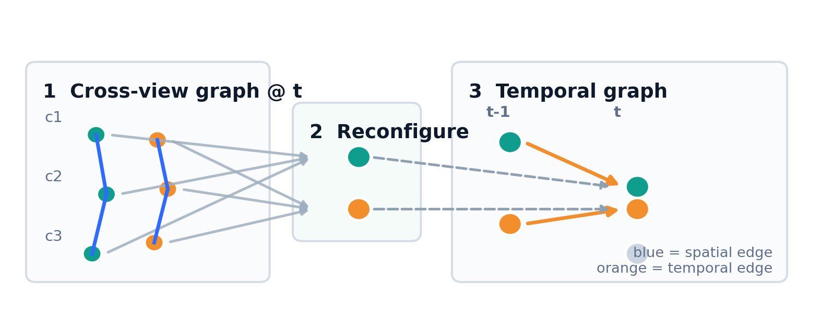
4
ReST: spatial first, temporal second
Key idea: use a lightweight two-stage graph instead of trusting a single-camera tracker to survive occlusion.
85.7
81.6
154K
WildTrack IDF1
WildTrack MOTA
trainable params
• Spatial association matches objects across cameras at the current frame, then graph reconfiguration produces a compact temporal graph.
• Projection to a common ground plane is the dominant cue; speed helps temporal linking; appearance is not heavily relied on.
• Practical implication: ReST is a strong low-latency baseline when calibration exists but a full BEV stack is too costly.
Best fit
Fixed calibrated cameras with overlapping fields of view, an online latency target, and a GPU budget that favors simple graph reasoning over heavy 3D perception.
ReST (Cheng et al., ICCV 2023).
5
Notes:
[Sources] - ReST - A Reconfigurable Spatial-Temporal Graph Model for Multi-Camera Multi-Object Tracking.pdf, pp. 3-8 (architecture, results, feature ablations), pp. 11-12 (154K params, post-processing ablations). - Diagram on this slide is synthesized from the paper's method description.

Slide 6
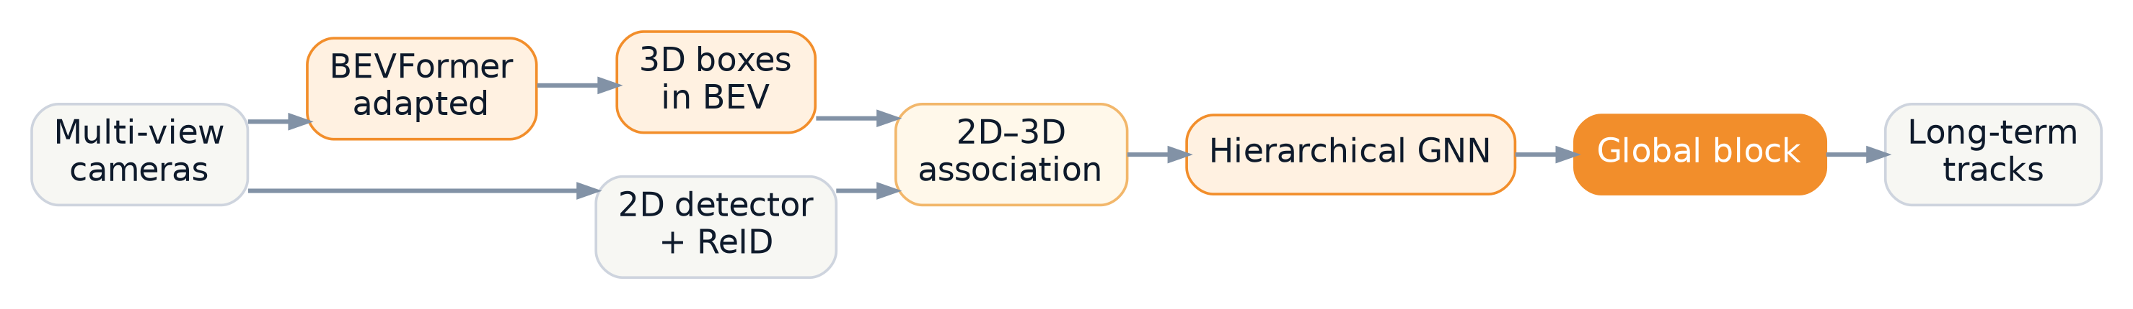
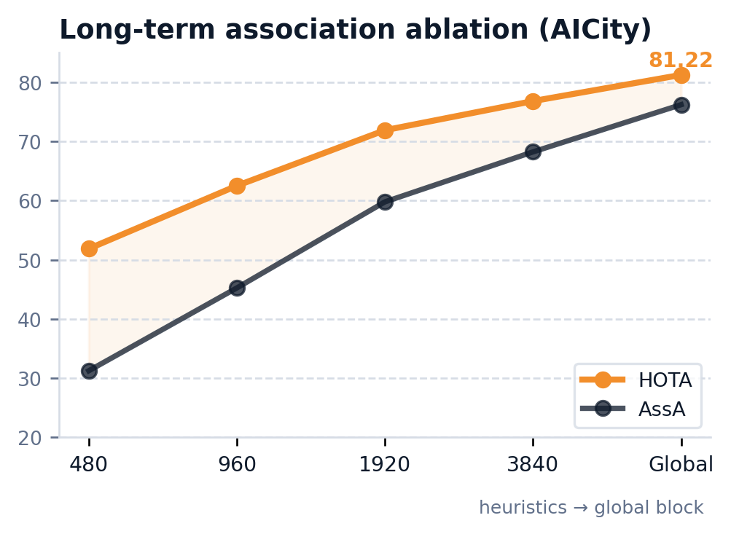
5
MCBLT: early BEV fusion + global long-term memory
Key idea: solve cross-view ambiguity before tracking, then add a sequence-level block for very long occlusions.
81.22
95.6
1.5 FPS
AICity HOTA
WildTrack IDF1*
end-to-end @ 10 cams
• BEVFormer aggregates multi-view image evidence before detection, reducing cross-view mismatch at the source.
• Their 2D–3D association step matters: it attaches cleaner 2D crops to 3D tracks, improving ReID quality.
• The global block is the differentiator for product use: it extends association from window-sized heuristics to full-sequence memory.
MCBLT (Wang et al., arXiv 2025). * best WildTrack number uses the same detections as EarlyBird.
6
Notes:
[Sources] - MCBLT - Multi-Camera Multi-Object 3D Tracking in Long Videos.pdf, pp. 3-8 (pipeline, AICity/WildTrack results), p. 8 (long-term association Table 5 and runtime discussion), pp. 12-13 (2D-3D association improvement and runtime). - Diagram on this slide is synthesized from the paper's method description.

Slide 7
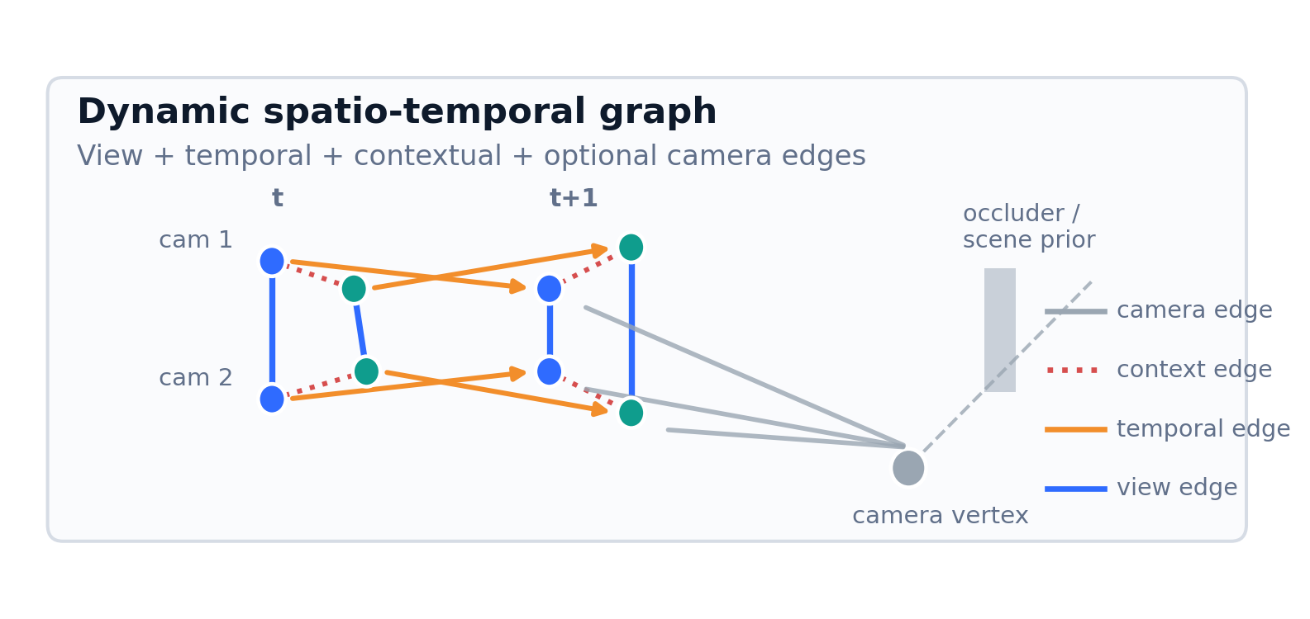
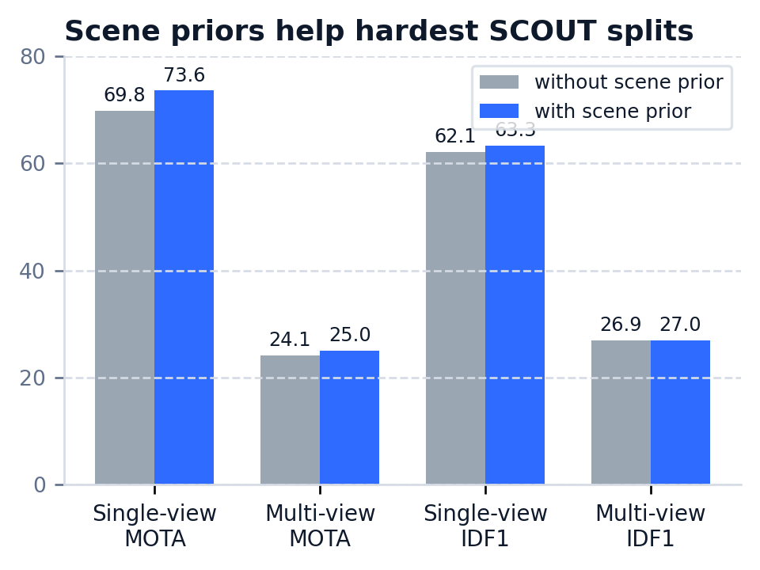
6
UMPN / One Graph: unify single- and multi-view tracking
Key idea: a rolling online graph with view, temporal, context, and optional camera edges can cover many deployment modes.
96.3
93.9
23 FPS
WildTrack IDF1
WildTrack MOTA
runtime
Why it matters
UMPN is the cleanest “one family for many deployments” paper here: it runs online, spans single- and multi-view, and can exploit scene priors when a site map or mesh is available. The trade-off is heavier training memory.
One Graph to Track Them All / UMPN (Engilberge et al., arXiv 2025).
7
Notes:
[Sources] - One Graph to Track Them All - Dynamic GNNs for Single and Multi-View Tracking.pdf, pp. 4-12 (dynamic graph, results, runtime), pp. 17-20 (scene priors, memory analysis, temporal distance and SCOUT statistics). - Diagram on this slide is synthesized from the paper's method description.

Slide 8
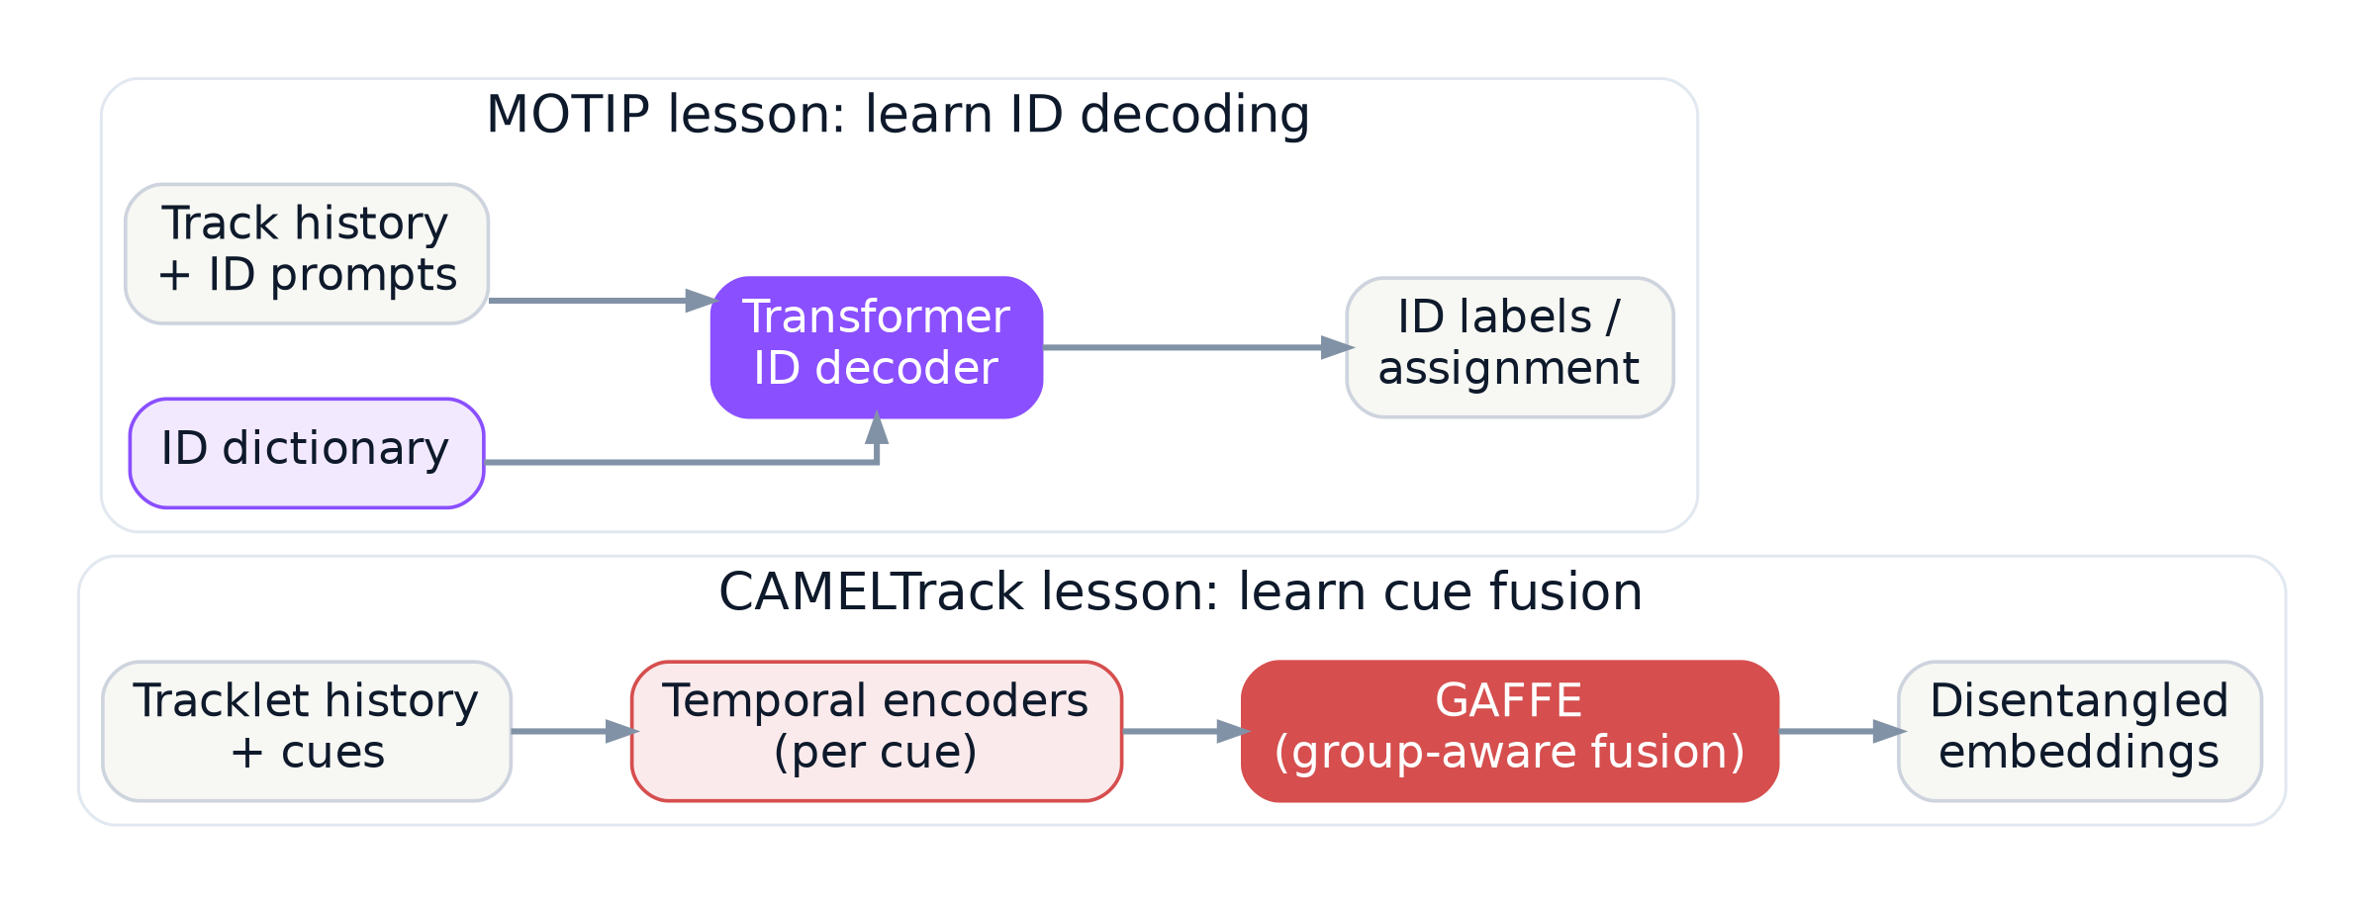
7
Association lessons from CAMELTrack + MOTIP
These are single-view MOT papers, but their association mechanisms port directly to MTMC if the cue bank includes geometry and camera context.
What CAMEL adds to MTMC
What MOTIP adds to MTMC
• Learn cue fusion instead of hand-tuning EMA / Kalman / static weights.
• Train on synthetic hard association cases cheaply.
• Feed it 3D geometry, ReID, pose, zone, and visibility cues—not just 2D motion.
• Reframe matching as ID decoding over track history.
• Use prompts or memory tokens to keep association in-distribution.
• Attractive option for re-entry-heavy environments where direct edge costs become brittle.
CAMELTrack (Somers et al., arXiv 2025) and MOTIP (Gao et al., CVPR 2024).
8
Notes:
[Sources] - CAMELTrack - Context-Aware Multi-cue ExpLoitation for Online Multi-Object Tracking.pdf, pp. 1-8, 13-18. - Multiple Object Tracking as ID Prediction.pdf, pp. 1-8. - Diagram on this slide is synthesized from the two papers' method descriptions.

Slide 9
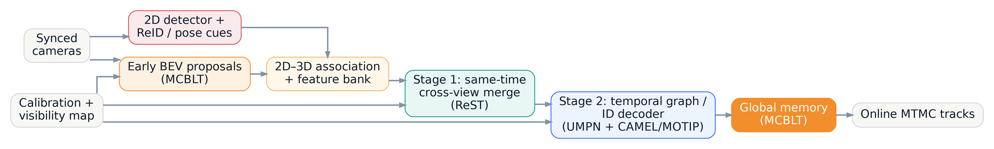
8
Recommended MTMC blueprint for our company
Assumption: fixed cameras, time synchronization, and at least coarse calibration. If not, start with the late-graph baseline first.
1
Geometry-first: track in world / BEV if cameras are calibrated.
2
Keep a 2D branch: it rescues 3D misses and improves ReID crops.
3
Separate same-time cross-view merge from across-time linking.
4
Learn cue fusion instead of tuning cost weights by hand.
5
Add global memory + visibility priors for re-entry and long occlusion.
Best synthesis: MCBLT front-end + ReST-style stage separation + UMPN scene priors + CAMEL/MOTIP learned association.
Blueprint synthesized from ReST, MCBLT, UMPN, CAMELTrack, and MOTIP.
9
Notes:
[Sources] - ReST - A Reconfigurable Spatial-Temporal Graph Model for Multi-Camera Multi-Object Tracking.pdf, pp. 3-8. - MCBLT - Multi-Camera Multi-Object 3D Tracking in Long Videos.pdf, pp. 3-8, 12-13. - One Graph to Track Them All - Dynamic GNNs for Single and Multi-View Tracking.pdf, pp. 4-12, 17-20. - CAMELTrack - Context-Aware Multi-cue ExpLoitation for Online Multi-Object Tracking.pdf, pp. 3-8, 13-18. - Multiple Object Tracking as ID Prediction.pdf, pp. 3-8. - The blueprint on this slide is a synthesized recommendation generated for this deck.

Slide 10
9
Build plan and decision rules
Start with the strongest cheap baseline, then pay complexity only when the product need is real.
Suggested implementation path
Phase 1 • strong online baseline
Decision rules
Per-view detector + world projection + ReST/UMPN-style online graph. First target: reliable IDs, evaluation tooling, and failure taxonomy on your own site.
• Dense overlap + long occlusions → prioritize early BEV / 3D.
• Partial overlap or shaky calibration → start with a late-graph baseline.
• Edge / real-time deployment → keep ReST or UMPN core and defer BEV.
• High re-entry rate → add global memory and an ID-decoder sooner.
• Unknown environment → invest first in synchronization, calibration, and site evaluation data.
Phase 2 • learned association
Keep the modular cue bank, but swap static fusion for a CAMEL- or MOTIP-style association head trained on hard synthetic cases.
Phase 3 • BEV / 3D branch
Only when overlap is dense and long occlusions matter: add MCBLT-style early BEV proposals and a global block for re-entry-heavy scenes.
The wrong optimization is “more matcher heuristics.” The right optimization is “better geometry, better memory, better learned fusion.”
Synthesis across all five papers.
10
Notes:
[Sources] - ReST - A Reconfigurable Spatial-Temporal Graph Model for Multi-Camera Multi-Object Tracking.pdf. - MCBLT - Multi-Camera Multi-Object 3D Tracking in Long Videos.pdf. - One Graph to Track Them All - Dynamic GNNs for Single and Multi-View Tracking.pdf. - CAMELTrack - Context-Aware Multi-cue ExpLoitation for Online Multi-Object Tracking.pdf. - Multiple Object Tracking as ID Prediction.pdf. - This slide contains synthesized recommendations generated from the cited papers.

Slide 11
10
Primary citations
Page-level source details for each slide are included in the speaker notes.
ReST
CAMELTrack
Cheng, C.-C., Qiu, M.-X., Chiang, C.-K., & Lai, S.-H. (2023). ReST: A Reconfigurable Spatial-Temporal Graph Model for Multi-Camera Multi-Object Tracking. ICCV 2023.
Somers, V., Standaert, B., Joos, V., Alahi, A., & De Vleeschouwer, C. (2025). CAMELTrack: Context-Aware Multi-cue ExpLoitation for Online Multi-Object Tracking. arXiv:2505.01257.
MCBLT
MOTIP
Wang, Y., Meinhardt, T., Cetintas, O., Yang, C.-Y., Pusegaonkar, S. S., Missaoui, B., Biswas, S., Tang, Z., & Leal-Taixé, L. (2025). MCBLT: Multi-Camera Multi-Object 3D Tracking in Long Videos. arXiv:2412.00692.
Gao, R., Qi, J., & Wang, L. (2024). Multiple Object Tracking as ID Prediction. CVPR 2024.
One Graph / UMPN
Usage note
Engilberge, M., Vrkic, I., Grosche, F. W., Pilet, J., Türetken, E., & Fua, P. (2025). One Graph to Track Them All: Dynamic GNNs for Single- and Multi-View Tracking. arXiv:2507.08494.
The last two papers are not MTMC papers; they are included because their learned association modules offer reusable ideas for a modular MTMC stack.
Recommendation summary: use the three direct MTMC papers for system architecture, and the two MOT papers for association design.
All citations correspond to the five uploaded source papers.
11
Notes:
[Sources] - ReST - A Reconfigurable Spatial-Temporal Graph Model for Multi-Camera Multi-Object Tracking.pdf. - MCBLT - Multi-Camera Multi-Object 3D Tracking in Long Videos.pdf. - One Graph to Track Them All - Dynamic GNNs for Single and Multi-View Tracking.pdf. - CAMELTrack - Context-Aware Multi-cue ExpLoitation for Online Multi-Object Tracking.pdf. - Multiple Object Tracking as ID Prediction.pdf.

