Slide 1
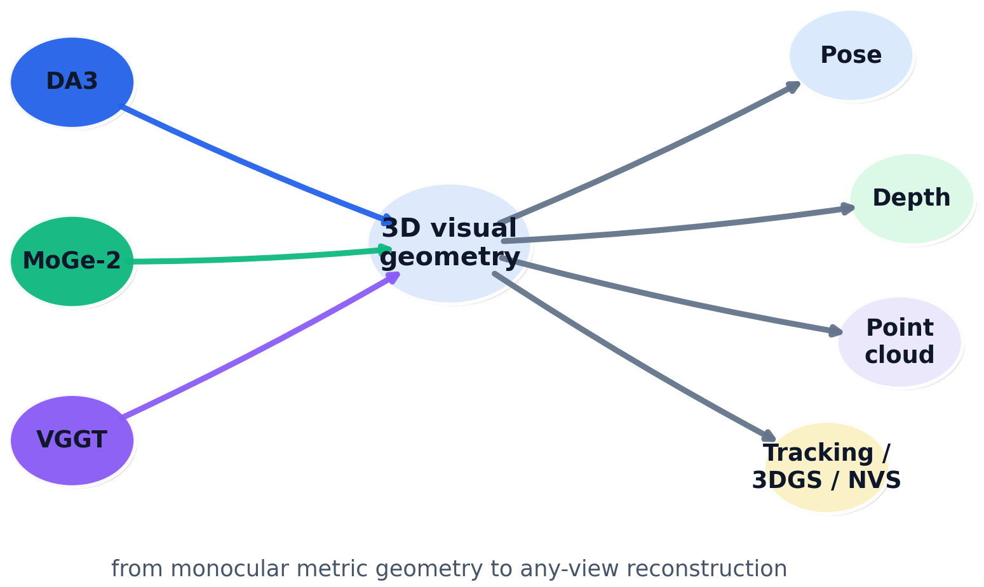
What DA3, MoGe-2, and VGGT mean
for our next vision model
Compact review of architectures, benchmarks, and build implications for a strong 3D-aware vision foundation model.
DA3 · any-view geometry
MoGe-2 · metric monocular detail
VGGT · unified 3D backbone
Architecture • Benchmarks • Company blueprint • Citation snapshot
Key idea
These papers converge on simple ViT-style backbones, but differ in representation choice, data curation, and what they optimize at inference time.
Notes:
[Sources] - Depth Anything 3 uploaded PDF: title, abstract, and architecture overview (pages 1, 3-5) and conclusions (page 22). - MoGe-2 uploaded PDF: title, abstract, and architecture overview (pages 1-5) and conclusions (page 9). - VGGT uploaded PDF: title, abstract, architecture overview, and conclusions (pages 1-6, 10-11). [/Sources]

Slide 2
One-slide comparison
Scope, geometry target, data recipe, and where each paper is strongest.
Paper
Input
Representation
Data
Best at
Caution
Capability snapshot
MoGe-2
1 image
Point map +
separate scale
Synthetic +
refined real
Metric mono
+ detail
No multi-view
or tracks
Capability
M2
V
D
Metric mono
H
M
M
Any-view pose
L
H
H
VGGT
1 to 100+
images
Cameras + depth
+ points + tracks
Large mixed
3D-annotated sets
Shared 3D
backbone
Point head weaker
than depth+cam
Track transfer
L
H
M
3DGS / NVS
L
H
H
DA3
1 to N, posed
or unposed
Depth + ray
(+ optional cam)
Public data +
teacher labels
Any-view pose
+ recon
Training cost;
dynamics later
Inference simplicity
H
M
H
Bottom line
MoGe-2 is the cleanest answer for single-image metric geometry. DA3 is the current best any-view reconstruction bet. VGGT remains the most attractive general 3D backbone when we care about shared features and tracking.
Notes:
[Sources] - MoGe-2 uploaded PDF: abstract, method, and benchmark summary (pages 1-9, especially Tables 1-4). - VGGT uploaded PDF: abstract, method, and experiments (pages 1-10). - Depth Anything 3 uploaded PDF: abstract, method, and experiments (pages 1-8, 14-22). [/Sources]

Slide 3
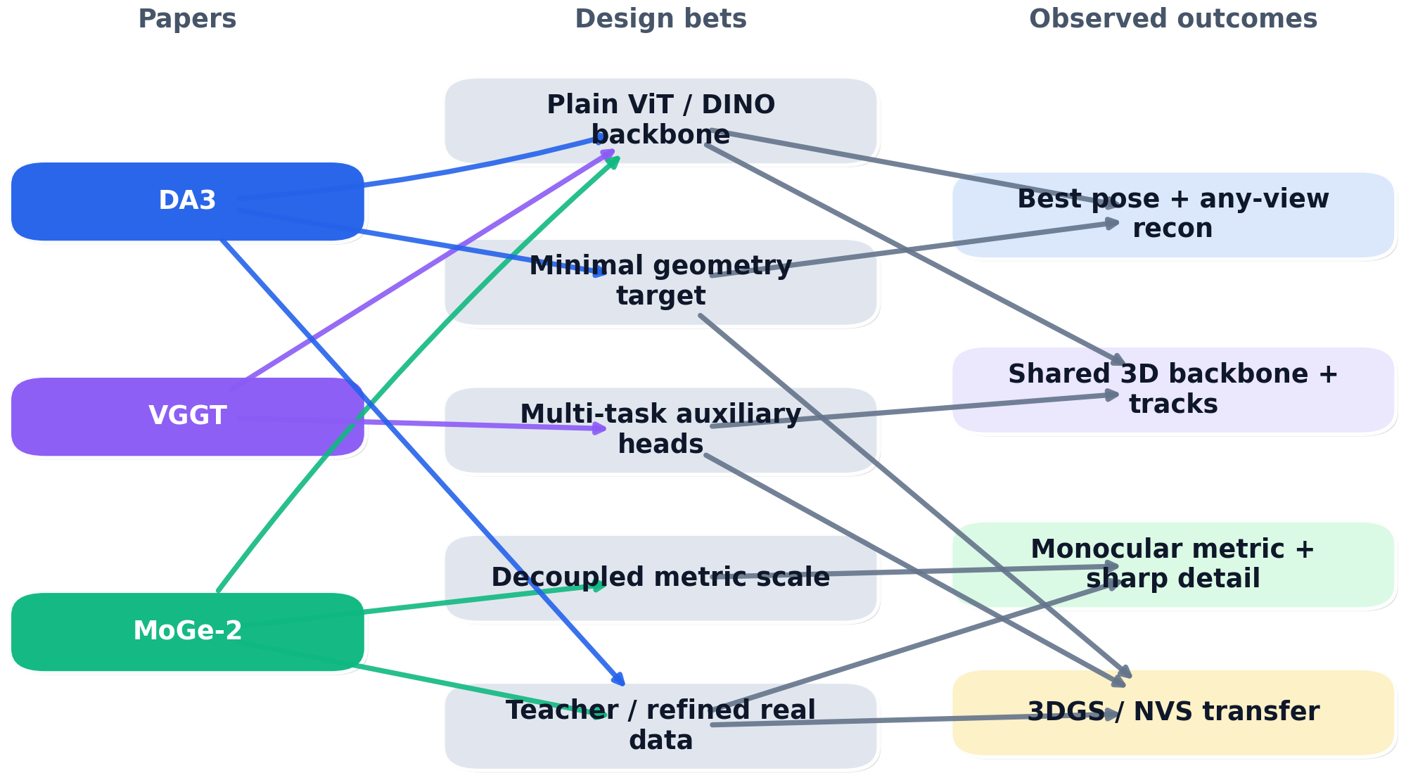
How the three papers connect
All three push toward scalable 3D geometry backbones, but they make different bets on representation and supervision.
Convergence
• Large DINO / ViT backbones plus dense prediction heads are now the default recipe. • All three papers show that geometry quality scales with better data, not only fancier 3D modules.
Divergence
• DA3 argues for a minimal depth-ray target. • MoGe-2 explicitly decouples metric scale from relative geometry. • VGGT leans into many auxiliary outputs to regularize a shared backbone.
Synthesis
• Train with redundancy only when it improves representation learning. • At deployment, prefer simpler, derived outputs that are easier to calibrate and trust.
Notes:
[Sources] - Depth Anything 3 uploaded PDF: architecture, representation, and ablations on depth-ray sufficiency and single-transformer design (pages 5-8, 16-18). - MoGe-2 uploaded PDF: metric-scale decoupling and real-data refinement (pages 3-6, 9). - VGGT uploaded PDF: alternating attention, multi-task outputs, and downstream transfer (pages 3-10). [/Sources]

Slide 4
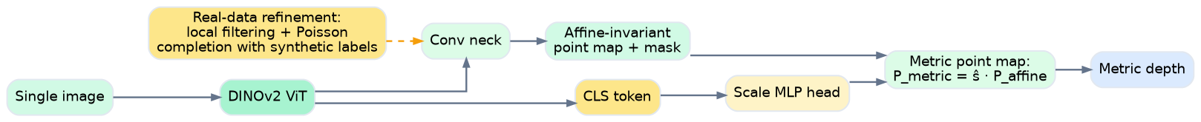
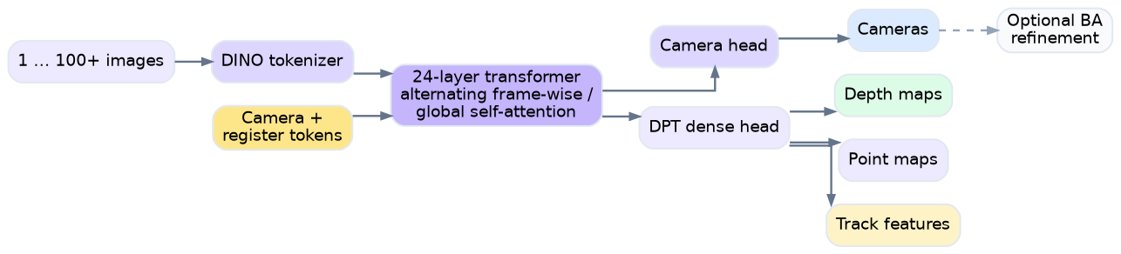
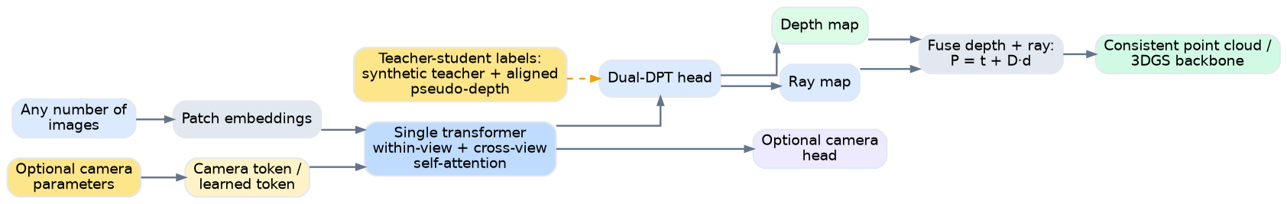
Architectures at a glance
Our diagrams compress each model to the part that matters most for system design.
MoGe-2
Decouple global scale from relative geometry.
VGGT
One backbone, many 3D outputs.
DA3
Minimal depth + ray target for any-view fusion.
Notes:
[Sources] - MoGe-2 uploaded PDF: architecture overview and scale-decoupling design (pages 3-5, Figure 2 and Figure 3). - VGGT uploaded PDF: architecture overview, problem definition, and prediction heads (pages 3-6, Figure 2). - Depth Anything 3 uploaded PDF: pipeline, cross-view attention, dual-DPT head, and camera conditioning (pages 5-8, Figures 2 and 3). [/Sources]

Slide 5
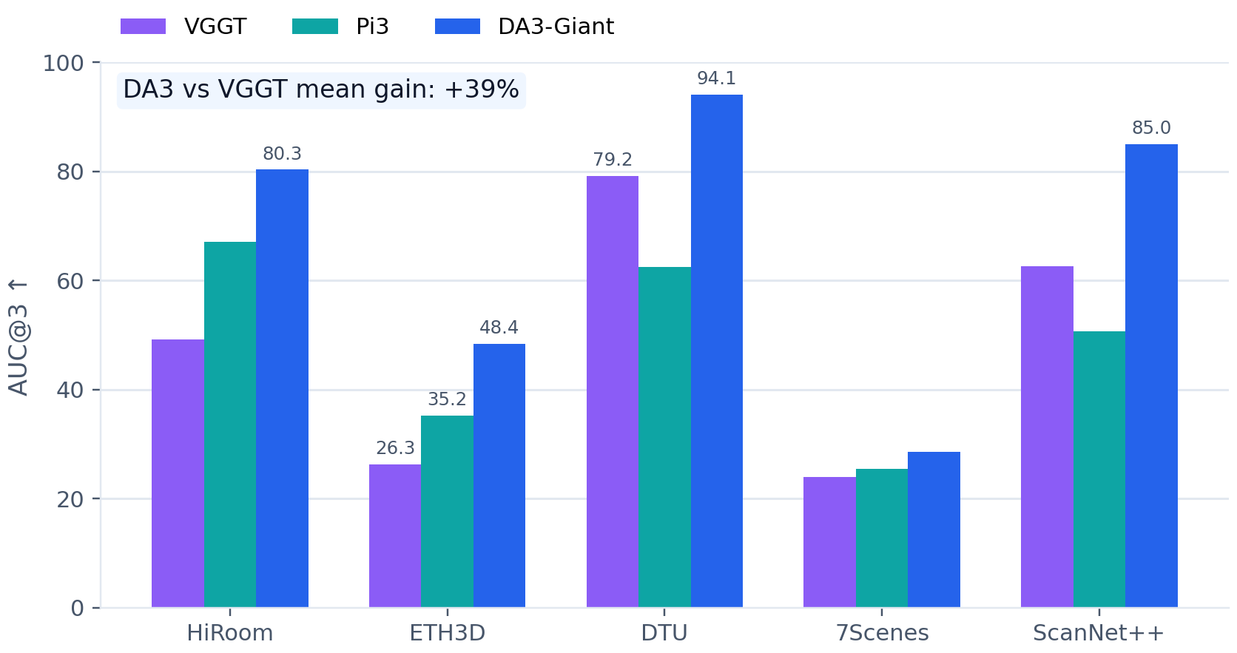
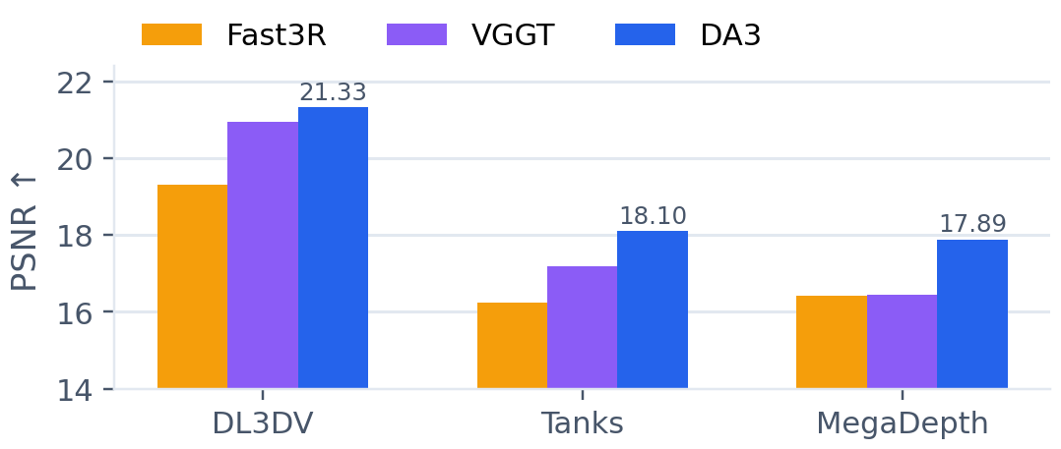
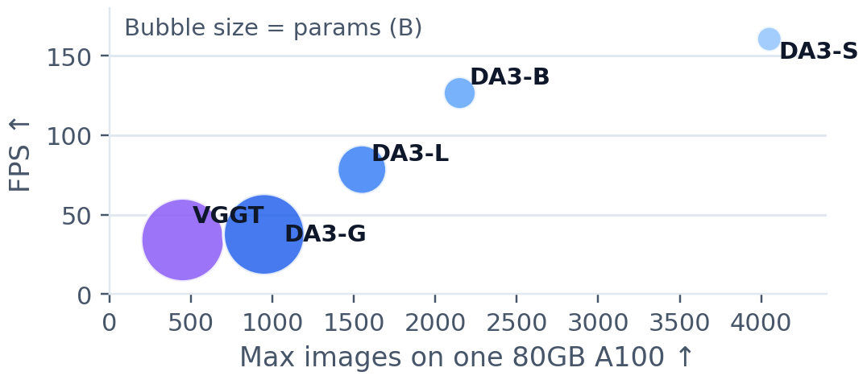
Any-view geometry: DA3 moves the frontier
Pose, feed-forward novel view synthesis, and scalability all improve over the earlier VGGT generation.
Why this matters: DA3 is not just a better benchmark number; its smaller variants also scale to more views and higher throughput, making it the strongest current candidate for an any-view production backbone.
Notes:
[Sources] - Depth Anything 3 uploaded PDF: Table 2 (pose AUC@3/AUC@30), Table 5 (NVS PSNR/SSIM/LPIPS), Table 8 (runtime, max images, parameters), and accompanying discussion (pages 14-18). [/Sources]

Slide 6
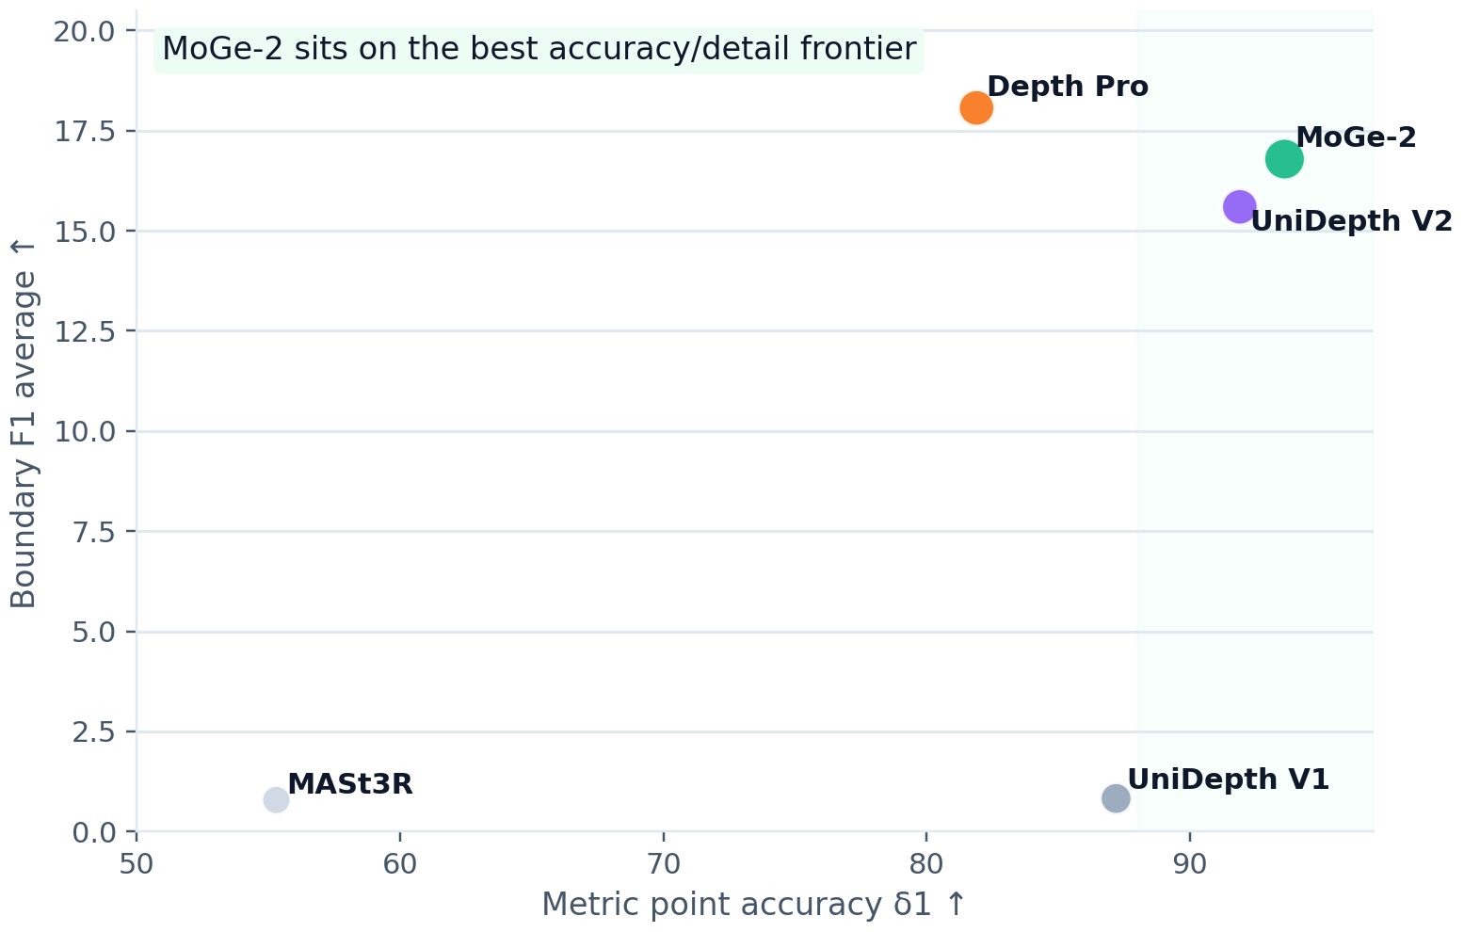
MoGe-2 closes the monocular accuracy–detail gap
The paper’s core contribution is not only a stronger head, but a stronger data-cleaning story.
Why it works
1) Representation. Predict affine-invariant geometry, then recover metric scale with a separate CLS-token MLP head.
2) Data.
Use synthetic predictions to filter noisy real depth locally and fill holes with edge-preserving completion.
3) Outcome.
You retain strong geometry while getting much closer to Depth Pro’s sharpness.
Ablation cues from the paper
Finding
Before
After
Metric depth rank
3.83
(Depth Pro)
1.95
(MoGe-2)
Sharpness rank
1.50
(Depth Pro)
1.75
(MoGe-2)
Refined real data F1
10.3
(raw real)
12.5
(refined)
Interpretation: use MoGe-2-style scale decoupling and real-data refinement even if the final company model is multi-view.
Notes:
[Sources] - MoGe-2 uploaded PDF: Tables 2 and 3 (metric geometry and boundary sharpness), Table 4 ablations, and qualitative method discussion (pages 5-9). [/Sources]

Slide 7
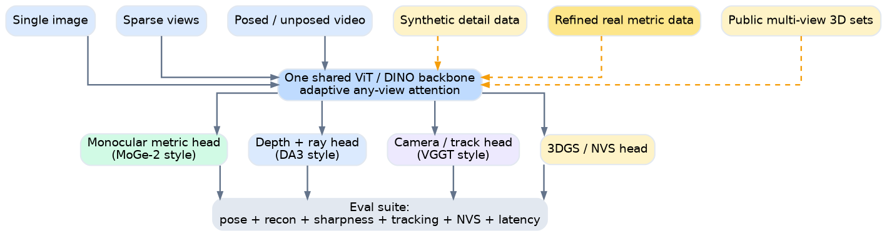
Recommended blueprint for our company model
Combine the strongest ideas instead of copying any one paper wholesale.
Recommended synthesis = MoGe-2 metric head + DA3 depth-ray geometry + VGGT multi-output reuse
Backbone
Heads
Data + eval
• One shared ViT / DINO encoder with adaptive 1→N view attention. • Train at multiple resolutions so monocular and multi-view modes share tokens.
• Default inference path: monocular metric head for 1 view, depth+ray + camera head for multi-view. • Keep a track head and NVS head as reusable downstream adapters, not the core product output.
• Invest in a data engine: synthetic detail, refined real metric data, public multi-view 3D sets, and later in-domain capture. • Benchmark pose, reconstruction, sharpness, tracking, NVS, and latency together.
Notes:
[Sources] - Synthesis based on: MoGe-2 uploaded PDF pages 3-9; Depth Anything 3 uploaded PDF pages 5-18, 22; VGGT uploaded PDF pages 3-10, 12. [/Sources]

Slide 8
Decision matrix and launch checklist
Use the papers as complementary building blocks, then prove the stack with a broader eval harness than any single paper uses.
Use case
Default recipe
Why
Launch checklist
Single-image metric perception
MoGe-2-style metric head on shared backbone
Best metric/detail trade-off in the review.
• Pose AUC, reconstruction F1/CD, and boundary sharpness all on the same held-out scenes. • Latency + memory measured at 1 / 4 / 12 / 32 views, not just a single benchmark setting. • Downstream checks: 3DGS / NVS, tracking, and any in-product perception tasks. • OOD stress tests: thin structures, non-rigid scenes, fisheye/panoramas, and large scale ambiguity.
Sparse unposed multi-view recon
DA3 depth + ray (+ optional camera head)
Strongest pose-free geometry and better view scalability.
Track-heavy world model / video understanding
VGGT-style shared track and camera head
Best transfer story for shared 3D features.
Edge or real-time deployment
Distilled small/base variants
Both DA3 and MoGe-2 show strong scaling benefits at smaller sizes.
Known paper-side failure modes
• Dynamic / non-rigid motion is still a weak spot for DA3 and VGGT. • Very fine wires, hair, and extreme foreground/background scale gaps remain hard for MoGe-2. • Fisheye / panoramic imagery is explicitly called out as a limitation for VGGT.
Notes:
[Sources] - Decision logic synthesized from all three uploaded papers: MoGe-2 (pages 8-9), Depth Anything 3 (pages 14-22), VGGT (pages 6-10, 10-11). [/Sources]

Slide 9
Citations and reference snapshot
The bibliographic references below are the versions used for this review; citation counts are only rough adoption signals and will move quickly.
VGGT
Wang, J., Chen, M., Karaev, N., Vedaldi, A., Rupprecht, C., & Novotny, D. (2025). VGGT: Visual Geometry Grounded Transformer. CVPR 2025.
Status / project snapshot
Paper
Status
Availability
VGGT
CVPR 2025
Best Paper
Project page + GitHub
MoGe-2
Wang, R., Xu, S., Dong, Y., Deng, Y., Xiang, J., Lv, Z., Sun, G., Tong, X., & Yang, J. (2025). MoGe-2: Accurate Monocular Geometry with Metric Scale and Sharp Details. arXiv:2507.02546.
MoGe-2
arXiv
Jul 2025
Project page + code
DA3
arXiv 2025
ICLR 2026 Oral
Project page + GitHub
DA3
Lin, H., Chen, S., Liew, J. H., Chen, D. Y., Li, Z., Shi, G., Feng, J., & Kang, B. (2025). Depth Anything 3: Recovering the Visual Space from Any Views. arXiv:2511.10647.
Citation snapshot (web, Mar 2026)
Paper
Approx.
Source
VGGT
792
arXiv snippet
MoGe-2
70
arXiv snippet
DA3
45
OpenReview snippet
Use counts only as weak adoption signals; the numbers move quickly and should not drive the model decision by themselves.
Notes:
[Sources] - VGGT uploaded PDF first page and title; project page / Best Paper notice: turn0search29 and turn0search12; citation count snippet: turn0search3. - MoGe-2 uploaded PDF first page and title; project page: turn0search19; citation count snippet: turn0search4 or turn0search8. - Depth Anything 3 uploaded PDF first page and title; project page / GitHub citation block: turn3search5 and turn1search11; ICLR 2026 Oral and citation count snippet: turn3search0 and turn3search3. [/Sources]

