Slide 1
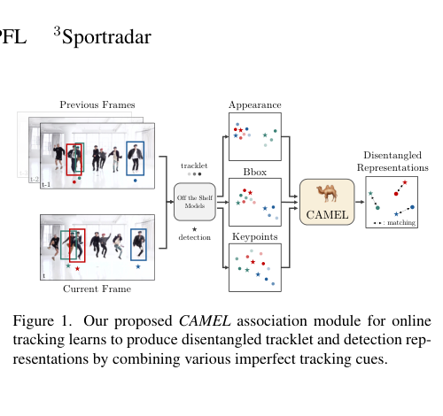
CAMELTRACK
1/5
Problem & Motivation
Online MOT still relies too much on heuristics
Where hand-crafted rules still dominate
tracklet representation
cue fusion
multi-stage matching
Teaser figure from the paper
Why static rules break
Association failure modes
cue quality changes with context occlusion breaks static rules
appearance-only matching can confuse similar targets long gaps make motion unreliable
CAMELTrack idea: keep the modular tracking-by-detection pipeline, but learn the association strategy.
Source paper: CAMELTrack: Context-Aware Multi-cue ExpLoitation for Online Multi-Object Tracking
CAMELTrack
Notes:
[Sources] - Markdown summary: /mnt/data/cameltrack_5_slide_summary.md - Paper PDF: /mnt/data/CAMELTrack - Context-Aware Multi-cue ExpLoitation for Online Multi-Object Tracking.pdf - Figure assets in this deck were extracted or cropped from the cited CAMELTrack paper PDF. [/Sources]

Slide 2
CAMELTRACK
2/5
Core Idea
CAMEL = learned multi-cue association
Cue fusion concept
Learned ability 1
Learned ability 2
bbox
confidence
Temporal Encoder
GAFFE
summarize cue history
combine multiple cues
ReID
pose
metadata
per cue
fusion
Learned ability 3
separate matched and unmatched pairs in embedding space
Output
unified embeddings -> bipartite matching
Important property: heuristic-free association while still using off-the-shelf models.
tracklets
detections
Source paper: CAMELTrack: Context-Aware Multi-cue ExpLoitation for Online Multi-Object Tracking
CAMELTrack
Notes:
[Sources] - Markdown summary: /mnt/data/cameltrack_5_slide_summary.md - Paper PDF: /mnt/data/CAMELTrack - Context-Aware Multi-cue ExpLoitation for Online Multi-Object Tracking.pdf - Figure assets in this deck were extracted or cropped from the cited CAMELTrack paper PDF. [/Sources]

Slide 3
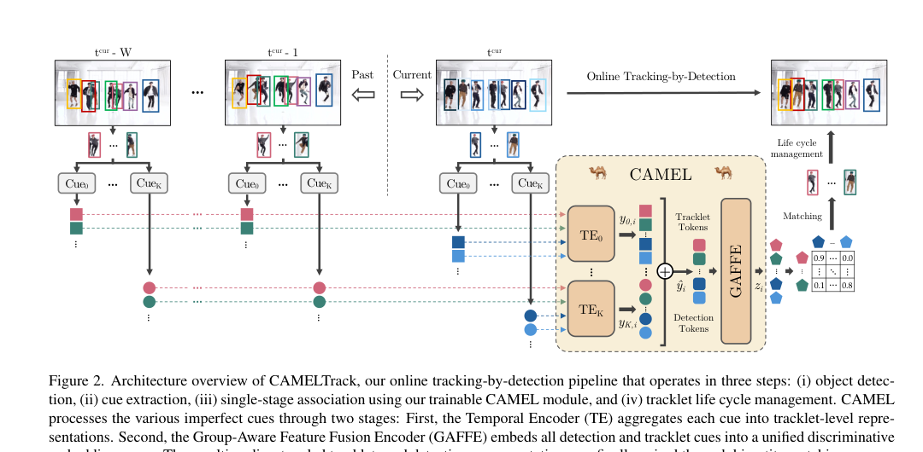
CAMELTRACK
3/5
Architecture
Temporal Encoder + GAFFE + Hungarian matching
detections + cues -> Temporal Encoder per cue
cue-specific tracklet tokens
GAFFE produces unified object embeddings
pair detections and tracklets with Hungarian matching
Cues supported
bounding boxes
confidence
ReID features
pose keypoints
task metadata
CAMEL keeps the tracking-by-detection modularity of classic pipelines while replacing brittle manual fusion with a learned association head.
Architecture overview of CAMELTrack
Source paper: CAMELTrack: Context-Aware Multi-cue ExpLoitation for Online Multi-Object Tracking
CAMELTrack
Notes:
[Sources] - Markdown summary: /mnt/data/cameltrack_5_slide_summary.md - Paper PDF: /mnt/data/CAMELTrack - Context-Aware Multi-cue ExpLoitation for Online Multi-Object Tracking.pdf - Figure assets in this deck were extracted or cropped from the cited CAMELTrack paper PDF. [/Sources]

Slide 4
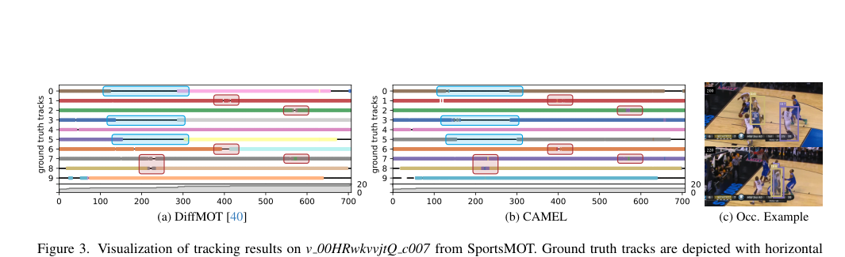
CAMELTRACK
4/5
Training Strategy
Association-Centric Training (ACT)
Robust matching under hard scenarios
precomputed cues
hard augmentations
longer temporal windows
association loss
train association directly on cue sequences instead of raw video
stress-test the model with swaps, dropout, and noisy cues
Benefits
Failure simulation
learn embeddings that stay discriminative through occlusion
cheaper training longer temporal windows easy hard-example generation
identity swaps detection dropout cue perturbation
Instead of training the whole image pipeline end-to-end, ACT directly supervises the association module on stored cues and hard cases.
Tracking timeline visual from the paper
Source paper: CAMELTrack: Context-Aware Multi-cue ExpLoitation for Online Multi-Object Tracking
CAMELTrack
Notes:
[Sources] - Markdown summary: /mnt/data/cameltrack_5_slide_summary.md - Paper PDF: /mnt/data/CAMELTrack - Context-Aware Multi-cue ExpLoitation for Online Multi-Object Tracking.pdf - Figure assets in this deck were extracted or cropped from the cited CAMELTrack paper PDF. [/Sources]

Slide 5
CAMELTRACK
5/5
Results & Insights
CAMELTrack improves association without abandoning modular MOT design
Headline benchmark numbers
DanceTrack HOTA
69.3
SportsMOT HOTA
80.4
Qualitative tracking strip
MOT17 IDF1
76.5
SportsMOT IDF1
84.8
Main insight: association is the bottleneck. Learned cue fusion beats fixed heuristic fusion.
Qualitative timeline analysis
What to remember
learned cue fusion outperforms fixed heuristic fusion the approach stays lightweight by reusing off-the-shelf detectors and ReID models CAMELTrack bridges simple SORT-style trackers and end-to-end association learning
Source paper: CAMELTrack: Context-Aware Multi-cue ExpLoitation for Online Multi-Object Tracking
CAMELTrack
Notes:
[Sources] - Markdown summary: /mnt/data/cameltrack_5_slide_summary.md - Paper PDF: /mnt/data/CAMELTrack - Context-Aware Multi-cue ExpLoitation for Online Multi-Object Tracking.pdf - Figure assets in this deck were extracted or cropped from the cited CAMELTrack paper PDF. [/Sources]

