Slide 1
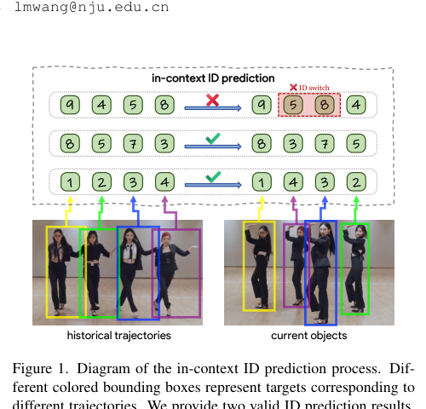
MOTIP
1/5
Problem & Motivation
Why rethink association?
traditional MOT = detection + hand-crafted trajectory matching
motion heuristics fail on irregular motion
ReID struggles when targets look similar
joint detection+tracking models can create task conflicts
MOTIP idea: keep detection and association decoupled, but make association fully learnable.
In-context ID prediction formulation
Source paper: Multiple Object Tracking as ID Prediction
MOTIP
Notes:
[Sources] - Markdown summary: /mnt/data/motip_5_slide_summary.md - Paper PDF: /mnt/data/Multiple Object Tracking as ID Prediction.pdf - Figure assets in this deck were extracted or cropped from the cited MOTIP paper PDF. [/Sources]

Slide 2
MOTIP
2/5
Core Reformulation
MOT as in-context ID prediction
Reformulation in three moves
attach a temporary learnable ID token to each historical trajectory
for every new detection, predict which token it should match
use a newborn token whenever no old trajectory explains the detection
This avoids fixed global identity classes and treats labels more like prompts than semantic categories.
Historical trajectories -> ID prediction for current detections
Source paper: Multiple Object Tracking as ID Prediction
MOTIP
Notes:
[Sources] - Markdown summary: /mnt/data/motip_5_slide_summary.md - Paper PDF: /mnt/data/Multiple Object Tracking as ID Prediction.pdf - Figure assets in this deck were extracted or cropped from the cited MOTIP paper PDF. [/Sources]

Slide 3
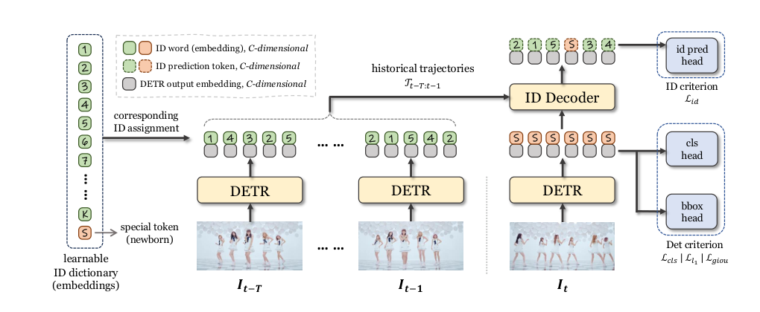
MOTIP
3/5
Architecture
A detector, a learnable ID dictionary, and a transformer decoder are enough
Main components
Deformable DETR produces object embeddings
a learnable ID dictionary stores temporary track labels
an ID decoder predicts the matching label
a newborn token handles unseen objects
image
DETR
object embeddings
ID decoder
ID label
MOTIP architecture from the paper
Source paper: Multiple Object Tracking as ID Prediction
MOTIP
Notes:
[Sources] - Markdown summary: /mnt/data/motip_5_slide_summary.md - Paper PDF: /mnt/data/Multiple Object Tracking as ID Prediction.pdf - Figure assets in this deck were extracted or cropped from the cited MOTIP paper PDF. [/Sources]

Slide 4
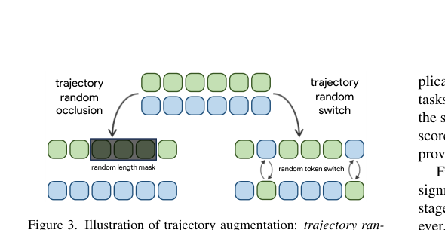


MOTIP
4/5
Training & Inference
Train with detection + ID loss, then keep inference simple
Training loss
Robustness tricks
detection loss ID prediction loss
random trajectory occlusion random token switch
Inference loop
filter detections by confidence
Trajectory augmentation during training
predict the highest-confidence old ID
if none is valid, create a newborn trajectory
recycle IDs from finished tracks when needed
Dance example
Another frame
Source paper: Multiple Object Tracking as ID Prediction
MOTIP
Notes:
[Sources] - Markdown summary: /mnt/data/motip_5_slide_summary.md - Paper PDF: /mnt/data/Multiple Object Tracking as ID Prediction.pdf - Figure assets in this deck were extracted or cropped from the cited MOTIP paper PDF. [/Sources]

Slide 5
MOTIP
5/5
Results & Insights
The reformulation itself matters: ID prediction beats heuristic matching
Headline benchmark numbers
DanceTrack HOTA
69.6
DanceTrack + extra
72.0
SportsMOT HOTA
72.6
BFT HOTA
70.5
ID prediction view of tracking
Main insights
the formulation itself is powerful
simple architectures can work when the task is framed well
historical trajectory context is enough to drive association
Qualitative example
Another qualitative example
Source paper: Multiple Object Tracking as ID Prediction
MOTIP
Notes:
[Sources] - Markdown summary: /mnt/data/motip_5_slide_summary.md - Paper PDF: /mnt/data/Multiple Object Tracking as ID Prediction.pdf - Figure assets in this deck were extracted or cropped from the cited MOTIP paper PDF. [/Sources]

