Slide 1
METRICS
1/5
Why We Need Multiple Metrics
Tracking is not one problem
a tracker can be good at detection and bad at identity preservation
Detection
Association
Localization
it can be good at consistency and bad at localization
FN FP recall precision
IDF1 AssA switches
IoU MOTP LocA
one score is never enough to explain failure modes
The best metric depends on the paper: association-centric papers should be judged differently from full pipeline papers.
Scope: formulas and intuition for the tracking metrics used across the five papers
Metrics
Notes:
[Sources] - Markdown summary: /mnt/data/metrics_5_slide_summary.md - Metric formulas are typeset programmatically in the deck. - Cross-paper framing is based on the five cited paper PDFs uploaded by the user. [/Sources]

Slide 2

METRICS
2/5
CLEAR MOT Metrics
MOTA
MOTP
rewards fewer misses
average localization quality of matched pairs
rewards fewer false alarms
higher is better in this set of papers
penalizes identity switches
implementation details can vary
Scope: formulas and intuition for the tracking metrics used across the five papers
Metrics
Notes:
[Sources] - Markdown summary: /mnt/data/metrics_5_slide_summary.md - Metric formulas are typeset programmatically in the deck. - Cross-paper framing is based on the five cited paper PDFs uploaded by the user. [/Sources]

Slide 3
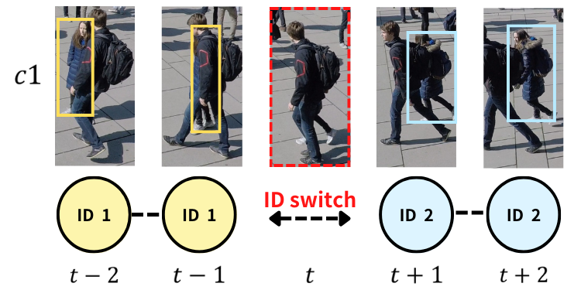
METRICS
3/5
Identity Metric
IDF1
directly measures identity preservation
especially useful when association is the main contribution
if IDF1 drops, the tracker is losing identity consistency
Identity switch example
Scope: formulas and intuition for the tracking metrics used across the five papers
Metrics
Notes:
[Sources] - Markdown summary: /mnt/data/metrics_5_slide_summary.md - Metric formulas are typeset programmatically in the deck. - Cross-paper framing is based on the five cited paper PDFs uploaded by the user. [/Sources]

Slide 4
METRICS
4/5
Balanced Metric Family
HOTA
DetA
AssA
LocA
detection accuracy
association accuracy
localization accuracy
balances detection and association
DetA = detection accuracy
This is why HOTA has become popular: it gives association-heavy papers less room to hide behind pure detection quality.
AssA = association accuracy
LocA may also be reported
Rule of thumb
Use IDF1 / AssA / HOTA for association-heavy papers and keep MOTA / MOTP / LocA for full-pipeline reading.
Scope: formulas and intuition for the tracking metrics used across the five papers
Metrics
Notes:
[Sources] - Markdown summary: /mnt/data/metrics_5_slide_summary.md - Metric formulas are typeset programmatically in the deck. - Cross-paper framing is based on the five cited paper PDFs uploaded by the user. [/Sources]

Slide 5
METRICS
5/5
How to Read Results
If the paper is about association
If the paper is about a full tracking pipeline
look first at IDF1
inspect MOTA
then AssA
inspect MOTP / LocA
then HOTA
also check MT / ML or equivalent recall coverage metrics
Final caution: only compare numbers directly when the benchmark, evaluation space, and detection protocol are all comparable.
Scope: formulas and intuition for the tracking metrics used across the five papers
Metrics
Notes:
[Sources] - Markdown summary: /mnt/data/metrics_5_slide_summary.md - Metric formulas are typeset programmatically in the deck. - Cross-paper framing is based on the five cited paper PDFs uploaded by the user. [/Sources]

