Slide 1
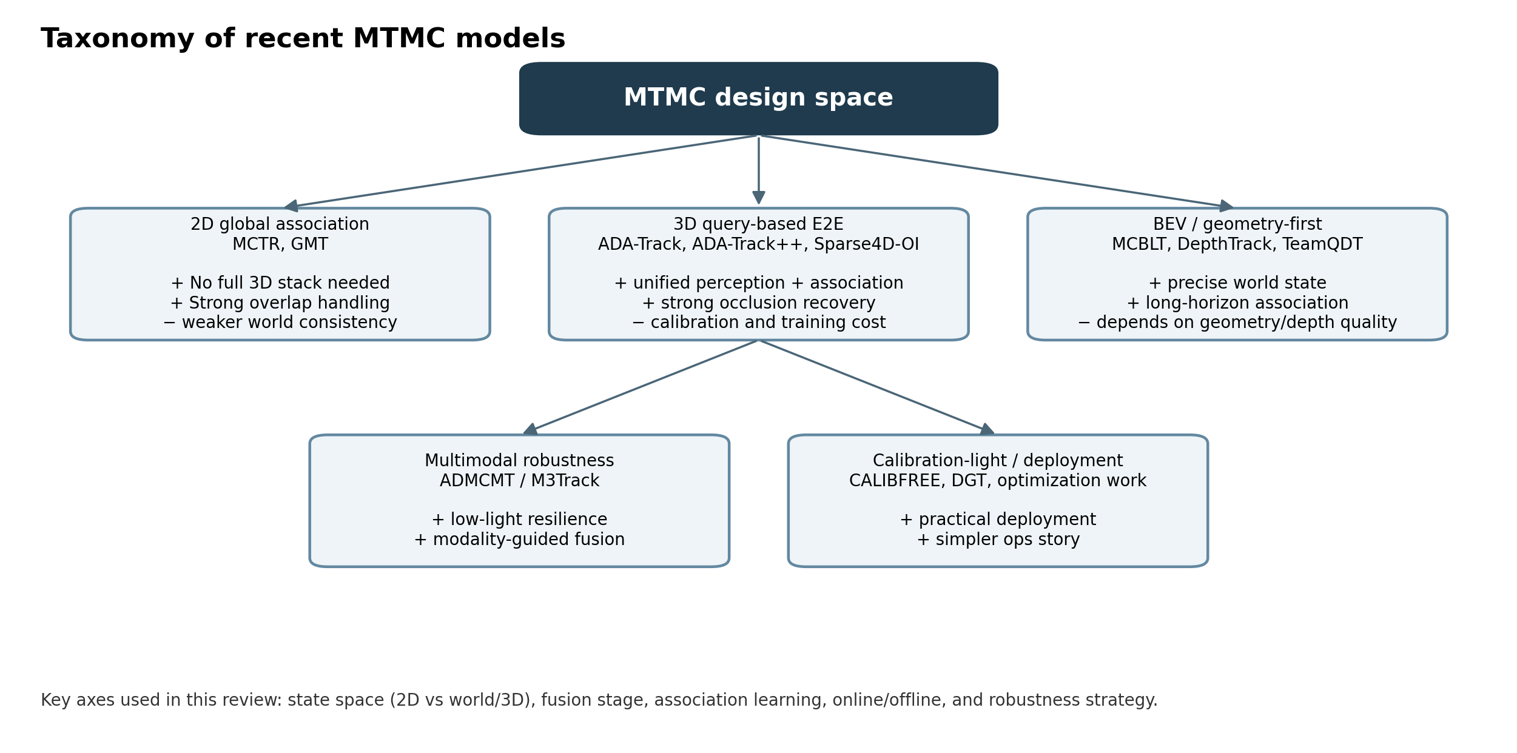
Latest MTMC models
and how to build the next one
Survey review through 12 Mar 2026
Report + recommendations for a production-focused MTMC team
Focus of this deck
• model families
• latest benchmark context
• recommended hybrid stack
MTMC survey · Mar 2026
Notes:
[Sources] - Generated figure: images/taxonomy.png from src/build_assets.py - MCTR https://arxiv.org/abs/2408.13243 - GMT https://arxiv.org/abs/2407.01007 - ADA-Track https://openaccess.thecvf.com/content/CVPR2024/html/Ding_ADA-Track_End-to-End_Multi-Camera_3D_Multi-Object_Tracking_with_Alternating_Detection_and_CVPR_2024_paper.html - ADA-Track++ https://arxiv.org/abs/2405.08909 - MCBLT https://arxiv.org/abs/2412.00692 - ADMCMT https://openaccess.thecvf.com/content/CVPR2025/html/Fan_All-Day_Multi-Camera_Multi-Target_Tracking_CVPR_2025_paper.html [/Sources]

Slide 2
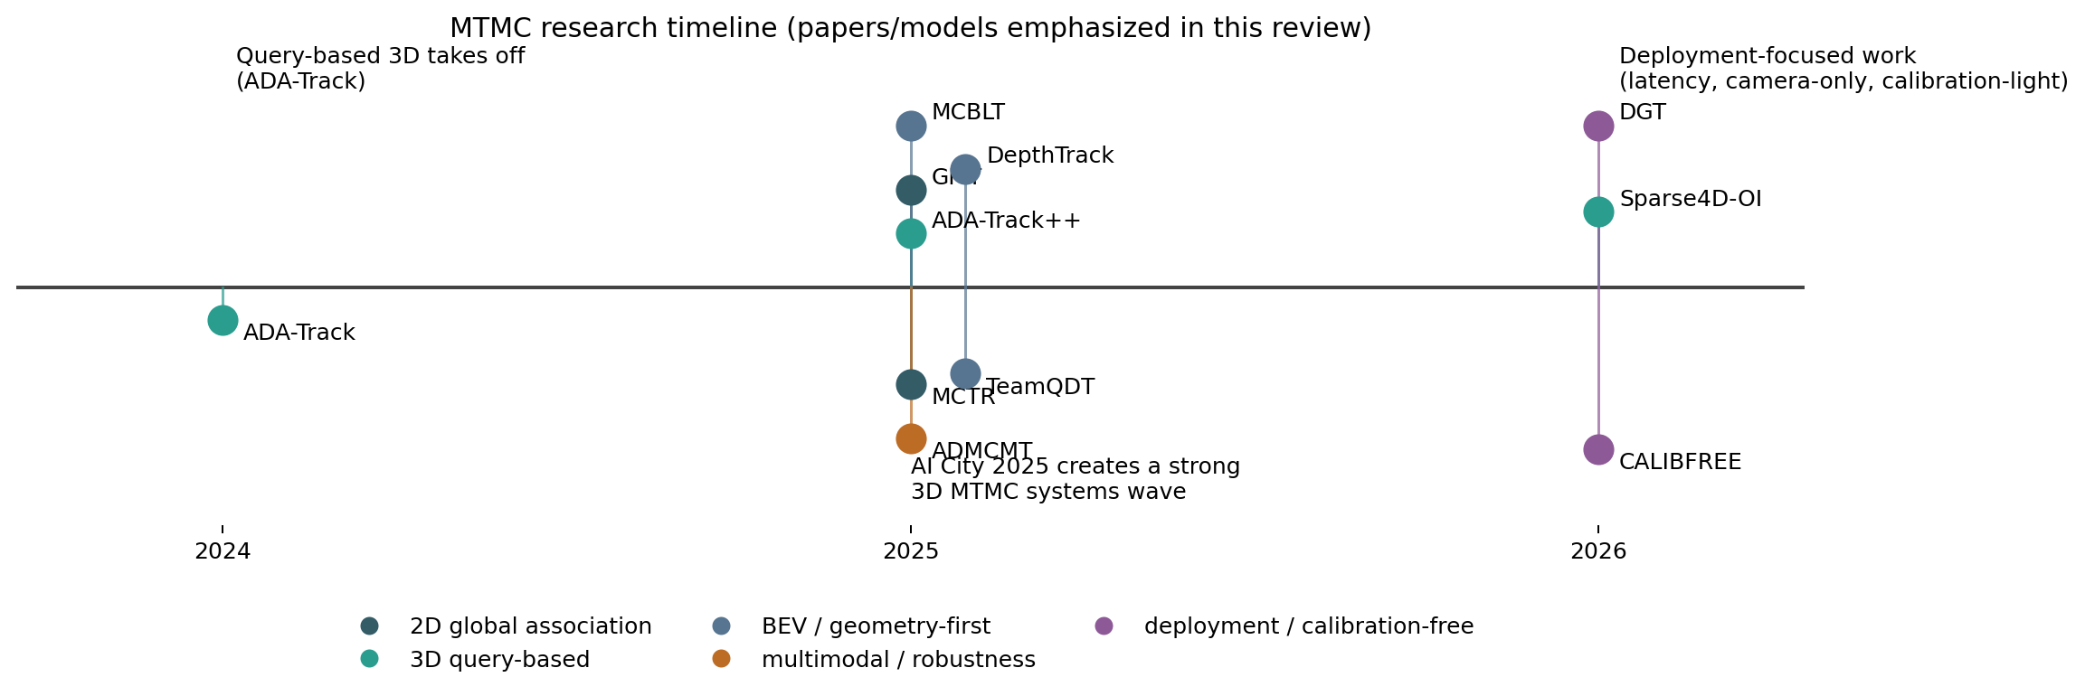
Executive summary
What changed in MTMC research over the last two years
Cross-camera identity is moving from heuristic post-processing to learned global association (MCTR, GMT).
A shared 3D / world state is increasingly the strongest way to stabilize handoff across views (ADA-Track++, MCBLT, Sparse4D-OI).
Deployment constraints now matter explicitly: online mode, camera-only inference, low-light, low-FPS, and calibration-light setups.
Bottom line:
Use a world-coordinate query memory, learn association inside the perception loop, and keep a slower global cleanup path.
MTMC survey · Mar 2026
Notes:
[Sources] - Generated figure: images/timeline.png from src/build_assets.py - MCTR https://arxiv.org/abs/2408.13243 - GMT https://arxiv.org/abs/2407.01007 - ADA-Track https://openaccess.thecvf.com/content/CVPR2024/html/Ding_ADA-Track_End-to-End_Multi-Camera_3D_Multi-Object_Tracking_with_Alternating_Detection_and_CVPR_2024_paper.html - AI City 2025 overview https://arxiv.org/html/2508.13564v1 - Sparse4D outside-in https://arxiv.org/abs/2601.10819 [/Sources]

Slide 3
Taxonomy of the current MTMC landscape
How to read the field
2D global association: simpler stack, strongest when cameras overlap a lot.
3D query-based: most elegant joint perception + association story.
Geometry-first / BEV: often strongest in structured challenge settings.
Multimodal: important only when lighting is a real failure mode.
Calibration-light / deployment: crucial for operational reality.
MTMC survey · Mar 2026
Notes:
[Sources] - Generated figure: images/taxonomy.png from src/build_assets.py - MCBLT https://arxiv.org/abs/2412.00692 - ADMCMT https://openaccess.thecvf.com/content/CVPR2025/html/Fan_All-Day_Multi-Camera_Multi-Target_Tracking_CVPR_2025_paper.html - CALIBFREE https://openreview.net/forum?id=4kb6vectZ3 - DGT https://www.nature.com/articles/s41598-026-35768-z [/Sources]

Slide 4
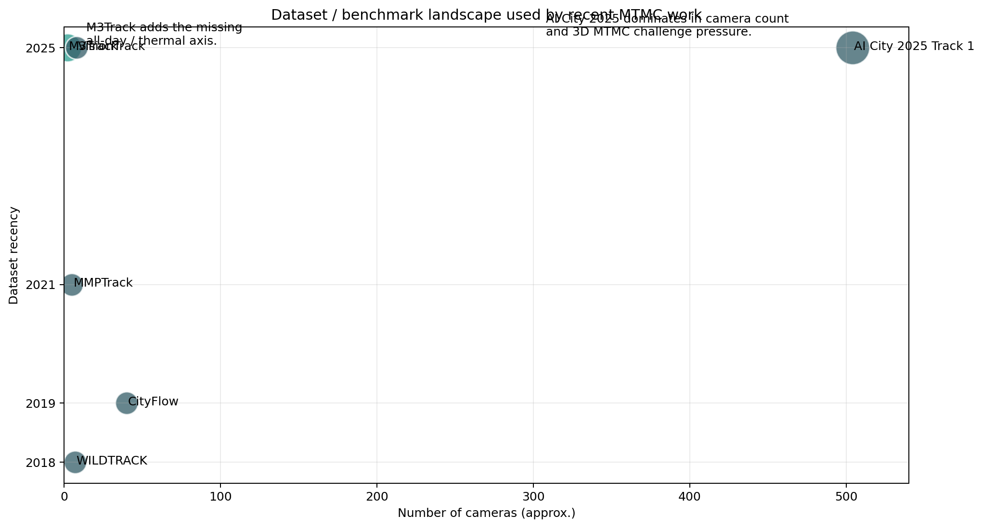
Dataset and benchmark landscape
Why the benchmarks matter
WILDTRACK: calibrated overlapping pedestrians; still useful for geometry and transfer stress tests.
MMPTrack: indoor people benchmark that exposes occlusion-heavy retail failure cases.
M3Track: first strong all-day RGBT MCMT dataset.
AI City 2025 Track 1: most important recent pressure test for large-scale 3D MTMC.
Rule of thumb: pick your benchmark by deployment regime, not by convenience.
MTMC survey · Mar 2026
Notes:
[Sources] - Generated figure: images/dataset_landscape.png from src/build_assets.py - CityFlow https://arxiv.org/abs/1903.09254 - WILDTRACK https://www.epfl.ch/labs/cvlab/data/data-wildtrack/ - M3Track / ADMCMT https://openaccess.thecvf.com/content/CVPR2025/html/Fan_All-Day_Multi-Camera_Multi-Target_Tracking_CVPR_2025_paper.html - AI City 2025 overview https://arxiv.org/html/2508.13564v1 [/Sources]

Slide 5
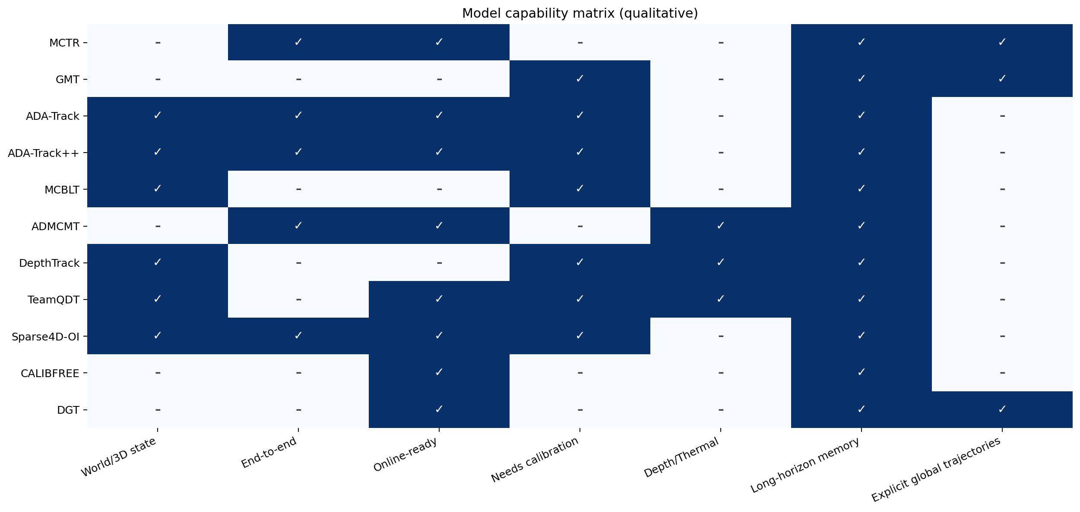
Family 1: 2D global association
The field is moving beyond “single-camera tracks first, cross-camera cleanup later”
Model
Key idea
Headline
MCTR
End-to-end tracking + association modules on top of DETR-like detection
71.81 HOTA / 80.21 IDF1 / 91.19 MOTA on MMPTrack industry; 9 FPS
GMT
Use global trajectories across views as the primary object
Up to +21.3% CVMA / +17.2% CVIDF1 over prior two-stage methods
Best when cameras overlap substantially and you want a lighter stack than full 3D perception.
The conceptual win: multi-camera cues help decide identity early, not only recover mistakes later.
Limitation: world consistency is still weaker than in world-coordinate / 3D systems.
MCTR and GMT are the clearest modern rejection of heuristic-heavy late MTMC.
MTMC survey · Mar 2026
Notes:
[Sources] - MCTR https://arxiv.org/abs/2408.13243 - GMT https://arxiv.org/abs/2407.01007 - Generated figure: images/comparison_matrix.png from src/build_assets.py [/Sources]

Slide 6
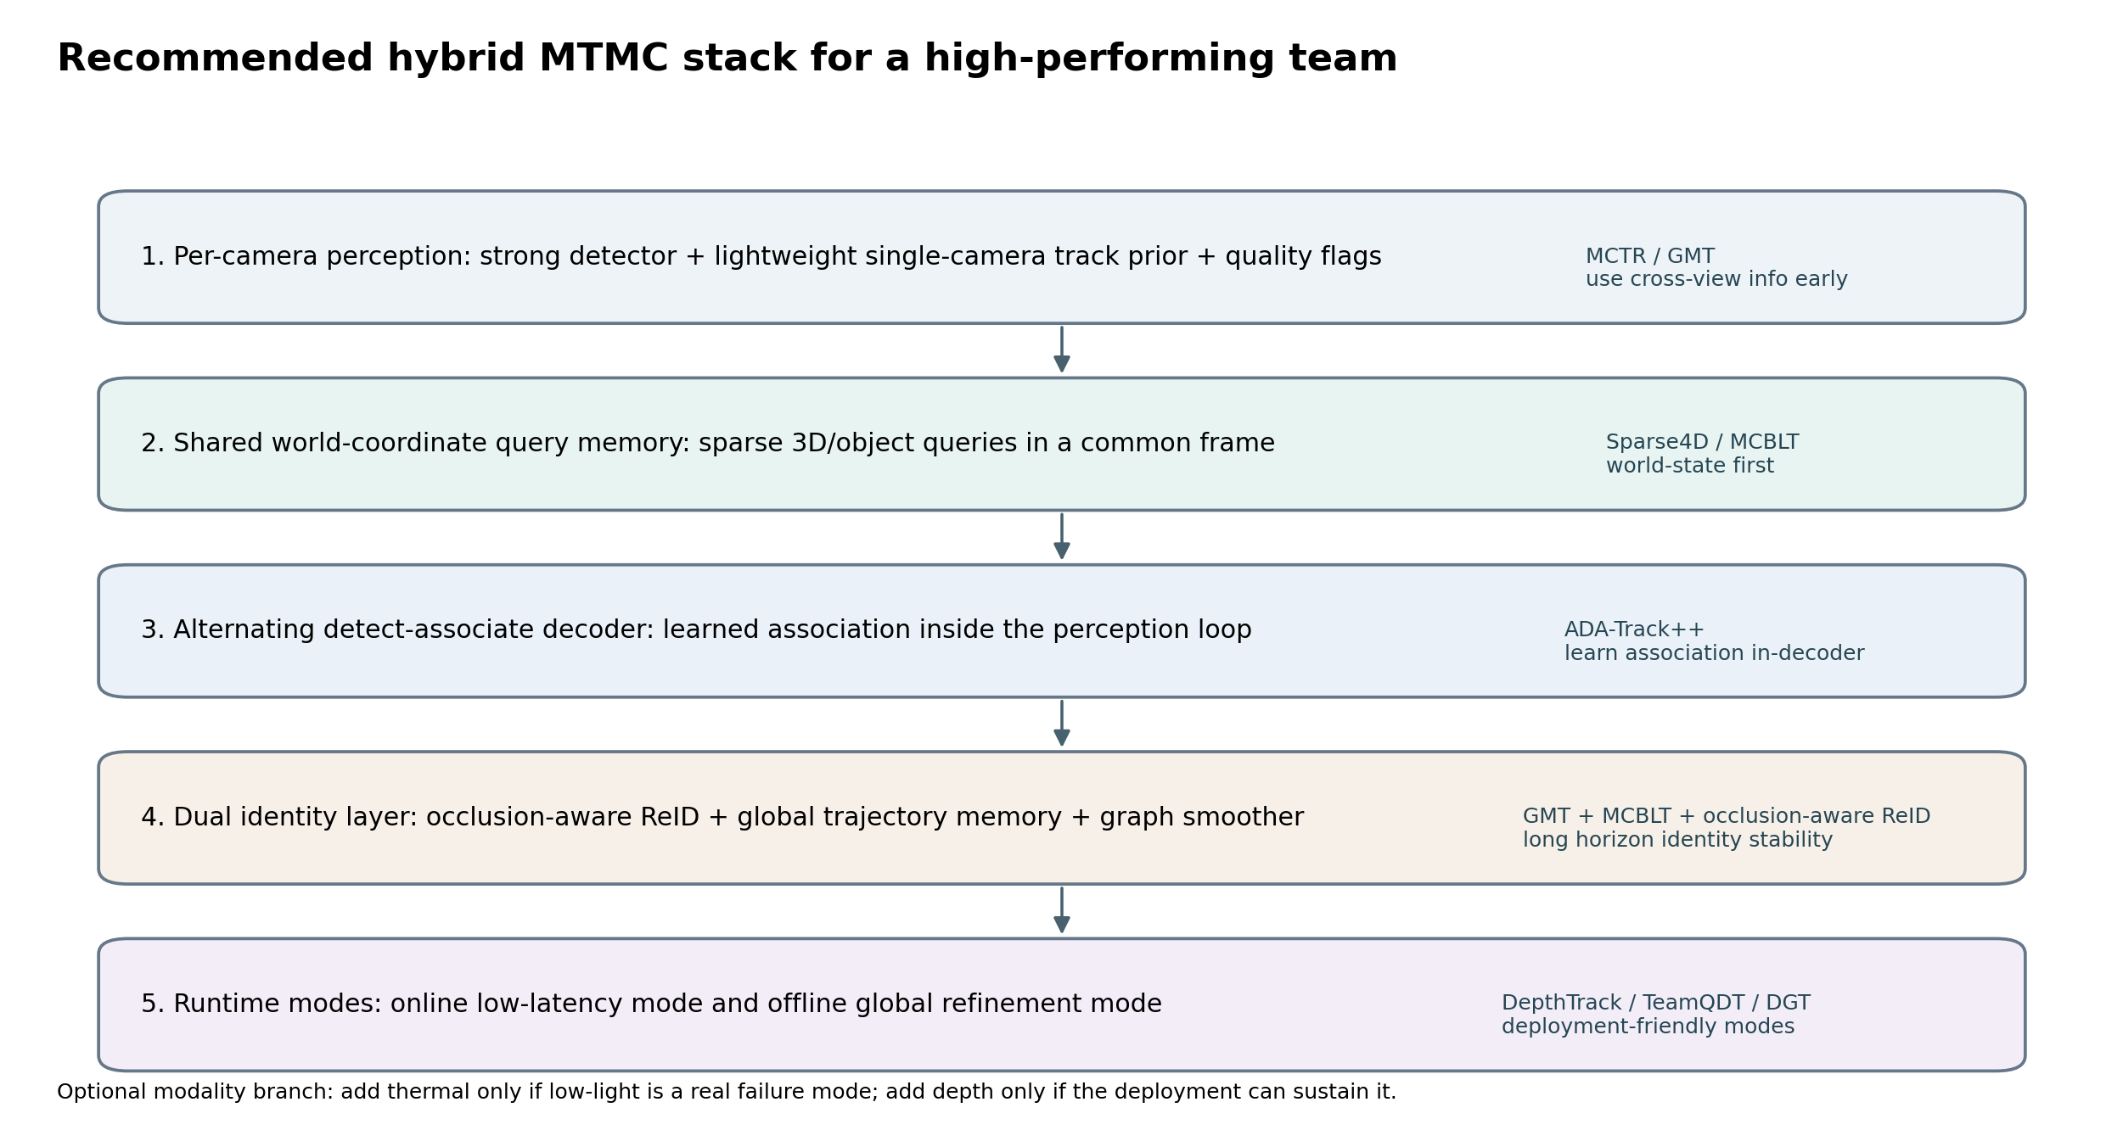
Family 2: query-based 3D systems
Shared object queries + temporal memory are becoming the cleanest MTMC abstraction
Model
What changed
Why it matters
ADA-Track
Alternating detection and association in the decoder
Bridges tracking-by-attention and tracking-by-detection
ADA-Track++
Edge-augmented association + auxiliary token
Improves association stability and raises AMOTA
Sparse4D-OI
Adapts sparse query memory to outside-in static camera networks
Best online camera-only result among reported AI City 2025 systems
Shared pattern: the model tracks persistent objects, not just boxes.
MTMC survey · Mar 2026
Notes:
[Sources] - ADA-Track https://openaccess.thecvf.com/content/CVPR2024/html/Ding_ADA-Track_End-to-End_Multi-Camera_3D_Multi-Object_Tracking_with_Alternating_Detection_and_CVPR_2024_paper.html - ADA-Track++ https://arxiv.org/abs/2405.08909 - Sparse4D outside-in https://arxiv.org/abs/2601.10819 - Generated figure: images/recommended_stack.png from src/build_assets.py [/Sources]

Slide 7
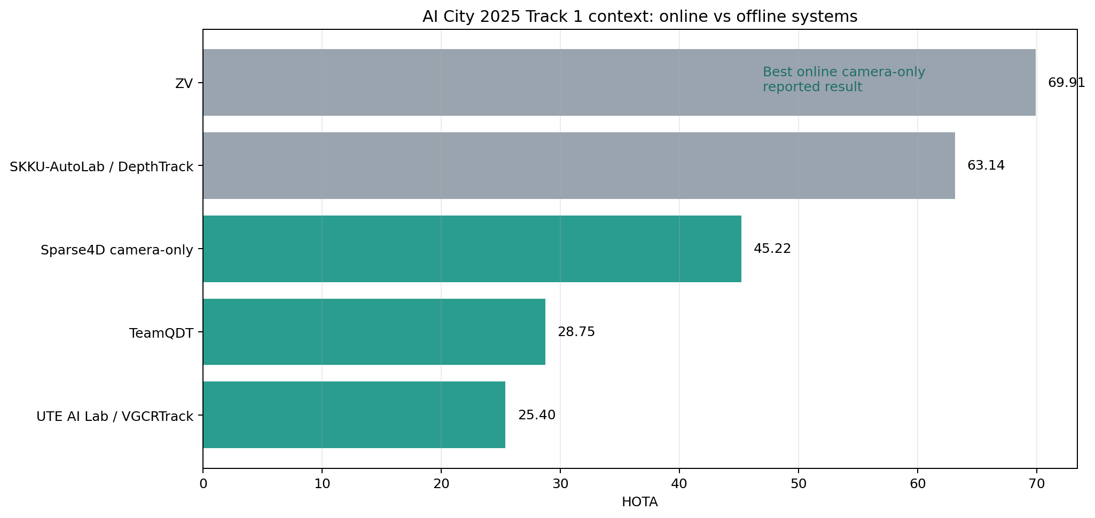
Family 3: geometry-first / challenge systems
The strongest structured-environment results still lean heavily on geometry, BEV, depth, and long-horizon association
MCBLT: BEV + hierarchical GNNs; strong evidence that world-state-first design helps long videos.
DepthTrack: Tracklet-Cluster Mapping links BEV tracklets with 3D point clusters; 2nd place on AI City 2025 Track 1.
TeamQDT: practical recipe that upgrades an existing 2D MTMC stack into 3D with late depth fusion.
Takeaway: if your deployment resembles a warehouse or synthetic smart-space benchmark, geometry is still a huge advantage.
MTMC survey · Mar 2026
Notes:
[Sources] - MCBLT https://arxiv.org/abs/2412.00692 - DepthTrack https://openaccess.thecvf.com/content/ICCV2025W/AICity/papers/Tran_DepthTrack_Cluster_Meets_BEV_for_Multi-Camera_Multi-Target_3D_Tracking_ICCVW_2025_paper.pdf - TeamQDT https://arxiv.org/html/2509.09946v1 - AI City 2025 overview https://arxiv.org/html/2508.13564v1 - Generated figure: images/ai_city_2025_context.png from src/build_assets.py [/Sources]

Slide 8
Family 4: robustness and deployment
The latest papers are finally tackling the failure modes product teams actually care about
Three important directions
ADMCMT / M3Track: use thermal + lighting-guided fusion for all-day tracking.
CALIBFREE: learn view-agnostic embeddings without precise calibration or labels (promising but still immature).
DGT and optimization work: prioritize latency, online global tracking, low-FPS robustness, and camera scalability.
Guiding principle: add complexity only when it removes a real failure mode.
MTMC survey · Mar 2026
Notes:
[Sources] - ADMCMT / M3Track https://openaccess.thecvf.com/content/CVPR2025/html/Fan_All-Day_Multi-Camera_Multi-Target_Tracking_CVPR_2025_paper.html - CALIBFREE https://openreview.net/forum?id=4kb6vectZ3 - DGT https://www.nature.com/articles/s41598-026-35768-z - Sparse4D optimization https://arxiv.org/abs/2602.00450 - Generated figure: images/dataset_landscape.png from src/build_assets.py [/Sources]

Slide 9
Compare and contrast: what each family buys you
Decision rule
If ops simplicity wins: start near MCTR / GMT.
If long-horizon identity wins: move to world-state / 3D.
If low light wins: add thermal, not just a better ReID head.
If calibration is unstable: keep a calibration-light backup path.
If latency wins: protect online mode and use offline refinement separately.
MTMC survey · Mar 2026
Notes:
[Sources] - Generated figure: images/comparison_matrix.png from src/build_assets.py - Review synthesis from cited papers in report.md [/Sources]

Slide 10
Recommended hybrid stack for your MTMC team
Combine the best ideas instead of copying any single paper end to end
What to borrow
World-coordinate query memory from Sparse4D / MCBLT.
In-loop association from ADA-Track++.
Global trajectory memory from GMT.
Occlusion-aware identity layer and optional graph smoother.
Two runtime modes: online serving and offline reprocessing.
MTMC survey · Mar 2026
Notes:
[Sources] - Generated figure: images/recommended_stack.png from src/build_assets.py - Sparse4D outside-in https://arxiv.org/abs/2601.10819 - ADA-Track++ https://arxiv.org/abs/2405.08909 - GMT https://arxiv.org/abs/2407.01007 - MCBLT https://arxiv.org/abs/2412.00692 [/Sources]

Slide 11
Execution roadmap and evaluation
4-phase build plan
Metrics that matter
Phase 1: strong online RGB baseline with world-state query memory.
Phase 2: add learned in-loop association and test AssA / IDF1 lift.
Phase 3: add long-horizon global cleanup or graph smoothing.
Phase 4: add thermal, depth, or calibration-light modules only if production evidence justifies them.
HOTA, IDF1, AssA, MOTA: standard view of quality.
AvgTrackDur (or equivalent): continuity of identity over time.
Latency / FPS at target camera count, not only single-scene speed.
Failure buckets: low light, occlusion, camera handoff, calibration drift.
Target outcome: best online quality under realistic sensor assumptions.
MTMC survey · Mar 2026
Notes:
[Sources] - Sparse4D optimization / AvgTrackDur https://arxiv.org/abs/2602.00450 - Review synthesis from report.md and cited papers [/Sources]

