Slide 1

Knowledge http://117.135.137.57:15604/mockup/knowledge.html
v
Red line under the header missing, I think this will be for all the headers in all the pagpes.

Slide 2
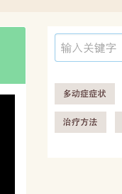
Knowledge http://117.135.137.57:15604/mockup/knowledge.html
Padding is too much on both sides.
Design shows gaps are smallerd.

Slide 3
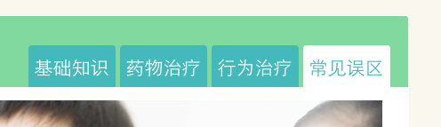
Knowledge http://117.135.137.57:15604/mockup/knowledge.html
v
Button sizing are smaller then the ones in the design. All sizes need changing.

Slide 4
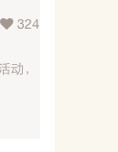
Knowledge http://117.135.137.57:15604/mockup/knowledge.html
v
Card sizing is also wrong. All sizes need changing.

Slide 5
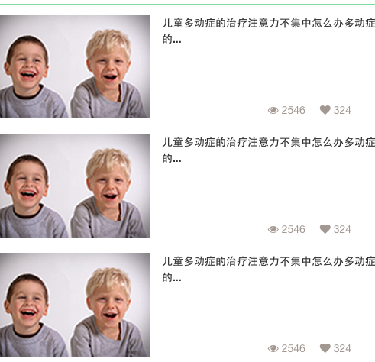
Knowledge http://117.135.137.57:15604/mockup/knowledge.html
v
Could we make the 768 break around 550? As it gives way too much space when the
sizes increase.

