Slide 1
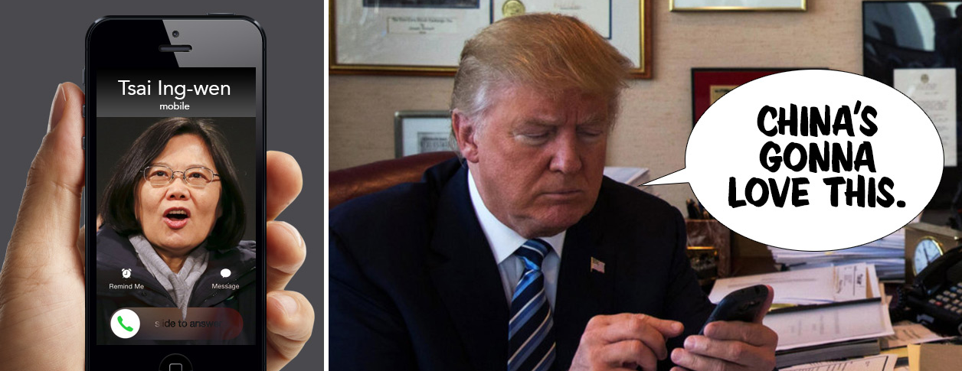
Trump's Taiwan Call What are people tweeting regarding Trump’s Taiwan call ? Dataset Pitch (Team 4)
趙上涵 Ricardo S. Chao
楊曜丞
趙晟瑋 Spencer Chao

Slide 2
Today’s Outline
Our Target
Dataset Overview
Procedures

Slide 3
Today’s Outline
Our Target
Dataset Overview
Procedures

Slide 4
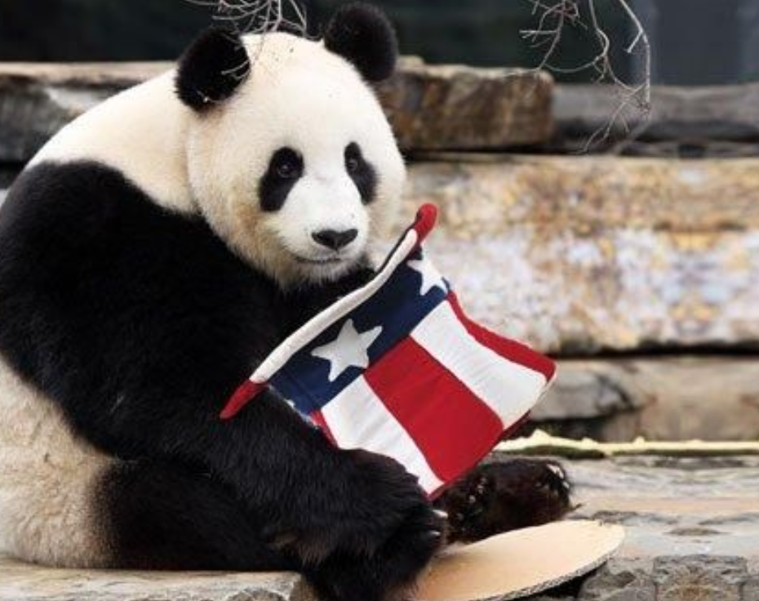
“Out main goal is to apply data analytics techniques we’ve learned to our dataset with tools manufactured by ourselves and with mathematical concept in our mind.”
Mathematical Concepts
More Handmade Models
Natural Language Processing Techniques

Slide 5
Today’s Outline
Our Target
Dataset Overview
Procedures

Slide 6
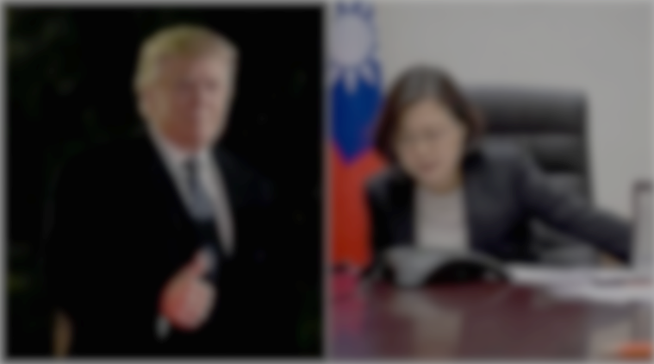
Trump's phone call with Taiwan president risks China's wrath
The Guardian | Sat 3 Dec 2016 10.19 GMT | https://reurl.cc/Y14aoL
Donald Trump looked to have sparked a potentially damaging diplomatic row with China on Friday after speaking to Taiwanese president Tsai Ing-wen on the telephone in a move experts said would anger Beijing.
The call, first reported by the Taipei Times and confirmed by the Financial Times, is thought to be the first between the leader of the island and a US president or president-elect since ties between America and Taiwan were severed in 1979, at Beijing’s behest.

Slide 7
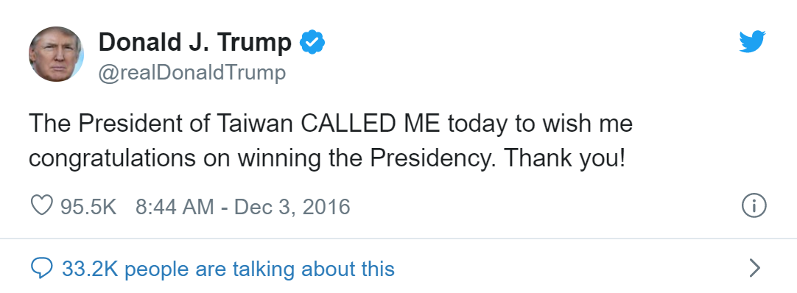
Trump's phone call with Taiwan president risks China's wrath
The Guardian | Sat 3 Dec 2016 10.19 GMT | https://reurl.cc/Y14aoL
Donald Trump looked to have sparked a potentially damaging diplomatic row with China on Friday after speaking to Taiwanese president Tsai Ing-wen on the telephone in a move experts said would anger Beijing.
The call, first reported by the Taipei Times and confirmed by the Financial Times, is thought to be the first between the leader of the island and a US president or president-elect since ties between America and Taiwan were severed in 1979, at Beijing’s behest.

Slide 8

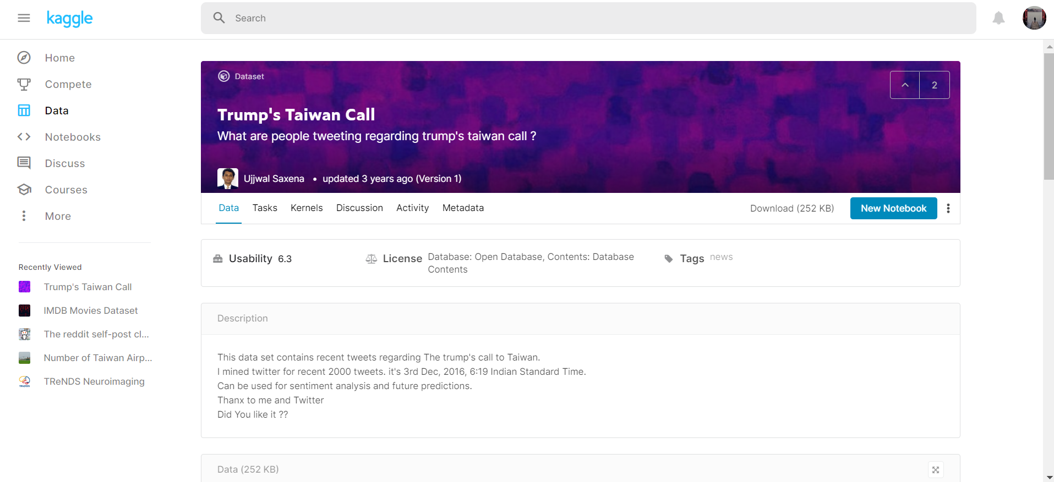

Slide 9


Dataset Overview
RT @SteveSGoddard: The @nytimes was thrilled by Obama talking to Communist dictator Castro, and horrified by Trump talking to the elected l??e
RT @anneapplebaum: How do we know that the Trump overtures towards Taiwan and the Phillipines aren't motivated by personal commercial inter??
RT @NolteNC: Trump should fire off a tweet claiming he got drunk and played 5 hours of Grand Theft Auto with the Taiwan president.
Trump Speaks With Taiwan???? Leader, an Affront to China https://t.co/AEeTzcpNS7 #SouthChinaSea #AsiaPacificnd

Slide 10
Dataset Overview
Tweet Type
At Sign
RT @SteveSGoddard: The @nytimes was thrilled by Obama talking to Communist dictator Castro, and horrified by Trump talking to the elected l??e
RT @anneapplebaum: How do we know that the Trump overtures towards Taiwan and the Phillipines aren't motivated by personal commercial inter??
Tweet Content
RT @NolteNC: Trump should fire off a tweet claiming he got drunk and played 5 hours of Grand Theft Auto with the Taiwan president.
Trump Speaks With Taiwan???? Leader, an Affront to China https://t.co/AEeTzcpNS7 #SouthChinaSea #AsiaPacificnd
Link
Hashtag

Slide 11
Dataset Overview
1229 tweets. (with 775 unique values.)
(May have to crawl additional data from twitter for later word2vec model build-up)
.csv file (each row represent an entry of the data.)
Include various “Twitter Slangs”, such as @ Sign, Hashtag , RT, etc.
Lots of noise, and misspellings.
Without labels.
(We would have to label the data by ourselves, e.g. pos & neg)

Slide 12
Today’s Outline
Our Target
Dataset Overview
Procedures

Slide 13
Exploratory Data Analysis (EDA)
Tokenizing, Word Embedding
Building Models
Parameter Tuning
Result Interpretation

Slide 14
Exploratory Data Analysis (EDA)
Tokenizing, Word Embedding
Building Models
Parameter Tuning
Result Interpretation
Standard Data Cleaning Measures
tf-idf Calculation
Word2Vec Model.
Regressions, Decision Tree, etc.

