Slide 1
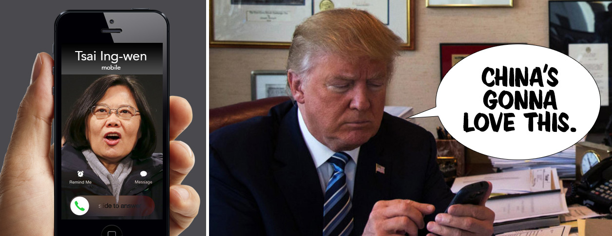
Trump's Taiwan Call What are people tweeting regarding Trump’s Taiwan call ? Dataset Pitch (Team 4)
趙上涵 Ricardo S. Chao
楊曜丞 Dylan Yang
趙晟瑋 Spencer Chao

Slide 2
Outline
Noise estimating & Data splitting
Problem Domain
Data Overview
Data representation
Interpretation
Modeling
Conclusion
Conclusion

Slide 3
Problem Domain
Noise estimating & Data splitting
Problem Domain
Data Overview
Data representation
Interpretation
Modeling
Conclusion
Conclusion

Slide 4
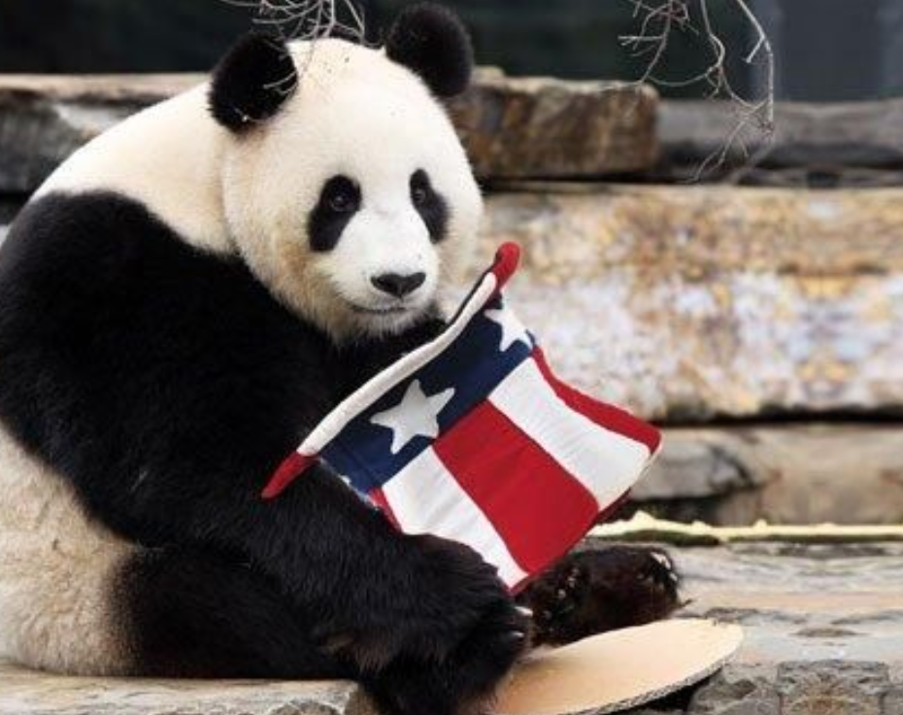
PROBLEM DOMAIN: Issue
“We are curious about the political tendency of each tweet. Could we classify all the tweets into different groups with different political tendencies?”
Pro-Trump
Anti-Trump

Slide 5
PROBLEM DOMAIN: Goal
“To resolve the issue, our main goal is to apply unsupervised algorithm we’ve learned to our dataset (tweets) with tools manufactured by ourselves and with mathematical concept in our mind.”
Mathematical Concepts
More Handmade Models
Natural Language Processing Techniques

Slide 6
Data Overview
Noise estimating & Data splitting
Problem Domain
Data Overview
Data representation
Interpretation
Modeling
Conclusion
Conclusion

Slide 7

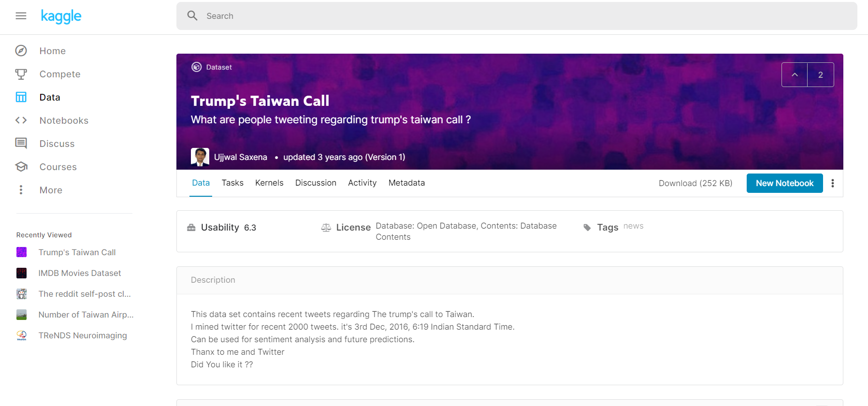
Dataset Overview

Slide 8

Dataset Overview
TWEETS
RT @SteveSGoddard: The @nytimes was thrilled by Obama talking to Communist dictator Castro, and horrified by Trump talking to the elected l??e
Oops. RT @thehill: Trump breaks decades of US protocol with phone call to Taiwan leader https://t.co/YU2x04PhV7 https://t.co/2WXDViC7lK
Donald Trump? call with Taiwan president was no surprise: Official https://t.co/F8TzF1U9UPps
RT @ShubieDobee: So, Trump spoke to the president of Taiwan.
Trumps wants to build hotel and resorts in Taiwan.
Does anyone see a CONFLICT???n
Same mental midgets that defended Castro https://t.co/Nrt2yCb7M0 are mad Trump talked to Taiwan
RT @guardian: Trump's Taiwan phone call preceded by hotel development inquiry https://t.co/nqKTBVr3eK
RT @laseptiemewilay: 1-About Trump's phone call to Taiwan's. First, it's a major diplomatic incident. Second, as part of the US normalizati??e
Trump Speaks With Taiwan? Leader, an Affront to China https://t.co/AEeTzcpNS7 #SouthChinaSea #AsiaPacificnd
RT @RawStory: REVEALED: Trump Organization eyes Taiwan for newest luxury resort location https://t.co/RuaFG6YTub https://t.co/je0TE0LXbE
RT @terrymendozer: Obama will not release info to congress on refugees deal and y'all worried about a congratulatory call from our ally Tai??e
RT @thehill: Trump says Taiwan leader called him, though Taiwan paper says Trump staffer arranged call https://t.co/QYprHM5BLs https://t.co??e
RT @_Makada_: Hoaxing media says Trump isn't allowed to talk to Taiwan, but Obama can sell them $1.83 billion worth of weapons?
https://t.??:
RT @kurteichenwald: I wonder how conservs will respond to Trump having just reversed a China/Taiwan policy put in place by Reagan &amp; honored??
RT @realwesmyers: Can you believe Donald Trump took a call from Taiwan without having them donate to his private foundation first?
RT @terrymendozer: Obama will not release info to congress on refugees deal and y'all worried about a congratulatory call from our ally Tai??e
@MarkJKremer @realDonaldTrump MSM continues to lie lie lie. Taiwan called Trump. He didn't call Taiwan.
RT @EricLiptonNYT: Trump Org: "we are not planning any expansion into Taiwan." How abt this? Great find @mega2e https://t.co/zBLAHLeJmz htt??e

Slide 9
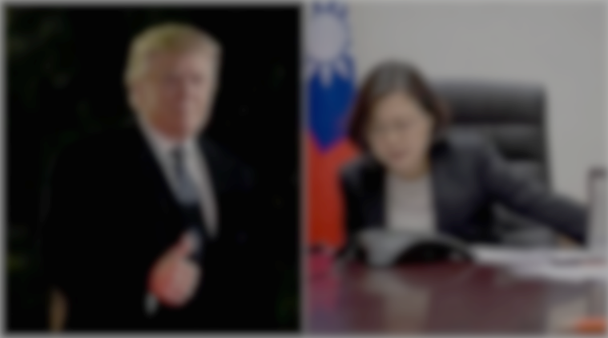
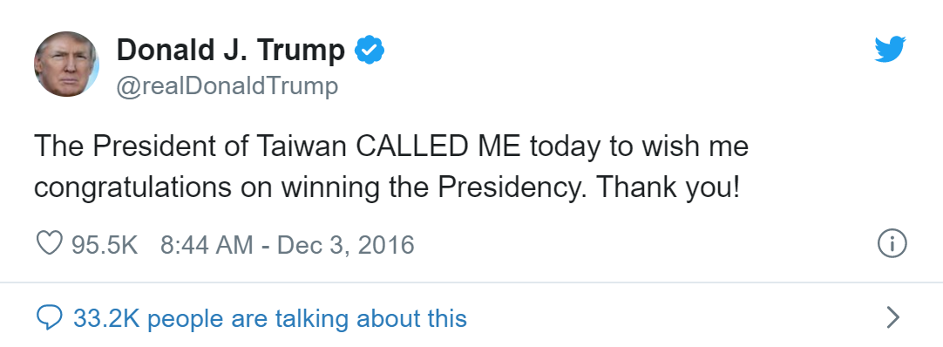
Dataset Overview
Trump's phone call with Taiwan president risks China's wrath
The Guardian | Sat 3 Dec 2016 10.19 GMT | https://reurl.cc/Y14aoL
Donald Trump looked to have sparked a potentially damaging diplomatic row with China on Friday after speaking to Taiwanese president Tsai Ing-wen on the telephone in a move experts said would anger Beijing.
The call, first reported by the Taipei Times and confirmed by the Financial Times, is thought to be the first between the leader of the island and a US president or president-elect since ties between America and Taiwan were severed in 1979, at Beijing’s behest.

Slide 10


Dataset Overview
RT @SteveSGoddard: The @nytimes was thrilled by Obama talking to Communist dictator Castro, and horrified by Trump talking to the elected l??e
Kate is donating a #kidney to her husband http://t.co/Xg95n9tFkE . You can help! I did @fundanything #donate
Retweet Without Comment
@Canvasguru: Lol! RT @martintagg: .@realDonaldTrump You've been popular with ladies for a while. What's your secret handsome?" My hair!
Tweet
Retweet With Comment

Slide 11
Dataset Overview
Tweet Type
At Sign
Retweet Text
RT @SteveSGoddard: The @nytimes was thrilled by Obama talking to Communist dictator Castro, and horrified by Trump talking to the elected l??e
Tweet Content
Link
Kate is donating a #kidney to her husband http://t.co/Xg95n9tFkE . You can help! I did @fundanything #donate
Retweet Without Comment
Hashtag
Personal Comment
@Canvasguru: Lol! RT @martintagg: .@realDonaldTrump You've been popular with ladies for a while. What's your secret handsome? My hair!
Tweet
Retweet With Comment

Slide 12
Dataset Overview
1229 tweets. (with 775 unique values.)
(May have to crawl additional data from twitter for later word2vec model build-up)
.csv file (each row represent an entry of the data.)
Include various “Twitter Slangs”, such as @ Sign, Hashtag , RT, etc.
Lots of noise, and misspellings.
Without labels.

Slide 13
Dataset Overview
Mojibake
Donald Trump?雓?call with Taiwan president was no surprise: Official https://t.co/F8TzF1U9UPps
RT @charliekirk11: Trump takes a congratulatory phone call from Taiwan and gets from grief from the media than Obama giving $500 billion to??e
RT @terrymendozer: Obama will not release info to congress on refugees deal and y'all worried about a congratulatory call from our ally Tai??e
Misspelling
Misspelling
→Before applying models, noise should be estimated.

Slide 14
Noise estimating & Data splitting
Noise estimating & Data splitting
Problem Domain
Data Overview
Data representation
Interpretation
Modeling
Conclusion
Conclusion

Slide 15
Purpose
Noise estimating
Data splitting
To make sure that only the important part of the corpora are fed into the models and ensure the accuracy of the result.
To split the important content of the tweet into individual vocabularies and input into the model.
Notes:
https://books.google.com.tw/books?id=HxmdDwAAQBAJ&pg=PA11&lpg=PA11&dq=Noise+Removal+natural+language&source=bl&ots=lQEYvoC4VW&sig=ACfU3U2KBAzXS_KJ1cZBhyyTE29hYzvkWw&hl=zh-TW&sa=X&ved=2ahUKEwigkNGy5oLqAhUsK6YKHU4CCrsQ6AEwA3oECAgQAQ#v=onepage&q=Noise%20Removal%20natural%20language&f=false

Slide 16
Noise estimating
To make sure that only the important part of the corpora are fed into the models and ensure the accuracy of the result. We had defined the noises:
Mojibake
Stop Words
Lowercase
Donald Trump?雓?call with Taiwan president was no surprise: Official https://t.co/F8TzF1U9UPps to??e #donate
Punctuation
donald call taiwan surprise official
Link
Misspelling
Notes:
https://books.google.com.tw/books?id=HxmdDwAAQBAJ&pg=PA11&lpg=PA11&dq=Noise+Removal+natural+language&source=bl&ots=lQEYvoC4VW&sig=ACfU3U2KBAzXS_KJ1cZBhyyTE29hYzvkWw&hl=zh-TW&sa=X&ved=2ahUKEwigkNGy5oLqAhUsK6YKHU4CCrsQ6AEwA3oECAgQAQ#v=onepage&q=Noise%20Removal%20natural%20language&f=false

Slide 17
Data splitting
To split the important content of the tweet into individual elements and input to the model.
Donald Trump?雓?call with Taiwan president was no surprise: Official https://t.co/F8TzF1U9UPps to??e #donate
donald call taiwan surprise official
RETWEET?: 0
donald
call
taiwan
surprise
official

Slide 18
Data splitting
is_RT | retweet_from | stopwords_removed_original_text
0 |  | mysticwolf12001 cmon one beating clinton
0 |  | chadwilliams91 ill move states you are hired thanks
0 |  | hunterbalthazor ran president vote back track
0 |  | kyleraccio vinnytitone think hell lead polls like healthy trump
0 |  | harrycraig96
0 |  | americanwoman00 great greta awesome thank you
0 |  | people proud fact obama birth certificate book miraculously
0 |  | garrykennedy great greta huge fan really inspire me thank you
0 |  | carlotalorenabr fact realdonaldtrump run excited
1 | DanScavino | join amp vpeotus pence live west allis wisconsin thankyoutour2016
1 | DanScavino | join live mobile alabama via thankyoutour2016 watch
1 |  | importing homeland agree mr trump
1 | realDonaldTrump | happy
1 | Reince | happy year blessings all looking forward things 2017 realdonaldtrump
1 | IvankaTrump | 2016 one exciting years life wish peace love happy new
1 | jamestaranto | serious people worry start war trump phone taiwans crazy oe
1 |  | photos show public
1 | DanScavino | one think photo says all
1 | King_Pepp | driving tons ugly realdonaldtrump talking
1 | realDonaldTrump | secret getting getting started twain

Slide 19
Data representation
Noise estimating & Data splitting
Problem Domain
Data Overview
Data representation
Interpretation
Modeling
Conclusion
Conclusion

Slide 20
Vector Space model
Since the content of tweets is mostly unstructured, the Vector Space model must be used to convert it into structured data and obtain useful information.
BOW (Bag of word)
WORD2Vec

Slide 21


BOW (Bag of Words)
BOW is a common representation of documents. The representation of a document d is the set of weight of its term.
Mary is quicker than John.
Sentence | Mary | John | Alex | quicker
Mary is quicker than John. | 1 | 1 | 0 | 1
John is quicker than Alex. | 0 | 1 | 1 | 1
John is quicker than Alex.

Slide 22
BOW (Bag of Words)
BOW is a common representation of documents. The representation of a document d is the set of weight of its term.
[CONS. 1] The Ordering of the terms is ignored!!!
Mary is quicker than John.
Sentence | Mary | John | Alex | quicker
Mary is quicker than John. | 1 | 1 | 0 | 1
John is quicker than Mary. | 1 | 1 | 0 | 1
[CONS. 2] If most of the feature vectors are sparse, bag-of-words feature matrix would be a sparse matrix!!!
John is quicker than Mary.

Slide 23

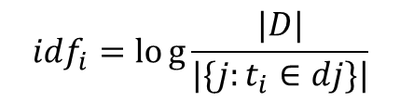
TF-IDF
TF-IDF (Term Frequency-Inverse Document Frequency) is an unsupervised learning algorithm and a statistical method that often be used to evaluate how important a word is to whole data. TF-IDF Keyword extraction is commonly used as a weighted method of information retrieval and text exploration.
TF
IDF
$$tf_{i,j}=\frac{n_{i,j}}{\sum_{k}{n_{k,j}}}$$
TF-IDF
$$idf_{i}=log{\frac{|D|}{|\{j:t_{i}∈dj\}|}}$$
The importance of the word
The frequency of the word’s occurrence
Inverse Document Frequency

Slide 24

TF-IDF
TF-IDF (Term Frequency-Inverse Document Frequency) is an unsupervised learning algorithm and a statistical method that often be used to evaluate how important a word is to whole data. TF-IDF Keyword extraction is commonly used as a weighted method of information retrieval and text exploration.
The weight of term t in document d is:
High, when t occurs many times in d and appears within a small number of documents.
Low, when t is a rare term in d and occurs in virtually all documents in the collection.
Sentence | Mary | John | Alex | quicker
Mary is quicker than John. | 0.34 | 1.56 | 0 | 5.16
John is quicker than Alex. | 0 | 1.56 | 0.54 | 5.16

