Slide 1
Image Metadata Extraction –– Drain the Data Swamp
Chaofeng Wu
Advisor: Kyle Chard, Tyler J. Skluzacek, Ian Foster
Computational Institute
The University of Chicago
Notes:
Image matadata extraction
-- drain the data Swamp

Slide 2
Motivation

Slide 3
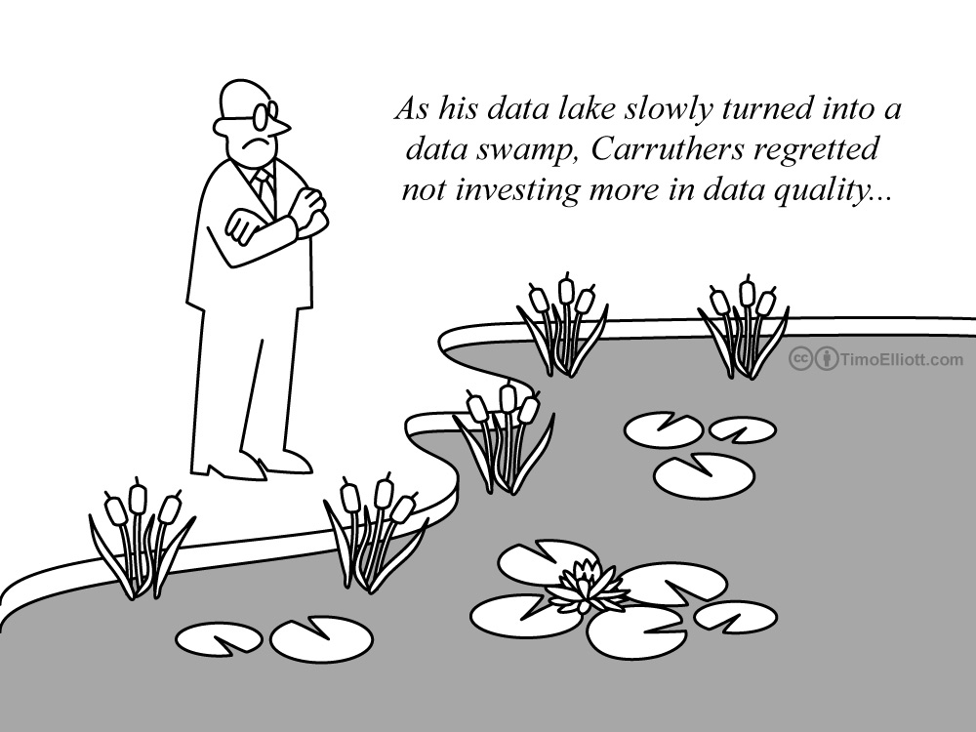
Notes:
The move towards data-driven science has resulted in a data explosion
Scientific file systems and data repositories continue to grow at alarming rate
Repositories quickly become data swamps if without considerable continued investment
Poor organization and clutter in large scientific repositories complicates data discovery and analysis

Slide 4
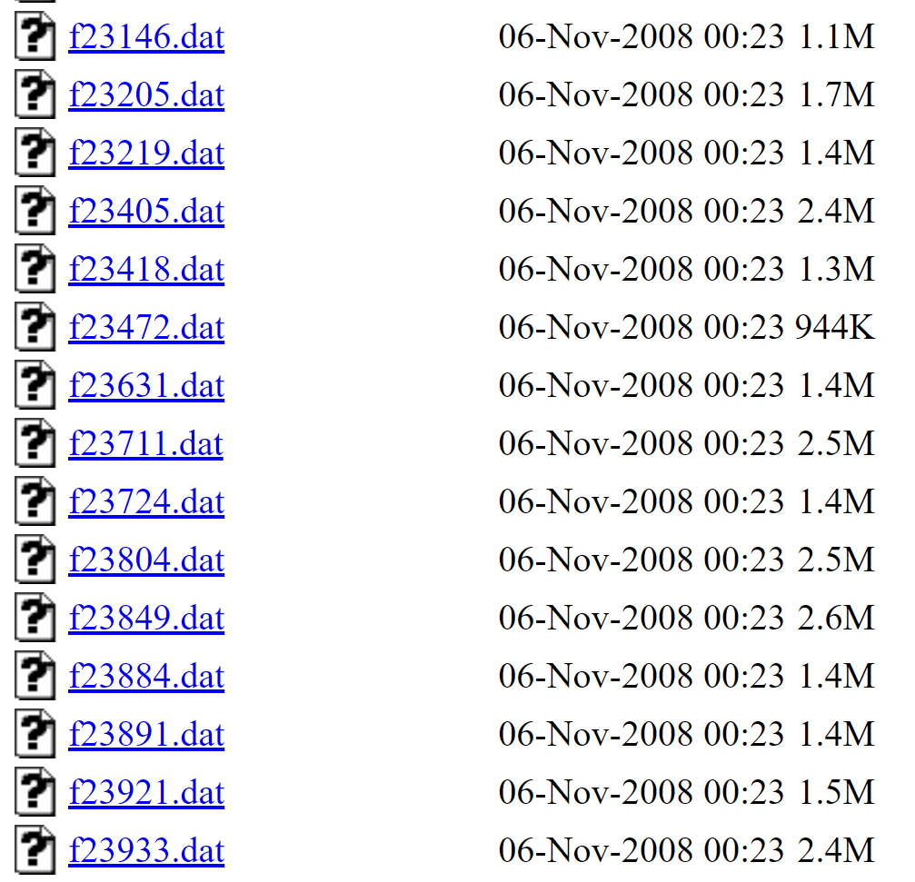
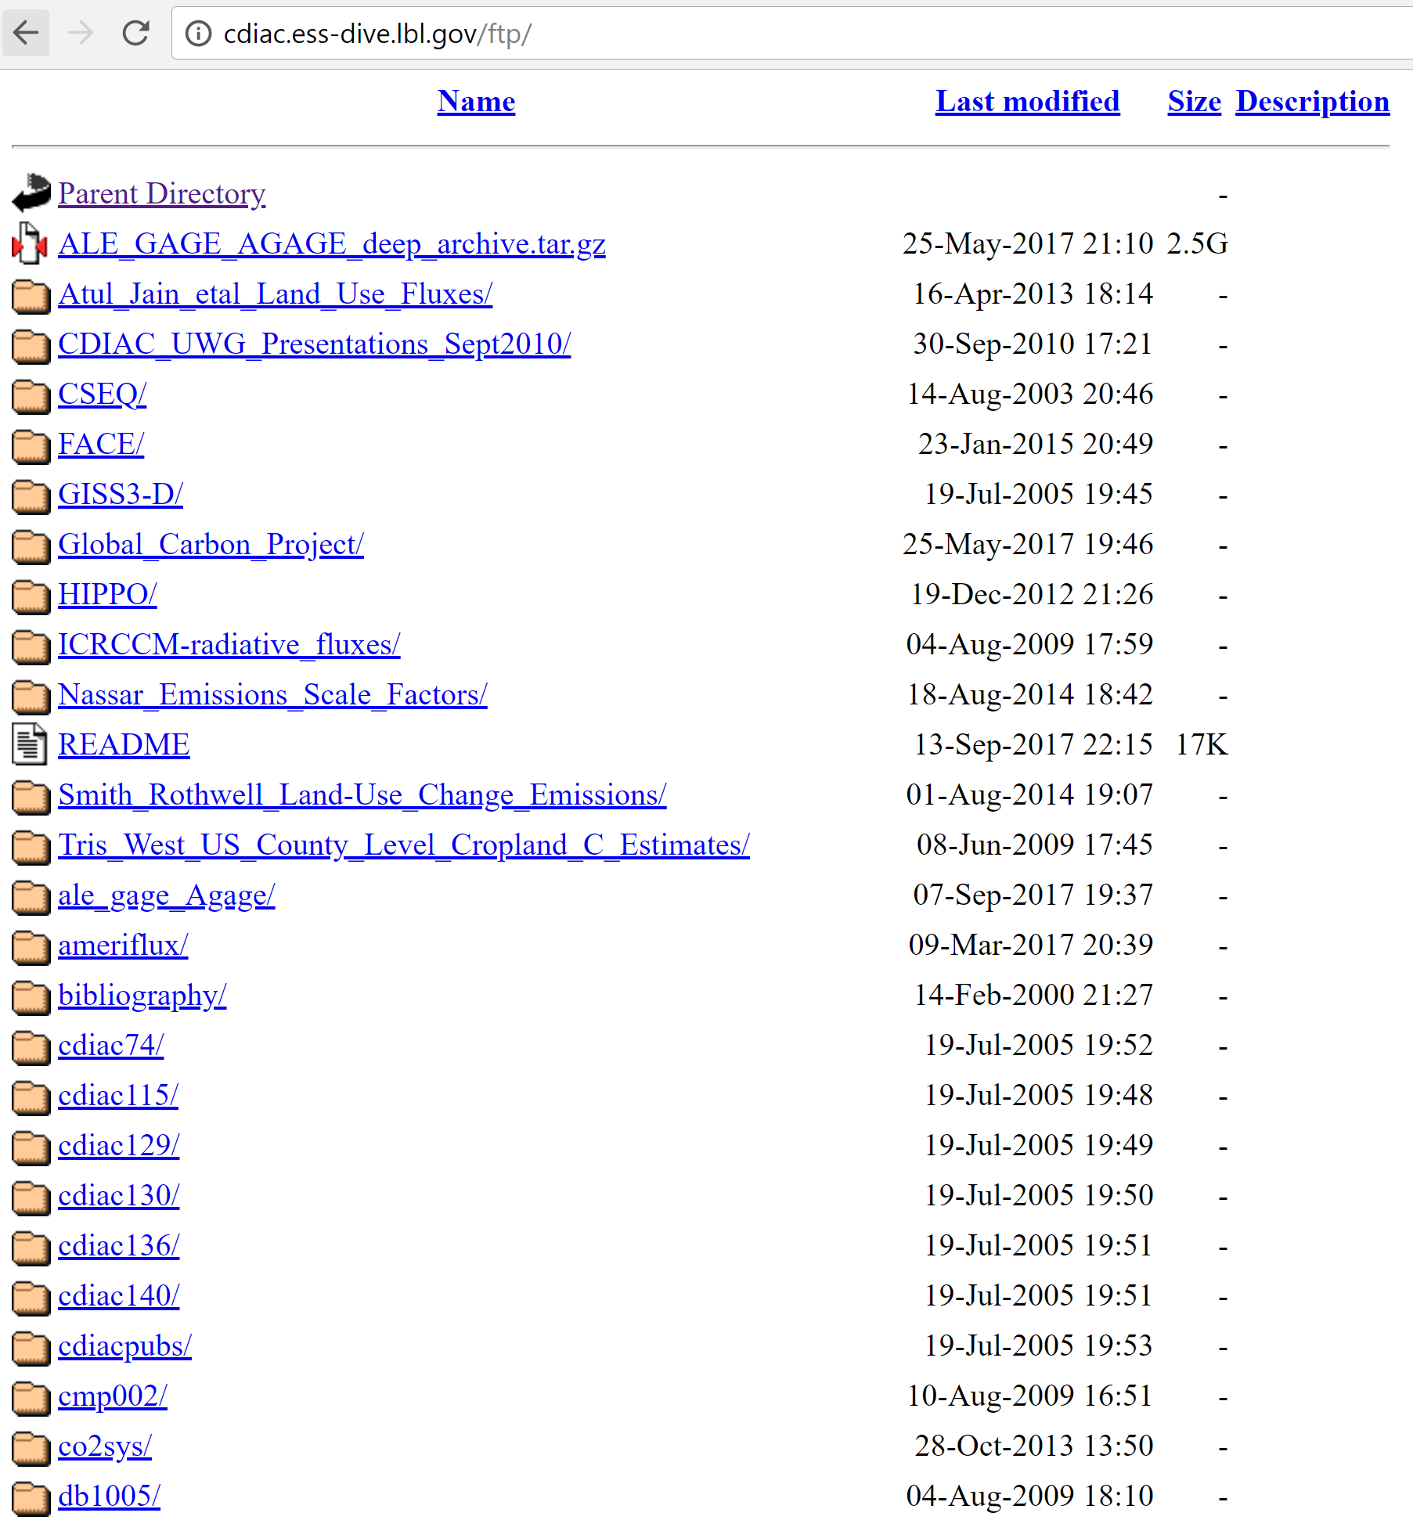
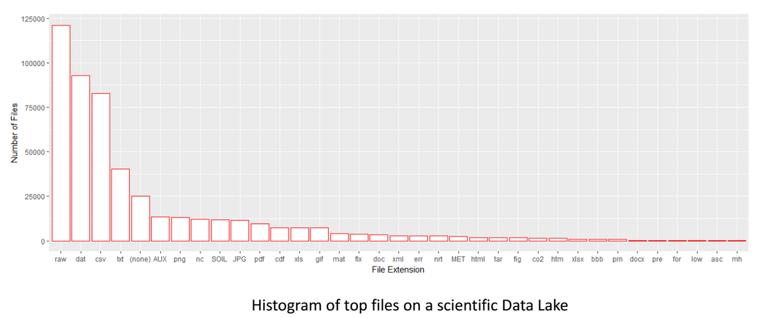
Data in,
different formats, different extensions, different repositories,
with similar name
Notes:
We can see from these example. We have data in different formats, different extensions, different repositories.
It’s hard to find desired data in all of these files. The different extensions may become annoying, you may get lost in all of these directories. How can you know where is your data among all of the similar files?
Change figures

Slide 5
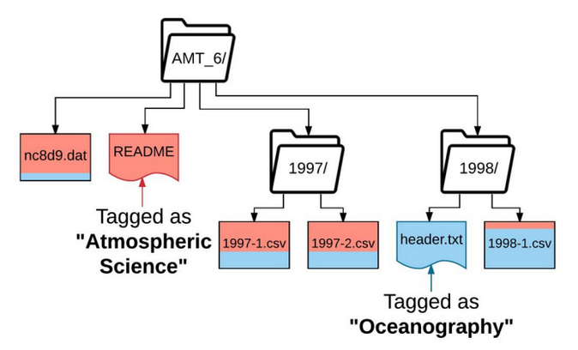
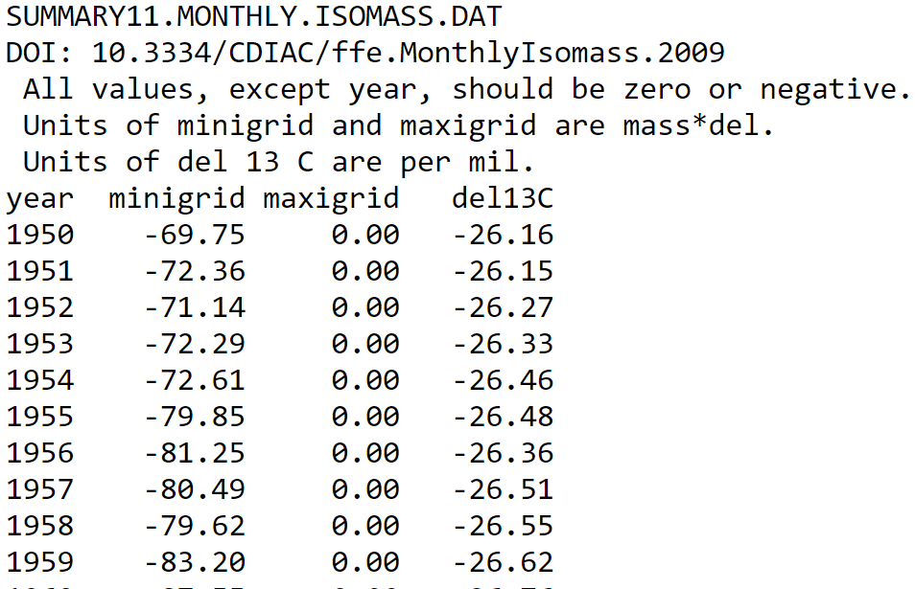
How to deal with all the mess? – Skluma!
Text-based files
Indexed searchable collection
Contextual relationship
File metadata
CDIAC
2009
Year range
Minigrid
Maxigrid
…
Notes:
To mitigate the effects of high-velocity data expansion and dis-organized data repositories, we develop
Skluma –
An automated metadata extraction system that extracts rich content and context-based metadata from scientific files
Able to extract from embedded structured data, free-text documents
Process extracting metadata and inferring contextual relationships between files in such repositories, converting them into indexed, searchable collections

Slide 6
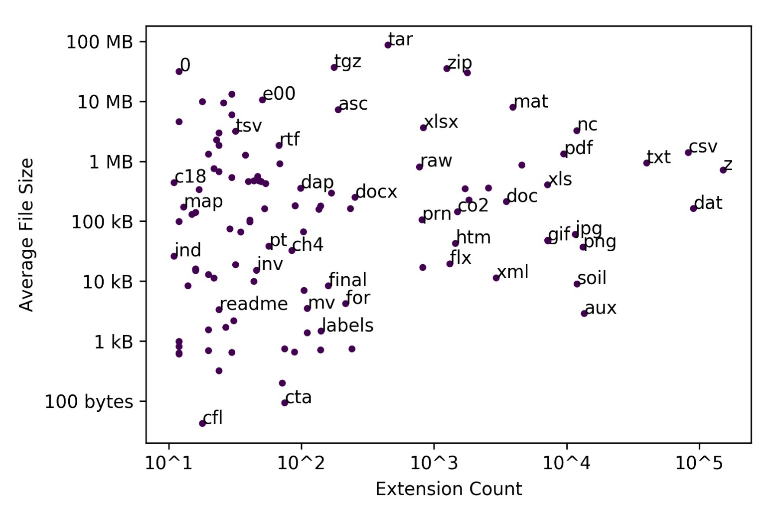
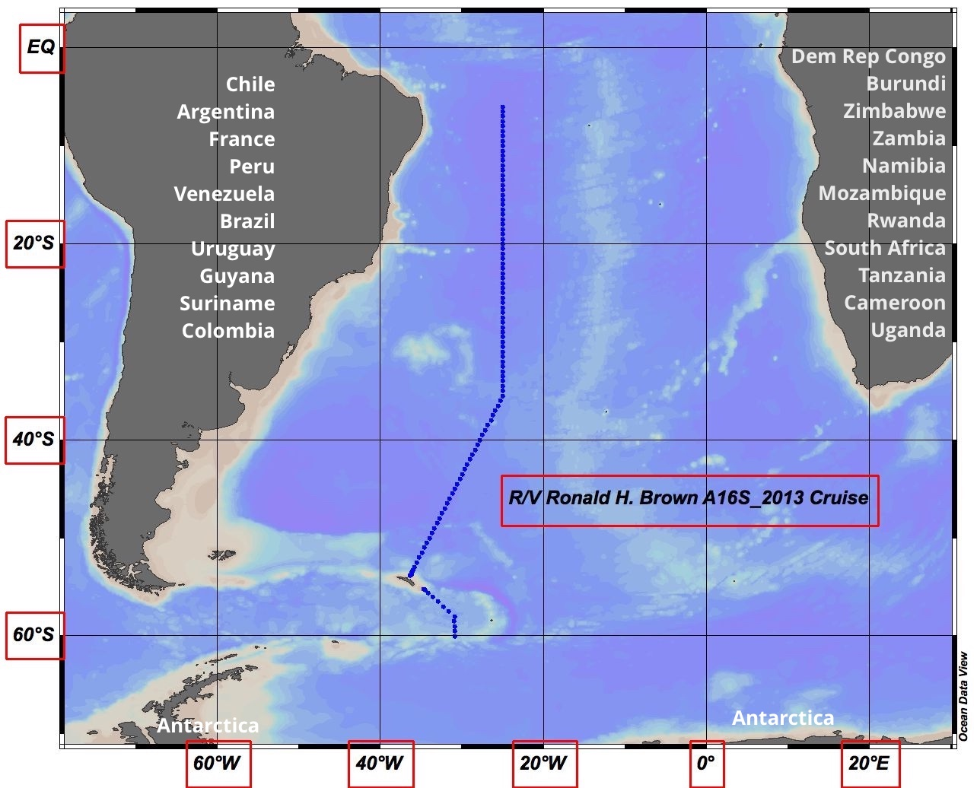
Goal: extract metadata from images
Notes:
There is still other types of file which are widely used for scientific data.
For example, we can see from the figure that there are images in scientific repositories. Skluma can deal with text based files now, but still need method for images. And this is the goal of my project: try to extract metadata from images, so that we can furtherly convert them into indexed, searchable data.

Slide 7
Designed Solution

Slide 8
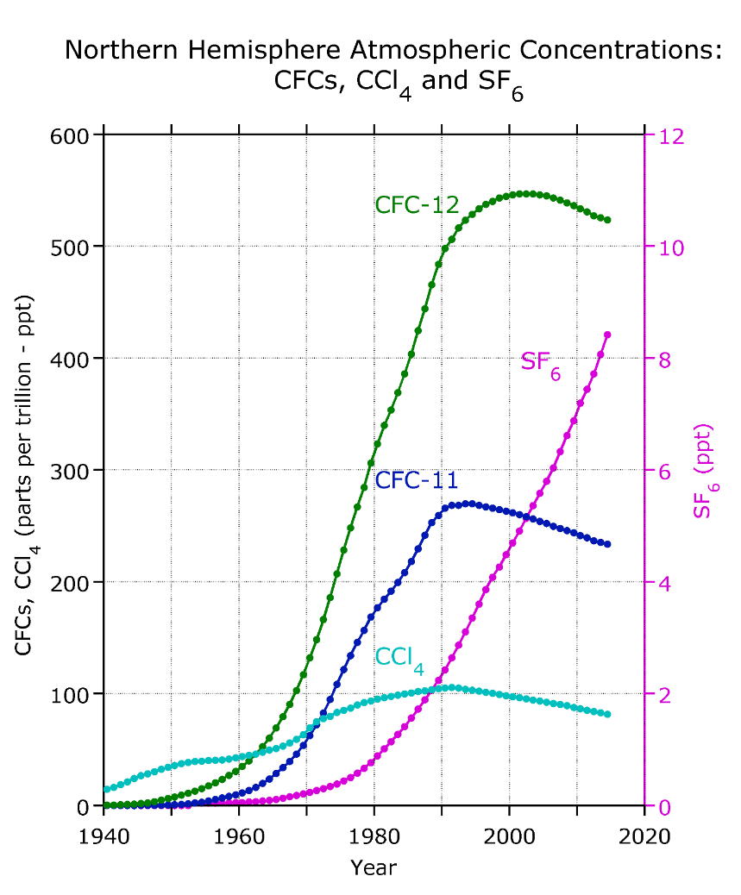
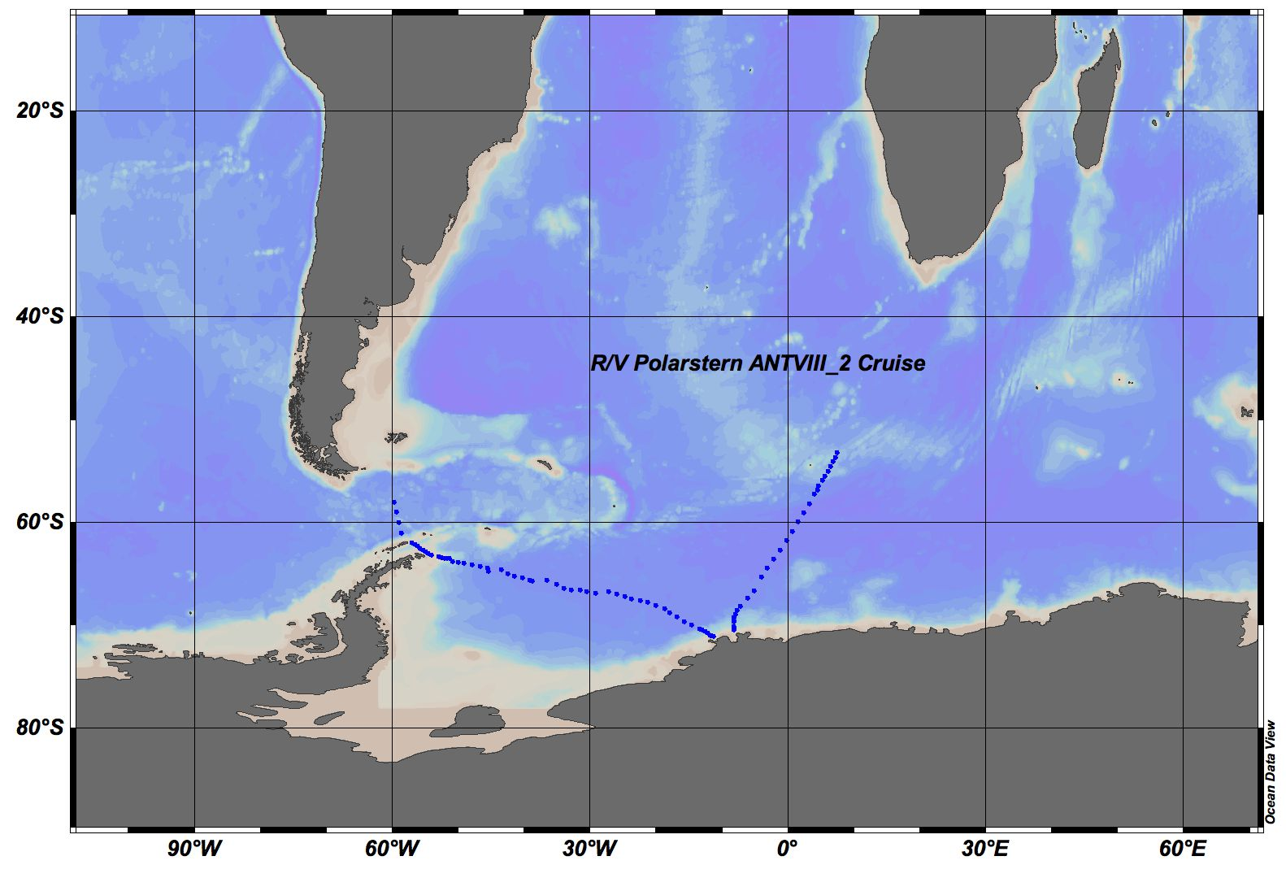
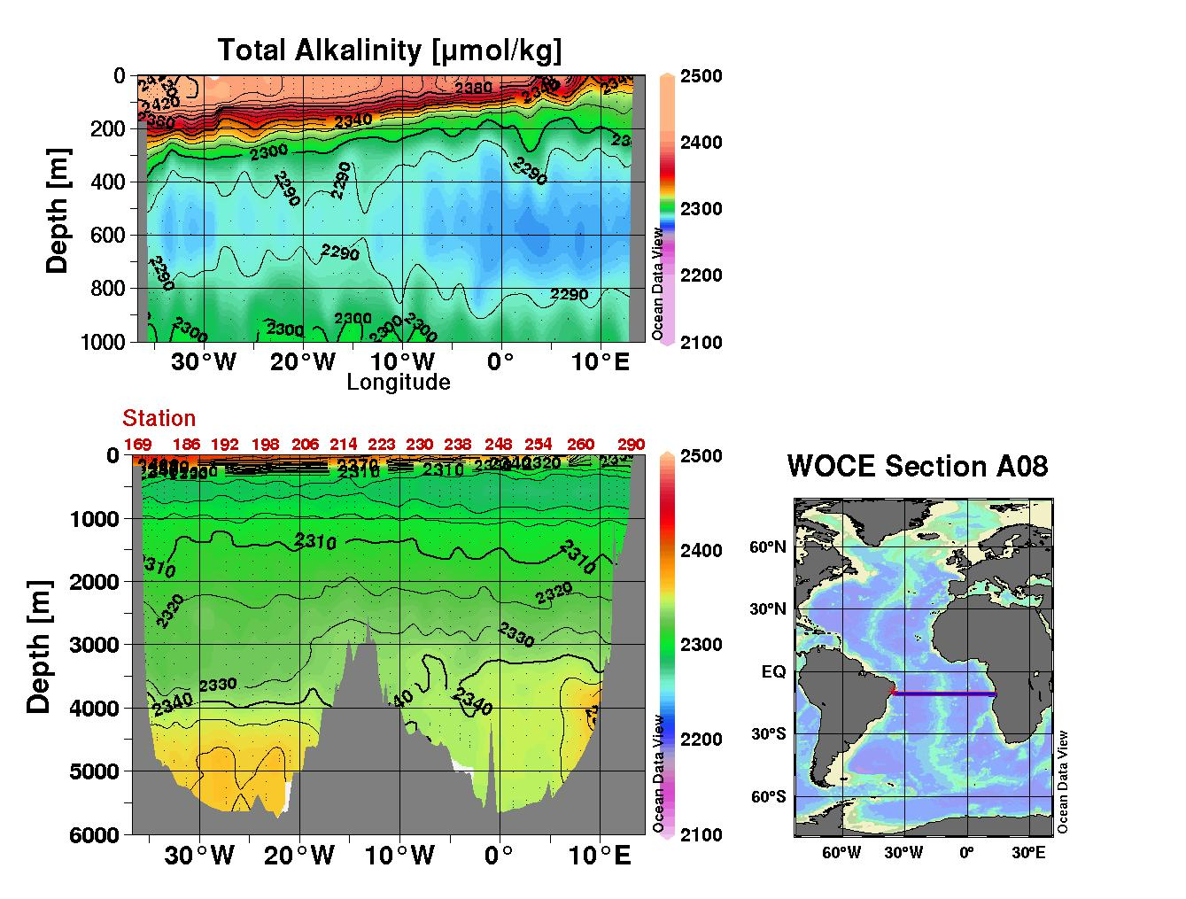
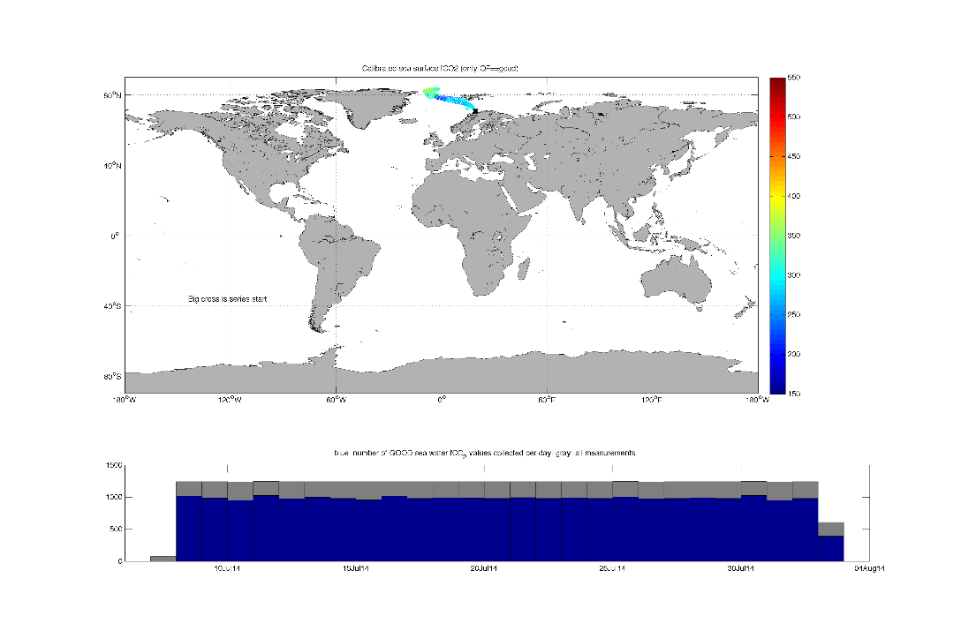
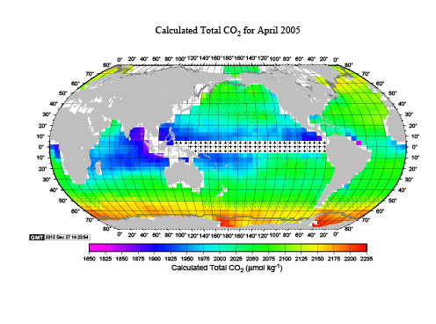

Slide 9
Metadata
System metadata
Image metadata
Image name
Image path
Image extension (jpg, png…)
Image file size (KB, MB…)
Image size (1024*768…)
Image color mode (RGB…)
A map?
A plot?
A figure?
A photo?
How to classify the image?
Notes:
First we consider what kind of metadata we can extract from a image file.

Slide 10

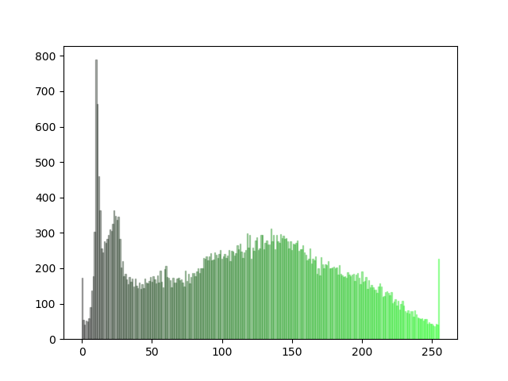
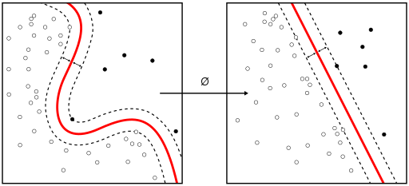
Process
MAP

Slide 11
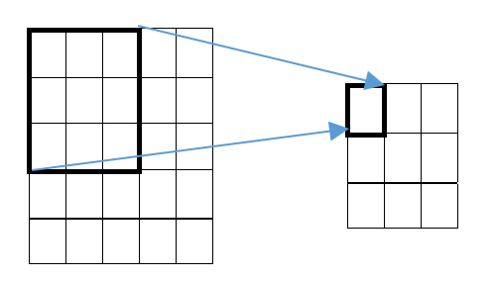
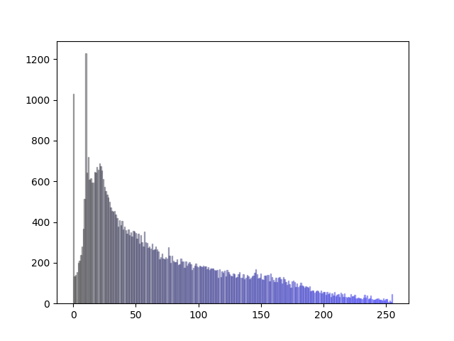
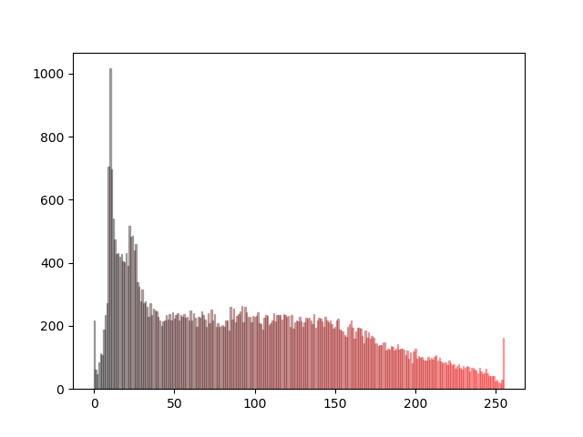
Features
Mean square
Color histogram
The average of small blocks in different part of original images
Hope this can show some local features of image
The color frequency in the images
Hope this can show color features of image
Notes:
Big figure

Slide 12
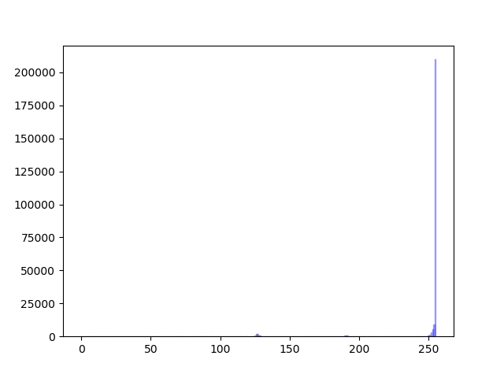
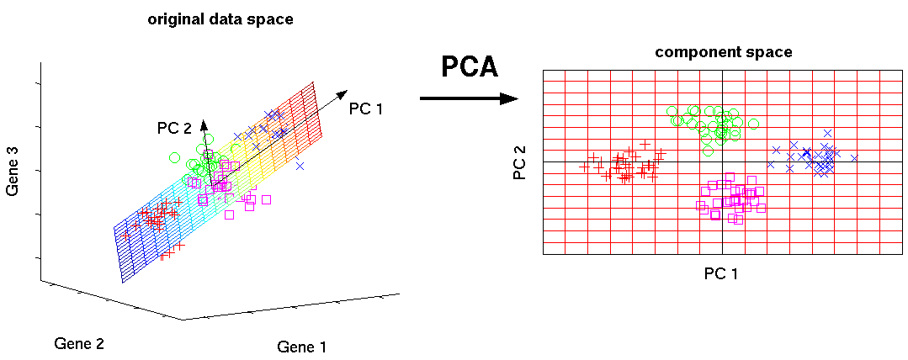
Reducing dimension of features
Principal Component Analysis (PCA)
Naïve way
Grouping color histogram in to small partitions
Repeat the mean square for small square
Statistical procedure to reduce dimension of variables
Keep the variable whose variance is large in result
Notes:
The curse of dimensionality refers to various phenomena that arise when analyzing and organizing data in high-dimensional spaces (often with hundreds or thousands of dimensions) that do not occur in low-dimensional settings such as the three-dimensional physical space of everyday experience. The expression was coined by Richard E. Bellman when considering problems in dynamic optimization.
With a fixed number of training samples, the predictive power of a classifier or regressor first increases as number of dimensions/features used is increased but then decreases,[5] which is known as Hughes phenomenon[6] or peaking phenomena
If not, slow, and not work

Slide 13
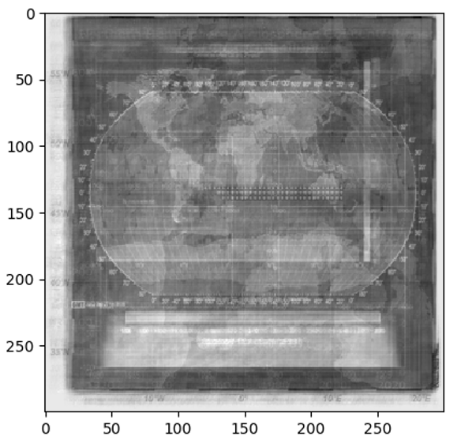
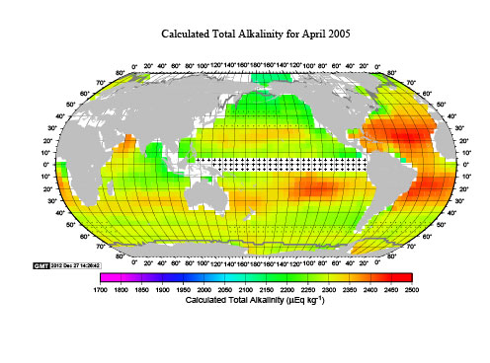
New feature by PCA
Resized image
Using PCA to form a basic set of images
Using basic set to represent new images

Slide 14
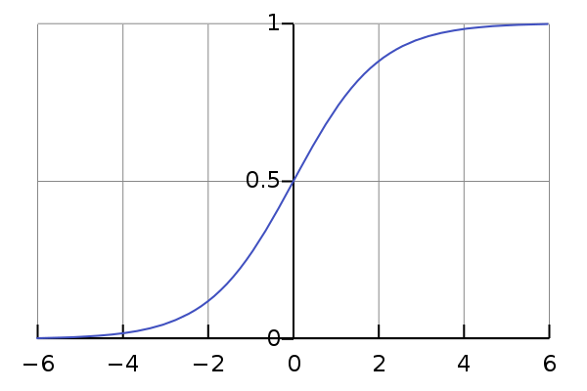
Models
support vector machine(SVM)
Logistic regression
Supervised learning model used for classification and regression analysis
SVM is applied to text categorization, image classification, and image segmentation
A classification method that generalizes logistic regression to multiclass problems
Logistic regression models the probability of classes
Notes:
Why using machine learning?
Fast
Flexible to change classes
Pictures for SVM and logistic regression

Slide 15
Evaluation

Slide 16
Dataset
Using part of data from Carbon Dioxide Information Analysis Center (CDIAC)
Labeling 532 images, half for training and half for testing
 | Gif | Png | Jpg | Bmp | Total
Number | 18 | 64 | 449 | 1 | 532
 | Line plot | Map | Map&chart | Map&colorplot | Map&histogram | figure
Number | 51 | 236 | 105 | 87 | 49 | 4
Notes:
half for training and half for testing

Slide 17
Comparison of reduction methods
Notes:
Why choose PCA

Slide 18
Comparison of models and features with PCA
Notes:
Why choose logistic regression and image_pca
Finally we choose image, PCA, and logistic regression for the final model

Slide 19
Time analysis across models and features
Notes:
Logistic regression and image_pca also use shorter time

Slide 20
Detailed result analysis -- logistic regression with image and PCA
 | precision | recall | F-score | support
line plots | 0.8947 | 1 | 0.9444 | 34
maps | 0.9652 | 0.9823 | 0.9737 | 113
map&depth chart | 1 | 1 | 1 | 44
map&colorplot | 1 | 0.9565 | 0.9778 | 46
map&histogram | 1 | 1 | 1 | 25
figures | 0 | 0 | 0 | 4

Slide 21
Detailed prediction time analysis -- logistic regression with image and PCA

Slide 22
conclusion
Applying PCA to get the feature can get better accuracy in image classification
SVM and logistic regression model work well in image classification
Future work
Test current model on larger dataset
Try convolutional layer with PCA
Try convolutional neural network and see performance
Extract more info from image
Notes:
Add related work before, to show machine learning would work
cite some exist work
Convolutional Neural network

Slide 23
Citation
Chapelle, O., et al. “Support vector machines for histogram-Based image classification.” IEEE Transactions on Neural Networks, vol. 10, no. 5, 1999, pp. 1055–1064., doi:10.1109/72.788646.
P. Beckman, T. J. Skluzacek, K. Chard, and I. Foster, “Skluma: A statistical learning pipeline for taming unkempt data repositories,” in Proceedings of the 29th International Conference on Scientific and Statistical Database Management, SSDBM ’17, (New York, NY, USA), pp. 41:1–41:4, ACM, 2017.
U.S. Department of Energy, “Carbon dioxide information and analysis center,” 2018.
Matthew A. Turk, Alex P. Pentland, “Face Recognition Using Eigenfaces.” MIT, IEEE 1991 https://www.cs.ucsb.edu/~mturk/Papers/mturk-CVPR91.pdf

Slide 24
Thanks!
Questions?

Slide 25
Eigenfaces
Eigenfaces is the name given to a set of eigenvectors when they are used in the computer vision problem of human face recognition
The eigenvectors are derived from the covariance matrix of the probability distribution over the high-dimensional vector space of face images
The eigenfaces themselves form a basis set of all images used to construct the covariance matrix
This produces dimension reduction by allowing the smaller set of basis images to represent the original training images
Classification can be achieved by comparing how faces are represented by the basis set

Slide 26
Curse of dimensionality
The curse of dimensionality refers to various phenomena that arise when analyzing and organizing data in high-dimensional spaces (often with hundreds or thousands of dimensions) that do not occur in low-dimensional settings such as the three-dimensional physical space of everyday experience
In machine learning problems that involve learning a "state-of-nature" from a finite number of data samples in a high-dimensional feature space with each feature having a range of possible values, typically an enormous amount of training data is required to ensure that there are several samples with each combination of values
A typical rule of thumb is that there should be at least 5 training examples for each dimension in the representation. With a fixed number of training samples, the predictive power of a classifier or regressor first increases as number of dimensions/features used is increased but then decreases, which is known as Hughes phenomenon` or peaking phenomena

