Slide 1
Model-free and Model-based Methods in Policy Search: a Brief Summary
Chao NI, Peking University

Slide 2
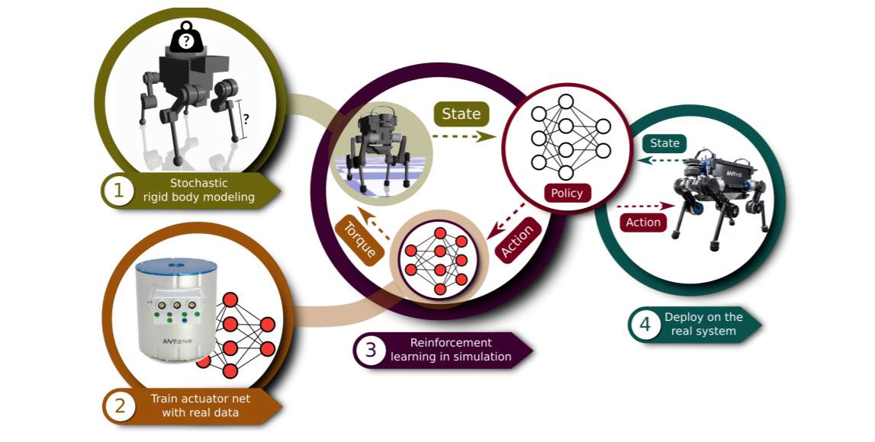
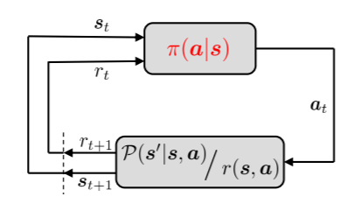

Reinforcement learning
Markov decision process:
State space: $s∈S$;
Action space: $a∈A$;
Transition dynamics $P(s_{t+1}|s_{t},a_{t})$;
Reward function $r\left(s,a\right);$
Initial state probabilities $μ_{0}(s)$
Learning: Adapting the policy $π(a|s)$ of the agent
Objective: maximize the long-term reward
Notes:
Infinite/finite horizon MDP

Slide 3

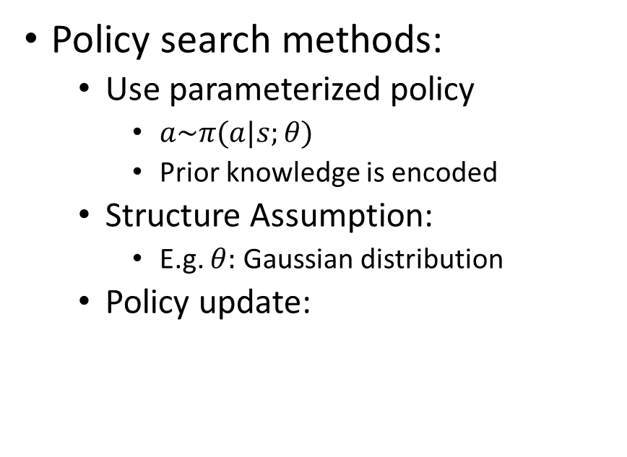
Robot reinforcement learning
Challenges:
Dimensionality
Continuous space
Real world environment
Lack of data
Noisy measurements
Exploration
Trajectory needs to be smooth
Do not damage the robot
Policy search methods:
Use parameterized policy
$a\sim π(a|s;θ)$
Prior knowledge is encoded
Structure Assumption:
E.g. $θ:$ Gaussian distribution
Policy update:
Notes:
Many tasks;
Deterministic/stochastic policy

Slide 4
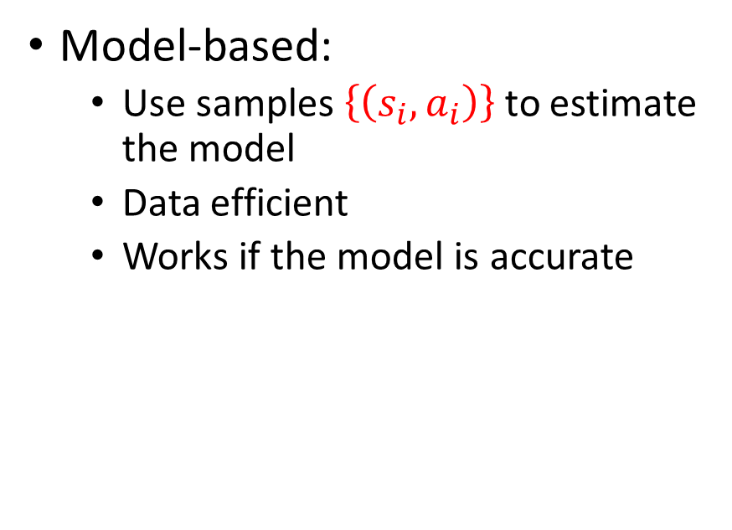

Model-free vs Model-based
Model-free:
Use samples $\{\left(s_{i},a_{i},r_{i}\right)\}$ to directly update the policy;
Samples!
Model-based:
Use samples $\left\{\left(s_{i},a_{i}\right)\right\}$ to estimate the model
Data efficient
Works if the model is accurate

Slide 5
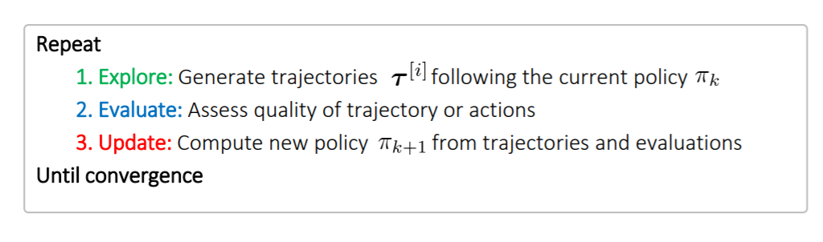
Model-free Policy Search

Slide 6
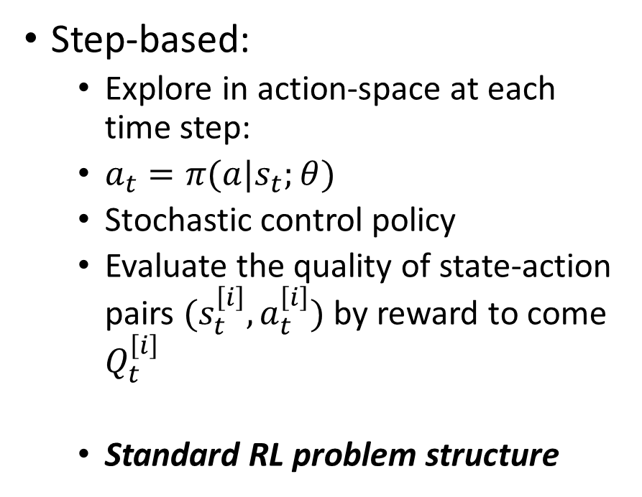
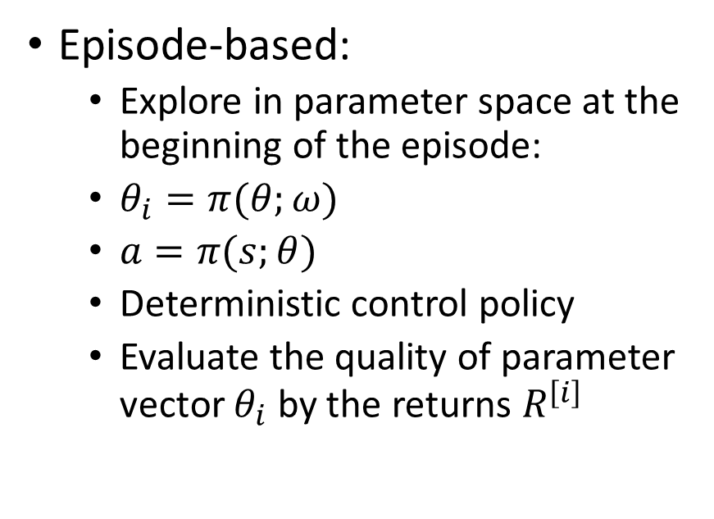
Episode-based & step-based methods
Episode-based:
Explore in parameter space at the beginning of the episode:
$θ_{i}=π(θ;ω)$
$a=π(s;θ)$
Deterministic control policy
Evaluate the quality of parameter vector $θ_{i}$ by the returns $R^{\left[i\right]}$
Step-based:
Explore in action-space at each time step:
$a_{t}=π(a|s_{t};θ)$
Stochastic control policy
Evaluate the quality of state-action pairs $(s_{t}^{\left[i\right]},a_{t}^{\left[i\right]})$ by reward to come $Q_{t}^{\left[i\right]}$
Standard RL problem structure

Slide 7
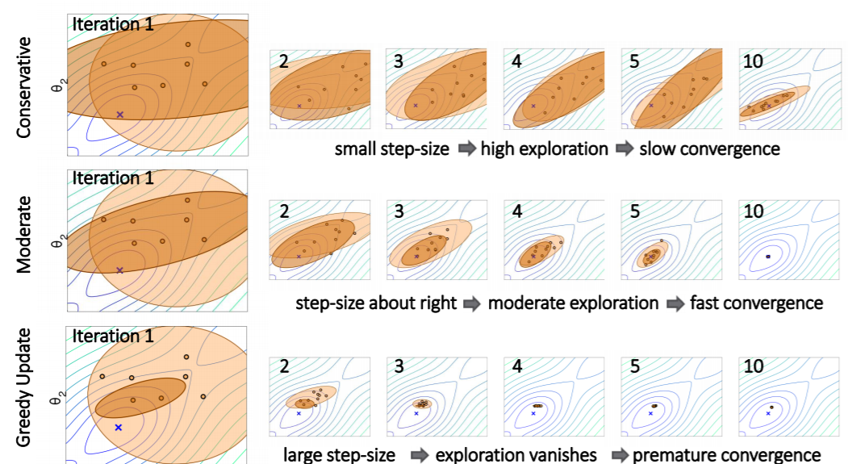
Desired properties for the Policy update
Invariance to parameter or reward transformations
Regularize policy update
Update is computed based on data
Controllable exploration-exploitation trade-off
Metrics used for the policy update (loss function)

Slide 8



Choose metric to measure the distance
Euclidian distance:
KL-divergence (Kullback Leibler)
KL divergence can be approximately by the Fisher information matrix (2nd order Tayler approximation)
Notes:
一般来说，p是reference distribution，q是待确定的distribution

Slide 9
Outline
Model-Free Policy Search Methods
Policy Gradient
Likelihood gradient
Natural Gradients
Weighted Maximum Likelihood Approaches
Success-Matching principle
Information theoretic methods
Model-based Policy Search
PILCO
Bounded Updates: Trajectory Optimization…

Slide 10
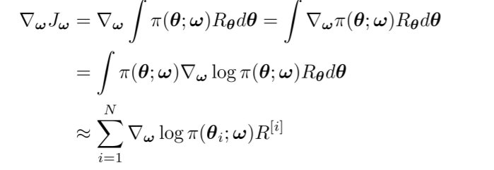


Likelihood Policy gradient*
Episode-based:
$θ_{i}\sim π(θ;ω)$
Subtract baselines
*Sehnke, Frank, et al. "Parameter-exploring policy gradients." Neural Networks 23.4 (2010): 551-559.
Notes:
Reduce variances
Average reward as baseline
Still high variance because of the returns

Slide 11



Likelihood Policy Gradient
Step-based
Trajectory distribution:
Return for a single trajectory:
Expected long term reward:
Notes:
Step-based so need trajectories,

Slide 12
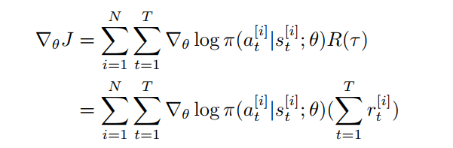
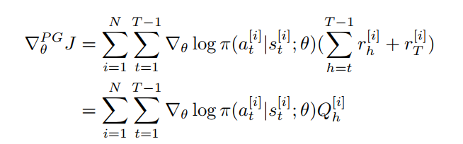
Likelihood Policy Gradient
Step-based:
Reduce the variance
Sutton, Richard S., et al. "Policy gradient methods for reinforcement learning with function approximation." Advances in neural information processing systems. 2000.

Slide 13
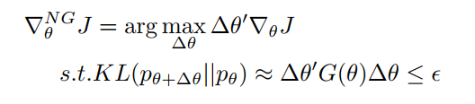


Natural Gradient*
Use Fisher information metric:
The solution is given by:
Estimate the reward to come by function approximation:
*Amari, Shun-Ichi. "Natural gradient works efficiently in learning." Neural computation 10.2 (1998): 251-276.

Slide 14



Natural Gradient
Use function approximation, and one can show the gradient is still unbiased;
The gradient is:
One can show:
And then:

Slide 15
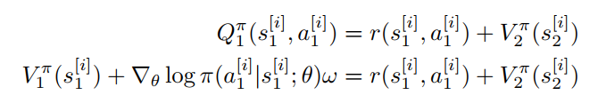
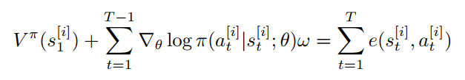

Natural Gradient
We don’t know the baseline function $b_{h}\left(s^{\left[i\right]}\right) or V(s^{\left[i\right]})$
Iterate around $i$ and sum up

Slide 16
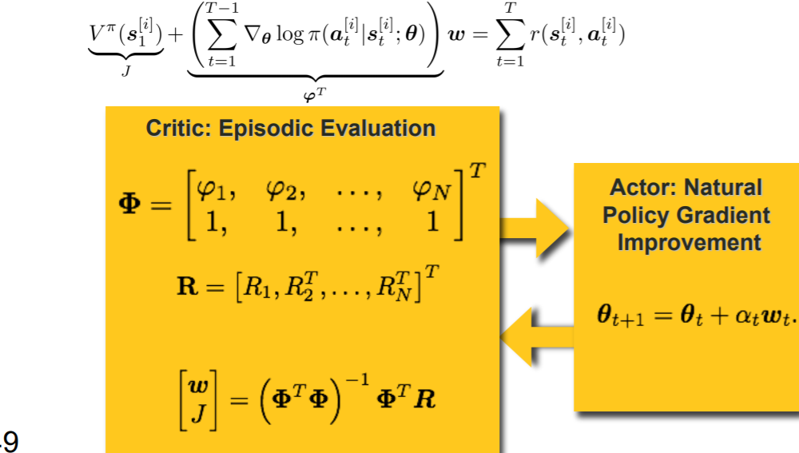
Using linear regression, the baseline function can be solved.

Slide 17
Outline
Model-Free Policy Search Methods
Policy Gradient
Likelihood gradient
Natural Gradients
Weighted Maximum Likelihood Approaches
Success-Matching principle
Information theoretic methods
Model-based Policy Search
PILCO
Bounded Updates: Trajectory Optimization…
Notes:
Policy search: lots of samples; need to tune the learning rate; learning the variance / exploration rate is still difficult

Slide 18

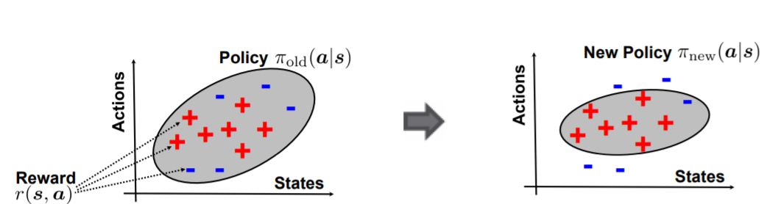

Success-matching principle
Success-matching principle: policy reweighting by success probability $f(r)$

Slide 19
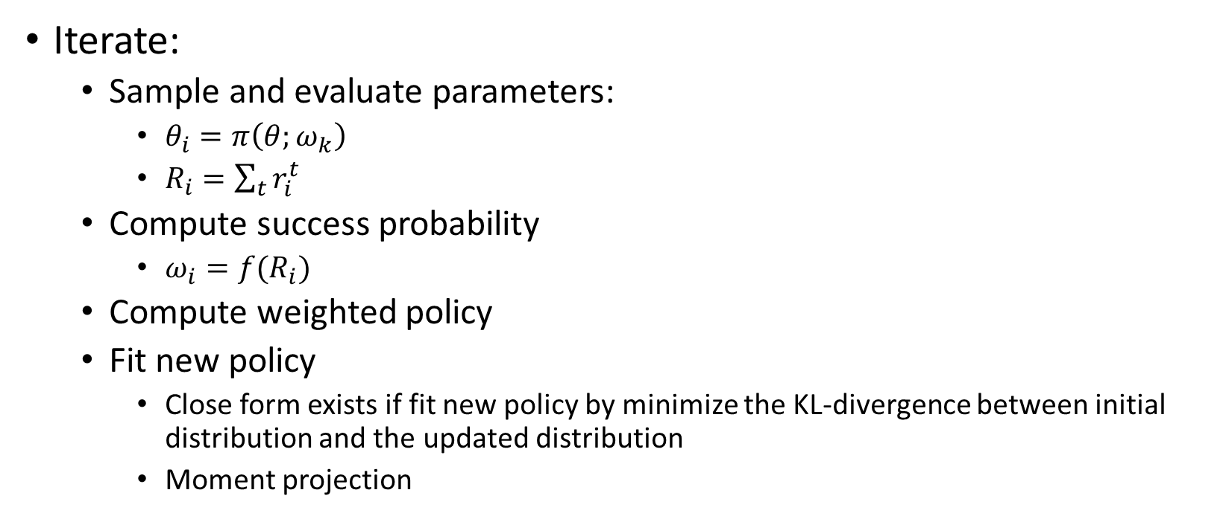
Episode-based Success Matching
Iterate:
Sample and evaluate parameters:
$θ_{i}=π\left(θ;ω_{k}\right)$
$R_{i}=\sum_{t}{r_{i}^{t}}$
Compute success probability
$ω_{i}=f(R_{i})$
Compute weighted policy
Fit new policy
Close form exists if fit new policy by minimize the KL-divergence between initial distribution and the updated distribution
Moment projection

Slide 20
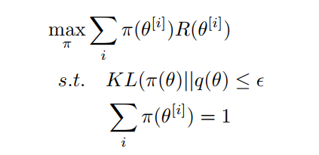

Information Theoretic Methods
Information Theoretic methods: directly obtain the policy using relative entropy as metric:
This optimization problem has an analytical solution:
Notes:
Epsilon directly control the exploration-exploitation trade-off

Slide 21

Model-based Policy Search Methods
Learn dynamics from data-set
More data efficient than model-free methods
More complex policies can be optimized:
RBF networks
Gaussian Process
Deep neural network
Time-dependent feedback controllers
Notes:
Learn a good model is hard;
Small error leads to disasters;
Computational consideration

Slide 22
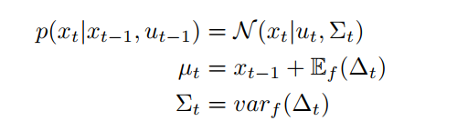
PILCO*: probabilistic inference for learning control
Learn the dynamic model:
Use learned model as simulator
Sampling
Probabilistic inference
Update policy
*Deisenroth, Marc, and Carl E. Rasmussen. "PILCO: A model-based and data-efficient approach to policy search." Proceedings of the 28th International Conference on machine learning (ICML-11). 2011.
Notes:
Learn the mean and the variance of the difference first, and the update the state
When updating the policy, one can use model-free methods

Slide 23

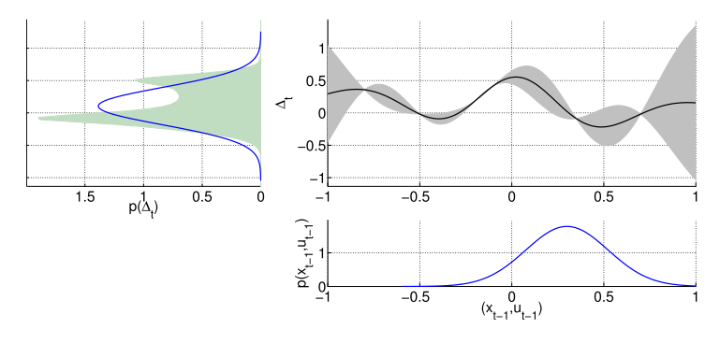


PILCO*: probabilistic inference for learning control
We need to obtain the distribution of the difference:
Use moment-matching method
Update the mean and the covariance

Slide 24
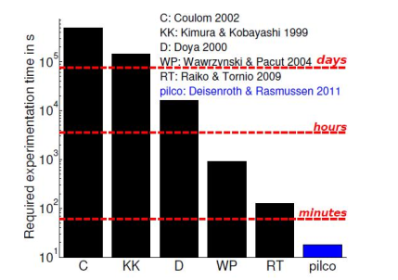
PILCO*: probabilistic inference for learning control
Unprecedent learning speed compared to state-of-the-art (2011)
Limitations:
GP-models are hard to scale to high-D
Computational consideration

