Slide 1
Foreign Exchange Prediction
IMPLEMENTATION WITH SPARK + Mlib + SCALA
Chao-Hung Chen

Slide 2
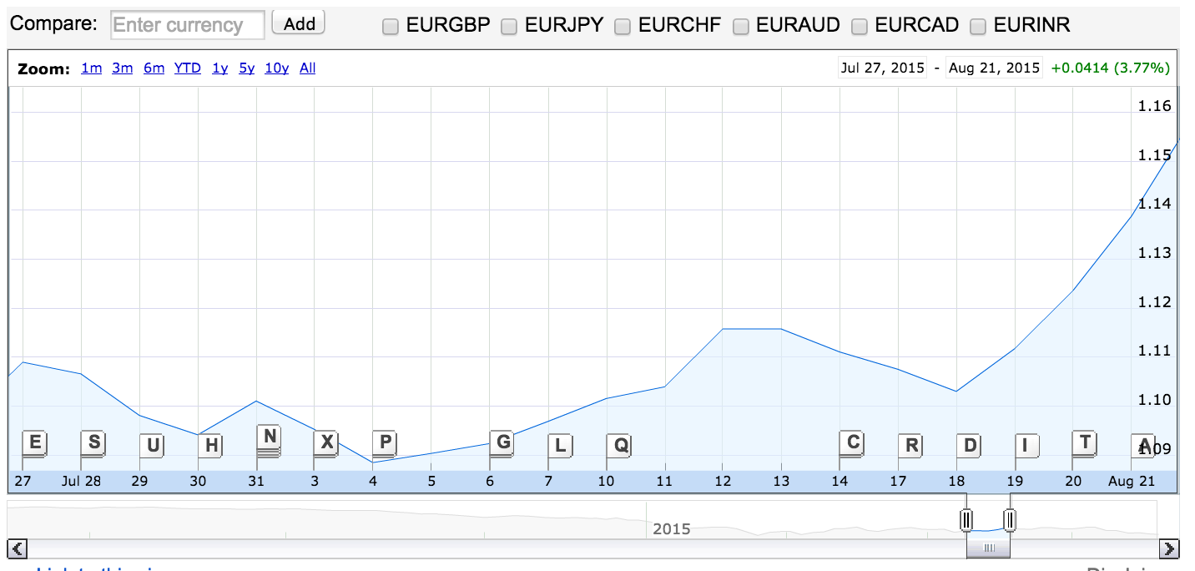
Problem Definition
Predicting Foreign Exchange is extremely difficult
?
?

Slide 3
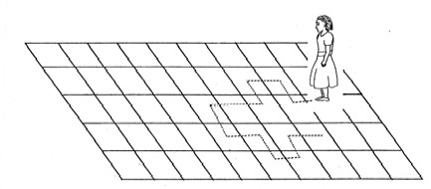
Problem Definition
Why?
Random Walk Hypothesis
The random walk hypothesis is a “financial theory” stating that stock market prices evolve according to a random walk and thus cannot be predicted. It is consistent with the efficient-market hypothesis.
Notes:
Random walk Hypothesis is a very popular theory under the efficient-market hypothesis
The basic idea is that people assumed that it’s impossible to predict the market

Slide 4
Problem Definition
Why?
Difficult Data Preprocessing and Feature Building
The dataset in foreign exchange is very large and time series. It exists with different “granularity”. We could build it in a time frame with days, hours, minutes, second, and even milliseconds.
Besides, feature building is also tough. Sometimes, it not only needs information about the historical price of the currency, but also the information about the size of trading, financial statement, and other currency to be included
Notes:
Data PreProcessing : Large dataset and time series
Feature building : not easy, too many possible features you could generate

Slide 5



Mission
“Predicting the direction of EUR/USD based on features on Spark with Scala”
Although predicting foreign exchange is tough, it’s a highly rewarded, and many prop trading companies are working to make money from trading

Slide 6



Framework
Data Preprocessing
Feature Engineering
Modeling

Slide 7

Pipeline on Spark
Data Preprocessing
Feature Engineering
Modeling
Raw Data
Data Frame
Data Frame
1. Combine
Rows into the same time Frame
1. Moving Average
Spark
Estimator 1.
Logistic
Regression
Spark
Estimator 2.
Random Forest
Spark
Estimator 3.
Gradient
Boosted Trees
2. Decide
Directions
2. Spark Transformer
- Polynomial Expansion
3. Combine EUR/USD with last minute GBP/USD
LR Model
RF Model
GBT Model
Data Frame
Data Frame
Evaluation
Notes:
Esitmator + Transformer

Slide 8
Pipeline on Spark
Data Preprocessing
Feature Engineering
Modeling
Raw Data
Data Frame
Data Frame
1. Combine
Rows into the same time Frame
1. Moving Average
Spark
Estimator 1.
Logistic
Regression
Spark
Estimator 2.
Random Forest
Spark
Estimator 3.
Gradient
Boosted Trees
2. Decide
Directions
2. Spark Transformer
- Polynomial Expansion
3. Combine EUR/USD with last minute GBP/USD
LR Model
RF Model
GBT Model
Data Frame
Data Frame
Evaluation
Notes:
Th

Slide 9
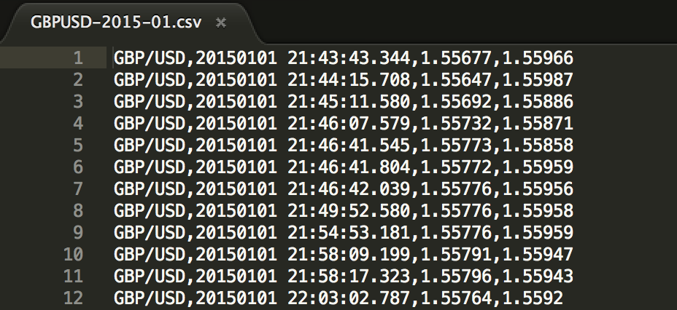
Data Preprocessing
What would be raw data actually looks like?
Pair of Currencies
Date
Time
Bid Price
Ask Price

Slide 10
Data Preprocessing
Mission : Predicting EUR/USD
Plan of data preprocessing
Decide the time frame => try 1 min at first
Other currencies might highly correlated with EUR/USD => Ex: GBP/USD
Using last minute data of GBP/USD to predict EUR/USD

Slide 11
Data Preprocessing
1. Combine rows in the same time frame
Transform one to N rows into a row with high, low, and closed price for each minute
Time | low (bid) | high (bid) | closed (bid) | low (ask) | high (ask) | closed (ask)
21:43 | 1.5521 | 1.5521 | 1.5521 | 1.5535 | 1.5535 | 1.5535
21:44 | 1.5514 | 1.5535 | 1.5535 | 1.5523 | 1.5537 | 1.5537
21:45 | 1.5527 | 1.5531 | 1.5527 | 1.5533 | 1.5534 | 1.5533
21:43:42.344 1.5521 1.5535
21:44:23.211 1.5514 1.5523
21:44:46.455 1.5516 1.5525
21:44:52.131 1.5535 1.5537
21:45:12:749 1.5531 1.5534
21:45:39:496 1.5527 1.5533
Do this on both EUR/USD and GBP/USD datasets

Slide 12
Data Preprocessing
2. Decide the direction of EUR/USD
Since we only need to predict the direction of EURUSD, we build the direction based on the closed price
Time | closed (bid) | closed (bid direction) | closed (ask) | closed (ask direction)
21:43 | 1.2102 |  | 1.2105
21:44 | 1.2105 | + | 1.2108 | +
21:45 | 1.2098 | - | 1.2102 | -
21:46 | 1.2099 | + | 1.2100 | -
21:47 | 1.2085 | - | 1.2095 | -
21:48 | 1.2071 | - | 1.2073 | -
21:49 | 1.2080 | + | 1.2083 | +

Slide 13
Data Preprocessing
3. Combine EUR/USD with last minute GBP/USD data to generate features for EUR/USD
Time | low (bid) | high (bid) | closed (bid) | low (ask) | high (ask) | closed (ask) | GBPUSD (closed bid direction) | GBPUSD (closed ask direction)
21:43 | 1.5521 | 1.5521 | 1.5521 | 1.5535 | 1.5535 | 1.5535 | - | -
21:44 | 1.5514 | 1.5535 | 1.5535 | 1.5523 | 1.5537 | 1.5537 | + | +
21:45 | 1.5527 | 1.5531 | 1.5527 | 1.5533 | 1.5534 | 1.5533 | - | -
Time | EURUSD (closed bid direction) | EURUSD (closed ask direction)
21:43
21:44 | + | +
21:45 | - | -
21:46 | + | -
Time | low (bid) | high (bid) | closed (bid) | low (ask) | high (ask) | closed (ask) | GBPUSD (closed bid direction) | GBPUSD (closed ask direction) | EURUSD (closed bid direction) | EURUSD (closed ask direction)
21:43 | 1.5521 | 1.5521 | 1.5521 | 1.5535 | 1.5535 | 1.5535 | + (1) | + (1) | + (1) | + (1)
21:44 | 1.5514 | 1.5535 | 1.5535 | 1.5523 | 1.5537 | 1.5537 | - (0) | - (0) | - (0) | - (0)
21:45 | 1.5527 | 1.5531 | 1.5527 | 1.5533 | 1.5534 | 1.5533 | + (1) | - (0) | + (1) | - (0)

Slide 14
Pipeline on Spark
Data Preprocessing
Feature Engineering
Modeling
Raw Data
Data Frame
Data Frame
1. Combine
Rows into the same time Frame
1. Moving Average
Spark
Estimator 1.
Logistic
Regression
Spark
Estimator 2.
Random Forest
Spark
Estimator 3.
Gradient
Boosted Trees
2. Decide
Directions
2. Spark Transformer
- Polynomial Expansion
3. Combine EUR/USD with last minute GBP/USD
LR Model
RF Model
GBT Model
Data Frame
Data Frame
Evaluation

Slide 15
Feature Engineering
Moving Average of past N direction
Moving average is an useful predictor using in the finance. We add the features including past direction of MA5, MA20, MA50 for both EUR/USD and GBP/USD
Time | low (bid) | ….. | closed (ask) | GBPUSD MA 5 (closed bid direction) | GBPUSDMA 20 (closed bid direction) | GBPUSDMA 50 (closed bid direction) | EURUSDMA 5 (closed ask direction) | EURUSDMA 20 (closed ask direction) | EURUSDMA 50 (closed ask direction) | GBPUSD (closed bid direction) | GBPUSD (closed ask direction) | EURUSD (closed bid direction) | EURUSD (closed ask direction)
21:43 | 1.5521 | ….. | 1.5535 | 0.8 | 0.75 | 0.74 | 0.8 | 0.55 | 0.72 | + (1) | + (1) | + (1) | + (1)
21:44 | 1.5514 | ….. | 1.5537 | 0.6 | 0.70 | 0.72 | 0.6 | 0.50 | 0.70 | - (0) | - (0) | - (0) | - (0)
21:45 | 1.5527 | ….. | 1.5533 | 0.8 | 0.75 | 0.74 | 0.6 | 0.50 | 0.70 | + (1) | - (0) | + (1) | - (0)
Notes:
MA: Moving average of past N frame

Slide 16
List of features and labels
Features | GBP/USD high bid price in Last minute GBP/USD low bid price in Last minute GBP/USD close bid price in Last minute GBP/USD high ask price in Last minute GBP/USD low ask price in Last minute GBP/USD close ask price in Last minute GBP/USD MA 5 bid direction GBP/USD MA 20 bid direction GBP/USD MA 50 bid direction GBP/USD close bid direction GBP/USD close ask direction EUR/USD MA 5 bid direction EUR/USD MA 20 bid direction EUR/USD MA 50 bid direction TimeStamp
Labels | EUR/USD close bid direction (mainly used in later Experiments) EUR/UDS close ask direction

Slide 17
Feature Engineering
Transformer in Spark (Feature Expansion)
Polynomial Expansion to second degree
GBP/USD high bid price in Last minute GBP/USD low bid price in Last minute GBP/USD close bid price in Last minute GBP/USD high ask price in Last minute GBP/USD low ask price in Last minute GBP/USD close ask price in Last minute GBP/USD MA 5 bid direction GBP/USD MA 20 bid direction GBP/USD MA 50 bid direction GBP/USD close bid direction GBP/USD close ask direction EUR/USD MA 5 bid direction EUR/USD MA 20 bid direction EUR/USD MA 50 bid direction TimeStamp
Original 15 features
Second
Degree
Polynomial
Transformation
Square of Original features = 15 features
Interaction between each feature
15
C
=
105 features
2
15 features
Increased to 135 features

Slide 18
Pipeline on Spark
Data Preprocessing
Feature Engineering
Modeling
Raw Data
Data Frame
Data Frame
1. Combine
Rows into the same time Frame
1. Moving Average
Spark
Estimator 1.
Logistic
Regression
Spark
Estimator 2.
Random Forest
Spark
Estimator 3.
Gradient
Boosted Trees
2. Decide
Directions
2. Spark Transformer
- Polynomial Expansion
3. Combine EUR/USD with last minute GBP/USD
LR Model
RF Model
GBT Model
Data Frame
Data Frame
Evaluation

Slide 19
Modeling
Spark Estimator 1: Logistic Regression
Logistic regression measures the relationship between the categorical dependent variable and independent variables by estimating probabilities using a logistic function
a special case of generalized linear model
To avoid overfitting, regularization is commonly used in Logistic Regression
Reference : https://en.wikipedia.org/wiki/Logistic_regression

Slide 20
Modeling
Train LR model in the pipeline on Spark
import org.apache.spark.ml.classification.LogisticRegression
val lr = new LogisticRegression()
.setMaxIter(30)
.setLabelCol("indexedLabel")
.setFeaturesCol("indexedFeatures")
.setRegParam(0.01)
val pipeline = new Pipeline()
.setStages(Array(labelIndexer, featureIndexer, lr, labelConverter))
val model = pipeline.fit(trainingData)

Slide 21
Results LR before/after feature expands

Slide 22
Modeling
Spark Estimator 2: Random Forest
Random forest is an ensemble method combining several number of decision trees, growing with only part of features (often used square root of number of features) and part of samples with replacement in the training dataset
The bagging method in random forest helps reduce the variance in the bias-variance tradeoff to avoid overfitting since the deeply grown decision tree had low bias, but high variance

Slide 23
Modeling
Train RF model in the pipeline on Spark
import org.apache.spark.ml.classification.RandomForestClassifier
val rf = new RandomForestClassifier()
.setLabelCol("indexedLabel")
.setFeaturesCol("indexedFeatures")
.setNumTrees(100)
val pipeline = new Pipeline()
.setStages(Array(labelIndexer, featureIndexer, rf, labelConverter))
val model = pipeline.fit(trainingData)

Slide 24
Results RF before/after feature expands

Slide 25
Modeling
Spark Estimator 3: Gradient Boost Tree
Gradient boosting is typically used with decision trees (especially CART trees) of a fixed size as base learners. GBT modifies the gradient boosting method which improves the quality of fit of each base learner
The general idea is to compute a sequence of simple trees, where each successive tree is built for the prediction residuals of the preceding tree
Reference : https://en.wikipedia.org/wiki/Gradient_boosting

Slide 26
Modeling
Train GBT model in the pipeline on Spark
import org.apache.spark.ml.classification. GBTClassifier
val gbt = new GBTClassifier()
.setLabelCol("indexedLabel")
.setFeaturesCol("indexedFeatures")
.setMaxIter(10)
val pipeline = new Pipeline()
.setStages(Array(labelIndexer, featureIndexer, gbt, labelConverter))
val model = pipeline.fit(trainingData)

Slide 27
Results GBT before/after feature expands

Slide 28
Conclusion
Random Forest has the best performance among the three estimators on Spark. However, it’s worthwhile to try more other estimators
The accuracy of ensemble models (Random Forest and Gradient Boosting Tree) are better than logistic models, which satisfies our expectations
After Polynomial Expansion in Spark transformers, it helps increase the number of features, and also the accuracy

