Slide 1
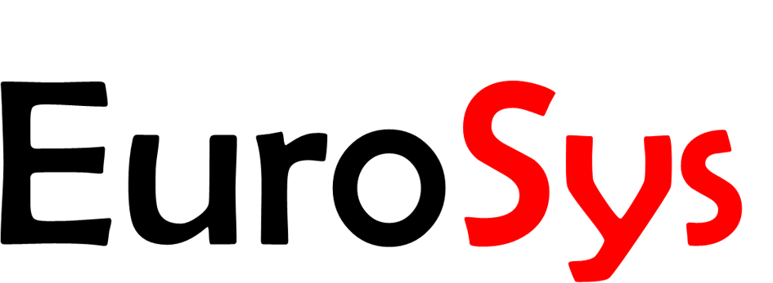
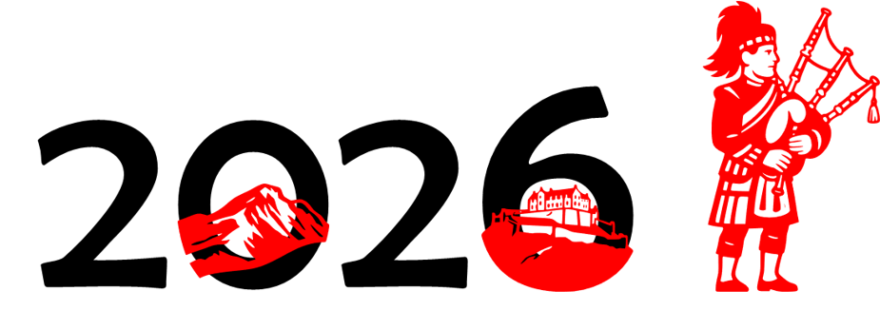


MegaScale-MoE: Large-Scale Communication-Efficient Training of Mixture-of-Experts Models in Production
Chao Jin^{1*}, Ziheng Jiang^{2*}, Zhihao Bai², Zheng Zhong², Juncai Liu²,
Xiang Li², Ningxin Zheng², Xi Wang², Cong Xie², Qi Huang², Wen Heng²,
Yiyuan Ma², Wenlei Bao², Size Zheng², Xuegui Zheng², Yanghua Peng²,
Haibin Lin², Xuanzhe Liu¹, Xin Jin¹, Xin Liu²
¹
²
Notes:
Hello, everyone! I’m Chao Jin from Peking University, Today I am going to talk about MegaScale-MoE— a large‑scale and communication-efficient training system for Mixture-of-Experts based large language models.
This project is a collaboration between ByteDance Seed and Peking University.
[00:20]

Slide 2





Scaling for Large Language Models
1T
LLM Applications
conversational assistants
code development
reasoning
tool-augmented agents
…
Kimi K2
671B
Deep
Seek-V3
314B
175B
Grok-1
GPT-3
Time
2020
2024,
Mar.
2024,
Dec.
2025,
Jul.
Notes:
Large language models have become a foundational technology in artificial intelligence. They have shown strong capabilities in a wide range of applications, such as conversational assistants, code generation, reasoning and agents with tool use.
At ByteDance, we train large language models to support AI products for billions of users. From a systems perspective, this means training models with hundreds of billions of parameters, over trillions of tokens, on thousands or even tens of thousands of GPUs. [click]
The reason behind this massive scale is simple: scaling remains one of the most effective ways to improve model capability. Driven by scaling laws, state-of-the-art models continue to grow larger.
[1:15]

Slide 3
Mixture-of-Experts (MoE)
Dense
MoE
vs.
Notes:
However, scaling dense models is extremely expensive. If we simply increase the size of a dense model, the computation cost also grows almost proportionally.
This motivates us to look for a more efficient way to scale model capacity. A promising and widely adopted solution is Mixture-of-Experts, or MoE. [click]
In an MoE model, each token is not processed by all feed-forward networks. Instead, a router dynamically sends each token to only a small subset of experts, named top-k experts. Because only a few experts are activated for each token, MoE allows the total number of model parameters to grow much faster than the actual computation per token. In other words, it enables sparse activation and more efficient scaling of model capacity.
[2:15]

Slide 4
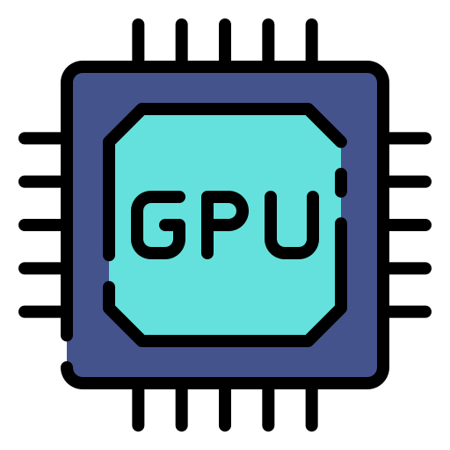
Communication Bottleneck
1. Dispatch & combine communication
Dispatch
Combine
Tokens
Expert 0
A
Attention
Router
+
Expert 1
All-to-All
All-to-All
Expert 2
B
Attention
Router
+
Expert 3
Notes:
MoE makes model scaling more compute-efficient, but it also makes training much more communication-intensive. There are two main reasons. First, MoE training inherently introduces more communication. [click]
Compared with dense models, MoE models usually have a much larger total parameter size, so training them often requires distributing the model across more GPUs. [click]
In each MoE layer, tokens need to be dispatched to the selected experts and then combined back after expert computation. This introduces extra all-to-all communication in both forward and backward passes.
[2:55]

Slide 5
Communication Bottleneck
2. Hardware evolution & low-precision training
Notes:
Second, hardware trends make the communication problem more important. GPU compute capability keeps improving rapidly, and lower-precision training such as FP8 further reduces computation time. However, communication bandwidth does not improve at the same rate. As a result, the relative cost of communication keeps increasing, and communication becomes the dominant bottleneck in large-scale MoE training. [click]
In our production training, this overhead is already significant: for one internal MoE model on NVIDIA Hopper GPUs, communication takes 43.6% of the forward pass time and 32% of the entire training time. [3:50]

Slide 6
Communication Bottleneck
2. Hardware evolution & low-precision training
Communication takes 43.6% of the forward pass time and 32% of the entire training time for an internal model
Notes:
Second, hardware trends make the communication problem more important. GPU compute capability keeps improving rapidly, and lower-precision training such as FP8 further reduces computation time. However, communication bandwidth does not improve at the same rate. As a result, the relative cost of communication keeps increasing, and communication becomes the dominant bottleneck in large-scale MoE training. [click]
In our production training, this overhead is already significant: for one internal MoE model on NVIDIA Hopper GPUs, communication takes 43.6% of the forward pass time and 32% of the entire training time. [3:50]

Slide 7
Our solution: MegaScale-MoE
Communication-efficient parallelism
Reduce communication volume by choosing better parallelism strategies
Communication-computation overlap
Hide the communication latency through operator scheduling and fusion
Communication compression
Compress bandwidth cost by lowering communication precision while preserving convergence
Notes:
To address the communication bottleneck, we build and deploy MegaScale-MoE, a production MoE training system that takes a holistic approach across the entire MoE layer.
The first idea is to reduce communication. We customize the parallelism strategy for each component: sequence parallelism for attention, and expert parallelism for feed-forward networks, while keeping each MoE layer within a single node to leverage high-bandwidth NVLink.
The second idea is to hide communication. We overlap communication with computation at two levels. Inter-operator overlap hides communication behind independent operators, while intra-operator overlap fuses communication with computation at tile granularity for communication on the critical path.
The third idea is to compress communication. We reduce communication precision, such as using BF16 communication for data parallel reduce-scatter, while carefully preserving numerical stability.
[5:10]

Slide 8
Our solution: MegaScale-MoE
Communication-efficient parallelism
Reduce communication volume by choosing better parallelism strategies
Communication-computation overlap
Hide the communication latency through operator scheduling and fusion
Communication compression
Compress bandwidth cost by lowering communication precision while preserving convergence
Notes:
The first idea is communication-efficient parallelism.
[5:10]

Slide 9
Communication-Efficient Parallelism
Notes:
Our key observation is that the major architectural difference between MoE and dense models happens inside each MoE layer, and this is also where most communication overhead comes from. Therefore, MegaScale-MoE confines each MoE layer within a single node, so that token routing and model parallel communication can use high-bandwidth NVLink.
Across nodes, we use pipeline parallelism to scale the model size, instead of using cross-node tensor or expert parallelism, which would introduce expensive per-layer communication.
Within each node, we customize the parallelism strategy for different components: sequence parallelism for attention, and expert parallelism for FFNs.
[6:05]

Slide 10
Sequence Parallelism for Attention
Grouped-Query Attention (GQA)
Notes:
Let’s first look at the attention module. A common approach is tensor parallelism, which partitions all attention operators along the hidden dimension. However, TP introduces all-gather and reduce-scatter communication for the entire hidden state on the critical path. MegaScale-MoE instead adopts sequence parallelism for attention. [click] The reason is closely related to grouped-query attention, or GQA, which is widely used in recent LLMs to reduce the number of key-value heads and improve attention efficiency. With GQA, the size of key and value tensors is much smaller than the query tensor. [click] Sequence parallelism takes advantage of this property: instead of communicating the whole hidden state, it mainly exchanges the query, key, and value tensors needed by attention.
As a result, compared with tensor parallelism, the communication volume is reduced by about three times in practice.
[7:15]

Slide 11
Expert Parallelism for FFNs
Communication volume: 2𝑘/𝑛×𝑏𝑠ℎ(𝑛−1)/𝑛 for EP vs. 2𝑏𝑠ℎ(𝑛−1)/𝑛 for TP
Notes:
For the FFNs, we use expert parallelism instead of tensor parallelism. Tensor parallelism partitions each expert along the hidden dimension, which reduces GEMM efficiency because each GPU only computes a smaller shard of the expert.
Expert parallelism is more natural for MoE: each GPU hosts a subset of experts, and each expert remains a full GEMM.
The challenge is token dispatch and combine. [click] A typical implementation uses all-to-all communication, whose volume grows with the top-k value. [click]
MegaScale-MoE therefore uses an adaptive communication pattern. For small top-k, we use all-to-all. [click] When top-k becomes large, we replace it with all-gather and reduce-scatter, together with efficient local operators.
In this way, we preserve high GEMM efficiency while keeping expert communication efficient.
[8:25]

Slide 12
Expert Parallelism for FFNs
Communication volume: 2𝑘/𝑛×𝑏𝑠ℎ(𝑛−1)/𝑛 for EP vs. 2𝑏𝑠ℎ(𝑛−1)/𝑛 for TP
Notes:
For the FFNs, we use expert parallelism instead of tensor parallelism. Tensor parallelism partitions each expert along the hidden dimension, which reduces GEMM efficiency because each GPU only computes a smaller shard of the expert.
Expert parallelism is more natural for MoE: each GPU hosts a subset of experts, and each expert remains a full GEMM.
The challenge is token dispatch and combine. [click] A typical implementation uses all-to-all communication, whose volume grows with the top-k value. [click]
MegaScale-MoE therefore uses an adaptive communication pattern. For small top-k, we use all-to-all. [click] When top-k becomes large, we replace it with all-gather and reduce-scatter, together with efficient local operators.
In this way, we preserve high GEMM efficiency while keeping expert communication efficient.
[8:25]

Slide 13
Our solution: MegaScale-MoE
Communication-efficient parallelism
Reduce communication volume by choosing better parallelism strategies
Communication-computation overlap
Hide the communication latency through operator scheduling and fusion
Communication compression
Compress bandwidth cost by lowering communication precision while preserving convergence
Notes:
After reducing communication volume, MegaScale-MoE hides the remaining communication latency at two levels: inter-operator and intra-operator.
[8:30]

Slide 14
Communication-Computation Overlap
Inter-operator
w/o data dependencies
reordering/scheduling
Intra-operator
w/ data dependencies
fusing
Notes:
We decompose the attention and FFN modules in each MoE layer into a sequence of operators for fine-grained communication-computation overlap. Here, an operator refers to a computation or communication unit that eventually runs as one or more GPU kernels, such as GroupedGEMM, all-to-all, all-gather, scatter, or reduce-scatter. With this decomposition, we can overlap communication with computation at two levels.
The first is inter-operator overlap. [click] If communication and computation do not have direct data dependencies, we can reorder them and execute them asynchronously on different CUDA streams, such as the all-to-all communication operator for the query tensor and the projection and RoPE positional encoding operators for the key tensor.
The second is intra-operator overlap. [click] For some communication on the critical path, the following computation directly depends on the communication result. In this case, operator-level scheduling is not enough. MegaScale-MoE further splits these operators into tiles, and fuses them into a kernel-level pipeline.
[9:50]

Slide 15
Inter-operator overlap
Holistic Scheduling
Fine-grained control over resources to minimize interference
Selective Activation Rematerialization
Minimal activation memory usage with no training performance degradation
Notes:
For inter-operator overlap, MegaScale-MoE treats the entire MoE layer as one scheduling task. Instead of relying on the default autograd execution order, we explicitly schedule these operators according to their dependencies. Through fine-grained control over resources such as number of SMs, we are able to minimize the interference between concurrent operators. [click]
Moreover, this scheduling enables selective activation rematerialization. We only store expensive activations and recompute or re-communicate the others during backward propagation. Since this rematerialization is also overlapped, MegaScale-MoE reduces activation memory with almost no training performance degradation.
[10:45]

Slide 16
Intra-operator overlap
Without intra-operator overlap
With intra-operator overlap
Notes:
Inter-operator overlap works when communication and computation are independent. However, some communication lies directly on the critical path. For example, before expert computation, the required tokens must first arrive from other GPUs.
Without intra-operator overlap, the entire communication has to finish before computation can start. This leaves the communication fully exposed. [click]
MegaScale-MoE addresses this by splitting both communication and computation into small tiles.
As shown here, once the first computation tile finishes, the corresponding communication tile can start immediately, while later computation tiles are still executing. In this way, communication and computation are pipelined at tile granularity inside the kernel, so the exposed communication is greatly reduced.
For MoE expert computation, we further fuse local scatter and gather into the kernel, and reorder tokens so that each computation tile depends on as few source GPUs as possible.
[11:50]

Slide 17
Our solution: MegaScale-MoE
Communication-efficient parallelism
Reduce communication volume by choosing better parallelism strategies
Communication-computation overlap
Hide the communication latency through operator scheduling and fusion
Communication compression
Compress bandwidth cost by lowering communication precision while preserving convergence
Notes:
Due to the time limit, I will skip the communication compression. Please refer to our paper for details.
[11:55]

Slide 18
Evaluation
Training Performance
Performance Breakdown
Effectiveness & Additional Overhead of Communication-Efficient Parallelism
Effectiveness of Inter-Operator Overlap
Effectiveness of Intra-Operator Overlap
Effectiveness of Data Parallelism Communication Compression
Notes:
We evaluate MegaScale-MoE from multiple perspectives. This includes end-to-end training performance, performance breakdown, and a set of ablation studies for each major optimization.
I will focus on two key results in this talk: the overall training performance and the performance breakdown. You can refer to our paper for more your interested part.
[12:15]

Slide 19
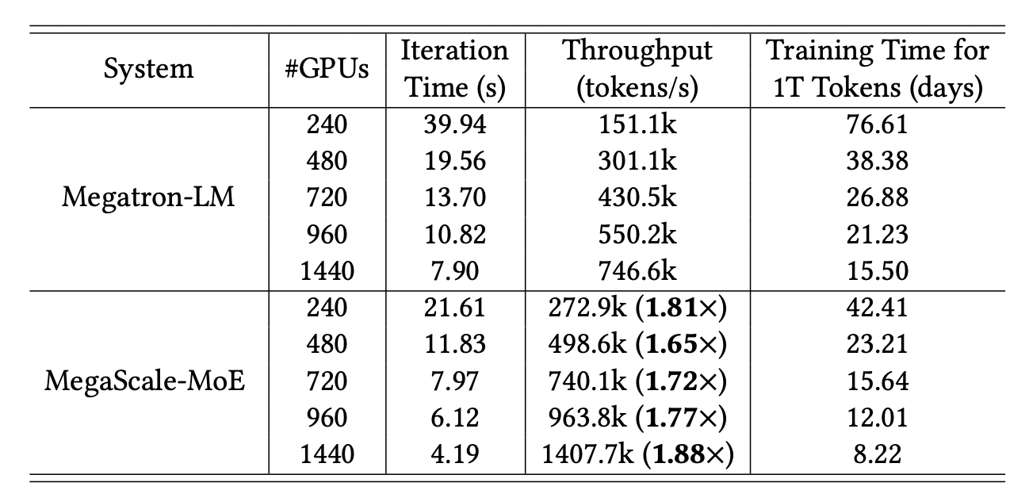
Training performance
1.65-1.88x higher training throughput for the 352B MoE model compared to Megatron-LM
Notes:
We evaluate the strong-scaling training performance of Megatron-LM and MegaScale-MoE on the there hundred and fifty two billion (352B) model with thirty two (32) experts each layer by increasing the number of GPUs and maintaining a constant batch size. This experimental setting is realistic, given that batch size is constrained by convergence effects and cannot be infinitely scaled with the number of GPUs.
From the table we can see that MegaScale-MoE achieves up to one point eight eight times (1.88x) speedups over Megatron-LM across all settings, enabling us to train the model over one trillion (1T) tokens on one thousand four hundred and forty (1440) GPUs for only eight point two (8.22) days.
[13:10]

Slide 20
Performance breakdown
MegaScale-MoE consistently improves MFU by nearly eliminating exposed communication across different GPU platforms
Notes:
To better understand where the performance improvement comes from, we further break down the iteration time on different GPU platforms, including H800, A100, and H20.
The left subfigure shows the iteration time breakdown. Here, exposed communication means the communication time that is not hidden by computation. FlashAttention and GEMMs are the major computation kernels counted in Model FLOPs Utilization, or MFU. We can see that MegaScale-MoE significantly reduces the exposed communication time across different GPUs.
[13:40]

Slide 21
Deployment Experience
Training loss curve on >10,000 GPUs for training a 200B-A20B MoE model
MoE training requires holistic optimization beyond attention and GEMMs, including routing, dispatch/combine, and operators with dynamic shapes.
Notes:
MegaScale-MoE has been deployed in our production environment and is responsible for most of large-scale MoE training tasks.
It supports training models beyond ten thousand GPUs and run for several months. By reducing exposed communication and optimizing memory usage, MegaScale-MoE has saved millions of GPU hours in production.
This figure shows one real production run. It trains an MoE model with 200 billion parameters, and 20 billion activated parameters per token, on more than ten thousand GPUs. The training lasts for months, and the loss continues to converge stably.
One lesson we learned is that MoE training is quite different from dense model training. In dense Transformers, performance optimization mainly focuses on attention and GEMMs. But in MoE models, many other components become important, including routing, communication, and dynamically shaped tensors. These components introduce non-trivial overhead and can become sources of stragglers.

Slide 22
Conclusion
Communication is a key bottleneck in large-scale MoE training
MegaScale-MoE: production-grade efficient MoE training system
Communication-efficient parallelism
Communication-computation overlap
Communication compression
MegaScale-MoE achieves up to 1.88x higher throughput compared to Megatron-LM and is deployed in production
Thank you!
chaojin@pku.edu.cn
Notes:
In summary, communication is a key bottleneck in large-scale MoE training. We propose MegaScale-MoE, a production-grade efficient MoE training system that reduces, hides, and compresses communication. It improves the training throughput by up to 1.88x against Megatron-LM and is deployed in production.
Thanks for listening. I’m glad to take questions now.

