Slide 1

Chaomein T.

Slide 2
PAC-MAN: Features
This program allows you to play the famous arcade game called Pac-Man game. It contains features like the current score in the game that is visible to the user and still displays the score even if the player wins or loses. The number of foods left in the game is still visible to the player. It also has a feature that the player can choose whether he/she will play again or quit the game.

Slide 3
PAC-MAN: Functions
The function of this program enables the user to use the arrow keys for the movement of Pac-Man. There is also a range of each corner or edge to have a smoother flow of the running Pac-Man. The movement of enemies are automatically randomize every edge or corner of the obstacles. Every food in the game has specific X and Y coordinates and can be eaten if and only if Pac-Man’s coordinates are equal to a food’s coordinates. It has also a function that enables the user to press space to play again and press ‘q’ to quit the game.

Slide 4

PAC-MAN: LIBRARIES

Slide 5
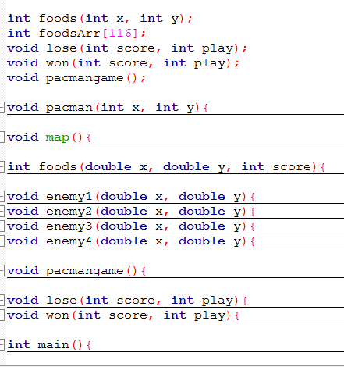
PAC-MAN: FUNCTIONS

Slide 6
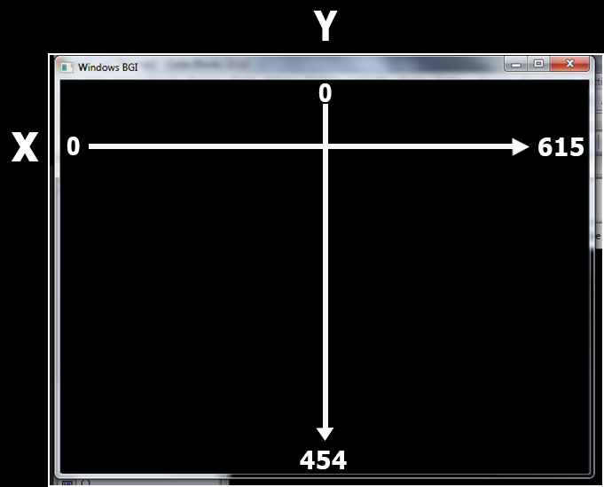
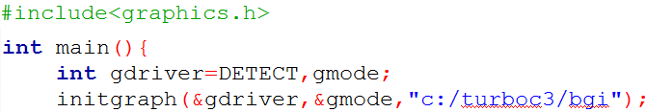
PAC-MAN: Graphics

Slide 7
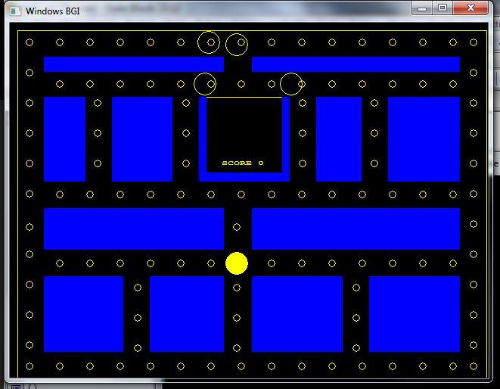
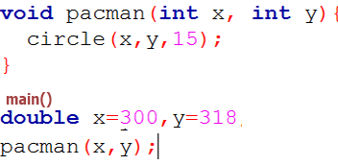
GRAPHICS (CIRCLE/PACMAN)

Slide 8
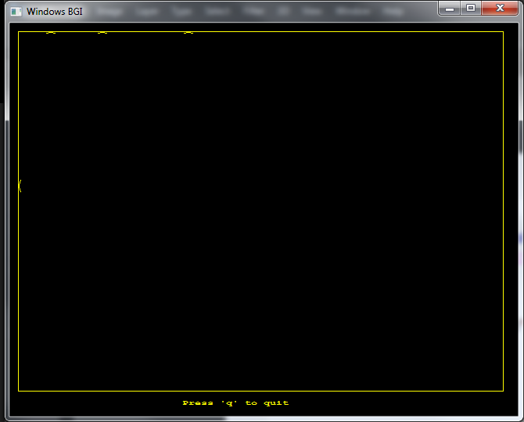

GRAPHICS (RECTANGLE)

Slide 9
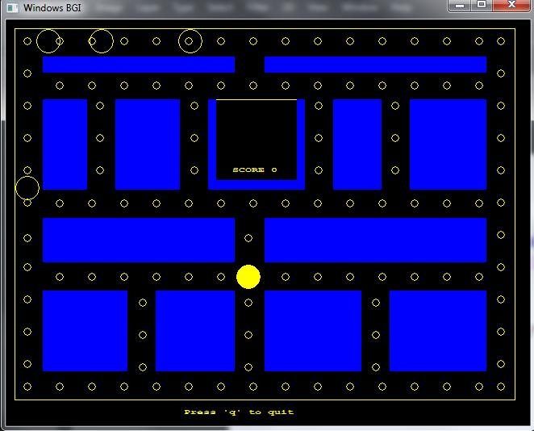
GRAPHICS (BAR)

Slide 10
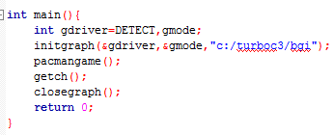
PAC-MAN: MAIN Function

Slide 11
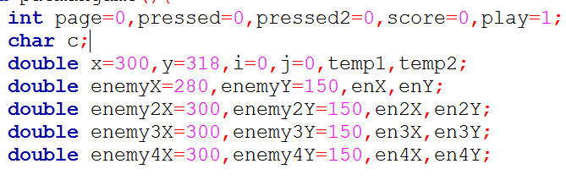
PAC-MAN: Variables pacmangame()

Slide 12
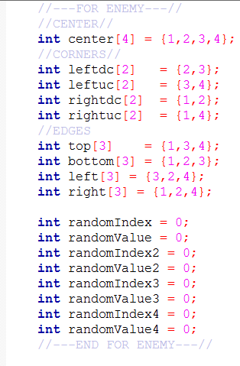
PAC-MAN: Variables | Enemy pacmangame()

Slide 13
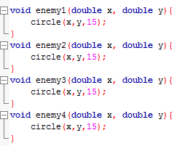
PAC-MAN: ENEMIES Function

Slide 14
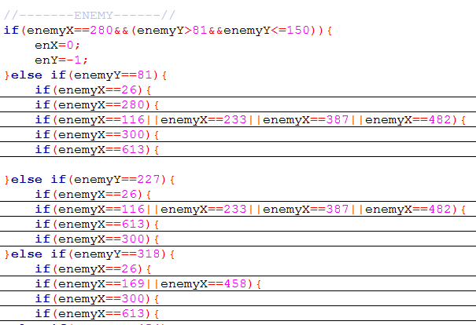
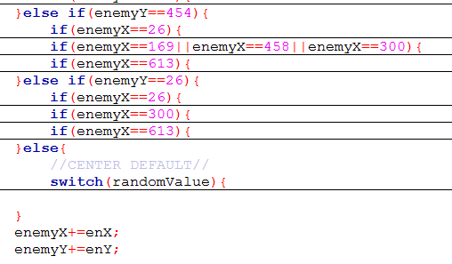
PAC-MAN: Ghost Movements pacmangame() Detecting Ghost

Slide 15
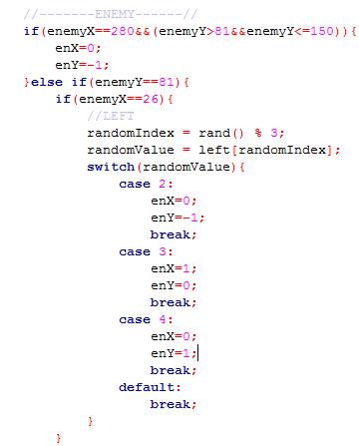
PAC-MAN: Ghost Movements pacmangame() LEFT

Slide 16
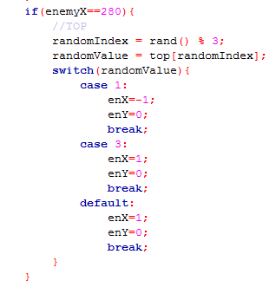
PAC-MAN: Ghost Movements pacmangame() TOP

Slide 17
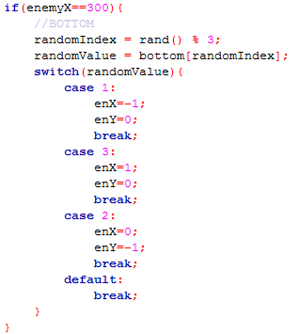
PAC-MAN: Ghost Movements pacmangame() BOTTOM

Slide 18
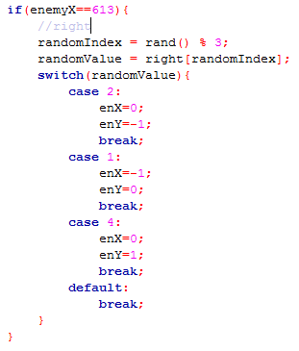
PAC-MAN: Ghost Movements pacmangame() RIGHT

Slide 19
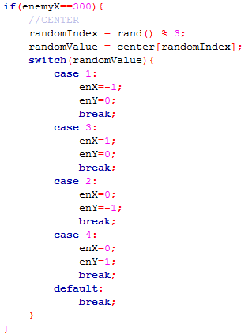
PAC-MAN: Ghost Movements pacmangame() CENTER

Slide 20
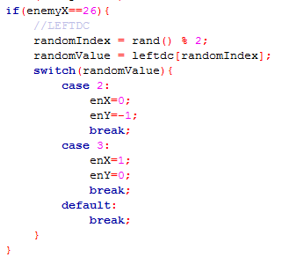
PAC-MAN: Ghost Movements pacmangame() LEFT DOWN CORNER

Slide 21
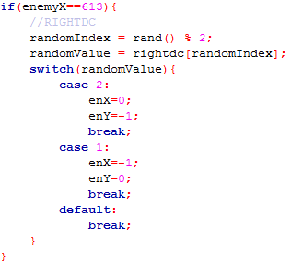
PAC-MAN: Ghost Movements pacmangame() RIGHT DOWN CORNER

Slide 22
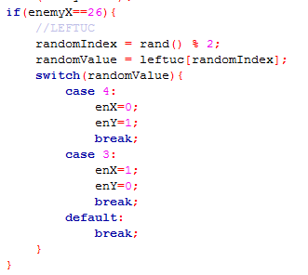
PAC-MAN: Ghost Movements pacmangame() LEFT UPPER CORNER

Slide 23
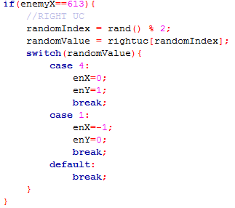
PAC-MAN: Ghost Movements pacmangame() RIGHT UPPER CORNER

Slide 24
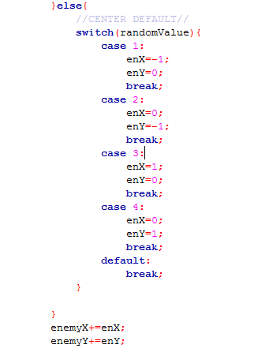
PAC-MAN: Ghost Movements pacmangame() DEFAULT MOVEMENT

Slide 25
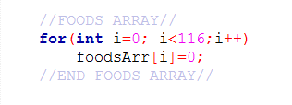
PAC-MAN: Variables | Foods pacmangame()

Slide 26
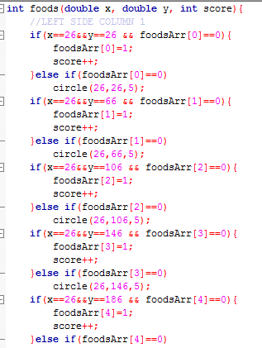
PAC-MAN: FOODS Function

Slide 27
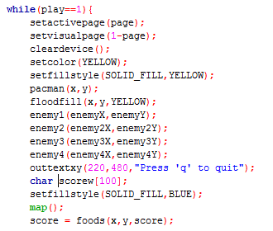
PAC-MAN: GAME LOOP pacmangame()

Slide 28
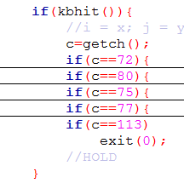
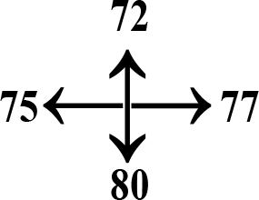
PAC-MAN: Movements pacmangame()

Slide 29
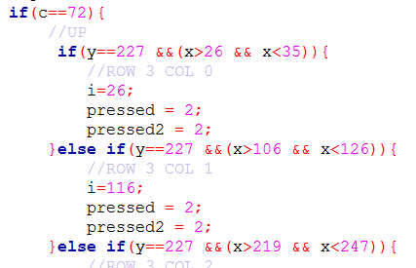
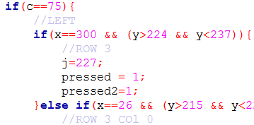
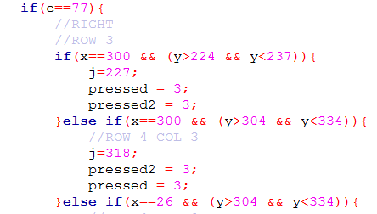
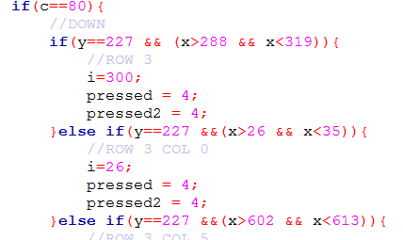
PAC-MAN: Movements pacmangame()

Slide 30
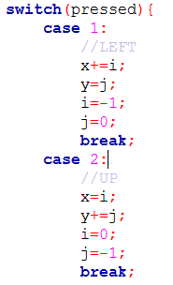
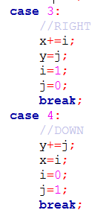
ADDING THE VALUES TO SPECIFIC KEYS | Movements

Slide 31
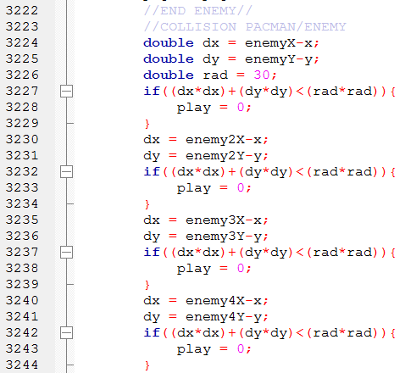
PAC-MAN TO GHOST: Collision pacmangame()

Slide 32
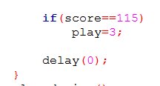
PAC-MAN: END OF GAME LOOP pacmangame()

Slide 33
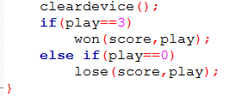
PAC-MAN: END OF FUNCTION pacmangame()

Slide 34
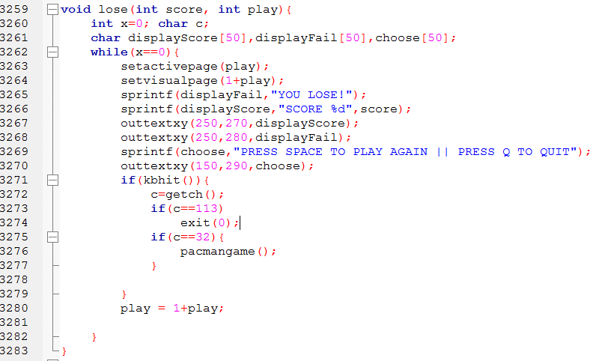
PAC-MAN: Loses

Slide 35
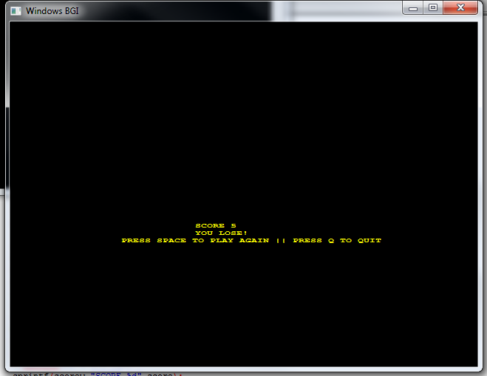
OUTPUT: LOSES

Slide 36
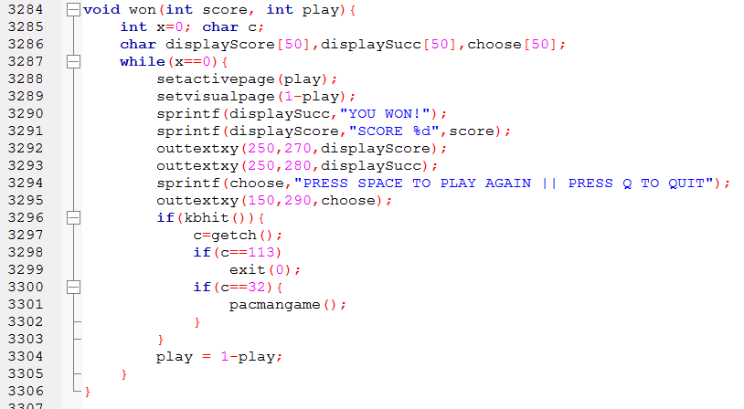
PAC-MAN: Wins

Slide 37
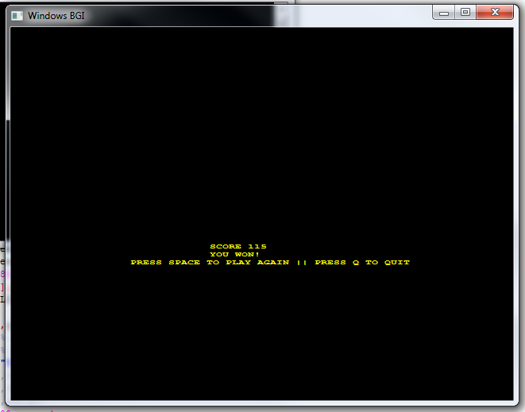
OUTPUT: WINS

Slide 38
THANK YOU FOR LISTENING!
Phoebe Gail Lopez
Cecille T. Velasco
BSCpE - 2

