Slide 1
Long Noncoding RNA FENDRR Exhibits
Antifibrotic Activity in Pulmonary Fibrosis
Huang C, Liang Y, Zeng X, Yang X, Xu D, Gou X, Sathiaseelan R, Senavirathna LK, Wang P, Liu L
American Journal of Respiratory Cell and Molecular Biology | Volume 62, Number 4 | April 2020
Journal Club Presentation | Presented by: [Your Name] | Date: [Date]
Notes:
Welcome everyone. Today I'll be presenting the paper 'Long Noncoding RNA FENDRR Exhibits Antifibrotic Activity in Pulmonary Fibrosis' by Huang et al., published in AJRCMB in April 2020. This study identifies FENDRR as a novel antifibrotic lncRNA that operates through two distinct mechanisms: iron regulation via IRP1 and miR-214 sponging.

Slide 2
Background & Clinical Significance
Idiopathic Pulmonary Fibrosis (IPF): Chronic, lethal fibrotic lung disease; median survival 3–5 years
No effective therapy exists — current FDA-approved drugs (pirfenidone, nintedanib) only slow progression
Abnormal activation of lung fibroblasts → excessive ECM deposition → lung scarring
Long noncoding RNAs (lncRNAs): >200 nt, non-protein-coding, regulate gene expression at multiple levels
lncRNAs implicated in IPF, but functional mechanisms largely unknown
This study: Identifies FENDRR as downregulated antifibrotic lncRNA; reveals dual mechanism (iron + miR-214)
Notes:
IPF is a devastating disease with no cure. The key pathological feature is fibroblast activation leading to excessive collagen deposition. While miRNAs have been studied in IPF, lncRNAs remain poorly understood. This paper makes a significant contribution by identifying FENDRR as a functionally important antifibrotic lncRNA and — crucially — elucidating its mechanism of action through two distinct pathways.

Slide 3
Study Design Overview
Experimental Approach
Model Systems
1. RNA-seq reanalysis of 2 public IPF datasets (SRA048904, GSE52463) → identify dysregulated lncRNAs
2. Validation in independent human IPF cohort (n=27) + mouse bleomycin model
3. In vitro: Human lung fibroblasts (HPF, LL29) — TGF-β1 stimulation, FENDRR OE/KD
4. Mechanism 1: RNA pulldown + mass spec → IRP1 identification → RIP + CLIP-qPCR
5. Mechanism 2: miRNA sponge prediction → miR-214 binding sites → luciferase assays
6. In vivo: Adenoviral FENDRR delivery in mouse bleomycin model → histology, mechanics, molecular
Human: IPF lung tissues (Lung Tissue Research Consortium)
Primary human pulmonary fibroblasts (HPF)
LL29 lung fibroblast cell line
Mouse: Bleomycin-induced pulmonary fibrosis (1 U/kg)
Primary mouse lung fibroblasts
Adenoviral gene delivery (5×10⁹ IU, intranasal)
Readouts: qPCR, ddPCR, Western blot, gel contraction,
immunohistochemistry, flexiVent respiratory mechanics,
hydroxyproline assay, Ashcroft scoring
Notes:
The study design is comprehensive — starting with bioinformatics identification, moving through in vitro mechanistic work, and culminating in in vivo therapeutic validation. They used two independent human IPF datasets for discovery, validated in an independent cohort, and used both cell lines and primary cells. The in vivo model uses adenoviral delivery which is translationally relevant.

Slide 4
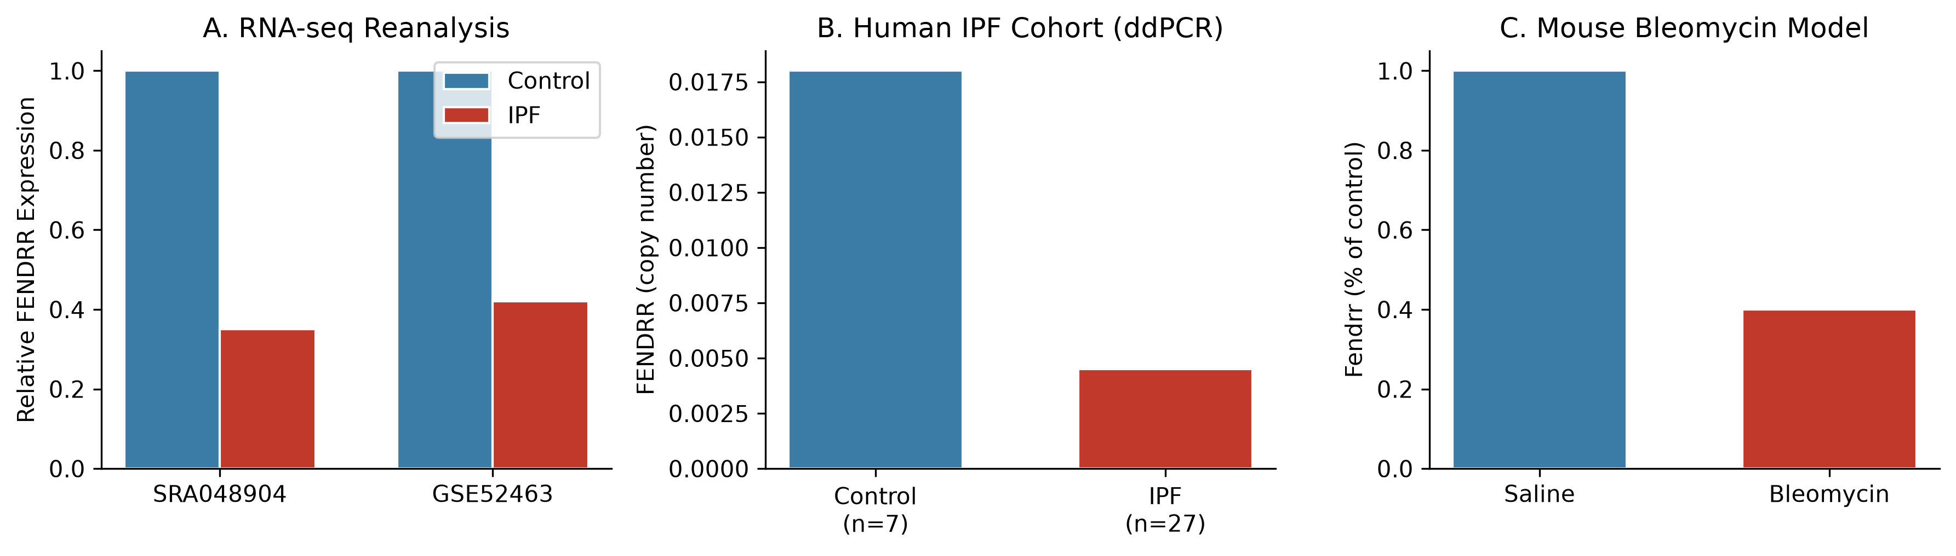
Key Finding 1: FENDRR Is Downregulated in Fibrotic Lungs & Fibroblasts
Key Evidence:
RNA-seq reanalysis: FENDRR downregulated in both SRA048904 and GSE52463 datasets (P<0.001)
Human IPF cohort (n=27): FENDRR ↓ 4-fold (0.018 vs 0.0045 copies/μL, ddPCR, P<0.001)
Mouse bleomycin model: Fendrr ↓ 60% (P<0.01); confirmed by ddPCR
Cell-type specific: Downregulated in fibroblasts, not in alveolar epithelial cells (AEC I/II)
TGF-β1 (5 ng/mL) reduces FENDRR in HPF and LL29 cells (dose- and time-dependent)
SMAD3 knockdown (not SMAD2) rescues TGF-β1-mediated FENDRR suppression
Notes:
This is a very strong finding. They used three independent lines of evidence: reanalysis of two public RNA-seq datasets, validation in an independent human cohort using the highly sensitive ddPCR technique, and a mouse model. The cell-type specificity is important — FENDRR is downregulated specifically in fibroblasts, the key effector cells in fibrosis. The TGF-β1/SMAD3 mechanism provides a clear pathogenic link.

Slide 5
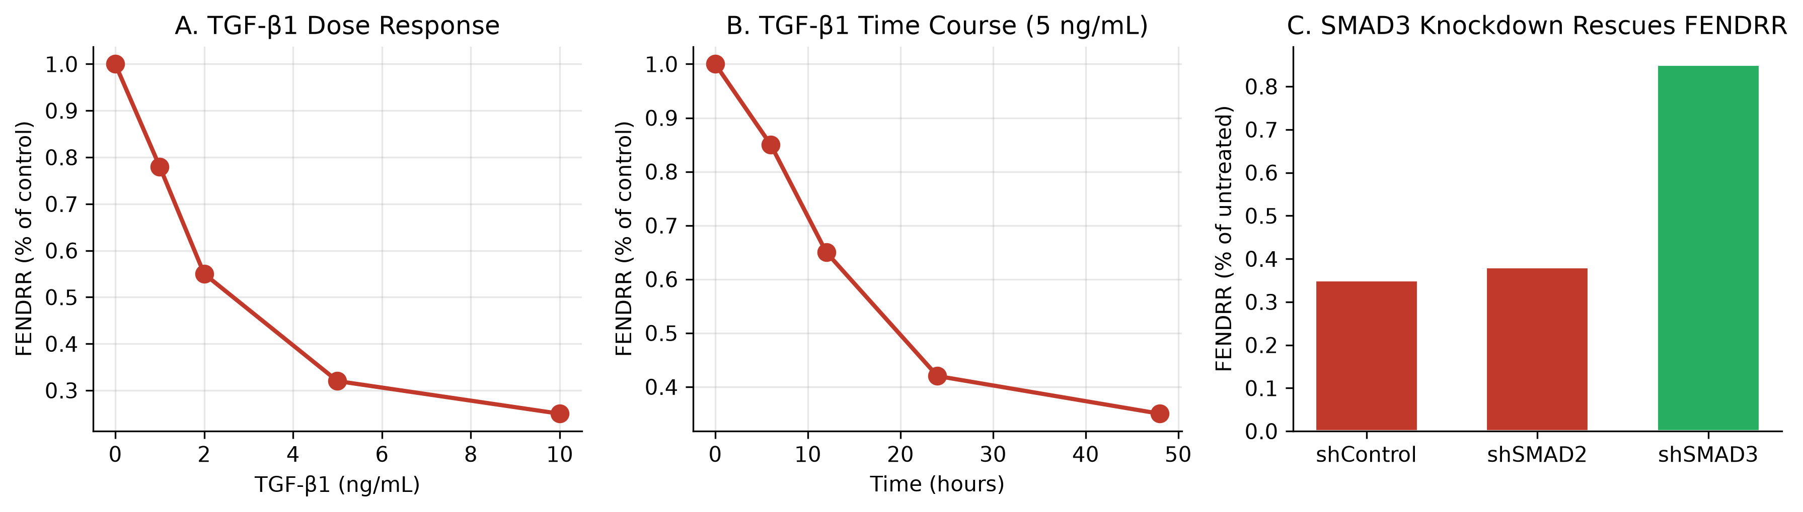
TGF-β1/SMAD3 Signaling Inhibits FENDRR Expression
TGF-β1 suppresses FENDRR in dose-dependent (IC₅₀ ~2 ng/mL) and time-dependent manner
SMAD3 knockdown (not SMAD2) reverses TGF-β1-mediated FENDRR downregulation
Implies canonical TGF-β1/SMAD3 pathway directly represses FENDRR transcription
FENDRR is primarily cytoplasmic in adult lung fibroblasts (Nuc/Cyt ratio ~0.2)
Cytoplasmic localization suggests post-transcriptional mechanism (protein/RNA interactions)
Consistent with known role of TGF-β/SMAD3 in pulmonary fibrosis pathogenesis
Notes:
This figure shows the upstream regulation of FENDRR. TGF-β1 is the master profibrotic cytokine, and SMAD3 is its canonical transducer. The fact that SMAD3 but not SMAD2 knockdown rescues FENDRR is an important specificity finding. The cytoplasmic localization is critical — it tells us FENDRR likely functions by interacting with cytoplasmic proteins or RNAs, not by chromatin regulation like some nuclear lncRNAs.

Slide 6
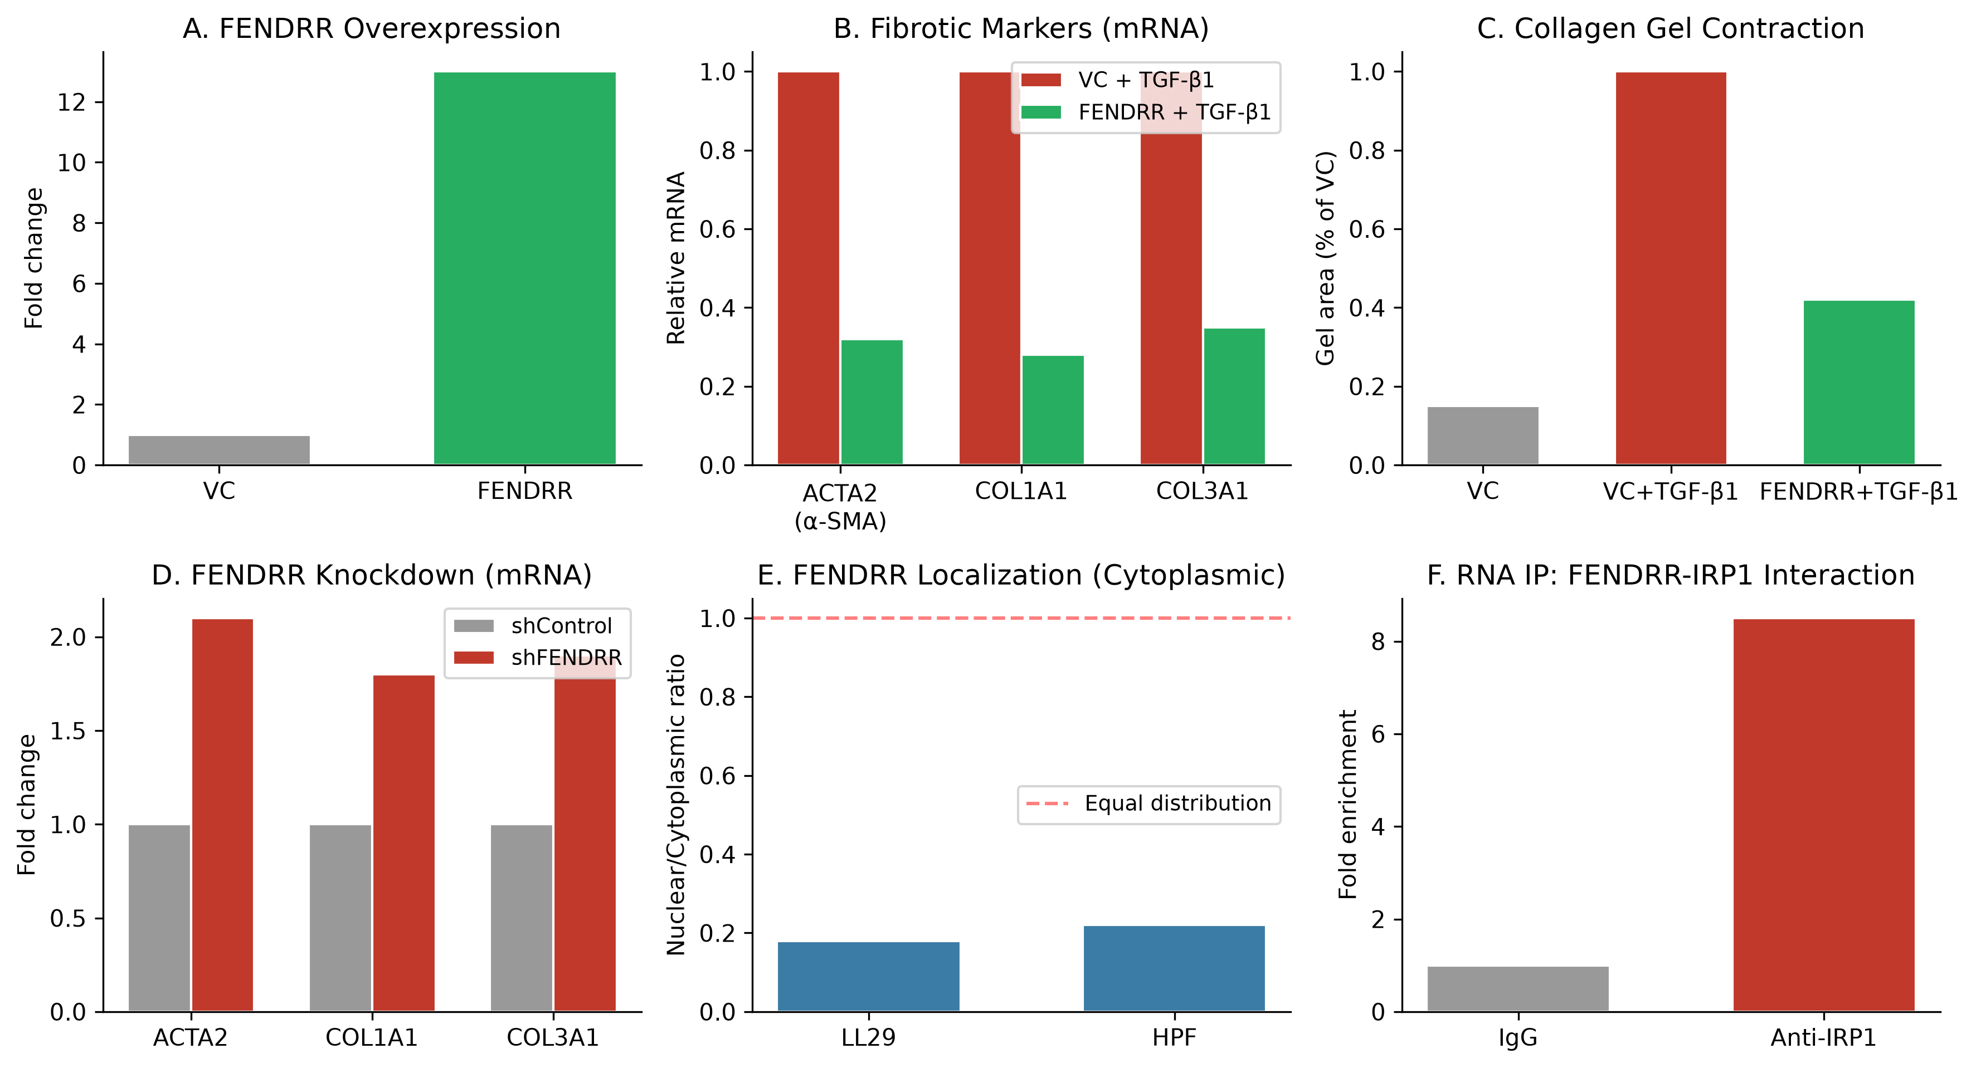
FENDRR Overexpression Inhibits TGF-β1-Induced Fibroblast Activation
Notes:
This is the functional core of the paper. FENDRR overexpression (13-fold increase) dramatically suppresses all major fibrotic markers: ACTA2/α-SMA, COL1A1, COL3A1 at both mRNA and protein levels. Functionally, it reduces collagen gel contraction and stress fiber formation — both hallmarks of fibroblast activation. Conversely, FENDRR knockdown enhances fibrotic markers. The effect is specific to TGF-β1-stimulated conditions; basal levels are largely unaffected, suggesting FENDRR specifically modulates the activated state.

Slide 7
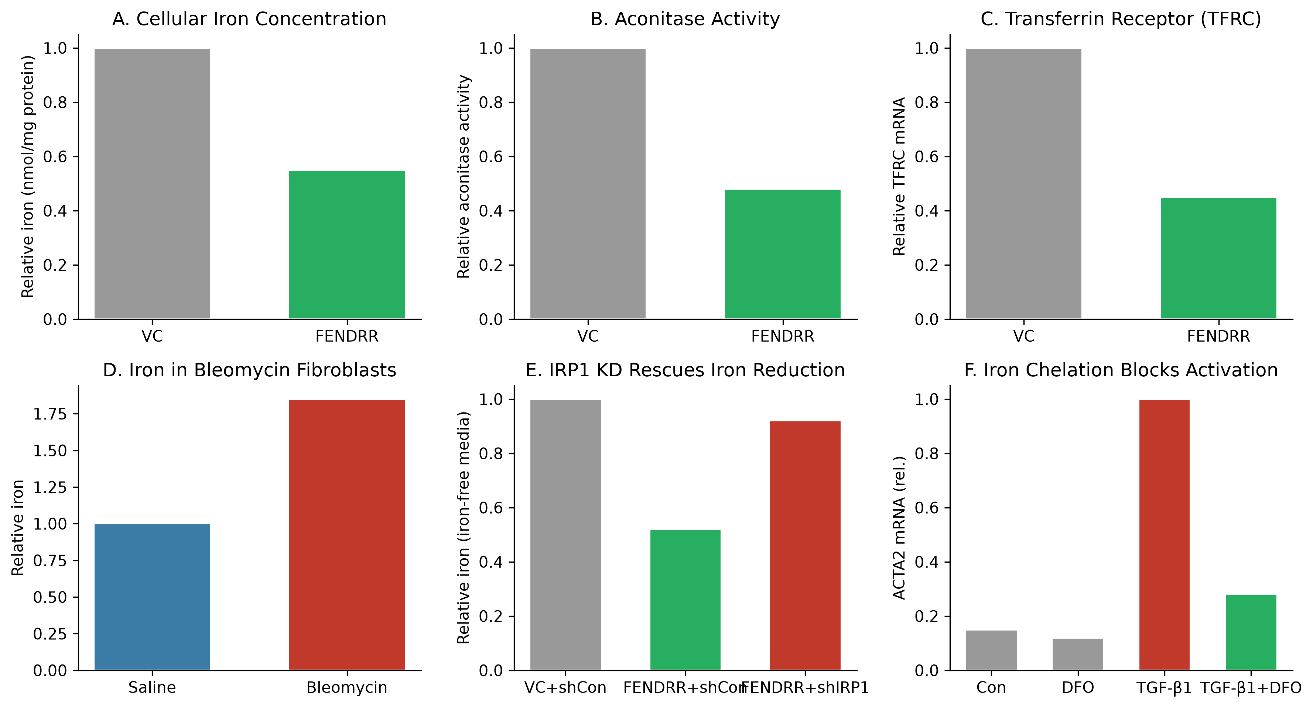
Mechanism 1: FENDRR Binds IRP1 to Reduce Cellular Iron
Notes:
This is a novel mechanism for a lncRNA in fibrosis. IRP1 (iron-responsive element-binding protein 1) is a dual-function protein: at low iron it binds IREs on mRNAs to regulate iron transport/storage; at high iron it functions as aconitase. FENDRR overexpression reduces cellular iron, inhibits aconitase activity, and decreases TFRC (transferrin receptor) mRNA — all consistent with IRP1 activation. Critically, IRP1 knockdown rescues the iron reduction, proving IRP1 is the functional mediator. Iron chelation (deferoxamine) blocks TGF-β1-induced fibroblast activation, proving iron is REQUIRED for activation. This is a major mechanistic insight.

Slide 8
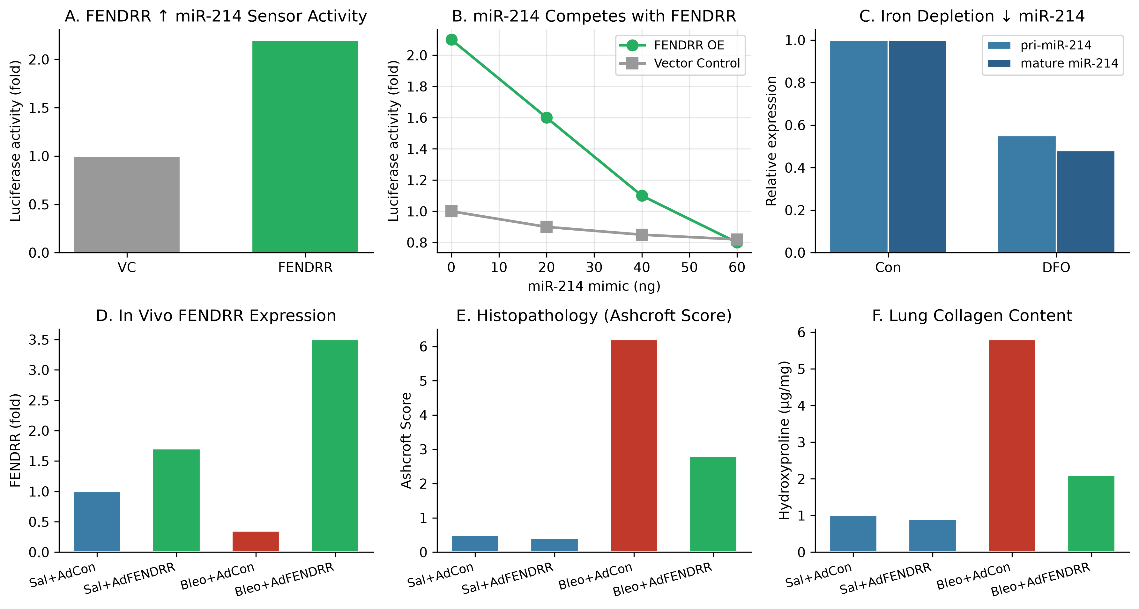
Mechanism 2: FENDRR Acts as a Competing Endogenous RNA for miR-214
Notes:
The second mechanism is ceRNA activity. FENDRR contains 6 predicted miR-214 binding sites. The luciferase sensor assay shows FENDRR increases miR-214 sensor activity (meaning it sponges miR-214, relieving repression of the sensor). The competition experiment is elegant: adding increasing miR-214 mimic reverses FENDRR's effect. Iron depletion reduces both pri- and mature miR-214, suggesting the iron and miR-214 pathways cross-talk. In vivo, adenoviral FENDRR delivery attenuates bleomycin fibrosis: reduces Ashcroft score, hydroxyproline, collagen mRNA/protein, and improves respiratory mechanics (elastance).

Slide 9
In Vivo: Adenoviral FENDRR Attenuates Bleomycin-Induced Fibrosis
Histopathology & Biochemistry
Respiratory Function & Mechanism In Vivo
Ad-FENDRR (5×10⁹ IU) delivered intranasally Day 0; Bleomycin (1 U/kg) Day 1
Analysis at Day 14 (peak fibrosis)
Ashcroft score: Bleomycin 6.2 → Bleo+AdFENDRR 2.8 (P<0.001)
Hydroxyproline (collagen): Bleomycin 5.8 → Bleo+AdFENDRR 2.1 μg/mg (P<0.001)
Col1a1/Col3a1 mRNA: ~60% reduction with AdFENDRR (P<0.01)
COL1A1 protein: ~65% reduction (Western blot, P<0.001)
flexiVent respiratory mechanics: Elastance (Ers)
Saline: ~0.5 cmH₂O/mL; Bleomycin: ~2.5; Bleo+AdFENDRR: ~1.2 (P<0.05)
FENDRR expression: 1.7-fold (saline), 3.5-fold (bleomycin) increase
Mechanism confirmed in vivo:
↓ COL1A1 protein, ↓ miR-214 activity (indirect)
Human FENDRR variant 3 (positionally conserved to mouse variant 1)
Limitations: Adenovirus targets epithelial cells more than fibroblasts;
possible effects on epithelial cells contribute to phenotype
Notes:
The in vivo data is compelling. The Ashcroft score reduction from 6.2 to 2.8 is a massive improvement — that's going from severe fibrosis to mild. Hydroxyproline (biochemical collagen measurement) confirms it. The functional improvement in elastance is clinically relevant — this isn't just histology, it's physiology. However, the caveat about adenovirus targeting is important: fibroblasts express low CAR (coxsackie-adenovirus receptor), so the gene may be delivered mainly to epithelial cells, which could indirectly affect fibroblasts.

Slide 10
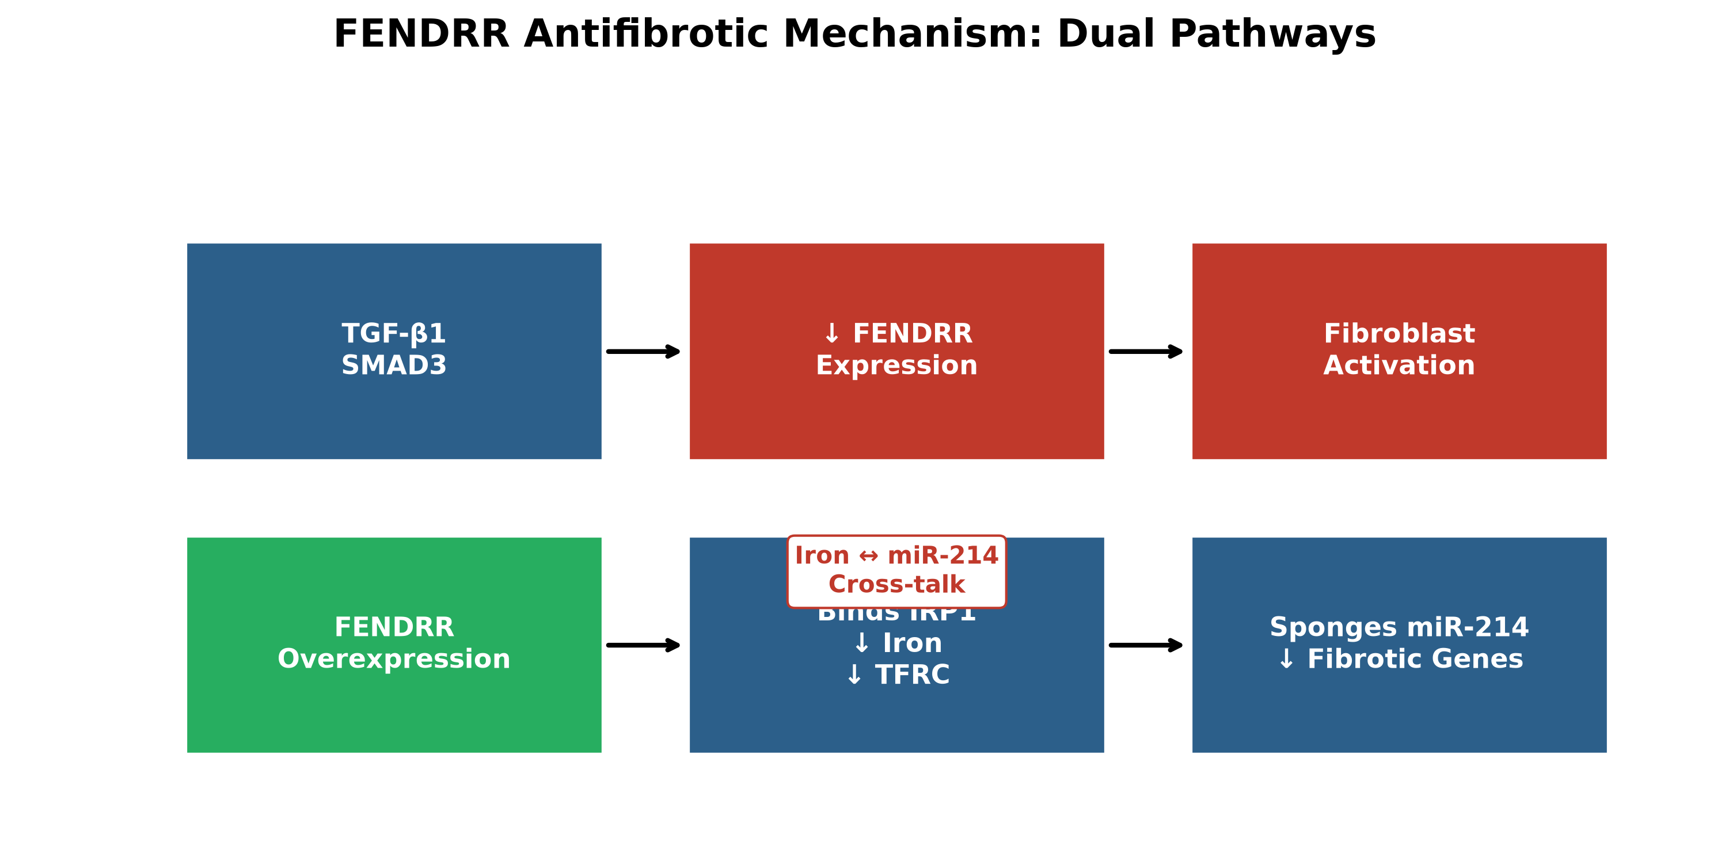
Integrated Model: Dual Antifibrotic Pathways of FENDRR
Pathway 1 (Iron/IRP1): FENDRR binds IRP1 → ↑ IRP1-IRE binding activity → ↓ TFRC → ↓ cellular iron → inhibits TGF-β1-induced fibroblast activation
Pathway 2 (miR-214 sponge): FENDRR contains 6 miR-214 binding sites → competes with miR-214 targets → ↓ miR-214 activity → ↓ fibrotic gene expression
Cross-talk: Iron depletion reduces miR-214 expression → pathways are interconnected
Upstream: TGF-β1/SMAD3 signaling represses FENDRR → creates feed-forward loop promoting fibrosis
Therapeutic implication: Restoring FENDRR breaks this cycle at two nodes simultaneously
Notes:
This integrated model is the conceptual centerpiece. FENDRR sits at the intersection of iron metabolism and miRNA regulation. TGF-β1 suppresses FENDRR, which normally keeps both iron and miR-214 in check. When FENDRR is lost, iron rises and miR-214 is unleashed — both driving fibroblast activation. The cross-talk (iron regulates miR-214) creates a reinforcing loop. Therapeutically, restoring FENDRR hits both arms simultaneously, which may be more effective than targeting either alone.

Slide 11
Strengths of the Study
✓ Multiple independent lines of evidence: 2 RNA-seq datasets + independent human cohort + mouse model
✓ Rigorous quantification: ddPCR for absolute copy numbers (not just relative qPCR)
✓ Mechanistic depth: Two distinct mechanisms identified (IRP1/iron + miR-214 sponge) with rescue experiments
✓ Functional validation: Gain-of-function (OE) and loss-of-function (KD) in vitro + in vivo therapeutic test
✓ Physiologically relevant endpoints: Gel contraction, stress fibers, respiratory mechanics (flexiVent), hydroxyproline
✓ Clinical relevance: Human IPF tissues, primary human fibroblasts, conserved mechanism in mice
✓ Novelty: First demonstration of lncRNA regulating iron metabolism in pulmonary fibrosis
✓ Thorough controls: Vector controls, scrambled shRNAs, IgG RIP, multiple statistical tests
Notes:
This is a very strong paper. The use of ddPCR for absolute quantification is a major strength — it avoids the pitfalls of relative qPCR. The rescue experiments (IRP1 KD, miR-214 competition, iron chelation) are well-designed and provide causal evidence. The in vivo functional data with respiratory mechanics is clinically meaningful. The discovery of iron regulation by a lncRNA in fibrosis is genuinely novel.

Slide 12
Limitations & Weaknesses
✗ Adenoviral delivery: Low CAR expression on fibroblasts → primarily transduces epithelial cells;
fibroblast effects may be indirect (paracrine from epithelium)
✗ Single time point in vivo (Day 14); no long-term safety or durability data
✗ Bleomycin model: Acute injury-driven fibrosis that resolves spontaneously;
not fully representative of chronic, progressive human IPF
✗ No miR-214 rescue experiment in vivo: Cannot quantify relative contribution of iron vs. miR-214 pathways
✗ FENDRR variant complexity: Human has 3 variants (V2/V3 detected); mouse has 2;
functional equivalence assumed but not rigorously proven
✗ IRP1 binding region mapped (1419–1549 bp), but structural basis not resolved (no mutational analysis)
✗ No assessment of off-target effects of adenoviral FENDRR or systemic iron changes
✗ Sample sizes modest in some experiments (n=3–4); some stats use Fisher's LSD (liberal post-hoc)
Notes:
The limitations are important to acknowledge. The adenovirus delivery issue is the biggest technical caveat — if FENDRR isn't actually getting into fibroblasts in vivo, the mechanism in vivo might differ from in vitro. The bleomycin model limitation is standard but worth noting. The lack of miR-214 rescue in vivo means we don't know which mechanism dominates therapeutically. The statistical concern about Fisher's LSD is minor but worth noting for rigor.

Slide 13
Discussion Questions
1. Therapeutic translation: Given adenovirus limitations, what delivery strategy would you propose for clinical development? (AAV? Lipid nanoparticles? Exosomes?)
2. Mechanism hierarchy: The iron and miR-214 pathways cross-talk (iron depletion ↓ miR-214). Which is the primary driver? How would you design a definitive experiment?
3. Cell-type specificity: FENDRR is cytoplasmic in adult fibroblasts but nuclear in development. What regulates this shift? Could nuclear FENDRR have distinct functions?
4. Biomarker potential: FENDRR is downregulated in IPF. Could circulating FENDRR (exosomal?) serve as a diagnostic/prognostic biomarker?
5. Iron-fibrosis link: Iron chelation failed in some prior bleomycin studies (short treatment, single dose). Does this paper resolve the controversy? What's the therapeutic window?
6. SMAD3 specificity: Why SMAD3 not SMAD2? Is there a direct SMAD3 binding site on FENDRR promoter? ChIP data needed.
7. Broader relevance: FENDRR is downregulated in gastric cancer too. Is this a general antifibrotic/antitumor mechanism across tissues?
Notes:
These discussion questions cover translation, mechanism, cell biology, biomarkers, and broader relevance. Question 1 is critical for translation — adenovirus isn't clinically viable for chronic lung disease. Question 2 gets at the mechanistic hierarchy — the cross-talk means the pathways aren't independent. Question 3 about developmental vs adult localization is fascinating. Question 4 on biomarkers is clinically relevant. Question 5 addresses the historical controversy about iron chelation in fibrosis.

Slide 14
Conclusions & Take-Home Messages
🎯 FENDRR is a conserved, antifibrotic lncRNA downregulated in human IPF and mouse fibrosis
🎯 TGF-β1/SMAD3 signaling represses FENDRR — a pathogenic feed-forward loop
🎯 FENDRR inhibits fibroblast activation via TWO parallel mechanisms:
1) Binds IRP1 → reduces cellular iron → blocks iron-dependent fibroblast activation
2) Sponges miR-214 → de-represses antifibrotic targets → suppresses collagen/α-SMA
🎯 Iron and miR-214 pathways cross-talk: iron depletion reduces miR-214 expression
🎯 Adenoviral FENDRR delivery attenuates bleomycin fibrosis and improves lung function in vivo
🎯 FENDRR represents a novel therapeutic target that simultaneously modulates iron metabolism and miRNA networks
🎯 Key innovation: First lncRNA shown to regulate iron homeostasis in pulmonary fibrosis
Notes:
To summarize: This paper makes a significant contribution by identifying FENDRR as an antifibrotic lncRNA with a unique dual mechanism. The iron regulation via IRP1 is particularly novel for lncRNAs in fibrosis. The miR-214 sponge mechanism adds to the growing ceRNA literature. The in vivo efficacy data supports therapeutic potential. The work opens new avenues: targeting lncRNA-iron interactions, developing FENDRR-based therapeutics, and understanding the iron-miRNA cross-talk in fibrosis.

Slide 15
References & Acknowledgments
Primary Reference:
Huang C, Liang Y, Zeng X, Yang X, Xu D, Gou X, Sathiaseelan R, Senavirathna LK, Wang P, Liu L.
Long Noncoding RNA FENDRR Exhibits Antifibrotic Activity in Pulmonary Fibrosis.
Am J Respir Cell Mol Biol. 2020 Apr;62(4):441-453. doi: 10.1165/rcmb.2019-0171OC.
Key Related References:
Acknowledgments:
Szafranski et al. (2013) Genome Res — Fendrr lethal lung developmental disorder
Kino et al. (2010) Sci Signal — lncRNA GAS5 as glucocorticoid receptor co-repressor
Mehta et al. (2018) Am J Med Sci — Iron enhances TGF-β signaling in hepatic stellate cells
Chen et al. (2012) J Biol Chem — Iron chelators inhibit TGF-β via NDRG1
Furió-Tarí et al. (2016) NAR — spongeScan for miRNA binding in lncRNAs
Huang et al. (2015) Physiol Genomics — lncRNA-miRNA interactions in IPF
Lung Tissue Research Consortium (NHLBI) — human IPF specimens
Oklahoma Center for Respiratory and Infectious Diseases
Lundberg-Kienlen Lung Biology and Toxicology Laboratory, OSU
Department of Immunology and Microbiology, Jinan University
Funding: NIH/NHLBI grants (acknowledged in original publication)
Notes:
Thank you for your attention. The primary reference is Huang et al., AJRCMB 2020. The related references highlight the key prior work on FENDRR in development, the iron-TGF-β connection, and lncRNA-miRNA interactions in IPF. The study was supported by the Lung Tissue Research Consortium and conducted at Oklahoma State University and Jinan University. I'm happy to take questions.

