Slide 1

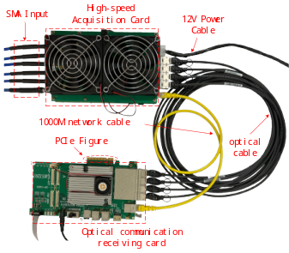

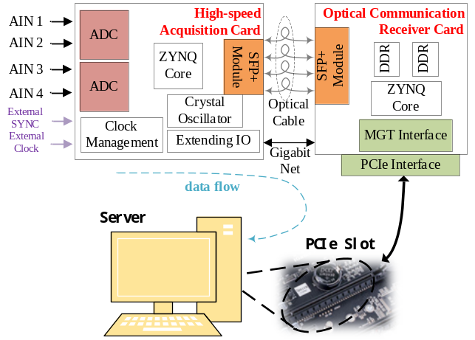


项目简介
Team Member Names Font: Times New Roman Size:12
队员：XXX, XXX, XXX
仙八色鸫鸣声与图像协同监测系统：仙八色鸫鸣声与图像协同监测系统：24
武汉大学
电子信息学院
校名
校徽
作品实物缩略图
Font: Calibri(Body) Size:11 Size:11
板端实测：AMD PYNQ-Z2 (XC7Z020)
背景：
仙八色鸫是国家二级保护动物、IUCN 易危物种，野外监测需长时间蹲守。
本系统在 PYNQ-Z2 上实现'鸣声检测-视觉确认-自动录像'全自动闭环。
技术方案：
1. PL 侧 I2S+AXI DMA 采集 INMP441 麦克风，32kHz 实时流不占 CPU
2. PS 侧 3 层 CNN 鸟鸣检测，阈值 0.985 触发视觉端
3. USB 摄像头 + YOLOv8n(NCNN) 确认目标，自动抓拍录像
4. Vitis HLS 定点 GEMM 核验证 conv1 硬件加速（纯核 4.64x）
5. 目标存在性录像：misses=3 后结束，存储效率提升 5-10 倍
作品测试平台信息
C
R
R
E
E
S
A
T
U
I
L
Typical application case
系统框图，关键创新点
V
T
系统架构
E
实测性能
• 音频事件级召回 97.4%（155 事件）
• 图像独立测试召回 96.2%（266 图）
• 音频窗口特异性 100%（2063 负样本）
• 端到端触发延迟约 10.5s
• GEMM 纯核加速 4.64x（端到端 0.59x）
• 音频 overlay LUT 仅占 3.15%
• 录像 37.4s / 187 帧 H.264
D
实测性能
• 音频事件级召回 97.4%（155 事件）
• 图像独立测试召回 96.2%（266 图）
• 音频窗口特异性 100%（2063 负样本）
• 端到端触发延迟约 10.5s
• GEMM 纯核加速 4.64x（端到端 0.59x）
• 音频 overlay LUT 仅占 3.15%
• 录像 37.4s / 187 帧 H.264
E
S
I
N
背景，关键信息摘要
G
音频采集与检测模块
• INMP441 I2S 数字 MEMS 麦克风
• 2s 窗口 → STFT/Mel [64,201]
• 3 层 CNN + Sigmoid 输出鸟鸣概率
• score ≥ 0.985 写触发文件
• 录像期间自动暂停让出 CPU
测试结果，性能，展望

Slide 2
INTRODUCTION
Team Member Names Font: Times New Roman Size:12
Team: XXX, XXX, XXX
Acoustic-Visual Collaborative Monitoring for Fairy Pitta：Acoustic-Visual Collaborative Monitoring for Fairy Pitta：24
Wuhan University
School of Electronic Engineering
校名
校徽
作品实物缩略图
Font: Calibri(Body) Size:11 Size:11
On-board: AMD PYNQ-Z2 (XC7Z020)
Background:
Fairy Pitta (Pitta nympha) is a national protected species
in China. Field monitoring requires long observation hours.
This system achieves 'call detection-visual confirm-auto record'
fully automated on a single PYNQ-Z2 board.
Approach:
1. PL I2S+AXI DMA: 32kHz mic stream, zero CPU overhead
2. PS 3-layer CNN bird call detection, trigger at 0.985
3. USB camera + YOLOv8n (NCNN) confirmation + recording
4. Vitis HLS GEMM IP for conv1 (4.64x core speedup)
5. Presence-based recording: 5-10x storage efficiency
作品测试平台信息
C
R
R
E
E
S
A
T
U
I
L
Typical application case
系统框图，关键创新点
V
T
System Architecture
E
Performance Results
- Audio event recall: 97.4% (155 events)
- Image recall: 96.2% (266 independent images)
- Audio specificity: 100% (2063 negatives)
- End-to-end trigger latency: ~10.5s
- GEMM core speedup: 4.64x (0.59x end-to-end)
- Audio overlay LUT: only 3.15%
- Recording: 37.4s / 187 frames H.264
D
Performance Results
- Audio event recall: 97.4% (155 events)
- Image recall: 96.2% (266 independent images)
- Audio specificity: 100% (2063 negatives)
- End-to-end trigger latency: ~10.5s
- GEMM core speedup: 4.64x (0.59x end-to-end)
- Audio overlay LUT: only 3.15%
- Recording: 37.4s / 187 frames H.264
E
S
I
N
Background:
Fairy Pitta (Pitta nympha) is a national protected species
in China. Field monitoring requires long observation hours.
This system achieves 'call detection-visual confirm-auto record'
fully automated on a single PYNQ-Z2 board.
Approach:
1. PL I2S+AXI DMA: 32kHz mic stream, zero CPU overhead
2. PS 3-layer CNN bird call detection, trigger at 0.985
3. USB camera + YOLOv8n (NCNN) confirmation + recording
4. Vitis HLS GEMM IP for conv1 (4.64x core speedup)
5. Presence-based recording: 5-10x storage efficiency
G
Audio Acquisition & Detection
- INMP441 I2S digital MEMS microphone
- 2s window to STFT/Mel [64,201]
- 3-layer CNN + Sigmoid call probability
- score >= 0.985 triggers visual module
- Pauses during recording to yield CPU
测试结果，性能，展望

