Slide 1
Crimes in the UK -Week 1
Crimes in the UK-Week1
Aser Abdelrahman
Chaoran Chen
Sergiu Soima

Slide 2
Crimes in the UK – Dataset structure
1. Street-level crime:
12 attributes
35,000,000 rows
2. Outcome
10 attributes
17,623,790 rows
3. Stop and search information
14 attributes
584,836 rows
Crimes:
15 attributes
38,550,660 rows
crime_id
Crimes in the UK-Week 1
Aser Abdelrahman, Chaoran Chen, Sergiu Soima
16.11.2016

Slide 3
Quality (with respect to outcome)
1. Street-level crime:
2. Outcome
3. Stop and search information
18,535,646 (52.96%) outcomes are missing
20,765,675 (53.87%) outcomes are missing
17,957 (3.07%) outcomes are missing
Crimes in the UK-Week 1
Aser Abdelrahman, Chaoran Chen, Sergiu Soima
16.11.2016

Slide 4
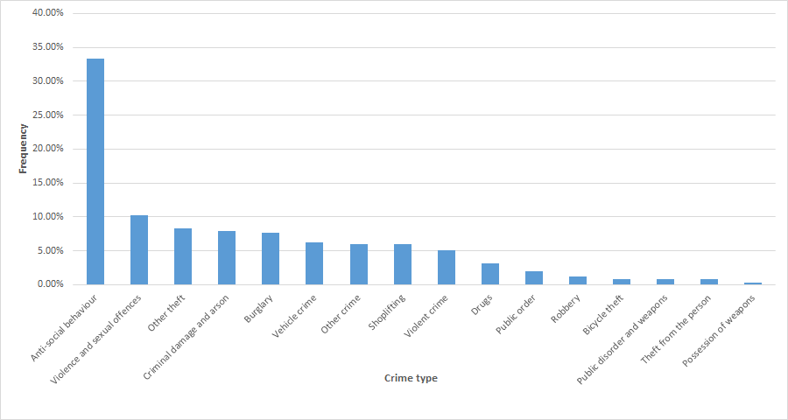
Crime Type Frequency
Crimes in the UK-Week 1
Aser Abdelrahman, Chaoran Chen, Sergiu Soima
16.11.2016

Slide 5
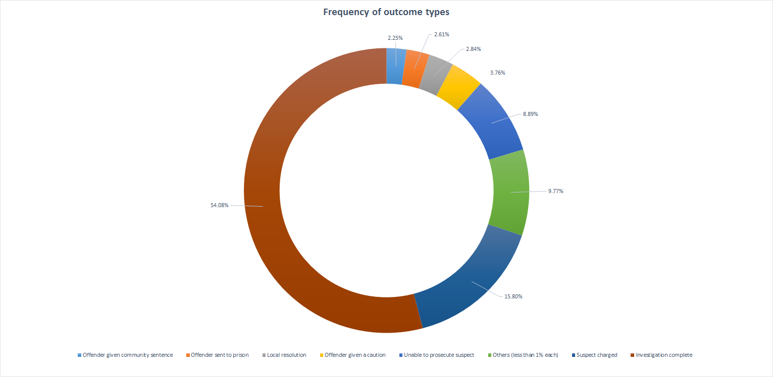
Outcomes distribution
Crimes in the UK-Week 1
Aser Abdelrahman, Chaoran Chen, Sergiu Soima
16.11.2016

Slide 6
Crime Type Frequency
Crimes in the UK-Week 1
Aser Abdelrahman, Chaoran Chen, Sergiu Soima
16.11.2016

Slide 7
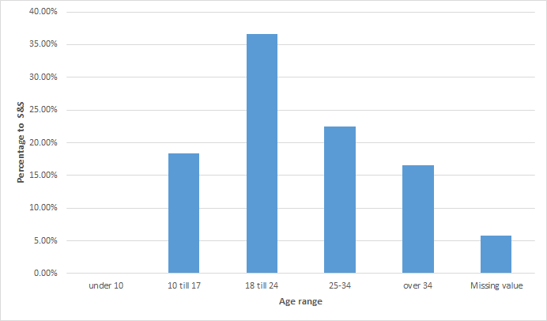
Age range frequency
Crimes in the UK-Week 1
Aser Abdelrahman, Chaoran Chen, Sergiu Soima
16.11.2016

Slide 8
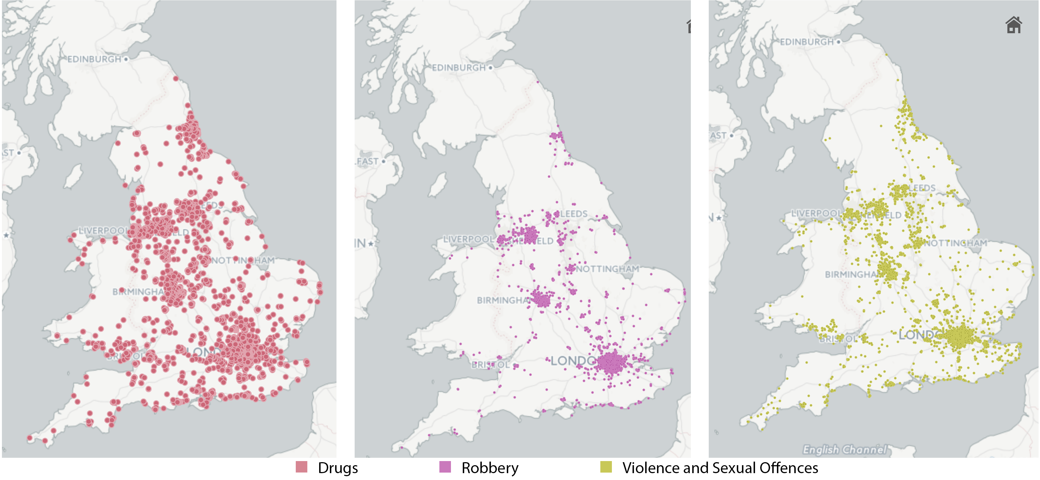
Drugs, rubbery and violence locations
Crimes in the UK-Week 1
Aser Abdelrahman, Chaoran Chen, Sergiu Soima
16.11.2016

Slide 9
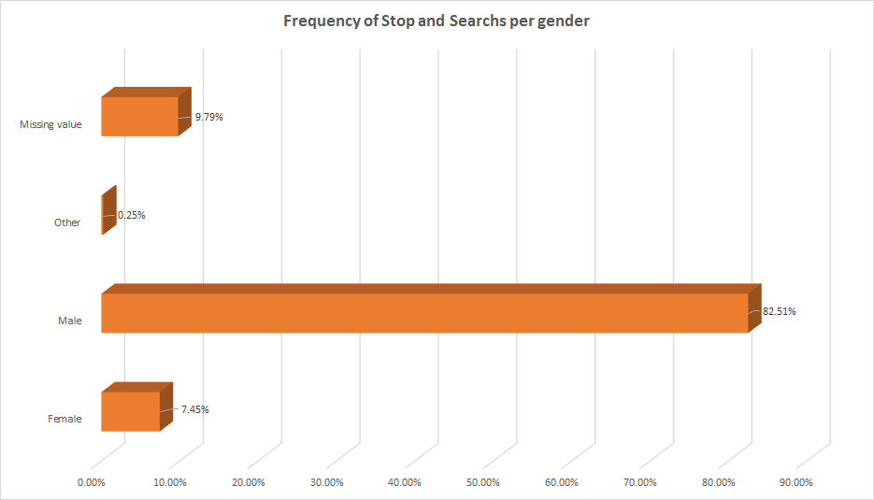
10 times more men investigated during stop & search
Crimes in the UK-Week 1
Aser Abdelrahman, Chaoran Chen, Sergiu Soima
16.11.2016

Slide 10
Ideas for data expansion
Neighborhood statistics using LSOAs
Points of Interest
Weather data
Education level - Health and care - People and society (income/lifestyle)
ATM - Attraction - Bank - Entertainment - Food & Drink - Parking lot
Are crimes influenced by weather?
Crimes in the UK-Week 1
Aser Abdelrahman, Chaoran Chen, Sergiu Soima
16.11.2016

Slide 11
Working Log:
Reading row data into database
Problems with MySQL
Join of Outcome and Street
Drawing samples and then throwing them away
Visualization Tools
Crimes in the UK-Week 1
Aser Abdelrahman, Chaoran Chen, Sergiu Soima
16.11.2016

Slide 12
Plan for next week
Consolidate the final table
Cleaning and preparing the data
Join “Crimes” and “Stop and search” datasets by aggregating information about the nearest “Stop and search” tuples located within a given range in km from the respective crime
Write the python script for finding the nearest Stop&Search tuples
Investigate if we can include Neighborhood statistics using LSOAs in the final table
Investigate if we can include Points of Interest (POI) information using geolocation in the final table
Crimes in the UK-Week 1
Aser Abdelrahman, Chaoran Chen, Sergiu Soima
16.11.2016

Slide 13
Sources
https://www.police.uk/crime-prevention-advice/anti-social-behaviour/
Crimes in the UK-Week 1
Aser Abdelrahman, Chaoran Chen, Sergiu Soima
16.11.2016

