Slide 1
What has been tried for the ANN in 3D

Slide 2
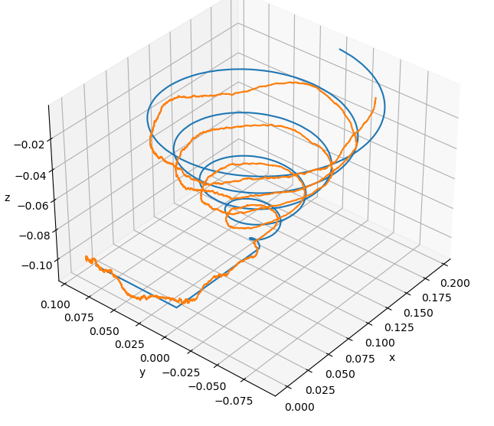
Most promising run to date
Errors :
3 cm in x
3 cm in y
4 mm in z
Comments :
Big errors in x and y could be caused by the detectors’ placement
Errors in x and y could also be explained by the coarse grids used to train the ANN

Slide 3
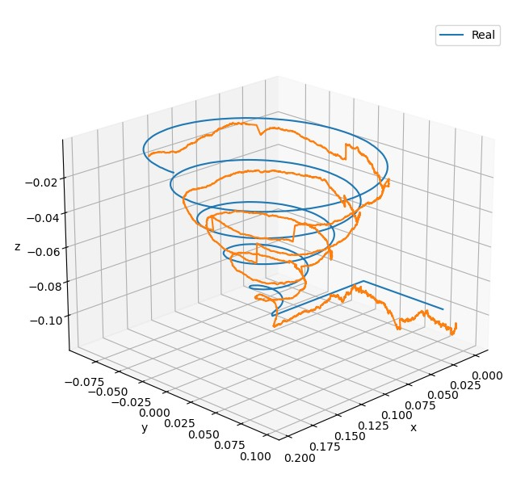
Cut-off the data
If the count value is below 75, replace the count by 0 or 75
Errors :
3 cm in x
3 cm in y
7 mm in z
Conclusion : No need to cut-off some low count data

Slide 4
Single Arch
Errors :
3 cm in x
3 cm in y
5 mm in z
Conclusion : Single Arch method takes much more time for a very similar result

Slide 5
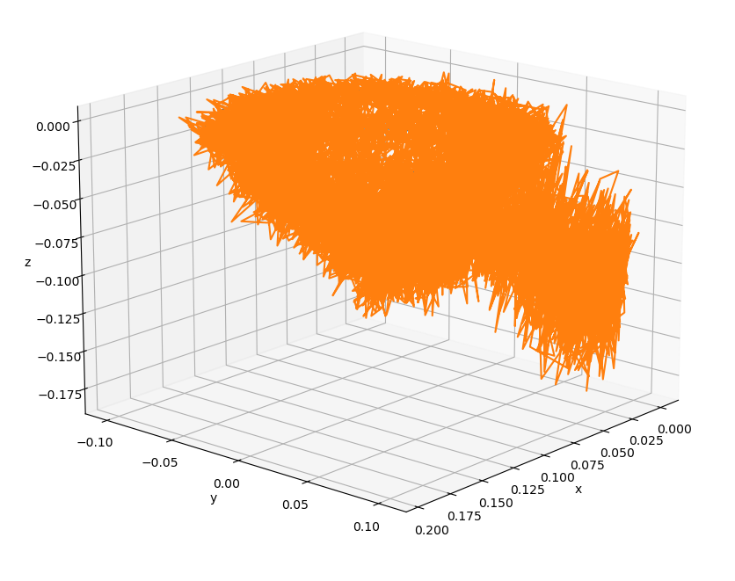
Using raw data (no denoising)
No filter used
Really bad results
Conclusion : Denoising is necessary

Slide 6
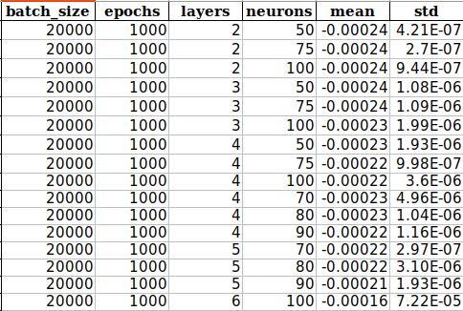
Grid Search
A deeper network seems to minimize the MSE

Slide 7
Analysis of coarse VS fine grid
Grid | Nb of rep | Error in x (mm) | Error in y (mm)
Coarse | 2 | 1.2 | 1.7
Coarse | 3 | 1.3 | 1.7
Fine | 2 | 0.9 | 1.1
Coarse | 2 | 2 | 2

Slide 8
What’s next?
Post-process new data
Run grid search with new data
Hopefully error in x and y is going to diminish

