Slide 1
EQ2401 Project 1
Yijie Li yijiel@kth.se

Slide 2
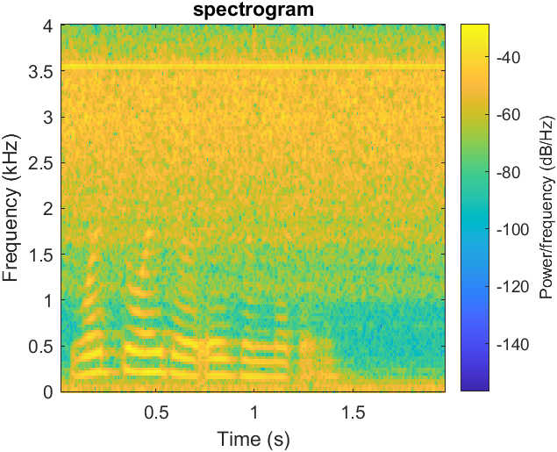
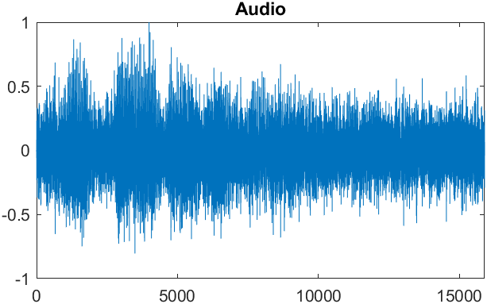

Task
Input: audio signal with noise, $y(k)$
Output: estimated signal $\hat{x}(k)$
Target: employ FIR Wiener, Causal Wiener and Non-Causal Wiener filters.

Slide 3
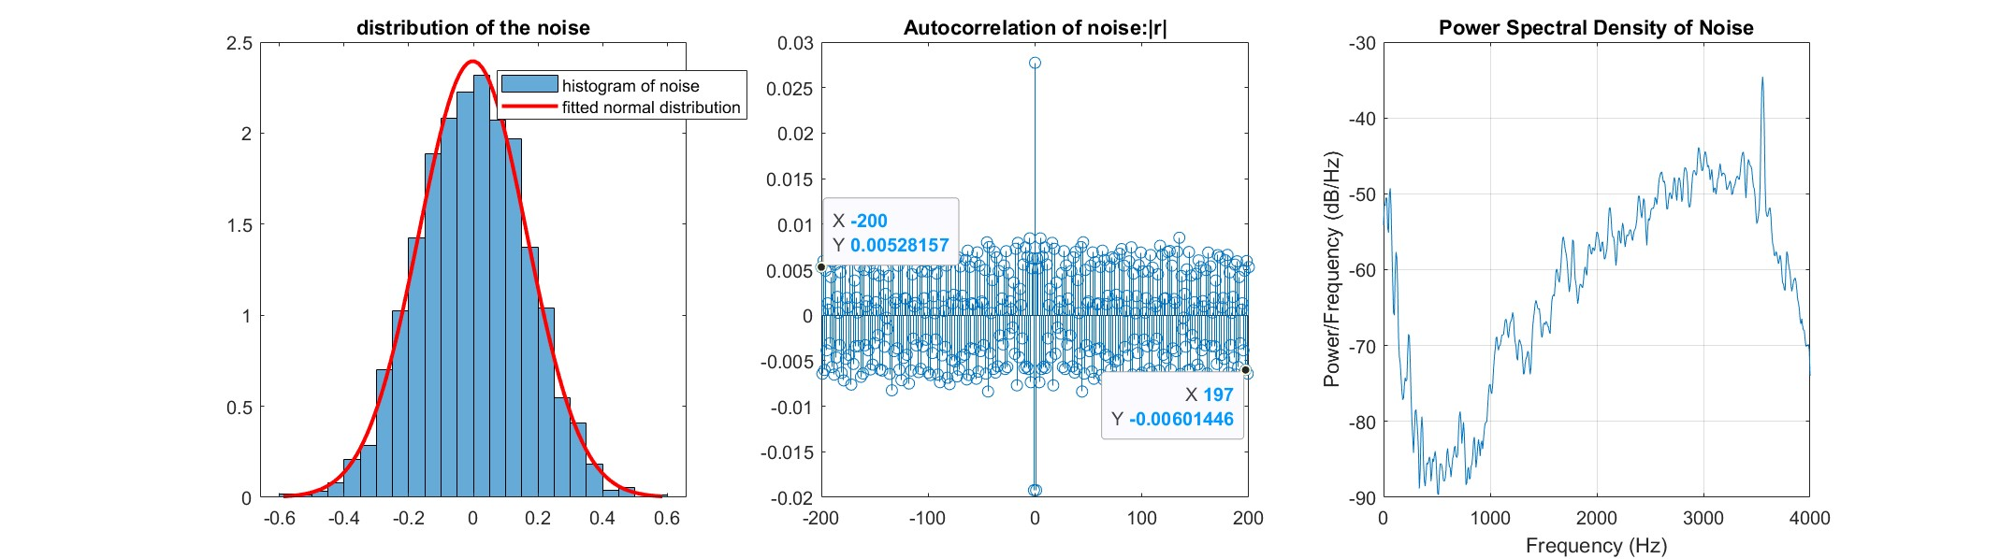

Noise statistics
Gaussian
Not white
Suppose stationary model:$y\left(n\right)=x\left(n\right)+v(n)$

Slide 4
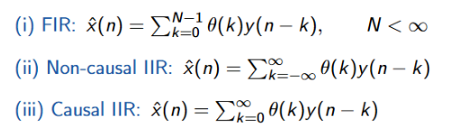

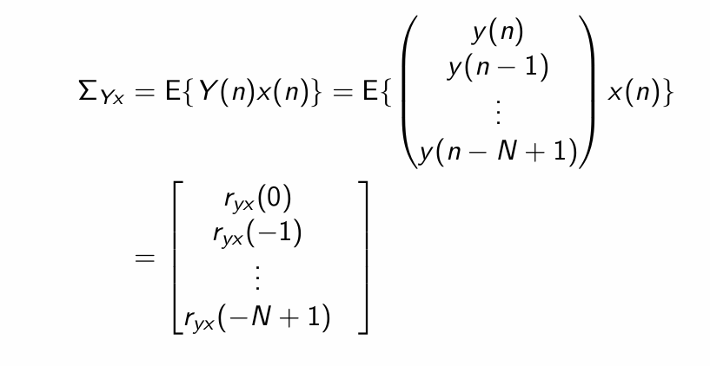
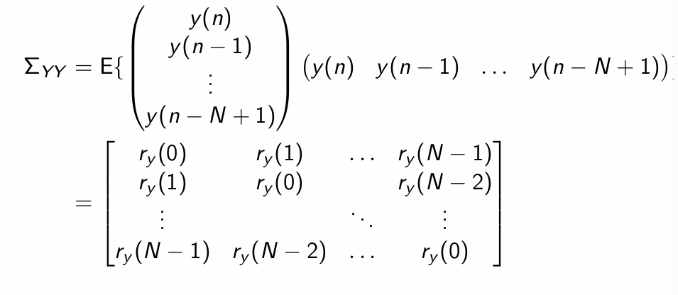


FIR wiener filter
Done in time domain
$\hat{x}\left(n\right)=θ∗y(n)$
Take filter order N=20
Since $y\left(n\right)=x\left(n\right)+v\left(n\right)$,
$E\left\{yx\right\}=E\left\{\left(y−v\right)v\right\}=E\left\{yv\right\}+E\left\{vv\right\}=r_{\left\{yv\right\}}−r_\{vv\}$
We have $\sum_{Yx}{=r_{Yx}=r_{y}−r_{v}}$

Slide 5

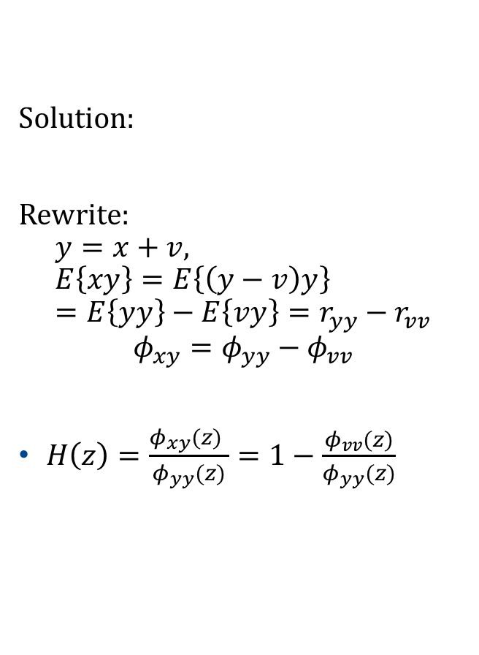

Non-Causal Wiener filter
Solution:
Rewrite:
$$y=x+v, E\left\{xy\right\}=E\left\{\left(y−v\right)y\right\}=E\left\{yy\right\}−E\left\{vy\right\}=r_{yy}−r_{vv}$$
$$φ_{xy}=φ_{yy}−φ_{vv}$$
$H\left(z\right)=\frac{φ_{xy}(z) }{φ_{yy}(z)}=1−\frac{φ_{vv}(z)}{φ_{yy}(z)}$
$$φ_{vv}=FT\left\{r_{vv}\right\}, φ_{yy}=FT\left\{r_{yy}\right\}$$
Note that $φ_{vv}$ ,$φ_{yy} are power spectrum\left(real−valued \right) and$ $H≥0$
$$Y=FT\left\{y\right\} \\ \hat{x}=IFT\{\hat{X}\}=IFT\{H ×Y\}$$
Done in frequency domain

Slide 6





Causal Wiener filter
Time domain
When $N→inf$ , FIR $→$ Causal IIR.
When $N→inf$ , FIR $→$ Causal IIR.
Set a large N
Frequency domain
For filtering, m =0.
Problem: spectrum factorization, separation of causal and anticausal parts.
$$φ_{xy}=φ_{yy}−φ_{vv}$$

Slide 7


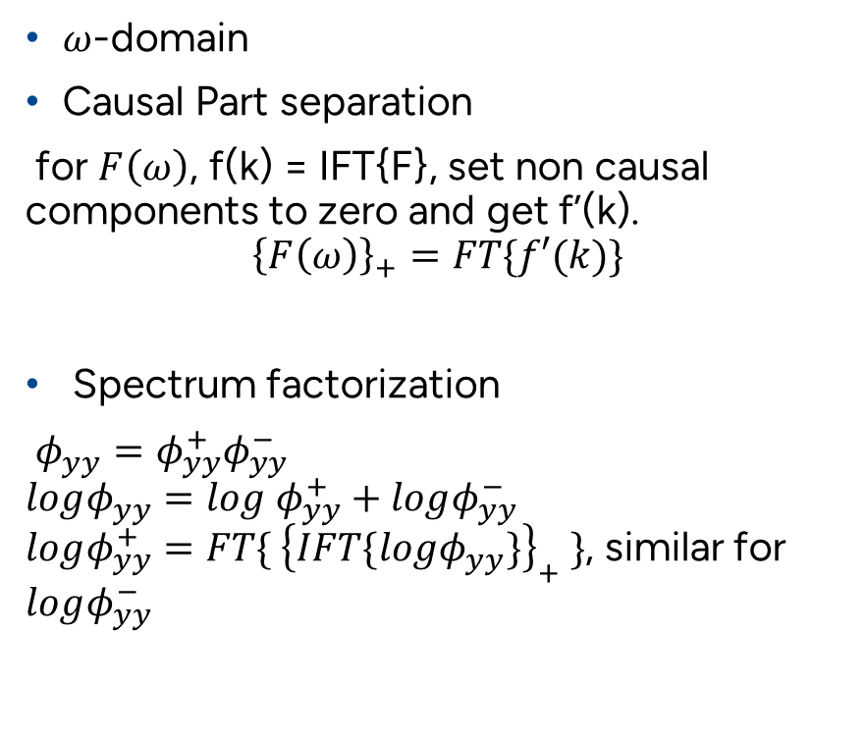
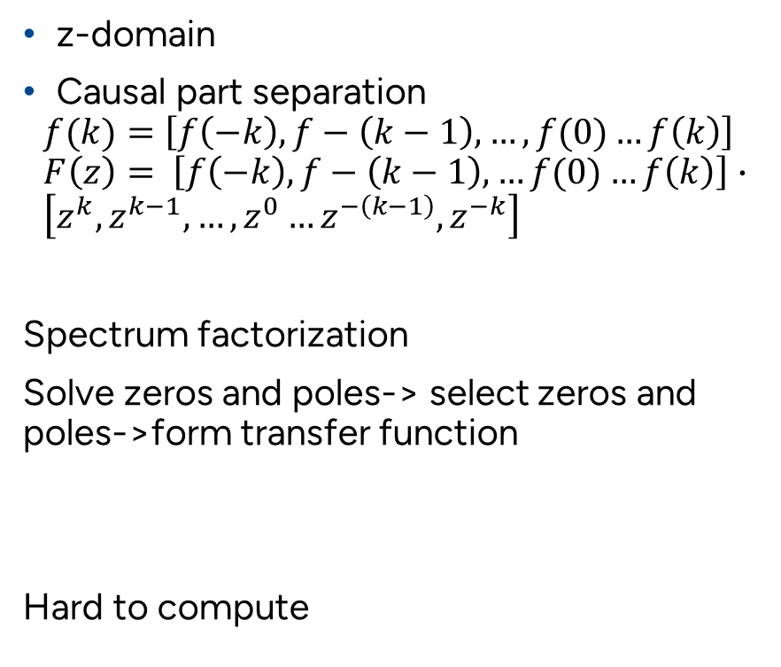
Causal Wiener filter
z-domain
Causal part separation
$$f(k)=\left[f\left(−k\right),f−\left(k−1\right),…,f(0)…f\left(k\right)\right] \\ F\left(z\right)= \left[f\left(−k\right),f−\left(k−1\right),…f(0)…f\left(k\right)\right]∙ \\ \left[z^{k},z^{k−1},…,z^{0}…z^{−\left(k−1\right)},z^{−k}\right]$$
Spectrum factorization
Solve zeros and poles-> select zeros and poles->form transfer function
Hard to compute
$ω$-domain
Causal Part separation
for $F\left(ω\right)$, f(k) = IFT{F}, set non causal components to zero and get f’(k).
$${\left\{F\left(ω\right)\right\}}_{+}=FT\{f′(k)\}$$
Spectrum factorization
$φ_{yy}=φ_{yy}^{+}φ_{yy}^{−}$
$logφ_{yy}=log$ $φ_{yy}^{+}+logφ_{yy}^{−}$
$logφ_{yy}^{+}={FT\{ \left\{IFT\{logφ_{yy}\}\right\}}_{+} \}$, similar for $logφ_{yy}^{−}$

Slide 8
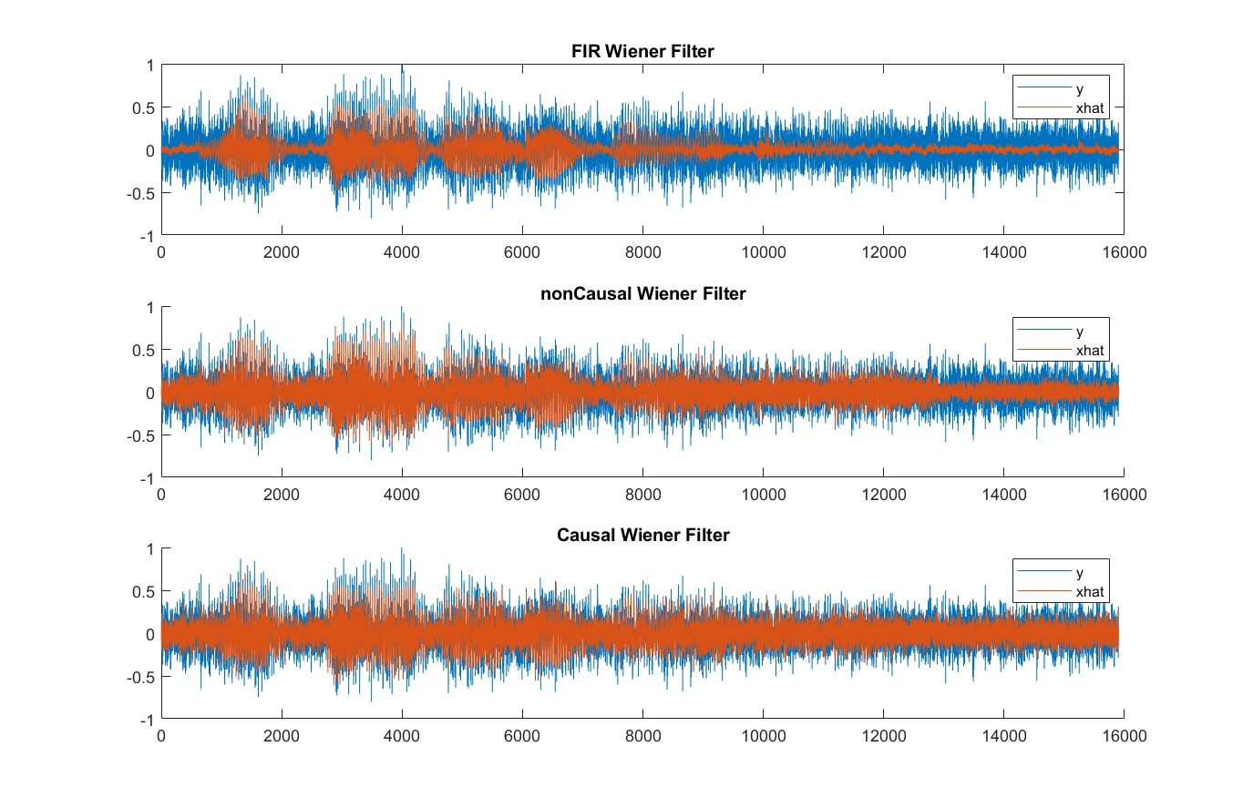
Result

Slide 9
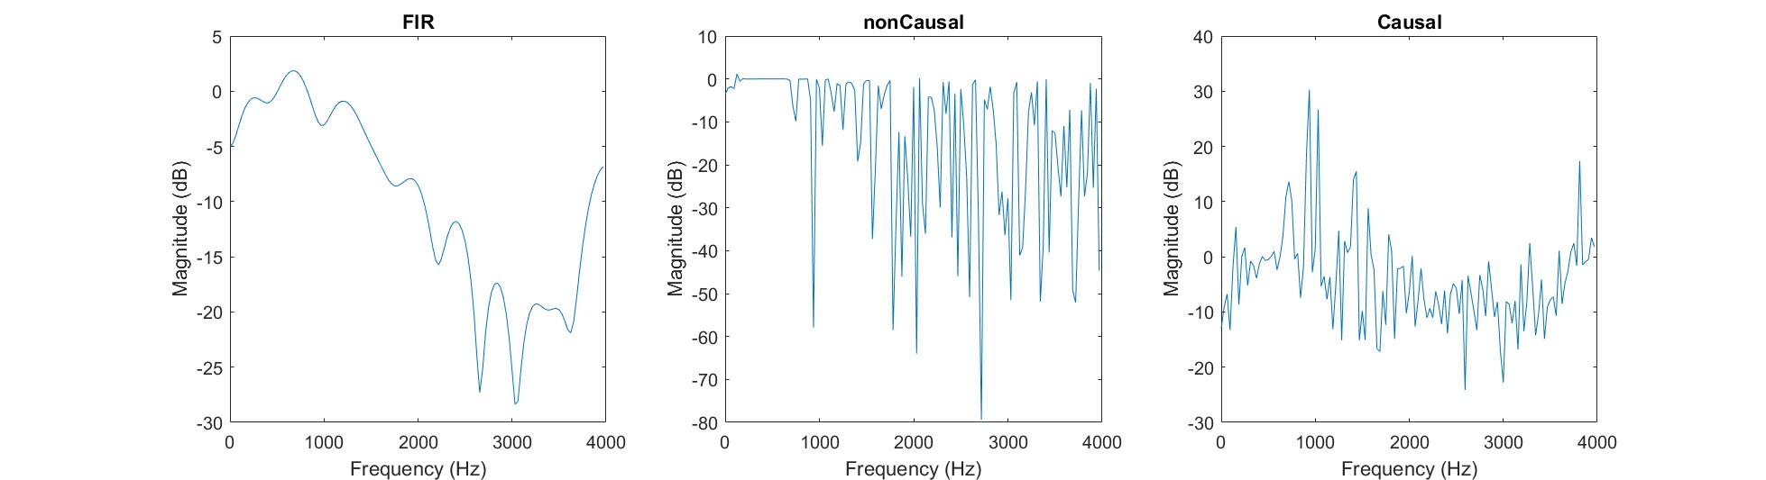
Frequency response

Slide 10
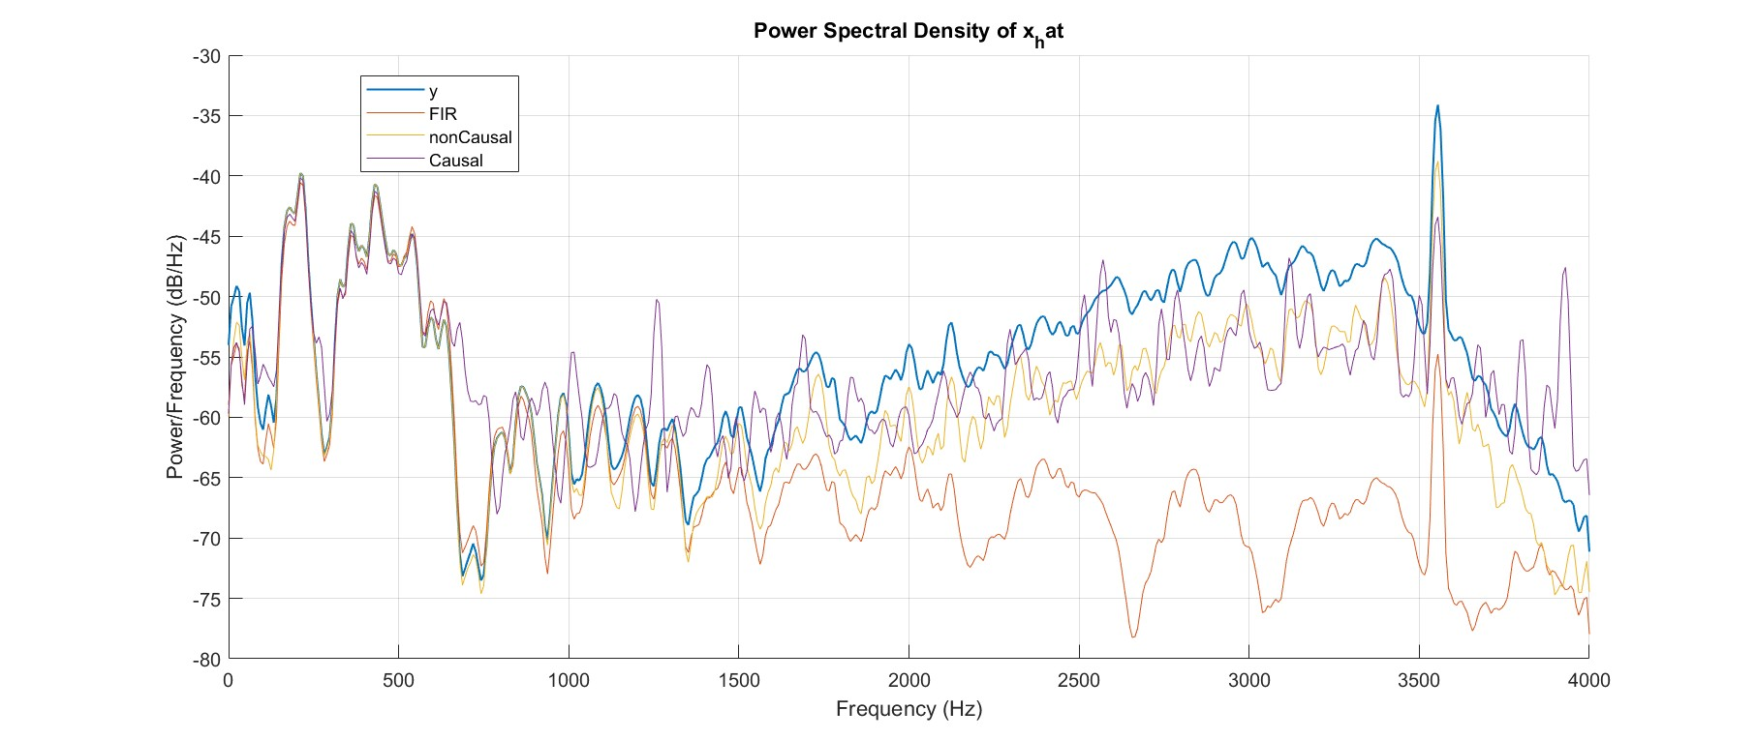
Spectrum

