Slide 1
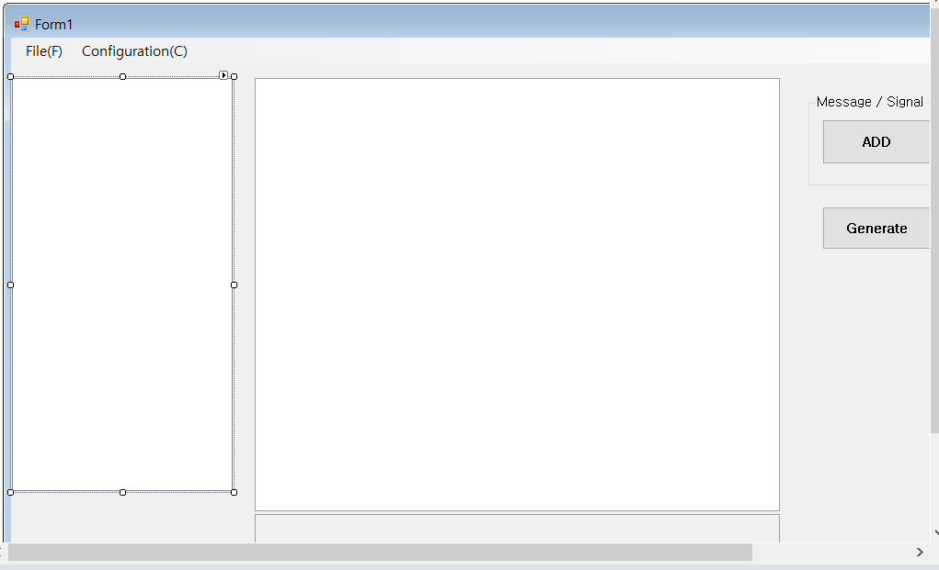
parameter_property
(속성뷰)
bswItem
(Treeview)

