Slide 1
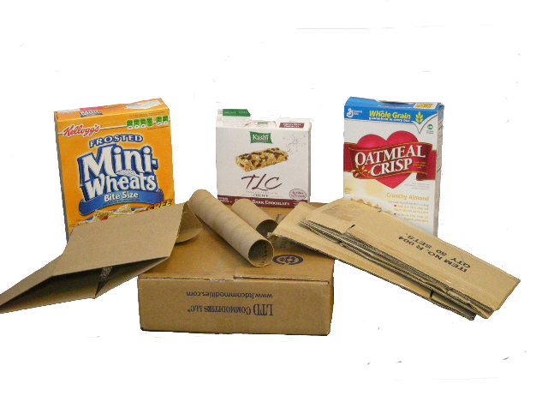

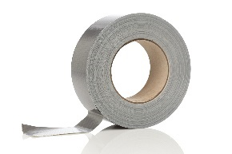
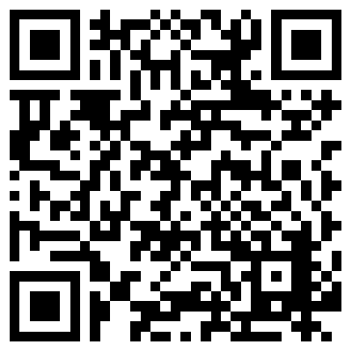
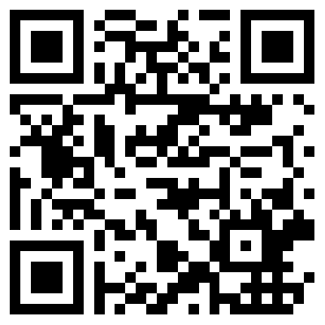
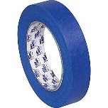
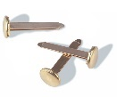
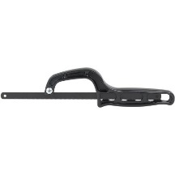
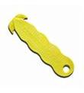
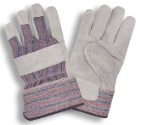
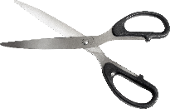
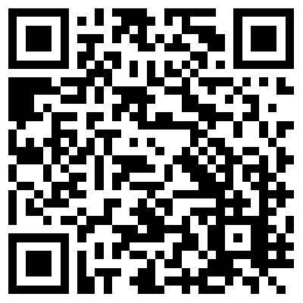
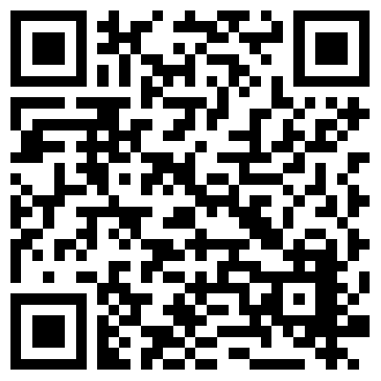
Cardboard Creations
ANYTHING cardboard!
Materials to help in creating...
Try Technique Cards available
Cardboard Creations
What can you recreate with cardboard or is there a need? Can you create something useful!
Here are QR Codes to some websites with ideas:
Getting Started
What Can You Make?
Supplies?
Safety?
Inspiration?
Tools?
PInterest | Instructables
Some creations with a little more expertise…
TrendHunter |  | Google Image Search
Help?
Available at:
https://github.com/chaosbuster/StarterCards
EVERYONE HAS A PART IN KEEPING OUR MAKERSPACE CLEAN!
Creative Credits to MIT for Make A Card:

