Slide 1
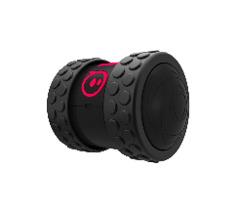
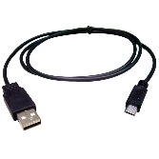
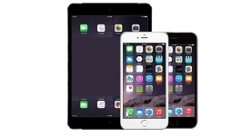
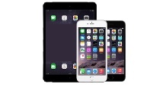


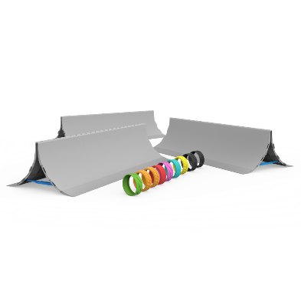
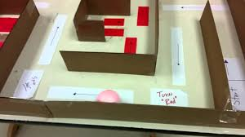









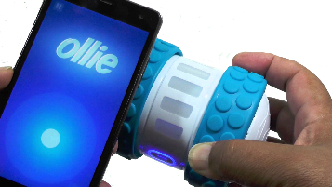
Ollie
Ollie USB Charging Cable iPad, iPhone
or Android
Accessories (Optional) Create Mazes (Optional)
1. Find Ollie app. If not found,
Scan to download for iOS,
iPad or Android.
2. Launch the app and lightly touch Ollie with your device. Ollie will connect automatically. .
Ollie
Find Sphero Lightening Lab app.
If not found, Scan to download
for iOS, iPad or Android
Getting Started
What Can You Program?
Supplies?
Programming?
Handling?
Connected To Device?
Inspiration?
Block Intros | Maze Mayhem
Available at:
https://github.com/chaosbuster/StarterCards
EVERYONE HAS A PART IN KEEPING OUR MAKERSPACE CLEAN!
Creative Credits to MIT for Make A Card:

