Slide 1
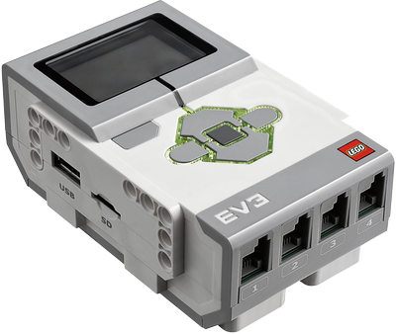
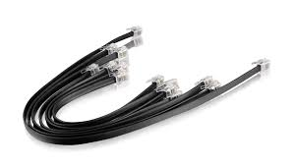
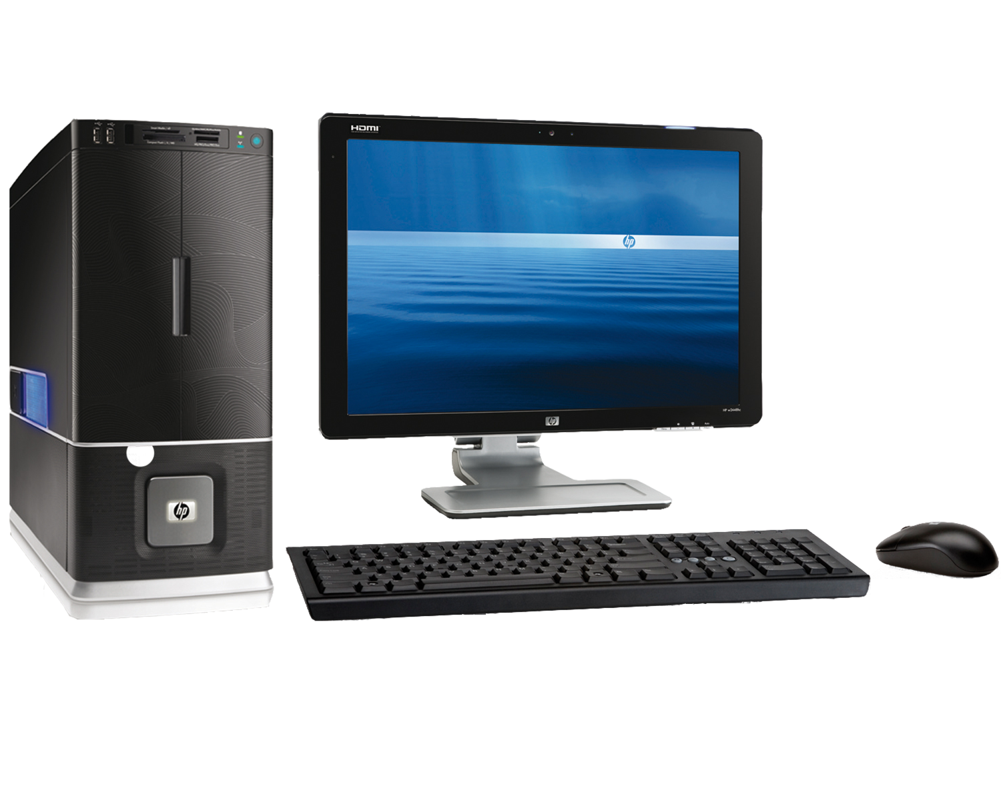

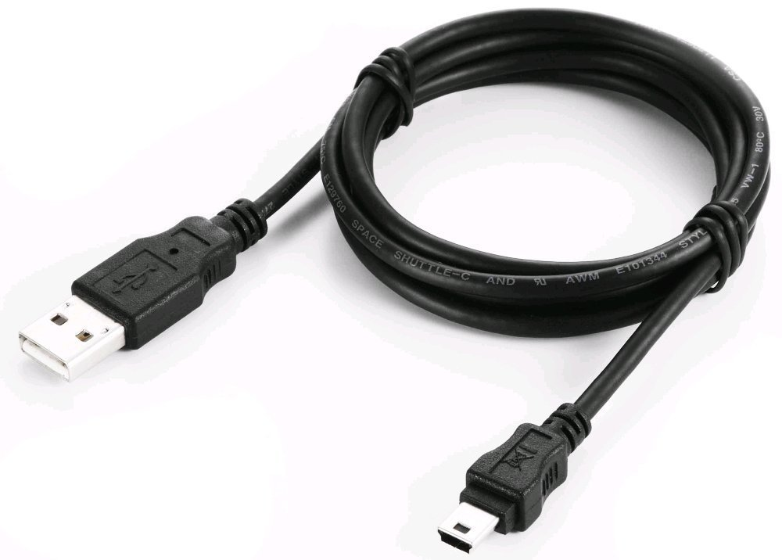
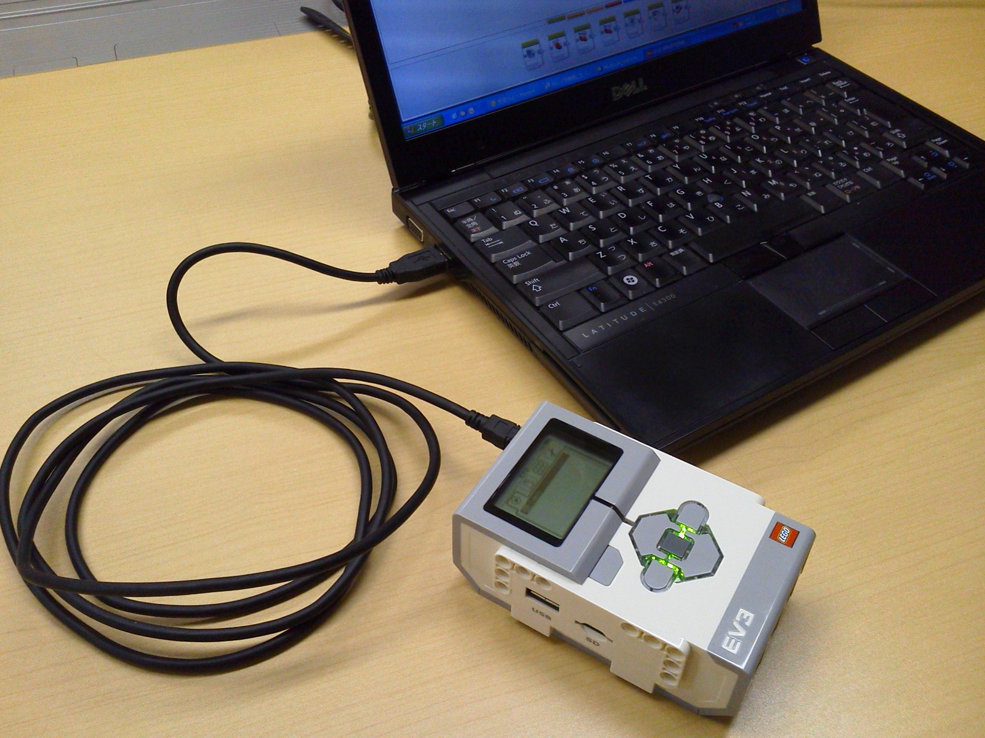
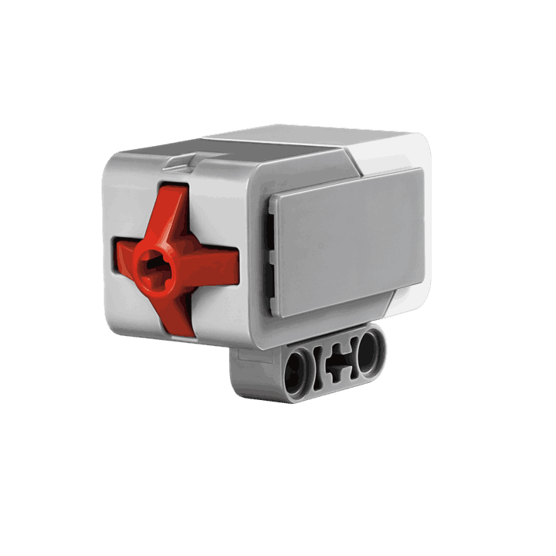
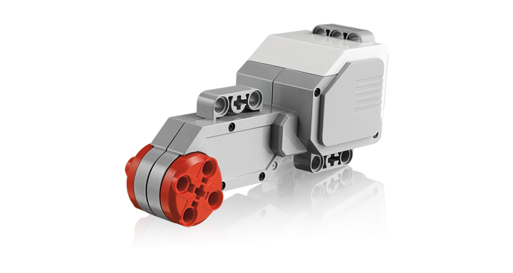
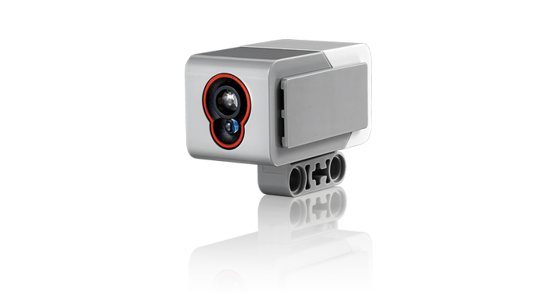
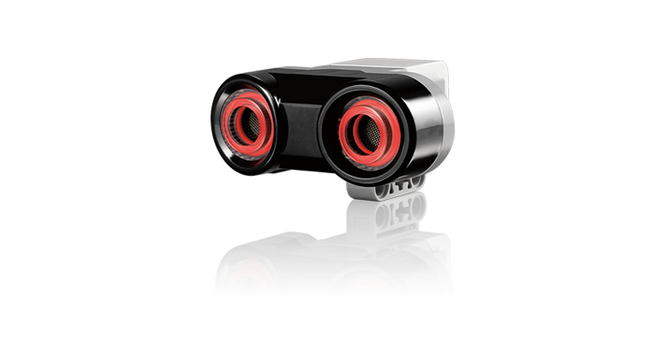
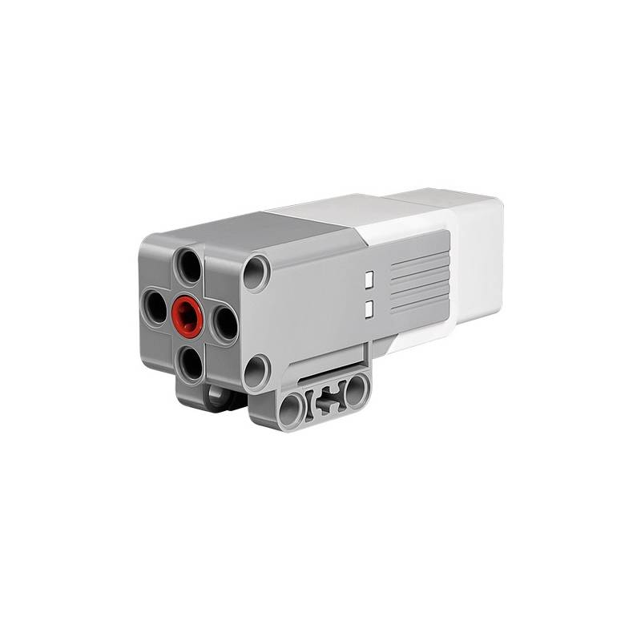
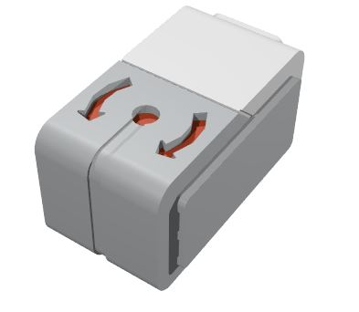
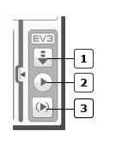

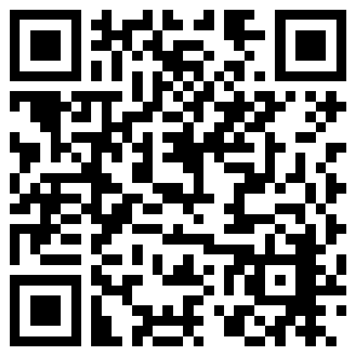
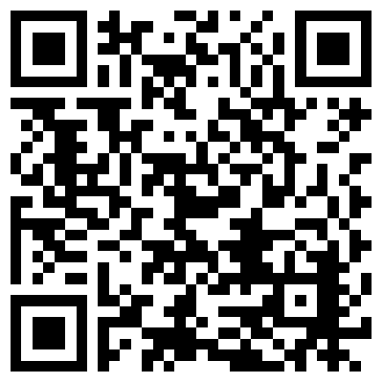
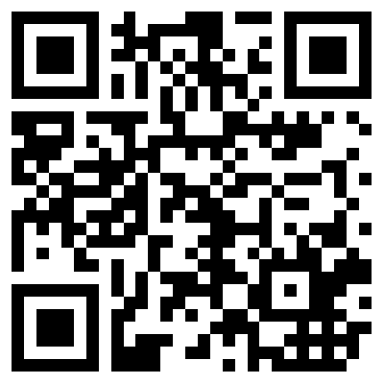




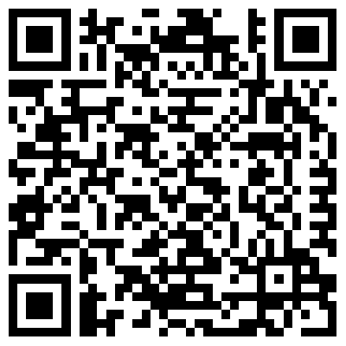
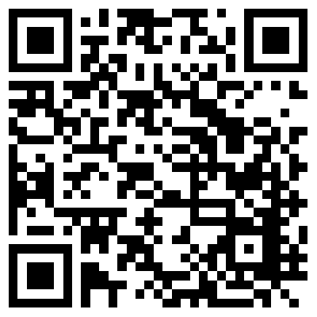
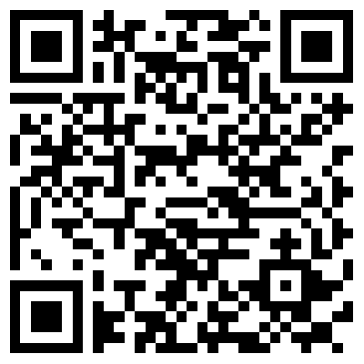
EV3
EV3 Controller Mini-USB Wires PC
Cable
Touch Color Gyro Ultrasonic Motors (2 Large &
Sensor Sensor Sensor Sensor 1 Medium)
The EV3 Controller has five different types of ports:
PC port for USB cable to download
Wire Output ports A,B,C and D for motors
Wire Input ports 1,2,3 and 4 for sensors
USB Host Port for Wi-Fi or connecting Bricks
SD Card Port
EV3
1. Go to a PC with the LEGO Mindstorm EV3 software installed. Run the software.
2. Connect PC and EV3 Controller in one of three ways: Mini-USB cable, Wireless Bluetooth or Wi-Fi via Wi-Fi Dongle
3. Create your program (see below for ideas & How-Tos)
4. Download program to EV3 by clicking one of the Hardware Page options
Getting Started
What Can You Program?
Supplies?
Downloading Programs?
Handling?
Inspiration?
Programming | Ideas & Challenges | Instructables
Simple Robot | More on the EV3 | How They Work!
Electronics Connections?
Available at:
https://github.com/chaosbuster/StarterCards
EVERYONE HAS A PART IN KEEPING OUR MAKERSPACE CLEAN!
Creative Credits to MIT for Make A Card:

