Slide 1
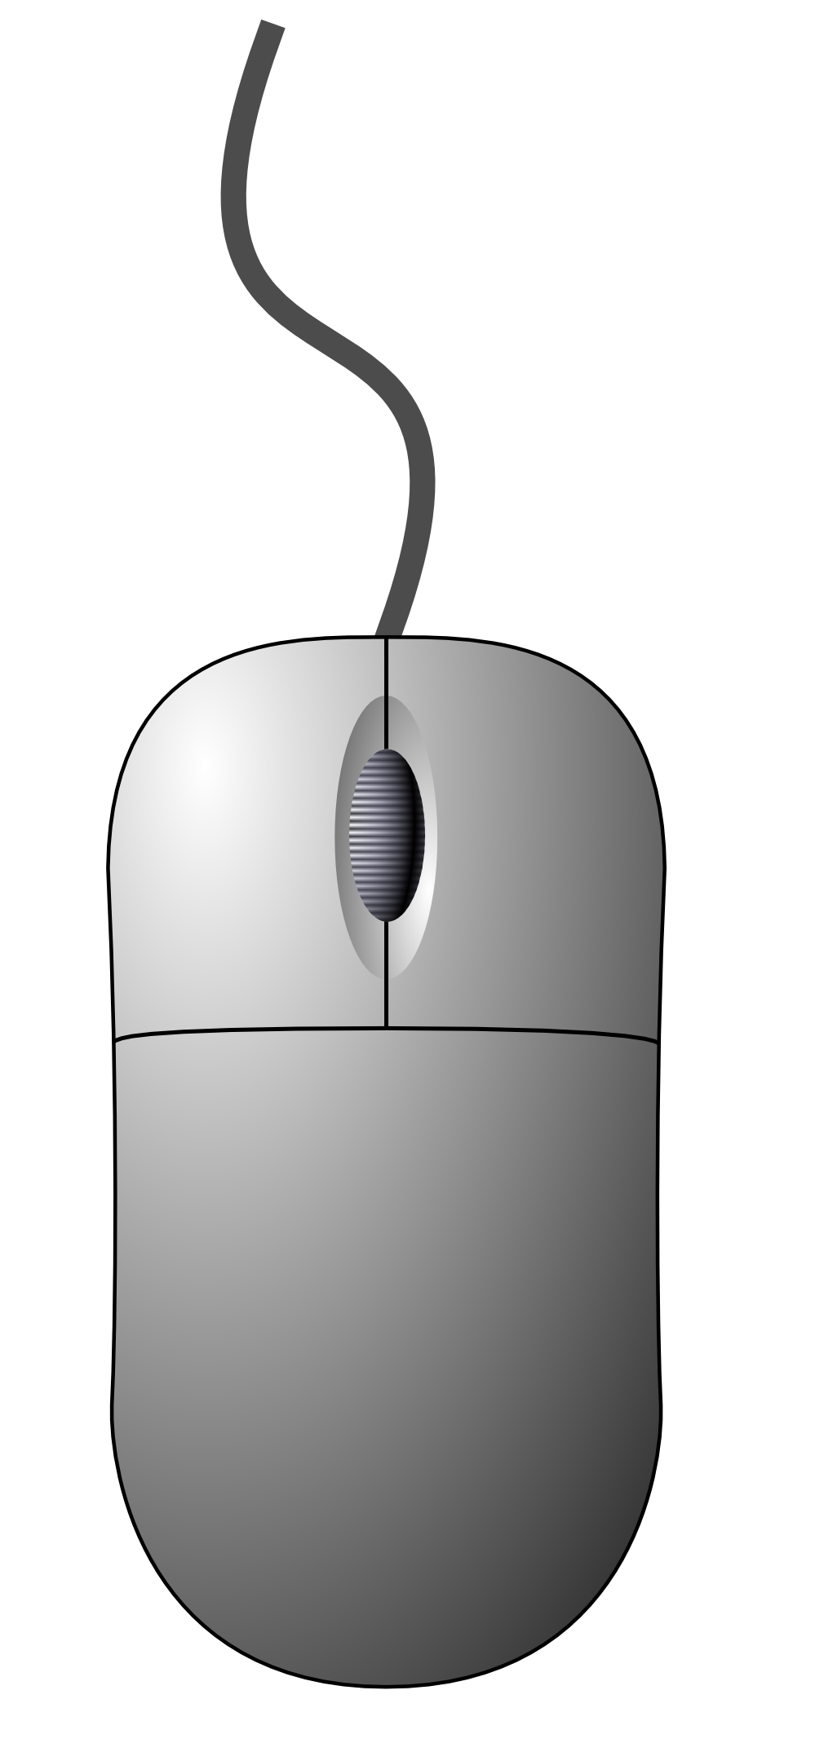

MinecraftEdu
Worlds that you can explore, build and discover. You will not need to use a Minecraft account to sign-on..
NOTE: MinecraftEdu clients cannot connect to regular Minecraft servers.
Start MinecraftEdu Client by clicking
icon on Desktop.
Press Start MinecraftEdu.
Select MinecraftEdu Login Mode and Press Launch.
After the client has started, type in a desired username and select your gender. Press Continue.
At the Main Menu select Multiplayer.
The group server should be listed. Select the server listed then press Join Server or double click server name.
Select I am a Student and choose your appearance. When ready, press Connect.
You should now be connected and in your group’s world.
MinecraftEdu
Each world will have different items and layout, but here are the controls to help you move, interact with items and discover the world.
BASIC MOVEMENT
Getting Started
What Can You Discover?
What?
Controls?
Switch Items
or Use Numbers [1-9]
Place Block or Use
Dig or
Break
Connect To World?
 | W
A |  | S |  | D
Look Around
Space
Shift
Q
Q
Jump / Climb
Crouch /
Walk Carefully
Drop Item
in Hand
Q
E
Q
Q
Q
Q
Open Inventory
Type Commands
or Talk
Student Menu
[Assignments & Teleports]
Available at:
https://github.com/chaosbuster/StarterCards
EVERYONE HAS A PART IN KEEPING OUR MAKERSPACE CLEAN!
Creative Credits to MIT for Make A Card:

